Slide 1
Final Year Major Project
Mentor:
Dr. Arun K Khosla
Project mentor
Dr. Arun K Khosla
Project Duration
July 2023 – May 2024
Institute
Dr. B R Ambedkar National Institute of Technology, Jalandhar
Team:
Gulshan
Hiteshwar Singh
Divya Gupta
Daksh Khatkar
Gemini Talker:
24*7 Education Counsellor

Slide 2
Determined to assist students and parents during the admission season, our team comes ahead with the idea of Gemini Talker.
It is a multi-feature application including real time AI enabled conversations, human-like interaction and multilingual support for a more customized approach. It even aids to the situation further with generative AI image support, for both upload as well as sharing.
Now, we take a dive into the details.
About the
Project
(A brief premise)

Slide 3
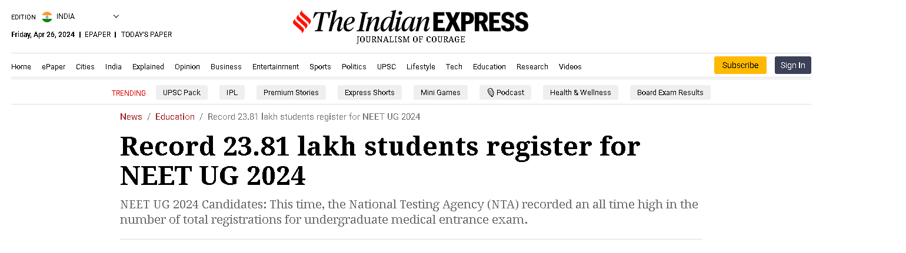
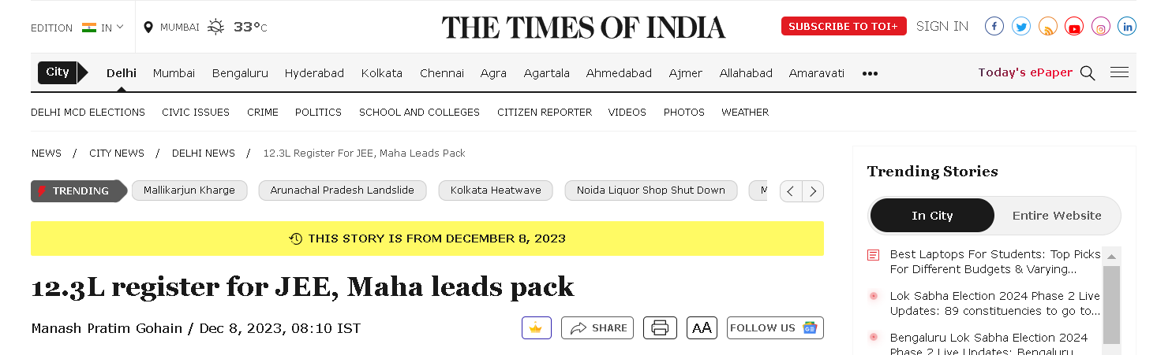
Admission Season
With students in tens of lakhs appearing for competitive exams around the nation, a need arises for a convenient way to answer one’s queries.

Slide 4
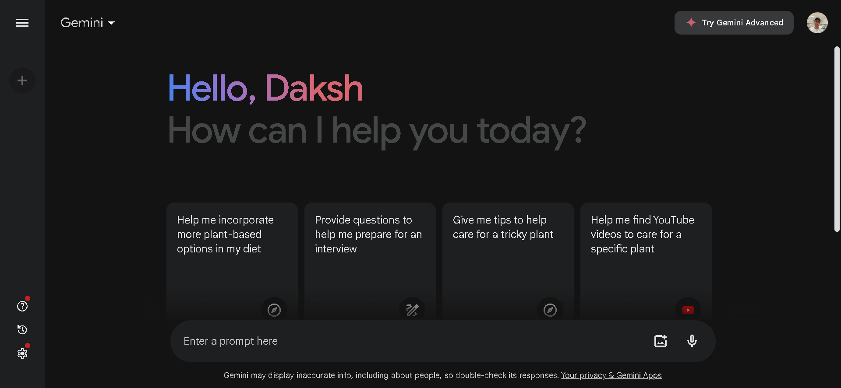
Gemini Talker
A generative AI chatbot to help students and parents take the right step ahead in education

Slide 5
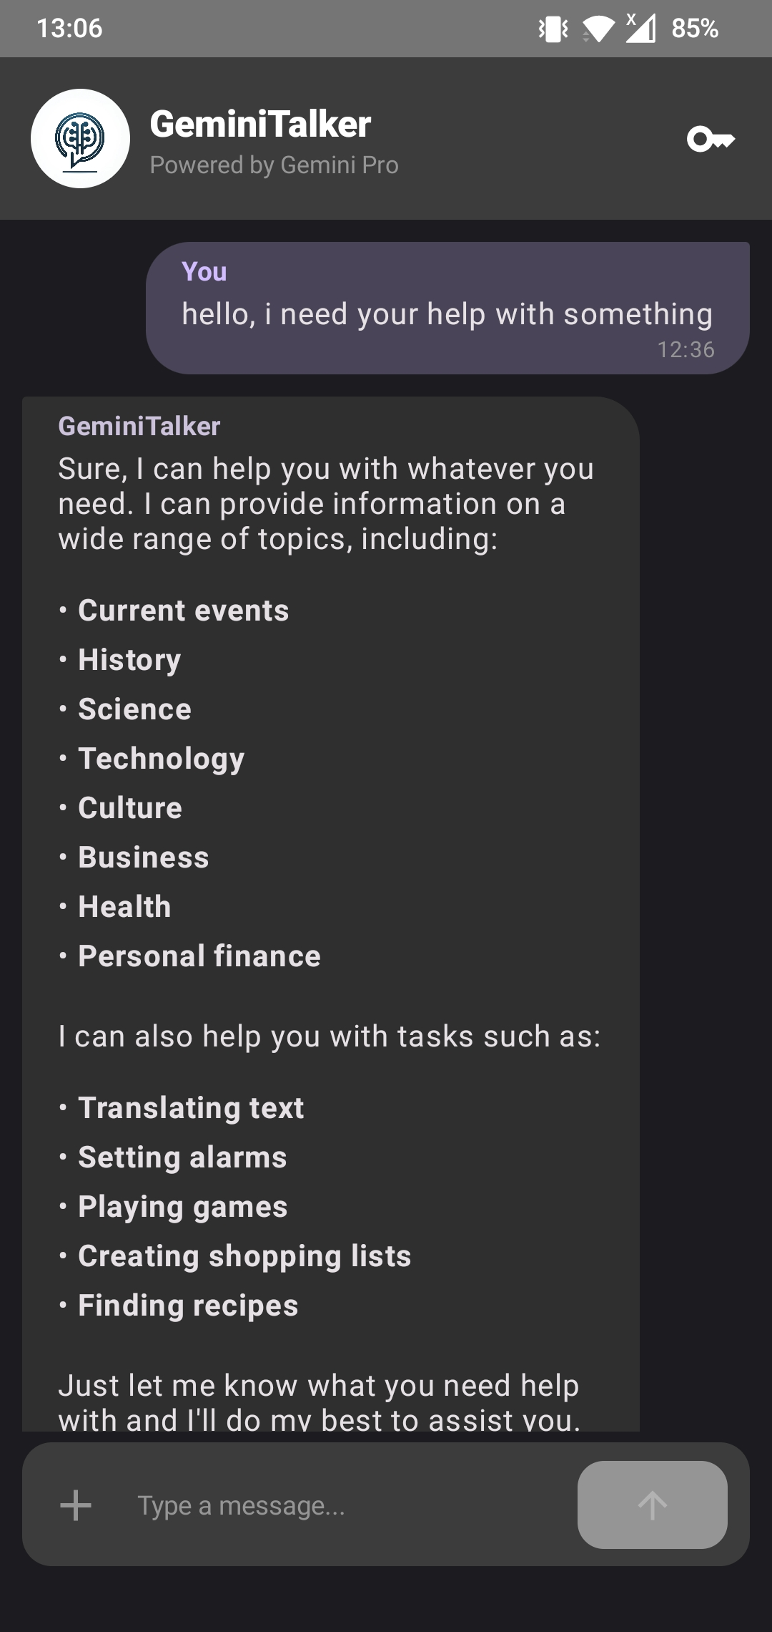
Live Conversations
The app works just like any other modern day messenger, creating a feeling of chatting with another person on the other side.

Slide 6
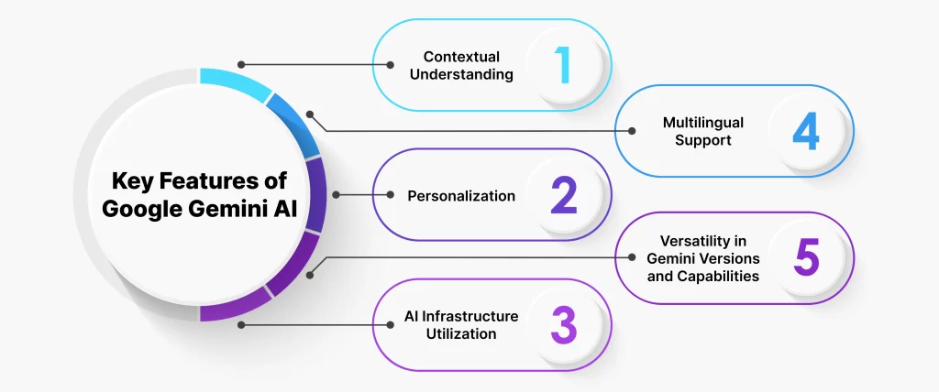
Gemini is Powerful
It can do much more than the generic AI currently available on the internet.
The more you talk to it, the better it gets.

Slide 7
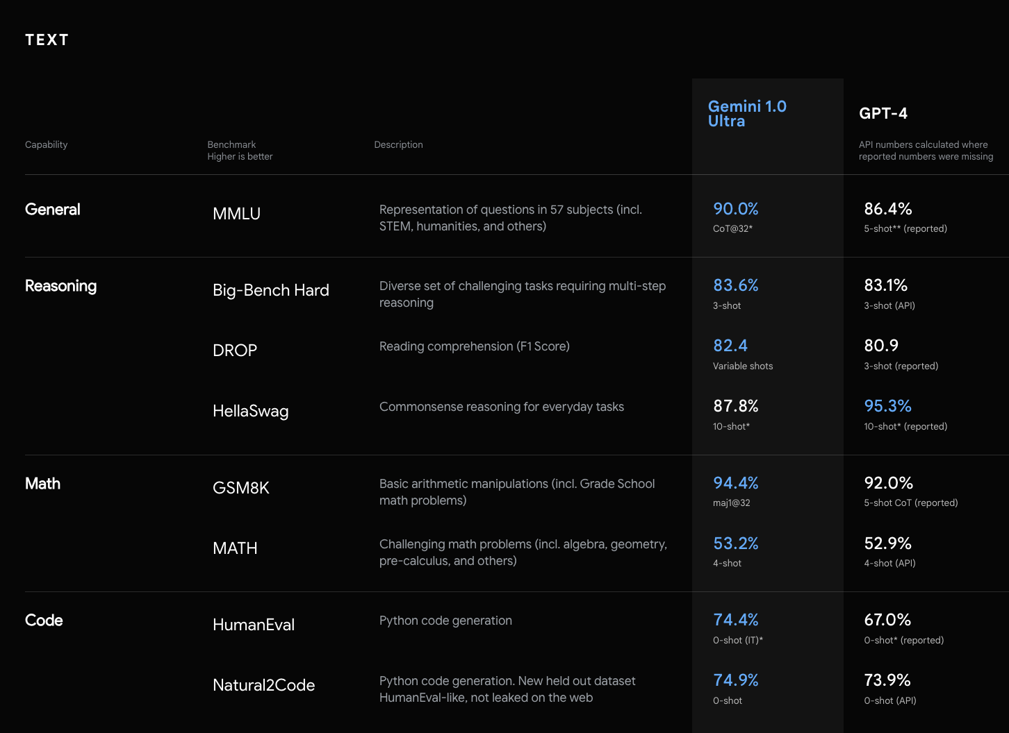
Why Gemini?
You might wonder why one may go for Gemini, with tools like GPT already available for free. Well…

Slide 8






The Google Experience
Gemini’s integration places the vast ocean of all the Google services at its disposal for an unparalleled user experience.

Slide 9
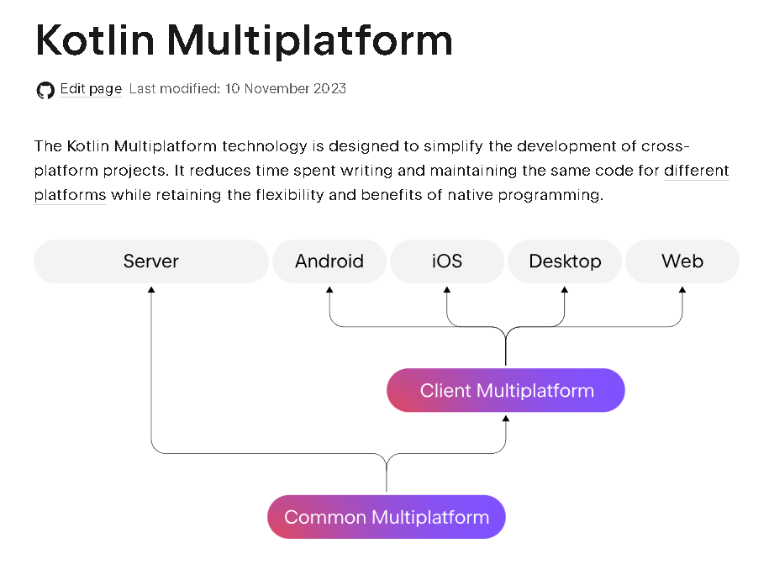
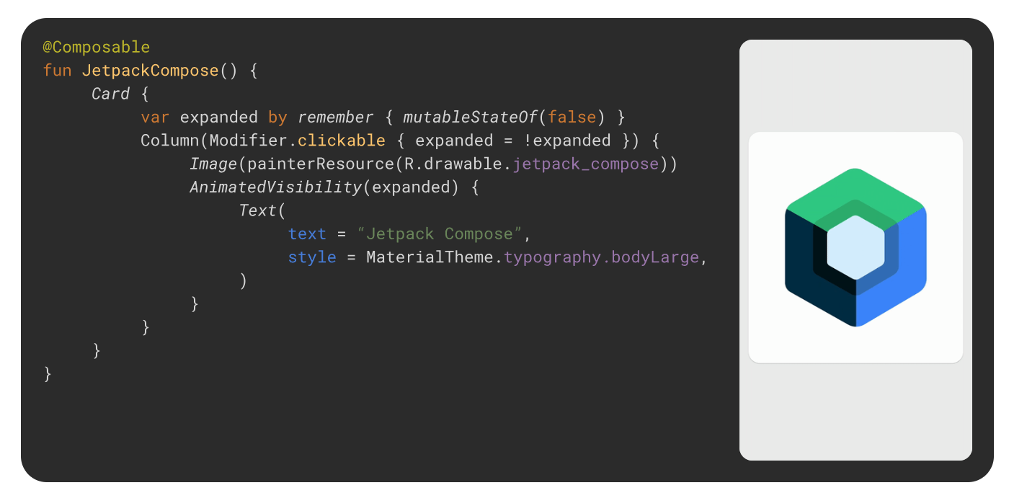
About the Frontend
So the large language model is ready, what now? Here’s a technical overview of what makes up the application you see on your screen.

Slide 10
जेमिनाई का लाभ उठाएं अब अपनी आंचलिक भाषा में
Gemini will go multilingual with the help of regional language translation APIs.
This is bound to increase its reach and versatility by providing a boost in its ease-of use and opening its way into a larger pool of the population.
Future Deliverables

Slide 11
Word of gratitude
We would like to express our immense gratitude for your patience, and request you to provide your valuable feedback on our performance.
Special thanks to:
Dr. Arun K Khosla (Team Mentor)
Dr. Bodile Roshan Mukindrao (Cohort Leader)
Respected Members of the Cohort-1

