Slide 1
Introduction to Machine Learning
Aswadi Abdul Rahman

Slide 2
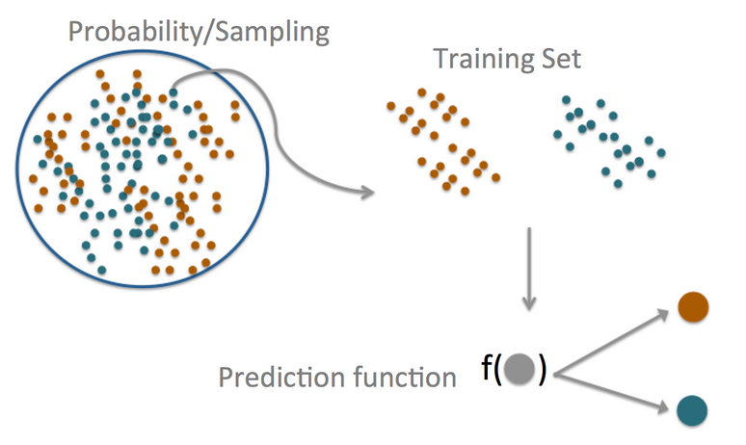
Introduction
Prediction can be understood to be the following things by different groups of people:
The central dogma of prediction
Prediction | Types of Statisticians
Statistical Learning | Statisticians
Machine Learning | Computer Scientists
Forecasting | Atmospheric scientists/Bankers
Artificial Intelligence | Members of the press

Slide 3
Machine Learning: Categories
Machine Learning basically can be classified into 2 categories:
Supervised Machine Learning: Learn to predict target values from labelled data
Classification: Target values are discrete values
Regression: Target values are continuous values
Unsupervised Machine Learning: Find structure in labeled data
Find groups of similar instances in the data (clustering)
Finding unusual patterns (outlier detection)

Slide 4




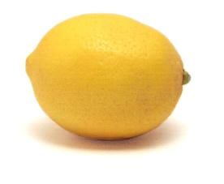









Supervised Learning: Classification Example
Future example
Training Set
X Sample | Y target value (Label)
Classifier
$$f:X→Y$$
$$x_{1}$$
$$y_{1}$$
Apple
f
f
$$x_{2}$$
Orange
$$y_{2}$$
At training time, the classifier uses labelled examples to learn rules for recognizing each fruit type.
$$x_{3}$$
$$y_{3}$$
Label : Orange
Apple
After training, at prediction time, the trained model is used to predict the fruit type for new instances using the learned rules
$$x_{4}$$
$$y_{4}$$
Lemon

Slide 5
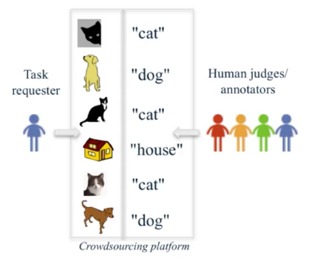

Examples of explicit and implicit label sources
Explicit Labels
Implicit Labels

Slide 6
Machine Learning: Categories
Machine Learning basically can be classified into 2 categories:
Supervised Machine Learning: Learn to predict target values from labelled data
Classification: Target values are discrete values
Regression: Target values are continuous values
Unsupervised Machine Learning: Find structure in labeled data
Find groups of similar instances in the data (clustering)
Finding unusual patterns (outlier detection)

Slide 7
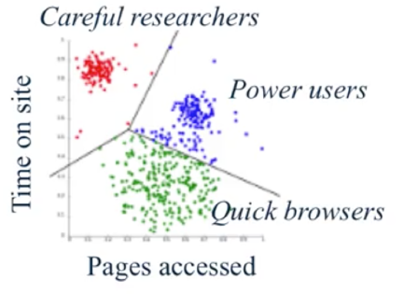
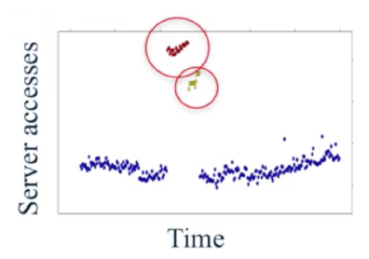
Unsupervised learning: finding useful structure or knowledge in data when no labels are available
Finding clusters of similar users (clustering)
Detecting abnormal server access patterns (unsupervised outlier detection)

Slide 8
Quiz
Which of the following are examples of supervised machine learning? Select all that apply.
Analyzing sales data to find groups of customers with similar buying habits
Making online movie recommendation based on the ”star” ratings that other users provided with their own online reviews
A face recognition system that trained using images with crowdsourced labels
A search engine that users user clicks on the results page to learn which pages are most relevant to popular queries

Slide 9

Quiz
Which of the following are examples of supervised machine learning? Select all that apply.
Analyzing sales data to find groups of customers with similar buying habits
Making online movie recommendation based on the ”star” ratings that other users provided with their own online reviews
A face recognition system that trained using images with crowdsourced labels
A search engine that users user clicks on the results page to learn which pages are most relevant to popular queries

Slide 10
Flow Chart of Predictive Modeling
Feature extraction
Normalization
Feature selection
Dimension reduction
Sampling
Model selection
Cross-validation
Metric
Hyperparameter optimization
Predicted Labels
Raw Data
Training Dataset
Learning Algorithm
New Data
Final Model
Labels
Testing Dataset
Labels
Pre-processing
Learning
Evaluation
Prediction

Slide 11
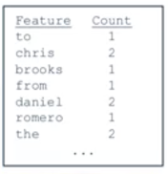
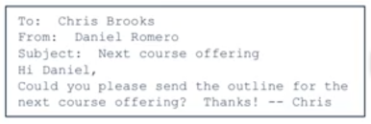

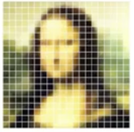
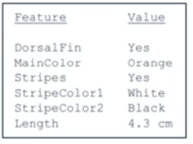

Feature Representations
Feature Representations
A list of words with their frequency counts
Email
A matrix of colour values (pixels)
Picture
A set of attribute values
Sea Creatures

Slide 12
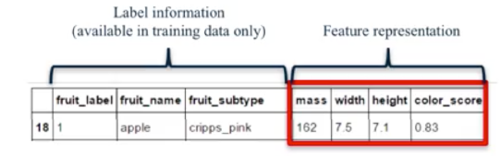
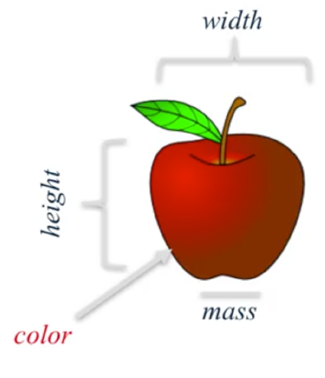
Representing a piece of fruits as an array of features (plus label information)
Feature Representations
Feature Representations
Classifier
Predicted Class (Apple)

Slide 13

Example: Classifying SPAM emails
Classic example of machine learning: SPAM emails classification

Slide 14
Summary of the SPAM example
Components | Elaboration
Question | Can I use quantitative attributes of the email to classify the email as belonging to the SPAM or non- SPAM group?
Input | Data Is the data perfect or sufficient? If not what do you do about it?
Features | In this context, can be a word count : in this example the count of the word ‘you’ is evaluated as a feature through
Algorithm | Here, a kernel density function of the frequency of the word ‘your’ in the email is used as the prediction function
Parameter | The cut-off point of 0.5 is used to differentiate spam emails from non-spam email
Evaluation | The prediction accuracy is measured in terms of percentage of correctly predicted labels

Slide 15
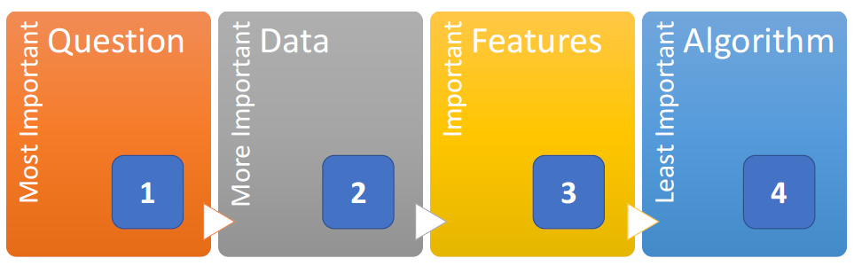
Which components are more important?

Slide 16
Key take-aways concerning Questions, Data, Features and Algorithm
For DATA, garbage in = garbage out
More DATA is better than BETTER prediction models
For FEATURES, it should be based on EXPERT domain knowledge, and lead to data COMPRESSION while RETAINING relevant information
It’s a mistake to rely heavily on automatic feature selection, ignore data quirks and throw away information
For ALGORITHM, it matters less, with sometimes marginal differences between prediction models

Slide 17
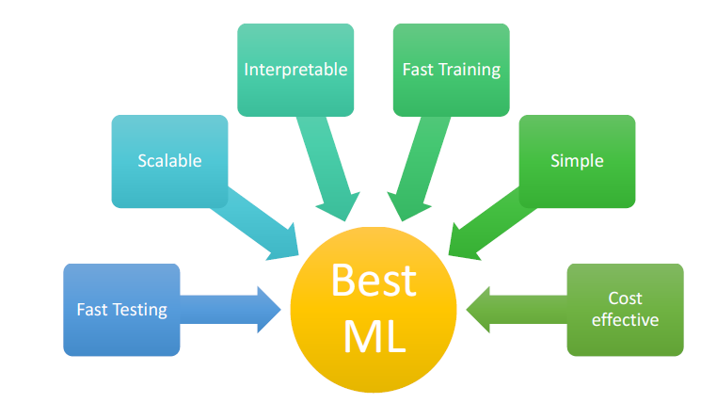
What is the “BEST” ML method then?

Slide 18

In Sample VS. Out of Sample Errors
In Sample Error : the error rate you get on the same data set you used to build your predictor, aka resubstitution error
Out of sample error: the error rate you get on a new data set, aka generalization error
This is what we should care about, due to overfitting errors (in other words, out of sample error is more important than in sample error)

Slide 19
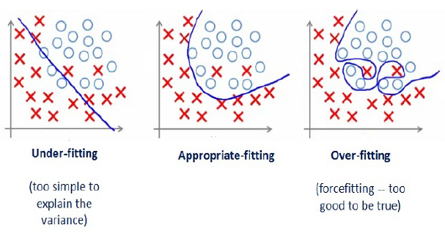
Generalization vs Overfitting vs Underfitting
Generalization – algorithm’s ability to give accurate predictions for new, previously unseen data
Overfitting - occurs when a model is excessively complex, such as having too many parameters relative to the number of observations. Overfitting describes random error or noise instead of underlying relationship
Underfitting - occurs when a statistical model or machine learning algorithm cannot capture the underlying trend of the data. It is when the model or the algorithm does not fit the data well enough

Slide 20
Tips on minimizing In and Out of Sample Error
Define your error rate
Split data into: training, testing, validation (optional)
On the training set, pick features. use cross-validation
On the training set, pick prediction function. use cross-validation
If no validation: apply once to test set (don't want to use test set to train the model)
If there is validation: apply to test set and refine, and apply once to
validation

Slide 21
Tips on minimizing In and Out of Sample Error..cont
Know the benchmarks
Study design:
E.g. Netflix, test may be 'hold out set', split to 3: probe (labels provided), quiz, test (so you would train on training, and apply to the probe. Netflix applied model to quiz set and you could see results. Test was for ultimate test at end of competition.)
Kaggle: used by professionals
Avoid small sample sizes, especially for test set

Slide 22
Tips on minimizing In and Out of Sample Error..cont
Rules of thumb for prediction study design
If you have a large sample size: 60% training, 20% test, 20% validation
Medium sample size: 60% training, 40% testing
Small: do cross validation, report caveat of small sample size, or even reconsider whether to do
Some principles to remember
Set the test validation set aside and don't look at it
In general, randomly sample training and test
Your data sets must reflect structure of the problem - if predictions evolve with time, split train/test in time chunks (called back testing in finance)
All subsets should reflect as much diversity as possible: random assignment does this; you can also try to balance by features, but this is tricky

Slide 23
Common error measures
Mean Squared Error (or Root Mean Squared Error)
For continuous data, e.g time-series data
Median Absolute Deviation
Also for continuous data, more robust
Sensitivity (recall): if you want few missed positives
Specificity: if you want few negatives called positives
Accuracy: weights false positives/negatives equally
Concordance: distance measures for multi-class data, example: kappa

Slide 24
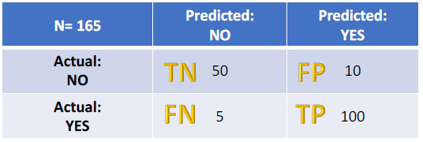
Some Error Measures From Confusion Matrix
Let's start with an example confusion matrix for a binary classifier (though it can easily be extended to the case of more than two classes): Here let’ consider prediction of diseases
Some Useful Terms
True Positives (TP): These are cases in which we predicted yes (they have the disease), and they do have the disease.
True Negatives (TN): We predicted no, and they don't have the disease.
False Positives (FP): We predicted yes, but they don't actually have the disease. (Also known as a "Type I error.")
False Negatives (FN): We predicted no, but they actually do have the disease. (Also known as a "Type II error.")

Slide 25
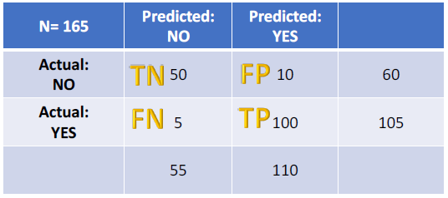
Some Error Measures from a Confusion Matrix..cont
This is a list of rates that are often computed from a confusion matrix:
Accuracy: Overall, how often is the classifier correct?
(TP+TN)/total = (100+50)/165 = 0.91
Misclassification Rate: Overall, how often is it wrong?
(FP+FN)/total = (10+5)/165 = 0.09
equivalent to 1 minus Accuracy
also known as "Error Rate“
Precision: When it predicts yes, how often is it correct?
TP/predicted yes = 100/110 = 0.91
True Positive Rate: When it's actually yes, how often does it predict yes?
TP/(TP+FN) = 100/105 = 0.95
also known as "Sensitivity" or "Recall"
False Positive Rate: When it's actually no, how often does it predict yes?
FP/(FP+TN)= 10/60 = 0.17
Specificity: When it's actually no, how often does it predict no?
TN/actual no = 50/60 = 0.83
equivalent to 1 minus False Positive Rate
Prevalence: How often does the yes condition actually occur in our sample?
actual yes/total = 105/165 = 0.64

Slide 26
Receiver Operating Characteristics (ROC)
ROC is a measure of the quality of the goodness of a prediction algorithm
ROC exists as a curve because:
In binary classification, you are predicting one of two categories: alive/dead, ad click/not
But predictions are often quantitative: P(alive), prediction on a scale from 1-10
The cutoff you choose gives different results

Slide 27
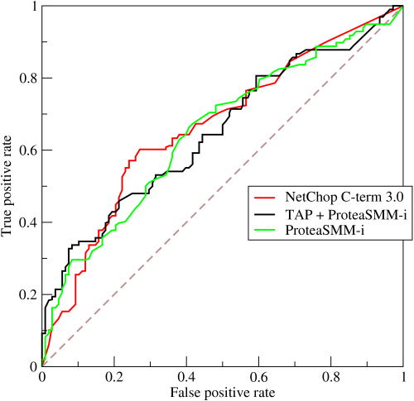
Description of a ROC curve
x axis = 1-specificity (P(FP) = false positive rate)
y axis = sensitivity (P(TP) = true positive rate)
Both axes go 0 to 1, with a concave down curve

Slide 28
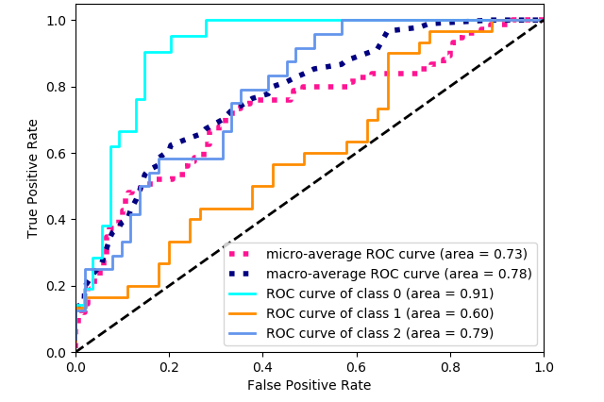
Evaluating Area Under ROC Curve (AUC)
AUC = 0.5: random guessing (45 degree line basically)
AUC < 0.5 means you did worse
AUC = 1: perfect classifier
In general, AUC above 0.8 is considered 'good'

Slide 29
Cross-Validation
Key ideas:
Accuracy on the training set (re-substitution accuracy) is optimistic
A better estimate comes from an independent set (test set accuracy)
However we can't use the test set when building the model or it becomes part of the training set
Therefore we estimate the test set accuracy with the training set

Slide 30
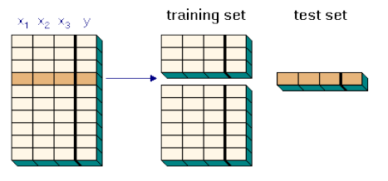
Cross Validation Approach
Approach:
Use the training set
Split this training into training/test sets
Build a model on the training subset
Evaluate on the test subset
Repeat and average the estimated errors

Slide 31
Cross Validation is used for...
Picking variables to include in a model
Picking the type of prediction function to use
Picking the parameters in the prediction function
Comparing different predictors

Slide 32
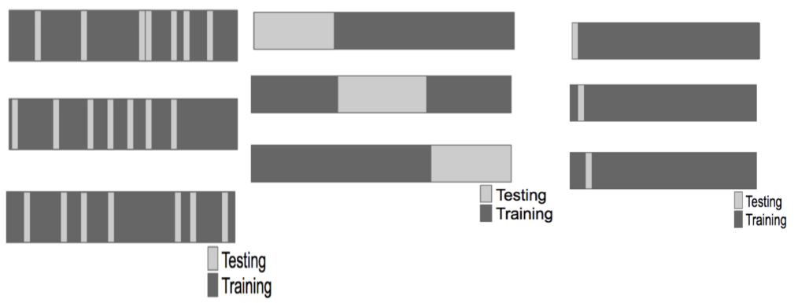
Subsampling can be done in various ways..
Random Subsampling
F-Fold
Leave one out

Slide 33
Some considerations
Considerations:
For time series data, data must be used in 'chunks': blocks of contiguous time, can't do randomly
For k-fold cross validation, larger k = less bias, more variance; smaller k = more bias, less variance
For random sampling must be done without replacement
Random sampling with replacement is the bootstrap - underestimates of the error; can be corrected, but it is complicated ( use 0.632 Bootstrap rule)
If you cross-validate to pick predictors estimate, you must estimate errors on independent data

Slide 34
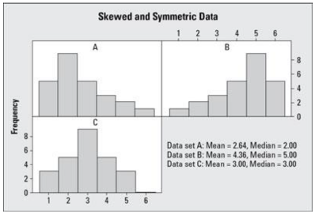
Preprocessing
Why do we need to preprocess?
Strange distributions, skewed vars in model-based predictors
Histogram & mean (mean not in centre shows skew)/standard deviation(watch out for highly inflated values!) can show skew in data

Slide 35

Preprocessing (standardization)
Generally, we can standardize by subtracting the mean of a predictor (column in your data set) and then dividing by the standard deviation
This will give a mean of zero and a standard deviation of one
Generally, preprocessing should be performed for both the training and the testing dataset
Preprocessing can also be incorporated in the model fitting stage, to be passed as an argument

Slide 36
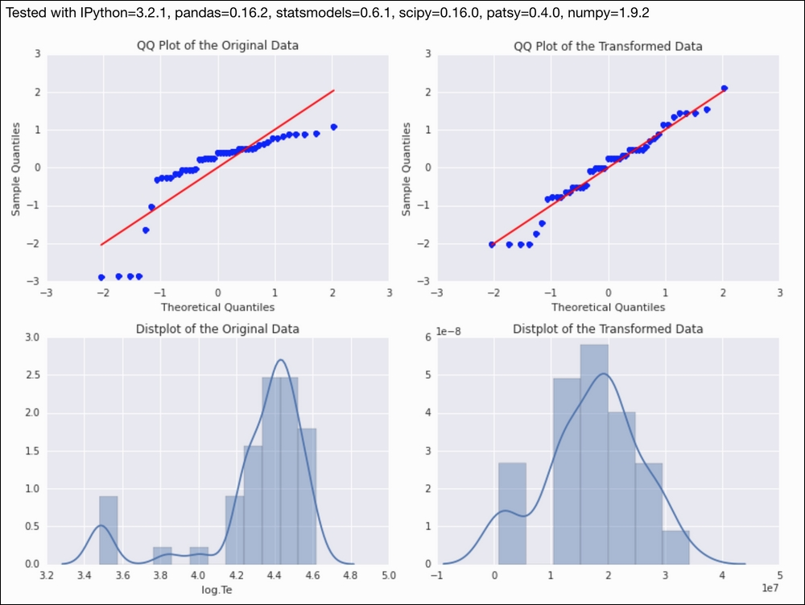
How to preprocess continuous data into normal data
If the dataset comprises continuous data (data measurable on a scale), it can be transformed into normal data (normally distributed data) using the Box-Cox transform.

Slide 37
Handle missing values
Some algorithms cannot handle missing data
Missing data can be imputed
Subsequently, once the missing data has been handled, remember to standardize!
REMINDER: Replace first, then standardize

Slide 38
On pre-processing
Training and test must be processed in the same way
Test transformations will likely be imperfect, especially if the test /training sets were collected at different times
Be careful when transforming factor/categorical variables!

Slide 39
Covariate creation
Covariates aka predictors, features – are variables you will use in your model to get at what outcome you care about
2 levels of covariate creation:
Level 1: from raw data to covariate: eg raw email text, get the avg capital letters, # times 'you' appears, etc. - features that describe the raw email
Level 2: transforming tidy covariates; ie no additional feature extraction steps needed

Slide 40
Level 1
Level 1, Raw data to covariates
Depends heavily on application
The balancing act is summarization vs info loss
Examples:
* text files: freq of words, phrases (Google ngrams), capital letters
* images: edges, corners, blobs, ridges (computer vision feature detection)
* webpages: number and type of images, position of elements, colors, videos (A/B testing, aka randomized trials in statistics)
* people: height, weight, hair color, sex, country of origin
The more knowledge of the system you have, the better the job you will do
When in doubt, err on the side of more features
It can be automated, but use caution! May be important for training but won't generalize well for test

Slide 41
Level 2
Level 2, tidy covariates to new covariates (functions on covariates)
More necessary for some methods (regression, svms) than for others (classification trees)
Only do on training set!
Best approach through exploratory analysis (plotting / tables)
New covariates should be added to data frames

Slide 42
Additional steps for covariates
Common covariates to add, dummy variables
Basic idea: convert factor variables to indicator variables
E.g var jobclass = industrial, information; change so 2 vars, industrial, info, with values 0 or 1
Removing zero covariates
Some variables have no variability at all - eg here, sex always male

Slide 43
Level 1 and Level 2 Covariates discussion
Level 1 feature creation (raw to covariates):
Science is key; Google 'feature extraction for [data type]' eg images, voice, etc.
Err on overcreation of features
In some applications (images, voices), automated feature creation is possible/ necessary
Level 2 feature creation (covariates to new cov)
Create new covariates if you think they will improve fit
Use exploratory analysis on the training set for creating them
Be careful about overfitting!

Slide 44
Preprocessing with PCA (principal components analysis)
In a dataset, we might have multiple quantitative variables, some highly correlated with others
With PCA, the basic ideas are:
We might not need every predictor (like here, num415 and num857, do not need both)
A weighted combination of predictors might be better
We should pick this combo to capture the 'most info' possible
Benefits: reduced # of predictors, reduced noise due to averaging, reduce computation time

Slide 45
What of multivariate variables?
Related problems:
Multivariate variables X1, ... Xn so X1 = (X11, ... X1m)
Find a new set of multivariate vars that are uncorrelated and explain as much variance as possible (in example, use X and throw out Y and original vars)
If you put all the vars together in one matrix, find the best matrix created with fewer variables (lower rank) that explains the original data
The first goal is statistical, and the 2nd is data compression

Slide 46
PCA/SVD
SVD: if X is a matrix with each var in a column and each obs in a row, then the SVD is a 'matrix decomposition', X = UDV^T, (ie 3 matrices), where the columns of U are orthogonal (left singular vectors), the columns of V are orthogonal (right singular vectors) and D is a diagonal matrix (singular values)
PCA: the principal components are equal to the right singular values if you first scale (subtract mean, divide by sd) the vars)

Slide 47
Summary
There are many machine learning algorithms and techniques
Machine learning models can range from a simple model to a complex model
Always pick model that is easy to interpret

Slide 48
In Sample Vs Out Sample Errors Discussion
Let’s assume a subset of the SPAM data is taken, and called smallSpam – this consists of 10 observations selected at random
A set of prediction rules is build around the feature capitalAve (average length uninterrupted sequence of capital letters)
Prediction rule 1:
capitalAve > 2.7 = 'spam’
capitalAve < 2.4 = 'nonspam’
between 2.4 and 2.45 = spam
between 2.45 and 2.7 = nonspam
This gives perfect results!

