Slide 1
Getupstartup.com
An agile start up collaboration platform

Slide 2
contents
Problem statement
About the Project
Scope
Modules
Future prospects

Slide 3
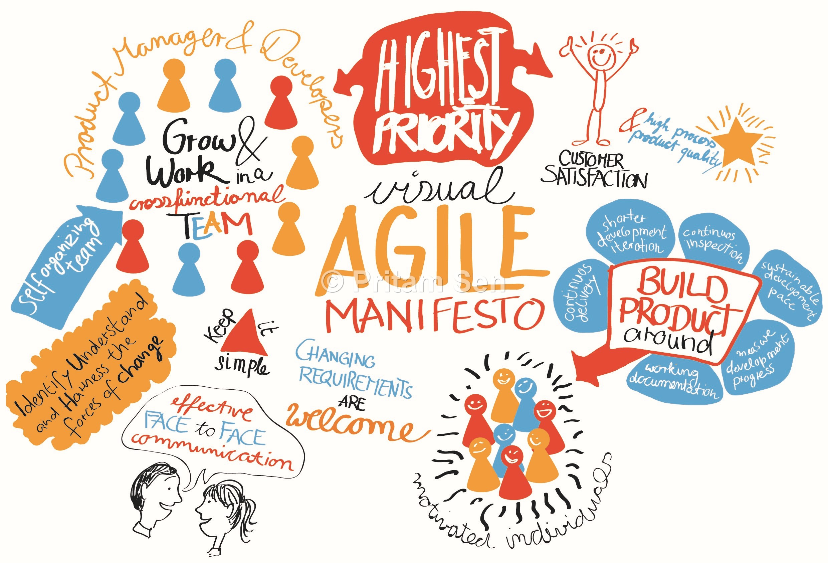
Problem statement
23% of start ups fail because they don’t have the right team
13% of start ups fail because of disharmony among team
13% of start ups fail because product is mistimed
Solution
introducing a team building and collaboration platform for start-ups
based on agile principles
which addresses all of the above mentioned problems effectively
providing them with much better chances to attract business investors, customers and market shareholders.
Source: CB insight

Slide 4

About the project
The website will act as a pipeline for start-ups
to walk them through processes of
team building,
customer evaluation,
product building through lean and
creating an agile environment through collaboration.

Slide 5
scope
Website is currently a minimum viable product
Backend functionality is a prototype – can be expanded
Portal will eventually include –
features to fully implement scrum agile and lean methodologies
allow users to look up and join start ups
Elaborate task + backlog management
getting in touch with investors and recruit team members through portal
Project will take at least an year to market

Slide 6
modules
Sign In
Sign Up
Projects Board
Project Dashboard/User Home Page

Slide 7
Future prospects
User Registration
Startup Registration
Startup Task Management -
Project Dashboard
CRUD Tasks
Backlog Maintenance Profile Setup (in future)
Projects Board/Newsfeed
Complete DBMS for the Portal’s Backend

Slide 8
Thank you

