Slide 1
Neural Solvers for CFD:
Introduction to Physics Informed Neural Networks (PINNs) and Neural Operators (PINOs)
Gulzar Ali

Slide 2
Introduction
Simulation Bottleneck ​
Classical Solvers (FEM/FED)
AI Opportunity
Numerical methods like Finite Element Analysis are the gold standard for accuracy. However, they rely on dense meshes and solving massive linear systems, making them computationally prohibitive for real-time applications or complex design optimization.
Deep Learning offers a paradigm shift: approximating complex physical functions directly. The challenge has historically been ensuring these approximations respect the immutable laws of physics

Slide 3

Introduction
What is PINNs ? ​
Neural networks that incorporates physical laws by describing PDEs into the learning process.
    Ensures that the prediction obey’s physics laws
    Removes uncertainty of false or unrealistic predictions
  Universal Approximation Theorem
  The Universal Approximation Theorem states that a feedforward neural network with at least one hidden layer can approximate any continuous function to any desired degree of accuracy, given sufficient neurons.
PINN acts as a function approximator. It takes spatial and temporal coordinates (x, t) as input and outputs the physical quantity (u).
$$∃\hat{θ}∈Θ, |u−u_{\hat{θ}}|_{L^{p}}<ε$$

Slide 4
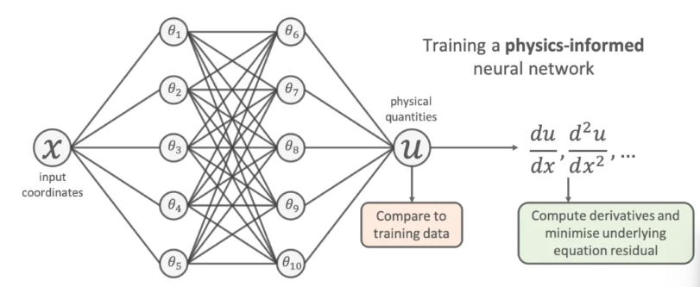
Introduction
How it Works ?
PINN acts as a function approximator. It takes spatial and temporal coordinates (x, t) as input and outputs the physical quantity (u).
Automatic differentiation calculates the derivatives of the output, allowing us to compute the residual of the Partial Differential Equation (PDE) directly in the loss function.
Notes:
Sampling a set of input training locations () and passing them through the network.
Next gradients of the network’s output with respect to its input are computed at these locations (which are typically analytically available for most neural networks and can be easily computed using auto differentiation.
Finally, the residual of the underlying differential equation is computed using these gradients and added as an extra term in the loss function.

Slide 5
Introduction
GOALS
Understand the different types of scientific tasks PINNs can be used for
Understand in more detail how PINNs are trained and how to improve their convergence
PINNs are divided into two classes:
1) Forward Problems: data-driven solution for PDEs
2) Inverse Problems: data driven discovery of PDEs (Finding missing parameters)

Slide 6
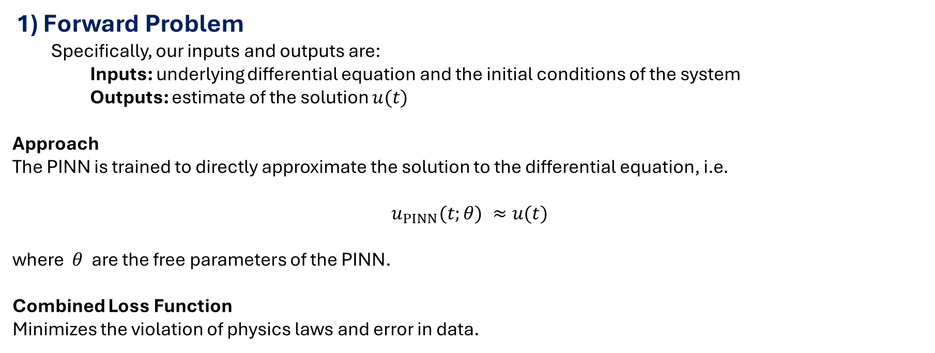
Introduction
1) Forward Problem
  Specifically, our inputs and outputs are:
    Inputs: underlying differential equation and the initial conditions of the system
    Outputs: estimate of the solution $u(t)$
Approach
The PINN is trained to directly approximate the solution to the differential equation, i.e.
$$u_{PINN}(t;θ) ≈u(t)$$
where $θ$ are the free parameters of the PINN.
Combined Loss Function
Minimizes the violation of physics laws and error in data.
$$Loss={MSE}_{data}+{MSE}_{Initial}+{MSE}_{boundary}+{MSE}_{PDE}$$

Slide 7
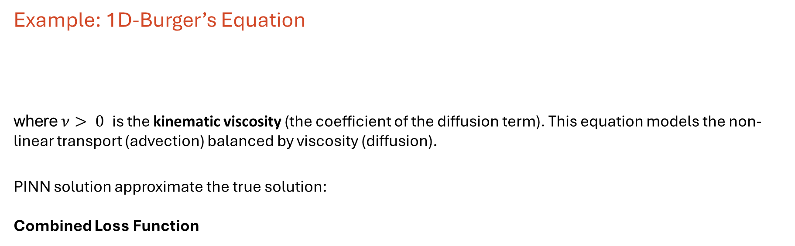


Introduction
  Example: 1D-Burger’s Equation
  where$ν> 0$ is the kinematic viscosity (the coefficient of the diffusion term). This equation models the non-linear transport (advection) balanced by viscosity (diffusion).
PINN solution approximate the true solution:
Combined Loss Function
$$\frac{∂u}{∂t}+u\frac{∂u}{∂x}=ν\frac{∂^{2}u}{∂x^{2}}$$
$$u_{\text{PINN}}\left(x,t\right)≈u\left(x,t\right)$$
$$L\left(θ\right)={\left(u_{\text{PINN}}\left(x_{i},t=0;θ\right)−u_{0}\left(x_{i}\right)\right)}^{2}+{λ_{\text{1}}\left(u_{\text{PINN}}\left(x_{j},t_{j};θ\right)−u_{\text{boundary}}\left(x_{j},t_{j}\right)\right)}^{2}+λ_{\text{2}}{\left[\frac{∂u_{\text{PINN}}}{∂t}+u_{\text{PINN}}\frac{∂u_{\text{PINN}}}{∂x}−ν\frac{∂^{2}u_{\text{PINN}}}{∂x^{2}}\right]}_{x_{k},t_{k}}^{2}$$
Boundary Loss
Physics Loss

Slide 8
Introduction
  1D-Burger’s Equation (PINNs training Script)
import os
import torch
import torch.nn as nn
import numpy as np
# --- Device (GPU if available) ---
device = torch.device("cuda" if torch.cuda.is_available() else "cpu")
print("Using device:", device)
# --- Define the neural network ---
class PINN(nn.Module):
def __init__(self):
super(PINN, self).__init__()
self.net = nn.Sequential(
nn.Linear(2, 30), nn.Tanh(),
nn.Linear(30, 30), nn.Tanh(),
nn.Linear(30, 1)
)
def forward(self, x, t):
X = torch.cat([x, t], dim=1)
return self.net(X)
Step 1# Import necessary libraries
Step 2# Define Your Neural Network

Slide 9
Introduction
  1D-Burger’s Equation (PINNs training Script)
# --- Initialize model and constants ---
model = PINN().to(device)
ν = 0.01 / np.pi # viscosity constant
# --- Physics Loss ---
def physics_loss(x, t):
u = model(x, t)
u_t = torch.autograd.grad(u, t, torch.ones_like(u), create_graph=True, retain_graph=True)[0]
u_x = torch.autograd.grad(u, x, torch.ones_like(u), create_graph=True, retain_graph=True)[0]
u_xx = torch.autograd.grad(u_x, x, torch.ones_like(u_x), create_graph=True, retain_graph=True)[0]
f = u_t + u * u_x - ν * u_xx
return torch.mean(f**2)
Step 3# Initialize model and define constants
Step 4# Define Physics loss (Residual of PDE)

Slide 10
Introduction
  1D-Burger’s Equation (PINNs training Script)
# --- Initial and Boundary Conditions ---
def initial_condition(x):
return -torch.sin(np.pi * x)
def loss_fn(x_ic, t_ic, x_bc, t_bc, x_f, t_f):
# Initial condition
u_ic_pred = model(x_ic, t_ic)
u_ic_true = initial_condition(x_ic)
loss_ic = torch.mean((u_ic_pred - u_ic_true)**2)
# Boundary condition (u=0)
u_bc_pred = model(x_bc, t_bc)
loss_bc = torch.mean(u_bc_pred**2)
# PDE residual
loss_pde = physics_loss(x_f, t_f)
return loss_ic + loss_bc + loss_pde
# --- Optimizer ---
optimizer = torch.optim.Adam(model.parameters(), lr=1e-3)
Step 5# Define Initial and boundary conditions
Step 6# Define Combined Loss function (loss_fn)
Step 7# Define Initial Conditions

Slide 11
Introduction
  1D-Burger’s Equation (PINNs training Script)
# --- Checkpoint settings ---
checkpoint_path = "pinn_checkpoint.pth" # change to a Google Drive path if you want persistence across Colab sessions
def save_checkpoint(epoch):
torch.save({
"epoch": epoch,
"model_state_dict": model.state_dict(),
"optimizer_state_dict": optimizer.state_dict(),
}, checkpoint_path)
print(f"Checkpoint saved at epoch {epoch} -> {checkpoint_path}")
def load_checkpoint():
if os.path.exists(checkpoint_path):
ckpt = torch.load(checkpoint_path, map_location=device)
model.load_state_dict(ckpt["model_state_dict"])
optimizer.load_state_dict(ckpt["optimizer_state_dict"])
start_epoch = ckpt.get("epoch", 0) + 1
print(f"Loaded checkpoint from epoch {ckpt.get('epoch', 0)}")
return start_epoch
else:
print("No checkpoint found, starting from scratch.")
return 0
Step 8#Define save_ and load_checkpoint functions

Slide 12
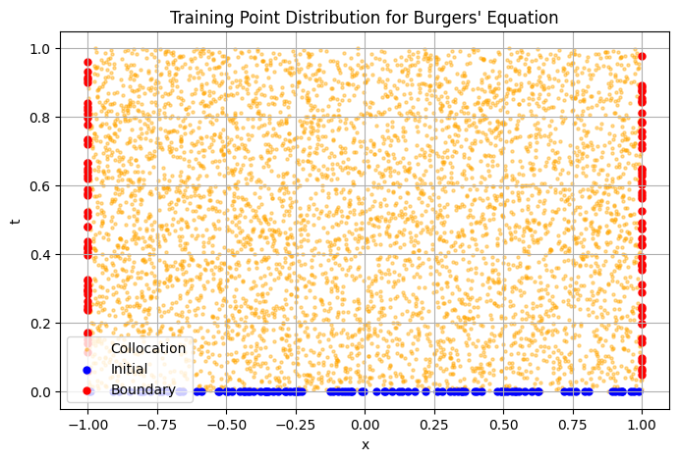
Introduction
  1D-Burger’s Equation (PINNs training Script)
# --- Generate training data (IC & BC) ---
N_ic = 100
x_ic = -1 + 2*torch.rand((N_ic, 1), device=device)
t_ic = torch.zeros_like(x_ic, device=device)
N_bc = 100
x_bc = torch.cat([
-torch.ones((N_bc//2, 1), device=device),
torch.ones((N_bc//2, 1), device=device)
], dim=0)
t_bc = torch.rand_like(x_bc, device=device)
Step 9# Generate training data
(Initial conditions and boundary conditions)

Slide 13
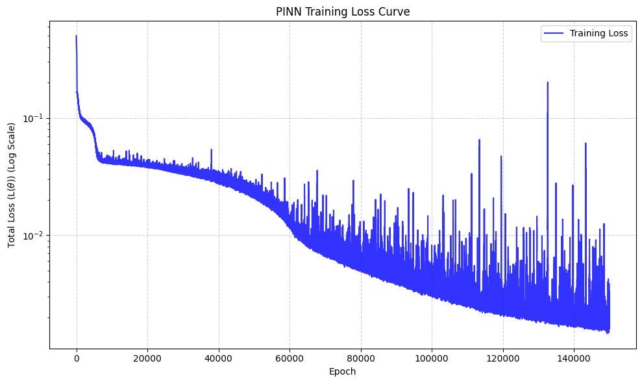
Introduction
  1D-Burger’s Equation (PINNs training Script)
# --- Training loop with resume support ---
num_epochs = 200000
start_epoch = load_checkpoint() # will resume if file exists, else start_epoch = 0
for epoch in range(start_epoch, num_epochs):
optimizer.zero_grad()
# Collocation points
N_f = 5000
x_f = -1 + 2*torch.rand((N_f, 1), device=device)
t_f = torch.rand((N_f, 1), device=device)
x_f.requires_grad_(True)
t_f.requires_grad_(True)
loss = loss_fn(x_ic, t_ic, x_bc, t_bc, x_f, t_f)
loss.backward()
optimizer.step()
if epoch % 5000 == 0:
print(f"Epoch {epoch}: Loss = {loss.item():.6f}")
# save a checkpoint periodically
save_checkpoint(epoch)
Step 10# Training Loop

Slide 14
Introduction
def burgers_fd_rk4_upwind(t_final, nu, Nx=201, dt=5e-5):
x = np.linspace(-1.0, 1.0, Nx)
dx = x[1] - x[0]
u = -np.sin(np.pi * x)
n_steps = int(t_final / dt)
def F(u_in):
u_t = np.zeros_like(u_in)
# viscous term (central)
u_xx_cd = (u_in[2:] - 2*u_in[1:-1] + u_in[:-2]) / dx**2
# advection term (upwind)
u_x_upwind = np.zeros_like(u_in[1:-1])
for i in range(1, Nx - 1):
if u_in[i] >= 0:
u_x_upwind[i-1] = (u_in[i] - u_in[i-1]) / dx
else:
u_x_upwind[i-1] = (u_in[i+1] - u_in[i]) / dx
u_t[1:-1] = -u_in[1:-1] * u_x_upwind + nu * u_xx_cd
return u_t
for n in range(n_steps):
k1 = dt * F(u)
u_k2 = u + k1 / 2.0
u_k2[0] = 0.0; u_k2[-1] = 0.0
k2 = dt * F(u_k2)
u_k3 = u + k2 / 2.0
u_k3[0] = 0.0; u_k3[-1] = 0.0
k3 = dt * F(u_k3)
u_k4 = u + k3
u_k4[0] = 0.0; u_k4[-1] = 0.0
k4 = dt * F(u_k4)
u_new = u + (k1 + 2*k2 + 2*k3 + k4) / 6.0
u_new[0] = 0.0; u_new[-1] = 0.0
u = u_new
return x, u
  1D-Burger’s Equation (Visualization)
Step 10# Define Finite Difference Solver
First Order Upwind Scheme (Spatial Discretization)
2) Fourth-Order Runge-Kutta (RK4) (Time integration)

Slide 15
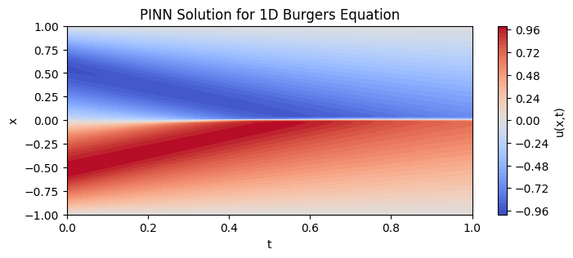
Introduction
  1D-Burger’s Equation (Compare Results)
model.to(device)
model.eval()
# 3. Create tensors
x_vals = torch.linspace(-1, 1, 100, device=device).reshape(-1, 1)
t_vals = torch.linspace(0, 1, 100, device=device).reshape(-1, 1)
X, T = torch.meshgrid(x_vals.squeeze(), t_vals.squeeze(), indexing='ij')
x_flat = X.reshape(-1, 1)
t_flat = T.reshape(-1, 1)
with torch.no_grad():
u_pred = model(x_flat, t_flat).reshape(100, 100)
# 4. Move to CPU for plotting
X_np = X.detach().cpu().numpy()
T_np = T.detach().cpu().numpy()
u_pred_np = u_pred.detach().cpu().numpy()
plt.figure(figsize=(8, 3))
plt.contourf(T_np, X_np, u_pred_np, 50, cmap='coolwarm')
plt.colorbar(label='u(x,t)')
plt.xlabel('t')
plt.ylabel('x')
plt.title('PINN Solution for 1D Burgers Equation')
plt.show()
Step 11# Visualize Prediction

Slide 16
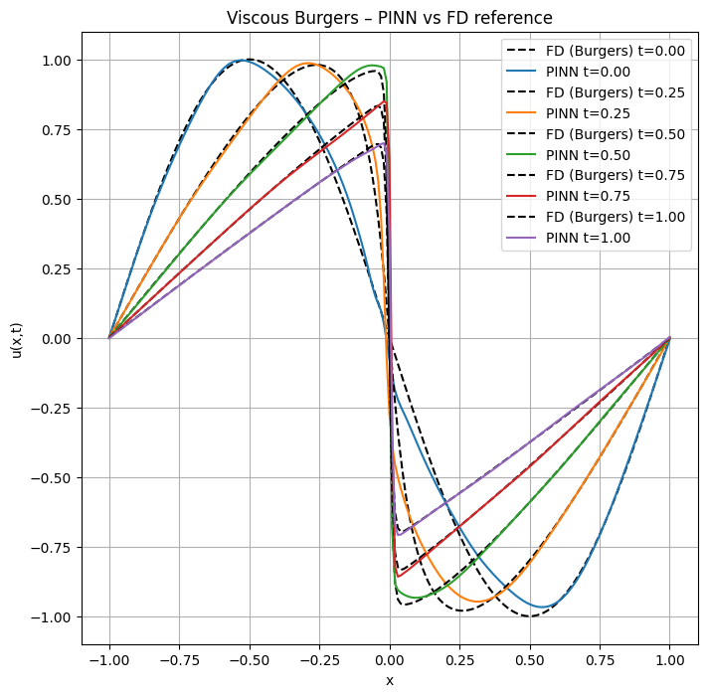
Introduction
  1D-Burger’s Equation (Visualization)
# --- Generate grid ---
t_vals = [0.0, 0.25, 0.5, 0.75, 1.0]
plt.figure(figsize=(8, 8))
for t in t_vals:
# FD reference (Burgers)
x_ref, u_ref = burgers_fd_rk4_upwind(t, nu, Nx=201, dt=5e-5)
# PINN prediction on same x grid -> put tensors on *device*
x_torch = torch.tensor(x_ref, dtype=torch.float32, device=device).reshape(-1, 1)
t_torch = torch.full_like(x_torch, float(t)) # same device & shape
with torch.no_grad():
u_pinn = model(x_torch, t_torch).detach().cpu().numpy().flatten()
# Plot
plt.plot(x_ref, u_ref, 'k--', label=f'FD (Burgers) t={t:.2f}')
plt.plot(x_ref, u_pinn, label=f'PINN t={t:.2f}')
plt.xlabel('x')
plt.ylabel('u(x,t)')
plt.title("Viscous Burgers – PINN vs FD reference")
plt.legend()
plt.grid(True)
plt.show()
Step 12# Compare Finite Difference with PINNs Prediction

Slide 17
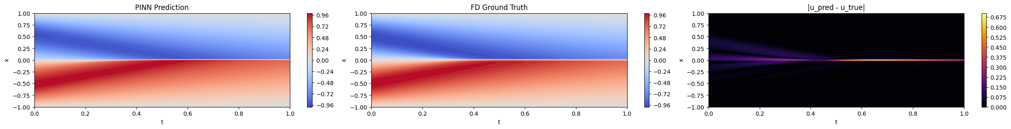
Introduction
# ===== Error =====
error = np.abs(u_pred - U_true)
l2_error = np.sqrt(np.mean((u_pred - U_true)**2))
max_error = np.max(error)
print(f"L2 error over space-time grid: {l2_error:.3e}")
print(f"Max abs error over space-time grid: {max_error:.3e}")
# ===== Plots: prediction, ground truth, error =====
fig, axs = plt.subplots(1, 3, figsize=(24, 3), constrained_layout=True)
vmin = min(u_pred.min(), U_true.min())
vmax = max(u_pred.max(), U_true.max())
c1 = axs[0].contourf(T_np, X_np, u_pred, 50, cmap='coolwarm',
vmin=vmin, vmax=vmax)
axs[0].set_title("PINN Prediction")
fig.colorbar(c1, ax=axs[0])
c2 = axs[1].contourf(T_np, X_np, U_true, 50, cmap='coolwarm',
vmin=vmin, vmax=vmax)
axs[1].set_title("FD Ground Truth")
fig.colorbar(c2, ax=axs[1])
c3 = axs[2].contourf(T_np, X_np, error, 50, cmap='inferno')
axs[2].set_title("|u_pred - u_true|")
fig.colorbar(c3, ax=axs[2])
for ax in axs:
ax.set_xlabel('t')
ax.set_ylabel('x')
plt.show()
  1D-Burger’s Equation (Visualization)
Step 11# Compare Finite Difference with PINNs Prediction
L2 error over space-time grid: 4.329e-02
Max abs error over space-time grid: 6.961e-01

Slide 18
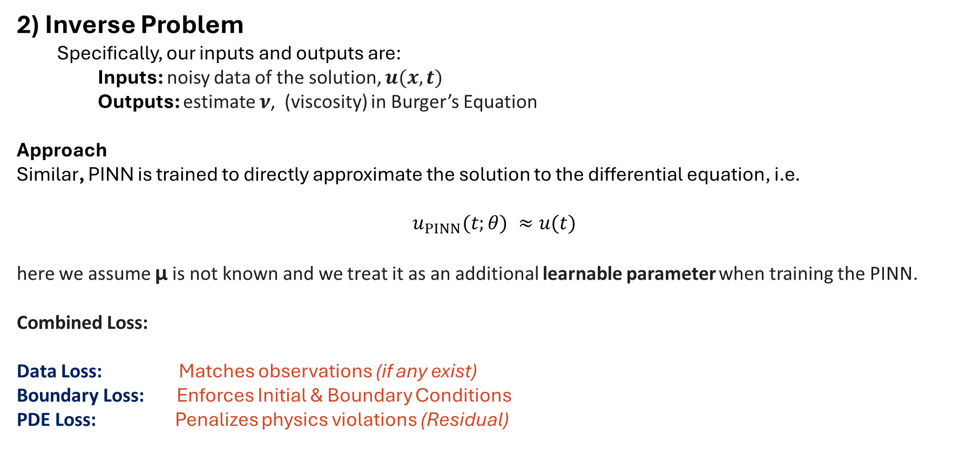
Introduction
2) Inverse Problem
  Specifically, our inputs and outputs are:
    Inputs: noisy data of the solution, $u(x, t)$
    Outputs: estimate $ν$, (viscosity) in Burger’s Equation
Approach
Similar, PINN is trained to directly approximate the solution to the differential equation, i.e.
$$u_{PINN}(t;θ) ≈u(t)$$
here we assume μ is not known and we treat it as an additional learnable parameter when training the PINN.
Combined Loss:
Data Loss: Matches observations (if any exist)
Boundary Loss: Enforces Initial & Boundary Conditions
PDE Loss: Penalizes physics violations (Residual)
$$Loss={MSE}_{data}+{MSE}_{boundary}+{MSE}_{PDE}$$

Slide 19
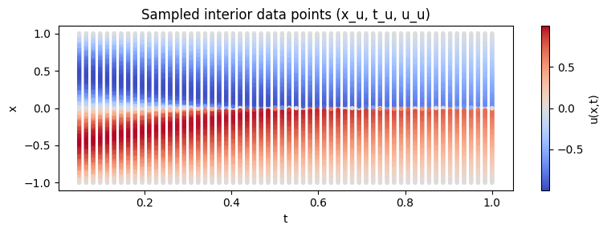
Introduction
  1D-Burger’s Equation (Finding Unknown Parameter)
Step 1# Generate/ Gather Course Data
# --- Define the neural network ---
class PINN(nn.Module):
def __init__(self):
super(PINN, self).__init__()
self.net = nn.Sequential(
nn.Linear(2, 30), nn.Tanh(),
nn.Linear(30, 30), nn.Tanh(),
nn.Linear(30, 1)
)
self.nu = nn.Parameter(torch.tensor([0.05],dtype=torch.float32, device=device))
def forward(self, x, t):
X = torch.cat([x, t], dim=1)
return self.net(X)
Step 2# Update model

Slide 20
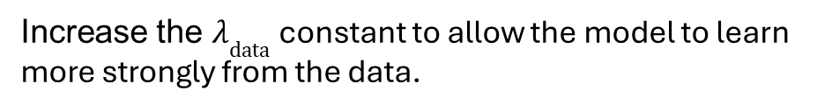
Introduction
  1D-Burger’s Equation (Finding Unknown Parameter)
# --- Physics Loss ---
def physics_loss(x, t):
u = model(x, t)
u_t = torch.autograd.grad(u, t, torch.ones_like(u), create_graph=True, retain_graph=True)[0]
u_x = torch.autograd.grad(u, x, torch.ones_like(u), create_graph=True, retain_graph=True)[0]
u_xx = torch.autograd.grad(u_x, x, torch.ones_like(u_x), create_graph=True, retain_graph=True)[0]
f = u_t + u * u_x - model.nu * u_xx
return torch.mean(f**2)
Step 3# Update Physics loss
Step 4# Update Combined loss
# Data term
if x_u is not None:
loss_data = data_loss(x_u, t_u, u_u)
else:
loss_data = torch.tensor(0.0, device=device)
loss = loss_ic + loss_bc + loss_pde + lambda_data * loss_data # Experiment with lambda_data constant
Increase the $λ_{\text{data}}$constant to allow the model to learn more strongly from the data.

Slide 21
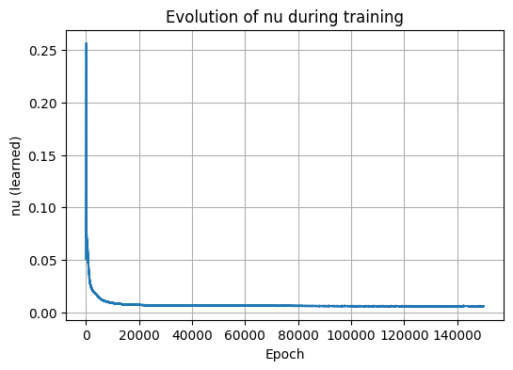
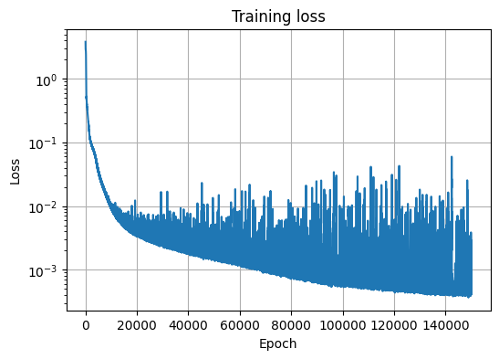

Introduction
  1D-Burger’s Equation (Finding Unknown Parameter)
Step 5# Visualize the loss
Final learned $ν$: 0.005945220589637756
True $ν:$ 0.00318309886184

