Slide 1
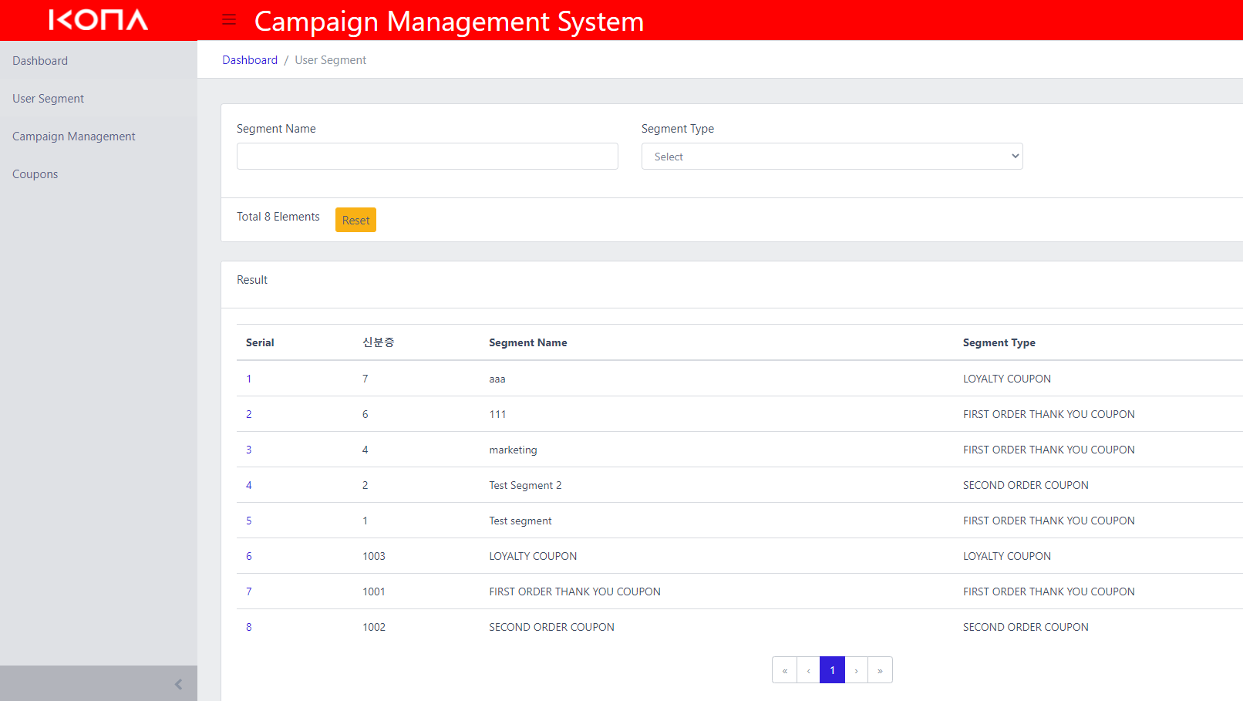
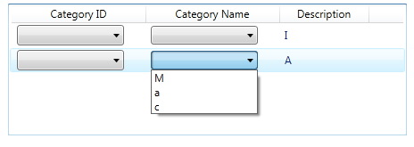
AI Recommand
1. Set conditions to filter members.
dasdf
User Filter
gender, age, point_amt
Target Time
month, hour, weekday
AI Recommand
2. Select the time the coupon can be used.
User_id | gender | age | Point_amt | Recommand Category
111111111 | Female | 20 | 12345 | CC0001
22222222 | Male | 25 | 0 | CC0010
33333333 | Female | 40 | 23456 | CC0001
444444444 | Male | 45 | 3345 | --
3. A filtered list of members is displayed.
4. The categories recommended by each member are displayed.
Recommand Category | Coupon Id | Coupon Name
CC0001
CC0010
5. Map coupons by recommended category.

Slide 2
AI Recommand
dasdf
User Filter
gender, age, point_amt, order_count(number of orders in the last month)
Target Time
month, hour, weekday
AI Recommand
User_id | gender | age | Point_amt | Order_count | Recommand Category
111111111 | Female | 20 | 12345 | 0 | CC0001
22222222 | Male | 25 | 0 | 1 | CC0010
33333333 | Female | 40 | 23456 | 1 | CC0001
444444444 | Male | 45 | 3345 | 2 | --
Recommand Category | Coupon Id | Coupon Name
CC0001
CC0010
Adding order_count seems to be very slow.
If performance is not an issue, use this model.

