Slide 1
Configuration Data
L1Trigger Upgrade Software Workshop
2013.05.23/24
Carlos Ghabrous Larrea
Carlo Battilana
Marc Magrans de Abril
Jim Brooke

Slide 2
Outline
Current DB operations workflow
Summary of problems/issues in the workflow
Proposal for workflow improvement
Proposal for design of upgraded config
Proposal for config. of upgraded emulators
Timeline/Milestones

Slide 3
Current workflow

Slide 4
Current DB operations (i)
Question:
what steps should a developer follow to integrate its subsystem with current DB operations/workflows?
Answer:
  Create configuration tables in OMDS
  Populate configuration tables with desired information (keys)
  Extract keys from OMDS and load into HW (configuration)
  Create and populate monitoring tables
  Produce Offline Condition formats
  Produce “fake” EventSetup producers to configure emulators w.o. O2O
  Produce code for Online to Offline transfer (O2O)

Slide 5
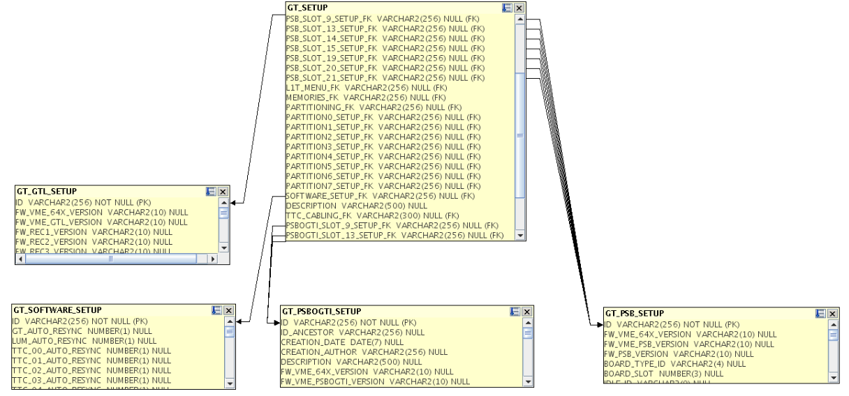
Current DB operations (ii)
Create configuration tables in OMDS
  Usually following HW structure (from HW address tables)
  Tables are related among each other using a hierarchical relationship (FK-PK) between them to allow for data reuse
  (manual process)

Slide 6
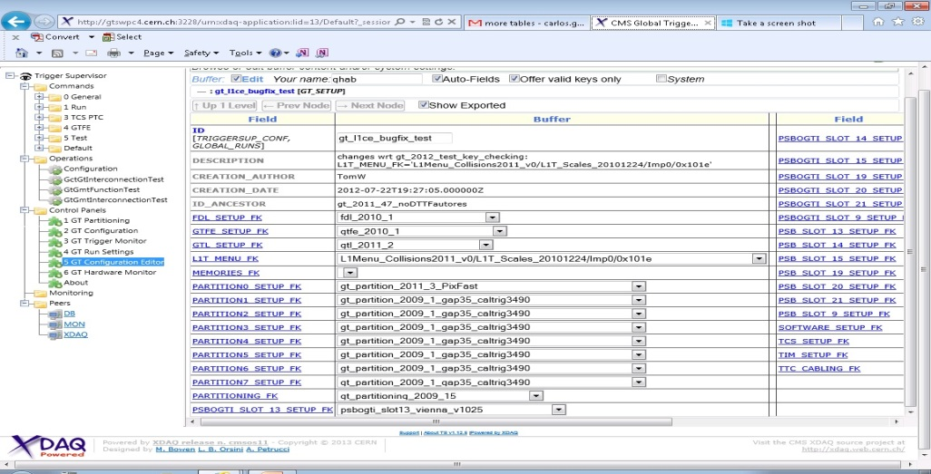
Current DB operations (iii)
Populate configuration tables with desired keys
  Manual process: writing own queries and using a SQL client (now mostly outdated)
  L1CE: well known by L1DOCs => developer doesn’t need to know about SQL
INSERT INTO
CMS_GT.GT_SETUP
(PARAM1, PARAM2… PARAMn)
VALUES
(VALUE1, VALUE2, …, VALUEn)

Slide 7
Current DB operations (iv)
Extract keys from DB and load into HW (configuration)
  Based on TS/XDAQ infrastructure (CellXhannelTB/TStore)
  Developer has to embed DB operations in C++ subsystem code
try {
tsframework::CellXhannelTB* x = dynamic_cast<tsframework::CellXhannelTB*>(getContext()->getXhannel("DB"));
x->connect(view, schema, pwd);
} catch (xcept::Exception& e) {
std::ostringstream msg;
msg << "Can not connect to TSTore. Exception caught: ";
XCEPT_RETHROW(tsexception::CellException,msg.str(),e);
}
// AND MANY MORE LINES TO PERFORM SELECTS/INSERTS
SUBSYSTEM
Cell
getXhannelTB()
TS
CellXhannelTB
SOAP
Oracle
XDAQ
TStore
OCCI

Slide 8
Current DB operations (v)
Create and populate monitoring tables
  Steps 1 and 3 (populated from subsystem’s monitoring appl.)
(+6.+7.) Emulators/Conditions/O2O
  Design condition format objects
  Write fake ES conditions producers (for algorithm testing/development and for MC production if no O2O)
  Subsystem customization of C++ classes provided by O2O framework (W. Sun)
    Existing documentation makes this step relatively quick and easy:
    https://twiki.cern.ch/twiki/bin/view/CMSPublic/SWGuideL1ConfigOnlineProd

Slide 9
Current workflow “weak” points and their improvement

Slide 10
Workflow “issues”
Create configuration tables in OMDS
  Could the process of creating tables be automate partially/totally?
  (e.g., generate SQL code from address table)
Populate configuration tables with desired information (keys)
  Process will still be manual
Configuration
  Depends on TS/XDAQ
  Requires writing specific C++ code with SQL queries[1][2]
  Non-homogeneous: each subsystem has implemented its own way to perform DB operations. Examples:
    GCT: classes that wrap up interaction with TS’s CellXhannelTB and XDAQ’s Tstore are used throughout the code [1]
    DTTF[2][3], CSCTF[4][5], DTSC[6][7]: code duplication
    NOT A CRITIC! Just saying how things have been done so far!

Slide 11
Room for improvement
Online Confguration DB
  C++ library
  Goal: simplify and homogenize DB operations
  Developed by Z. Xie, C. Ghabrous, M. Magrans
  References [1][2]
  Code snippets [3]
Status
  API prototype already written…
  … but complete scope not defined yet
Advantages
  Homogeneous
  Subsystem’s code is reduced, as complex operations are wrapped up
  Developer doesn’t have to write SOAP messages
  Use Tstore API directly and not depend on TS’s CellXhannelTB [4]:
  Not necessary to write a “Cell” to access DB (could be useful during integration stages)

Slide 12
Design proposals for the upgrade

Slide 13
Open questions
Run settings key: do we still keep it as a separate key from the general configuration key (TSC)?
Can we have an homogeneous table schema for online configuration HW tables (still hierarchical/can we use a flat table for subsystem?)
Can we homogenize the way of treating common entities (e.g. LUTs, masks)
Can the O2O process be simplified? (looks like it already relatively simple and well documented, but can we do better?)
FW versioning evolution: how can we configure emulators to reproduce a given FW “scenario”?
Schema evolution: current/future schema changes propagate potentially through all the chain
  Is it a nightmare to account for this at early stages of development?
  Should some constraints/bounds be provided for schema evolution?
  Or do we just take the hit when/if this arrives?
OMDS
C++ Online
CondFormat Objects
Emulators

Slide 14
A DB Schema proposal
Keep RS and TSC separated (e.g masks may change often)
Have one flat configuration table for subsystems
  Simplify management and object access (Ta->myPar inst. of Ta->Tb … ->myPar)
  Can turn into a simpler O2O (avoid many tables -> one CondFormat)
  Implies wasting more memory (but, how often TSC are changed, is it an issue?)
  Centrally will provide common way of accessing/handling basic objects
    int, strings, vectors…
    Can easily provide also primitives for translation of this object via O2O
Firmware version must come as part of configuration
  Needed to handle FW evolution in emulators (algos, LUTs…)
  More in next slides…
Schema evolution constraints coming mainly from offline formats (LINK to TWIKI be provided)
  Updates expected by DB crew for CMSSW 70X, must account them in L1 design

Slide 15
Objects of common usage (1)
Q: Is it possible to have common LUTs code?
  In the new system we might have O(GB) LUTs solutions might be different
A (proposals):
  Case A) LUTs are small:
  Can be stored in DB => likely to be key/value maps, with some limits, can probably treat them centrally
  Case B) LUTs are big but depend on well defined seed
  Can store seeds in DB => seed to LUT conversion in subsystem specific, can’t do much centrally
  Case C) LUTs are big and do not strictly depend on seeds
  Need to be generated within specific code (for emulation), can be retrieved from appropriate C++ Factories from FW version

Slide 16
Objects of common usage (2)
Q: Can we have common code for masks?
A: They are basically maps of boolenas in Cond Formats an might have different size (s) # of input params (n)
  But can foresee a common infrastructure is (s) (n) are known
  Common way of store them into DB (e.g. CLOBS)
  Common Cond Format classes in CMSSW
  Common management of O2O
Q: Is there anything else subsystems need that we are missing?

Slide 17
FW dependency in emulators (1)
FW versioning handled using factories that delivers “different emulators” (according to version (v) provided by CondFormats from O2O):
Subsystems have complete freedom in planning/designing emulator evolution
Might imply in quite some code cloning
“Validity” of all component (e.g. LUTs, algo…) w.r.t. (v) handled within emulator (base class should ideally know its configuration is OK before running)
“On the fly” created components might be embedded into emulators (e.g. need full emulatros to dump LUTs)
Event
Setup
FW version (v)
MyEmulator
Factory
MyEmulator v1
MyEmulator v2

Slide 18
FW dependency in emulators (2)
FW versioning handled using factories that delivers different “configuration objects” to “same emulator code” (according to version (v) provided by CondFormats from O2O):
“Validity” of all components (e.g. LUTs, algo…) w.r.t. (v) assesed before emulator
Can probe configuration w.o. creating full emulators:
  Within RelVal/DQM modules
  To dump (v) dep. LUTs to be used in new FW
Does not have full flexibility for large changes (well suited if (v) specific functions are simple/rather stable)
Event
Setup
FW version (v)
MyConfig
Factory
MyConfig v1
1. Conditions
2. Run Settings
3. Emu code that depend on (v)
3.1 LUTs
3.2 specifi func.
…
MyConfig v1
1. Conditions
2. Run Settings
3. Emu code that depends on (v)
3.1 LUTs
3.2 specifi func.
…
My Emulator

Slide 19
Deliverables, milestones, responsibilities

Slide 20
Deliverables
Sample workflow for a “dummy subsystem”
  Providing basic working prototype according to new DB deisgn covering all the steps of the workflow (DB schema / Configuration / Condition Formats O2O)
Documentation
  Design specifications
  How to go from dummy example to a concrete subsystem implementation (pointing to what is centrally available and what has to be implemented, describing correct practices/limitations…)
  Here referring only to central code, can adapt design on the basis of subsystems, but expect them to come with their specific implementation

Slide 21
Milestones
Cond Formats / CMSSW code (Fake Producers):
  Finalize design by Jul. 2013, sample code for Oct. 2013
  Needed for first version of emulators foreseen by the end of the year
DB schema / Online Config DB
  Finalize design by Aug. 2013, sample code for Dec. 2013
  Ready before subsystems write code for 904/P5 integration testing
O2O:
  Design by Oct 2013, sample code for Mar2014
  Ready for central testing with algos, DAQ and RC
  Here referring only to central code, assuming subsystem code comes 2 month after central examples are provided

Slide 22
Responsibilities
Central responsibilities:
  Finalize design (together with subsystems)
  Provide first “dummy” implementation
  Provide documentation to subsystems
  Give subsystem feedback on their implementation
Subsystem responsibilities:
  Interact with central crew to finalize design
  Provide subsystem final implementation
  Critical to establish an institutional responsibility for central development (now missing)
  “It is the right” moment to jump on this (we are in design phase responsible(s) will become real expert(s))

