Slide 1
Integration Testing Workflow at 904
L1 Trigger Upgrade Software Workshop
https://indico.cern.ch/conferenceDisplay.py?confId=250135
23rd May 2013
Darin Acosta, Carlo Battilana, Jim Brooke, Carlos Ghabrous, Joao Pela, Arno Heister, Gian Piero di Giovanni, Greg Iles, Homer Wolfe, Marc Magrans de Abril, Sudarshan Paramesvaran,Alex Tapper
…on behalf of the Level-1 Trigger

Slide 2
Index
  Introduction
  Current 904 infrastructure and Usage
  Future Usage of 904
  904 Milestones
  Step 1: Hardware Development
  Step 1’: Deploy Central Services
  Step 2: Request PC and Rack Space
  Step 3: Configuration and Self-Test
  Step 4: Integration Testing
  Step 5: Commissioning @P5 (aka porting HW, F/W, SW, and Tests)
  2

Slide 3
Introduction
  What is the goal of this talk?
  Describe the use of 904 as a facility for continuous integration testing
  Software milestones @904
  Deliverables before starting commissioning @P5
  And some requirements
  …That is, here we write down the easy stuff. The hardware, firmware, and software still has to be developed.
  3

Slide 4
Current 904 Infrastructure and Usage (1)
Example for the muon subsystems
CSCTF:
  1 VME crate + 1 LTC board
  Several boards
  1 PC with L1 Trigger Supervisor and standalone SW installed
  Hooked up to CSC boards which can receive input from a chamber
  Pattern injection/cosmic rays testing at 904, then the board validated can be used at P5
DTTF:
  1 VME crate ?
  General agreement with the DT was that there was no need for 904 integration, so
  DTTF testing is currently performed in a lab. at Meyrin site
  1 crate and 1 PC with standalone SW installed for configuration and testing
RPC:
  Several VME crates: trigger, sorter, link board. The full trigger chain available
  1 PC with SLC4 and out of the cms904 with L1 Trigger Supervisor
  Pattern injection test in lab. and then the board validated can be used at P5
Already in this specific (muon) case, we can observe a non coherent usage of the 904 resources
Not all subsystems have the slices of the P5 software and hardware installed
Goal is to achieve a more homogeneous replica of the P5 system
  4

Slide 5
Current 904 Infrastructure and Usage (2)
Example for the Stage 1 Calorimeter Trigger
RCT (Racks):
  2 9U RCT VME-based RCT crates (custom)
  1 6U RCT Master Clock Crate (custom)
  3 1U Rack PCs for control (PCI to CAEN VME)
  1 1U Rack PC on loan for PCIe testing (returning to online guys soon)
RCT (Lab):
  1 9U RCT VME-based RCT crate
  1 6U VME (32-bit)
  1 desktop Linux PC with two PCI to CAEN VME
  1 desktop Nice PC
GCT:
  1 uTCA crate
  4 boards (MP7 and GLIB)
  2 PCs (Control Hub PC, uHAL client PC)
Notice that the same infrastructure could be used to test PCIe and IPbus/TCP infrastructure
We should aim for an homogenous level of testing for all the subsystem components
  5

Slide 6
Current 904 Infrastructure and Usage (3)
Example for the Stage 1 Global Trigger
GMT-GT:
  1 VME-9U crate
  All boards types:L1AOUT, TCS, FDL, GTL, GMT, PSB, TIM, GTFE
  1 PCs
  Trigger Supervisor
GMT was never used (at least since 2007) to check Muon Sorters to GMT connections
  6

Slide 7
Future Usage of the 904 Infrastructure
Hardware and Firmware
Production
These are in fact are all the steps needed to successfully commission!
904 is key for the success of the project.
904 should be:
An integration testing infrastructure
AND a development infrastructure at CERN
AND a quality assurance after repairs
This is simplified if:
We use ELOG to communicate on-going tests and results
Software and firmware are under version control (i.e. use CACTUS SVN)
Software is provided using RPMs (transporting source code becomes a sysadmin task)
Configuration data can be easily ported from 904 and P5, and vice versa
Configuration service is portable
Tests are portable
Activity
Testing in external lab.
Activity done by
3rd party
Shipping to CERN
Happens before
Configuration and Self-test
at 904
Integration Test
at 904
Commissioning
at P5
Data taking
at P5
  7

Slide 8
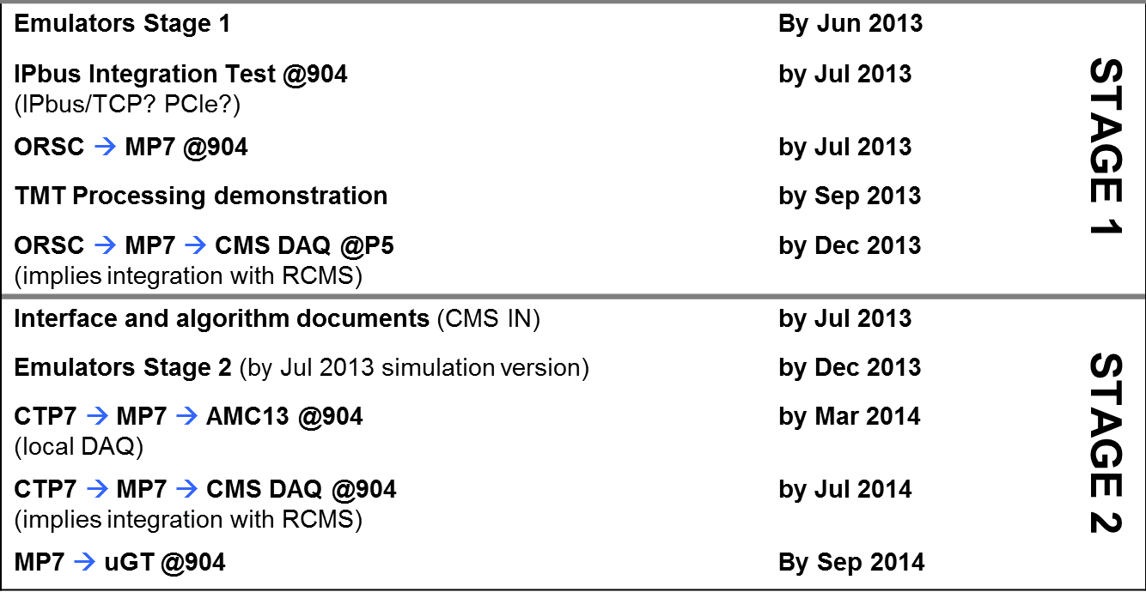
904 Milestones: Calorimeter Trigger (1)
Notice that the pattern test require: Unpackers & Emulators, TS Configuration service, and also the configuration of the TTC/TCDS
Notice that the DAQ tests require the configuration of the AMC13
  8

Slide 9
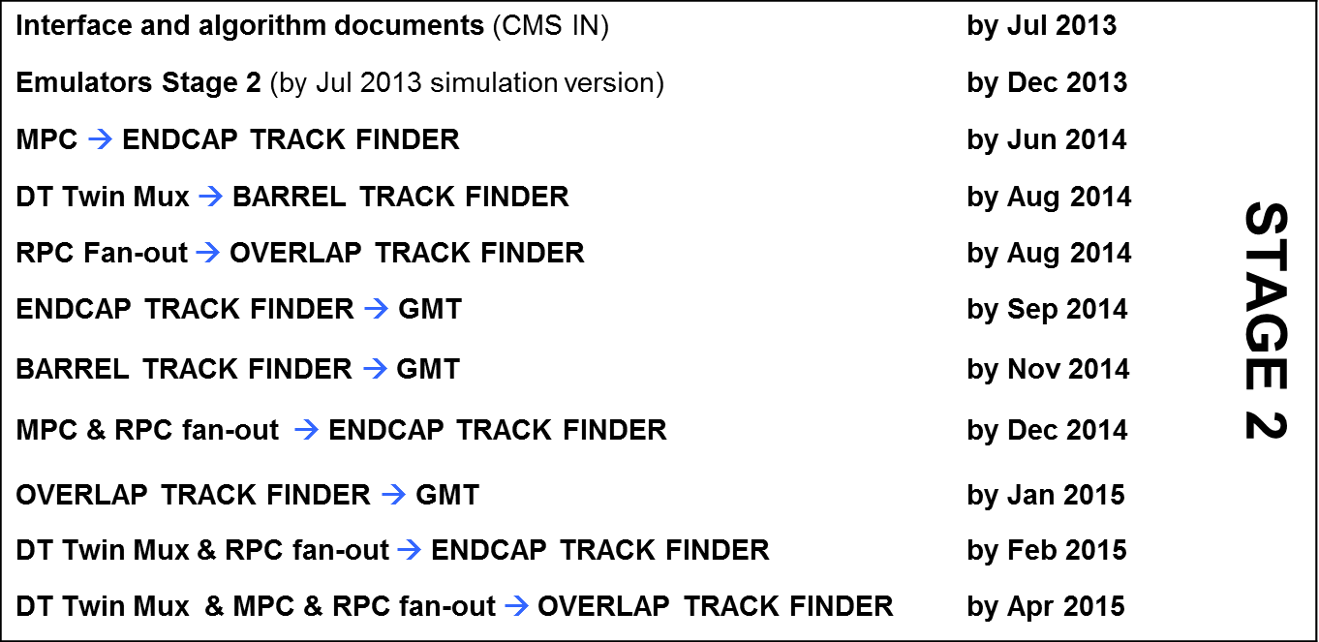
904 Milestones: Muon Trigger (2)
Notice that the pattern test require: Unpackers & Emulators, TS Configuration service, and also the configuration of the TTC/TCDS
Notice that the DAQ tests require the configuration of the AMC13
  9

Slide 10
904 Milestones (3)
Notice:
  Schedule is tight
  There are many tests
  The same tests have to be repeated at P5
Therefore, we should simplify the procedures and keep everybody in the loop:
  ELOG
  CATUS SVN (SW & F/W)
  Portable code (RPMs)
  Use L1CE to port Configuration data
  Portable Configuration service
  Portable Tests
  …work in parallel on Emulators and Unpackers (RerlVal)
  10

Slide 11
Step 1: Hardware Development
Hardware and Firmware
Production
Start the CMS IN of the physical and logical interfaces → DESY June 2013
Use CACTUS SVN for stand alone software and firmware (code and images):
  Contact marc@cern.ch and cghabrou@cern.ch for access
Portable integration testing requires:
  Input Pattern generators
  Input pattern generator memory for several BX (e.g. 256)
  L1A/BC0 triggered output memories (ideally an orbit of data)
Remote F/W uploading is “compulsory”
uHAL should be the common hardware access library with “plugins” for each hardware access method (Ipbus/UDP, IPbus/TCP, PCIe):
  Contact uHAL team for details (http://cern.ch/cactus)
Testing in external lab.
Shipping to CERN
Configuration and Self-test
at 904
Integration Test
at 904
Commissioning
at P5
Data taking
at P5
  11

Slide 12
Step 1’: Deploy Central Services @904
The following services should work 24/7 → Jun 2013
L1 Page
TRG FM
Central Cell
Level-1 Configuration Editor
  12

Slide 13
Step 2: Request PC and Rack Space
Hardware and Firmware
Production
Current list of 904 PCs: https://twiki.cern.ch/twiki/bin/viewauth/CMS/L1TriggerPCs#PCs_904
PROCEDURE:
1) Request PC to the CMS sysadmins:
  ticket to https://savannah.cern.ch/projects/cmsonlinesys/.
  CC to , “sudan”, “digiovan”, “marc”, “chabrou”
In the ticket one should specify if you will use VME, PCIe, IPBus.
It is worth calling directly to Marc Dobson afterwards
2) Contact Magnus.Hansen@cern.ch and tell him what hardware you want to install.
He will likely redirect you again to the sysadmins, but it is worth doing to keep everybody in the loop.
Testing in external lab.
Shipping to CERN
Configuration and Self-test
at 904
Integration Test
at 904
Commissioning
at P5
Data taking
at P5
  13

Slide 14
Step 3: Configuration and Self-test
Hardware and Firmware
Production
Before you start performing integration tests you should be able to:
Debug the system using stand alone tools
Configure() your system with a DB key using the Trigger Supervisor
LoadPattern() and ReadMemory() services using the Trigger Supervisor
Self-test that your system behaves as expected by visual inspection or using emulators and unpackers
Testing in external lab.
Shipping to CERN
Configuration and Self-test
at 904
Integration Test
at 904
Commissioning
at P5
Data taking
at P5
  14

Slide 15
Step 4: Integration Tests
Hardware and Firmware
Production
The 904 milestones can can not start without:
HW and PC integrated in the .cms904 infrastructure (Quattor, TCDS, DAQ,etc.)
Interface documents (CMS IN)
Trigger Supervisor Configuration()
Trigger Supervisor LoadPattern() and ReadPattern()
Unpacker, conditions, and emulator (these also require interface documents!)
(extra) Show emulator agreement in DQM
e.g. portable test:
import xdaqclient ad xc
calo1 = xc.Cell(“http://l1ts-calo1.cms904:2974”)
calo2 = xc.Cell(“http://l1ts-calo2.cms904:2974”)
Tcds = xc.Xdaq(“http://ttc-904.cms904:1972”)
tcds.configure(params={“PART_NUM”:”2”,
“KEY”:“file://myconfiguration.conf”)
calo1.configure(params={“KEY”:“my_config_key1”})
calo2.configure(params={“KEY”:“my_config_key1”})
#iterate this for each pattern
calo1.LoadPattern(params={“LOCATION“:”3”,
“FILE”:”file://mypattern.dat”)
Tcds.sendBC0()
Out = calo2.ReadPattern(“LOCATION”:”5”)
#Compare against generated input-output using emulators
compare_patterns(“mypattern.dat”,out)
Testing in external lab.
Shipping to CERN
Configuration and Self-test
at 904
Integration Test
at 904
Commissioning
at P5
Data taking
at P5
  15

Slide 16
Step 5: Commissioning @P5
Hardware and Firmware
Production
We should at least pass the 904 tests, but with the full system.
Commissioning @P5 can not start without:
RPMs for all the SW
CMSSW release with Emulator, unpacker/packer, and basic DQM
Alarms
e.g. adapting the same test:
import xdaqclient ad xc
calo1 = xc.Cell(“http://l1ts-calo1.cms:2974”)
calo2 = xc.Cell(“http://l1ts-calo2.cms:2974”)
Tcds = xc.Xdaq(“http://tcds.cms:1972”)
tcds.configure(params={“PART_NUM”:”3”,
“KEY”:“file://myconfiguration.conf”)
calo1.configure(params={“KEY”:“my_config_key_cms1”})
calo2.configure(params={“KEY”:“my_config_key_cms2”})
#iterate this for each pattern
calo1.LoadPattern(params={“LOCATION“:”6”,
“FILE”:”file://mypattern.dat”)
Tcds.sendBC0()
Out = calo2.ReadPattern(“LOCATION”:”5”)
#Compare against generated input-output using emulators
compare_patterns(“mypattern.dat”,out)
Testing in external lab.
Shipping to CERN
Configuration and Self-test
at 904
Integration Test
at 904
Commissioning
at P5
Data taking
at P5
  16

Slide 17
Step 6: Data-taking
Hardware and Firmware
Production
Data-taking means continuous development
The 904 infrastructure could be used to develop and test without affecting operations.
Testing in external lab.
Shipping to CERN
Configuration and Self-test
at 904
Integration Test
at 904
Commissioning
at P5
Data taking
at P5
  17

Slide 18
Questions?

