Slide 1
Introduction and Schedule
L1 Trigger Upgrade Software Workshop
https://indico.cern.ch/conferenceDisplay.py?confId=250135
23rd May 2013
Darin Acosta, Carlo Battilana, Jim Brooke, Carlos Ghabrous, Joao Pela, Arno Heister, Gian Piero di Giovanni, Greg Iles, Homer Wolfe, Marc Magrans de Abril, Sudarshan Paramesvaran,Alex Tapper
…on behalf of the Level-1 Trigger

Slide 2
Overview
Welcome
Motivation for this workshop
Agenda
Moving Forward:
  Timeline
  Common Deliverables
  Subsystem Deliverables
  Institutional Responsibilities

Slide 3
Overview
Welcome
Motivation for this workshop
Agenda
Moving Forward:
  Timeline
  Common Deliverables
  Subsystem Deliverables
  Institutional Responsibilities

Slide 4
Motivations for this
Workshop
Set baseline for common software components / procedures
  Feedback and agreement and with subsystem experts
Follow up all open issues from this point
Identify milestones and priorities
Establish personal and institutional responsibilities

Slide 5
Overview
Welcome
Motivation for this workshop
Agenda
Moving Forward:
  Timeline
  Common Deliverables
  Subsystem Deliverables
  Institutional Responsibilities

Slide 6
Agenda
May 23rd
  Introduction and Schedule (This Talk)
  Physical, Logical, and Data Interfaces
  Configuration Data
  Description of the Development Workflow and Skeleton Samples
  Common Firmware Components
  Integration Testing Workflow at 904
May 24th
  Subsystem Expert Feedback

Slide 7
  Agenda
  Expert Feedback (1/2)
MAX 1 SLIDE PER QUESTION
1. What of the common proposals do not agree with your subsystem needs, preferences, or constraints?
2. Do you agree on the milestones and dates?
3. Review the proposed software workflows:
3.1. What is not covered for you subsystem?
3.2. What is incompatible with respect to your subsystem?
4. Status of input-output interface documentation (physical, logical, formats)
5. Upgraded emulators for stage 2 (2016 onwards)
5.1. Where are they documented?
5.2. Status of the code? Is the code CMSSW compliant?
5.3. Have you started the emulator?
5.4. Bottlenecks for having a first emulator ready by the end of July
…

Slide 8
  Agenda
  Expert Feedback (2/2)
6. Changes planned for emulator in 2015 (report for legacy system if relevant)
6.1 Need to work on legacy emulator or new system?
6.2 List of foreseen changes (specify if in emulator code, or conditions payload)
6.3 Bottlenecks for having changes ready by the end of July
7.Testing:
7.1. What do you want to test during the 904 integration tests?
7.2. What tests will be available at P5?
8. What firmware components you are developing can be shared amongst the other subsystems?
9. What major difficulties are you facing?
10. What manpower is available (with names) for both common and the subsystem specialized software/firmware?

Slide 9
Overview
Welcome
Motivation for this workshop
Agenda
Moving Forward:
  Timeline
  Common Deliverables
  Subsystem Deliverables
  Institutional Responsibilities

Slide 10
Timeline (1/3)
Bird’s Eye View of the Milestones
LS1: 2013 and 2014
Phase 1: Feb 2016
  Operations at LHC startup must be guaranteed
  Stage 1: Dec 2013
    Replacement of GCT HW
    Proof of concept for Ipbus + TMT
  Stage 2: Jan/Mar 2016
    New Level-1 Trigger
    Incremental trigger improvements
LS2: 2018
Phase 2: Operation Post LS3
    Relevant to this workshop:
    We must provide reference trigger emulators
    for physics studies baseline

Slide 11
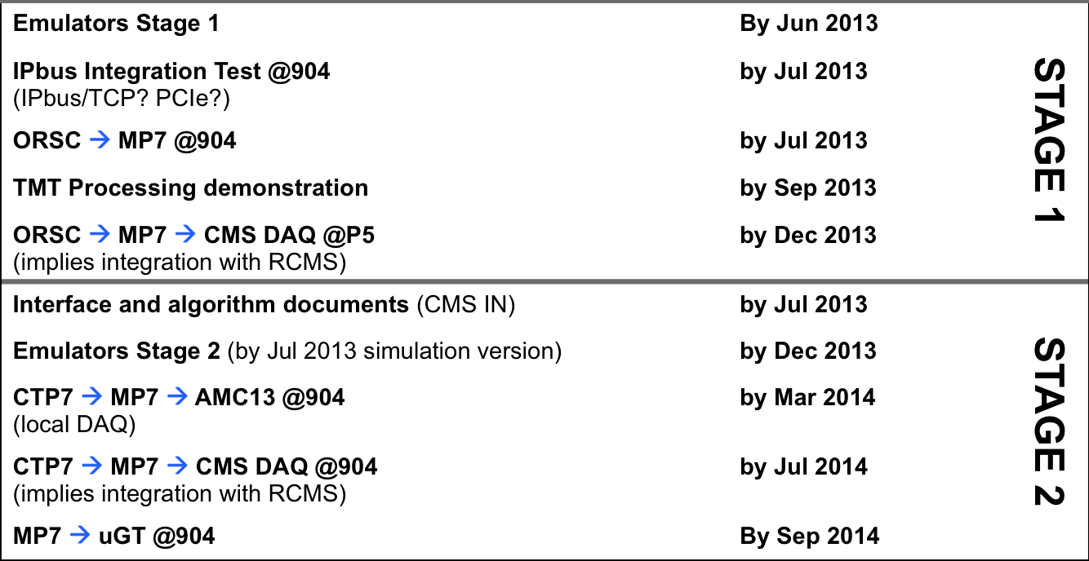
Timeline (2/3)
Integration Milestones: Calorimeter
see also L1 Trigger Upgrade TDR

Slide 12
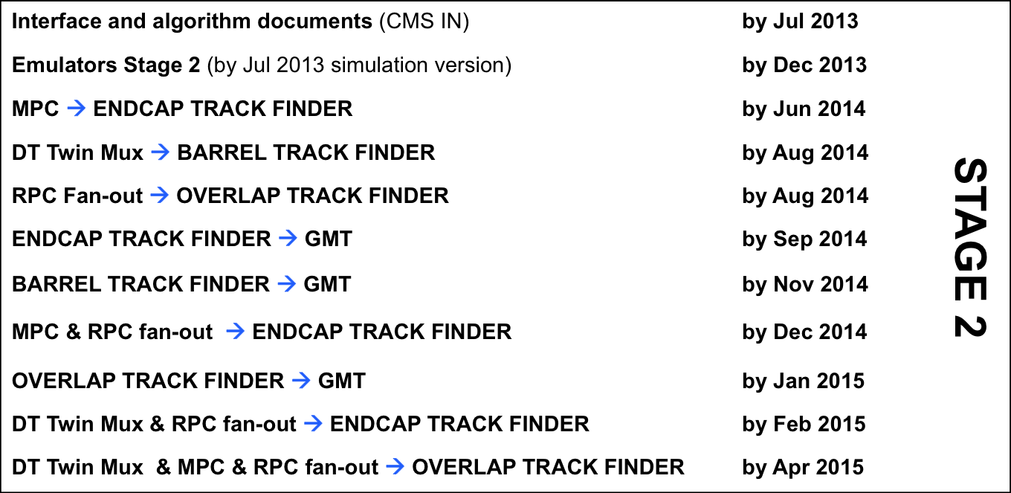
Timeline (3/3)
Integration Milestones: Muon
see also L1 Trigger Upgrade TDR

Slide 13
Overview
Welcome
Motivation for this workshop
Agenda
Moving Forward:
  Timeline
  Common Deliverables
  Subsystem Deliverables
  Institutional Responsibilities

Slide 14
Common Deliverables (1/2)
Offline
HLT and Analysis data formats | During emulator development
Multi-BX container | During emulator development
O2O framework updated | @904
Generic Unpacker/packer | @904
Condition Format example | @904
CMSSW validation suite | @P5
Common DQM: Efficiencies, Rates, Occupancy, Synchronization. | @P5

Slide 15
Common Deliverables (2/2)
Online
IPbus, uHAL, Control Hub | During hardware development
AMC13 interface firmware and software | @904
TCDS software | @904
L1Page, TRG FM, Central Cell, L1CE | @904
Configuration DB library and example schema | @904
Trigger Supervisor framework updated | @904
Portable test examples | @904
MMC standard commands document | @P5

Slide 16
Overview
Welcome
Motivation for this workshop
Agenda
Moving Forward:
  Timeline
  Common Deliverables
  Subsystem Deliverables
  Institutional Responsibilities

Slide 17
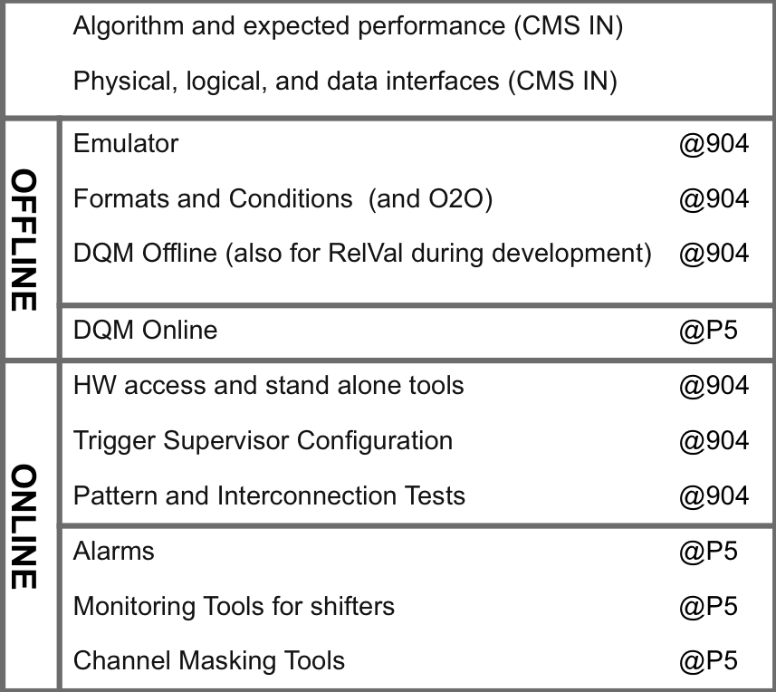

Subsystem Deliverables

Slide 18
Overview
Welcome
Motivation for this workshop
Agenda
Moving Forward:
  Timeline
  Common Deliverables
  Subsystem Deliverables
  Institutional Responsibilities

Slide 19
Overview
Welcome
Motivation for this workshop
Agenda
Moving Forward:
  Timeline
  Common Deliverables
  Subsystem Deliverables
  Institutional Responsibilities

Slide 20
Institutional Responsibilities (1/3)
Common Firmware & Software
Subsystem | Institute | Firmware and software developers
MMC standard commands document
AMC13 firmware and software | Boston
TCDS firmware and software | CERN
uHAL/IPBus | Bristol, Imperial, L1Trigger | Newbold, Williams, Rose, Magrans, Ghabrous

Slide 21
Institutional Responsibilities (2/3)
Common Firmware & Software
Subsystem | Institute | Firmware and software developers
L1 Page, TRG FM, TS, L1CE, Central Cell | L1Trigger | Magrans, Ghabrous
ConfigDB library and schema example | L1Trigger, Princeton | Ghabrous, Xie
O2O and conditions example
Portable test examples
HLT and Analysis formats
Multi-BX container
Genric Unpacker/packer
Common DQM | Imperial | Pela
CMSSW validation suite | Ohio | Wolfe

Slide 22
Institutional Responsibilities (3/3)
Subsystem Software
Subsystem | Institute | Software and Firmware Developers
GT | HEPHY | Rahbaran, Bergauer, Ghabrous
GMT | HEPHY, CERN | Rabady, Rahbaran, Lingemann, Sakulin
L2 Calorimeter Trigger | Bristol, Imperial | Iles, Rose, Paramesvaran, Rose, Williams, Harder, Brooke, Marrouche
L1 Calorimeter Trigger | Wisconsin | Gorski, Tikalsky
Endcap Muon Trigger | Florida | Madorsky, Scurlock, Khotlovich, di Giovanni
Barrel Muon Trigger | HEPHY, Ioannina | Ero
Overlap Muon Trigger | Warsaw | Konecki, Bunkowski

Slide 23
Questions?

