Slide 1
L1Trigger Upgrade Software Workshop
2013.05.23/24
Carlos Ghabrous Larrea
Carlo Battilana
Marc Magrans de Abril

Slide 2
Agenda
Current DB operations
Problem summary
Room for improvement
Open questions

Slide 3
Current DB operations (i)
Q: which steps should a developer follow to integrate its subsystem with current DB operations/workflows?
A:
  Create configuration tables in OMDS
  Populate configuration tables with desired information (keys)
  Extract keys from OMDS and load into HW (configuration)
  Create and populate monitoring tables
  Produce code for Online to Offline transfer (O2O)

Slide 4
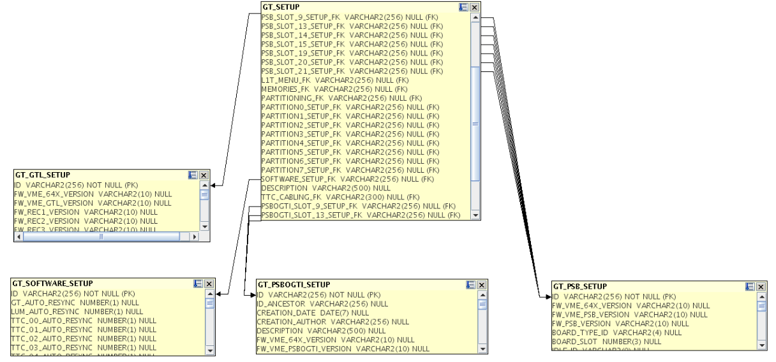
Current DB operations (ii)
Create configuration tables in OMDS
  Usually following HW structure (from HW address tables)
  Tables are related among each other using a hierarchical relationship (FK-PK) between them to allow for data reuse
  Manual process

Slide 5
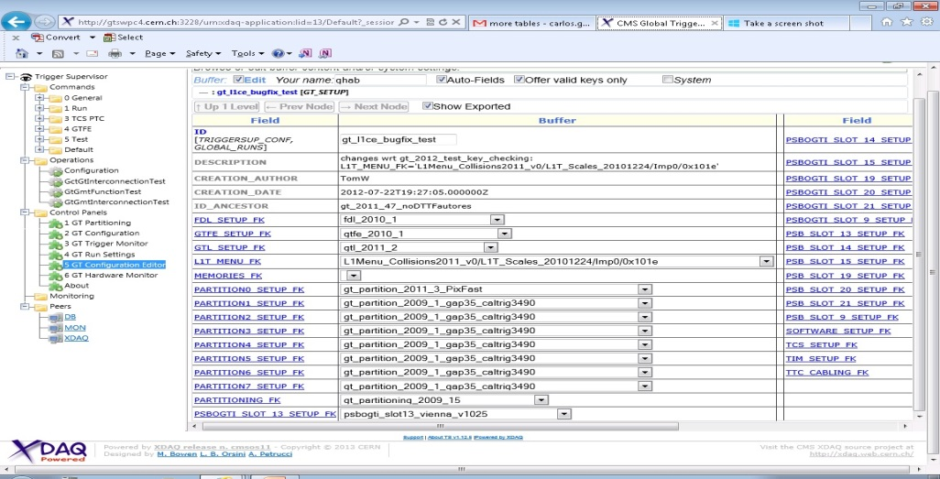
Current DB operations (iii)
Populate configuration tables with desired keys
  Manual process: writing own queries and using a SQL client
INSERT INTO
CMS_GT.GT_SETUP
(PARAM1, PARAM2… PARAMn)
VALUES
(VALUE1, VALUE2, …, VALUEn)
  L1CE: well known by L1DOCs: developer doesn’t need to know about SQL

Slide 6
Current DB operations (iv)
Extract keys from DB and load into HW (configuration)
  Based on TS/XDAQ infrastructure (CellXhannelTB/TStore)
  Developer has to:
    embed DB operations in C++ subsystem code
    write a SOAP message with the queries
SUBSYSTEM
Cell
getXhannelTB()
TS
CellXhannelTB
SOAP
Oracle
XDAQ
TStore
OCCI
try {
tsframework::CellXhannelTB* x = dynamic_cast<tsframework::CellXhannelTB*>(getContext()->getXhannel("DB"));
x->connect(view, schema, pwd);
} catch (xcept::Exception& e) {
std::ostringstream msg;
msg << "Can not connect to TSTore. Exception caught: ";
XCEPT_RETHROW(tsexception::CellException,msg.str(),e);
}
// AND MANY MORE LINES TO PERFORM SELECTS/INSERTS

Slide 7
Current DB operations (v)
Create and populate monitoring tables
  Steps 1 and 3 (populated from subsystem’s monitoring applications)
Code for O2O
  Subsystem customization of C++ classes provided by O2O framework (W. Sun)
  Create Condition Format objects
  Existing documentation makes this step relatively quick and easy:
  https://twiki.cern.ch/twiki/bin/view/CMSPublic/SWGuideL1ConfigOnlineProd

Slide 8
Problem summary
Create configuration tables in OMDS
  Although subsystems follow hierarchical relationships between tables, we are missing a homogeneous structure for tables that map HW
  Could the process of creating tables be automate partially/totally?
  (e.g., generate SQL code from address table)
Populate configuration tables with desired information (keys)
  Process will still be manual
  Developer doesn’t need to know SQL if L1CE is used
Configuration
  Depends on TS/XDAQ
  Requires writing C++ code and SOAP messages with SQL queries[1][2]
  Non-homogeneous: each subsystem has implemented its own way to perform DB operations. Examples:
    GCT: classes that wrap up interaction with TS’s CellXhannelTB and XDAQ’s Tstore are used throughout the code [1]
    DTTF[2][3], CSCTF[4][5], DTSC[6][7]: code duplication
    NOT A CRITIC! Just saying how things have been done so far!

Slide 9
Room for improvement
ConfDB
  C++ library
  Goal: simplify and homogenize DB operations
  Developed by Z. Xie, C. Ghabrous, M. Magrans
  References [1][2]
  Code snippets [3]
Status
  API prototype already written…
  … but complete scope not defined yet
Advantages
  Homogeneous
  Subsystem’s code is reduced, as complex operations are wrapped up
  Developer doesn’t have to write SOAP messages
  Use Tstore API directly and not depend on TS’s CellXhannelTB [4]:
  Not necessary to write a “Cell” to access DB (could be useful during integration stages)

Slide 10
Open questions
Run settings key -> Do we still keep it as a separate key from the general configuration key (TSC)?
Homogeneous table schema for online configuration HW tables
What will happen with O2O? (Plans for the upgrade and resources)
Can the O2O process be simplified? Personally I think the process is relatively simple and well documented
How one can check the validity/consistency of what will be written to offline?
Enforce FW versioning in online DB: useful for emulators to grab certain configuration
Schema evolution: current/future schema changes propagate potentially through all the following chain
  Is this a nightmare at early stages of development?
  Should some constraints/bounds be provided for schema evolution?
  Or do we just take the hit when/if this arrives?
OMDS
C++ Online
CondFormat Objects
Emulators

