Slide 1
DRI LLM vs. Humans
Human-AI Collaboration in Deliberation
Evaluating LLMs Against Human Collective Wisdom
Veri & Umbelino (2025)

Slide 2
1. LLMs are promising for emulating human reasoning

Slide 3
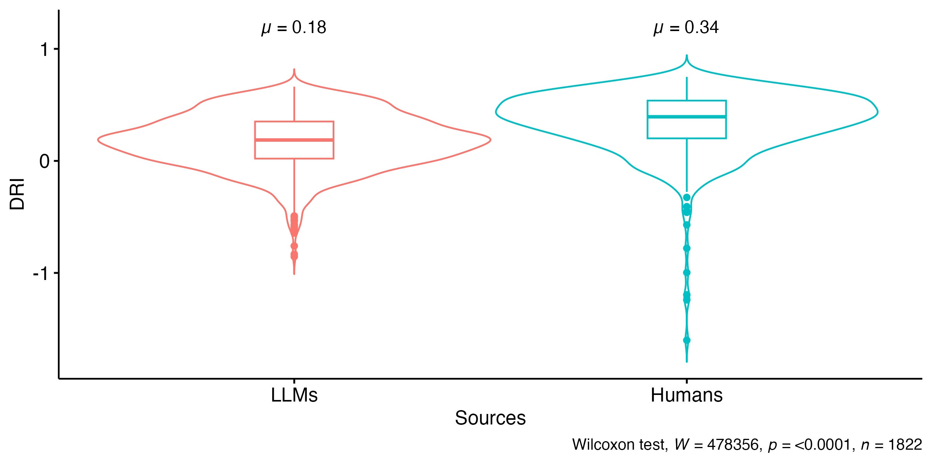
Humans generally outperform LLMs
Notes:
In aggregate, humans generally have a higher DRI score than LLMs.

Slide 4
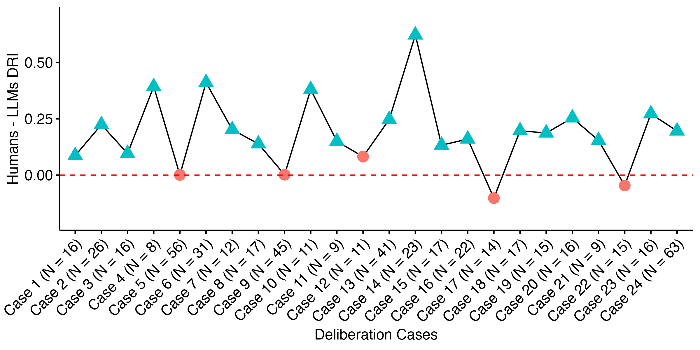
Humans outperform LLMs across cases
Notes:
Now looking across cases, humans significantly outperform LLMs in most case studies.
Blue triangles: statistically significant differences
Above 0: Humans outperform LLMs

Slide 5
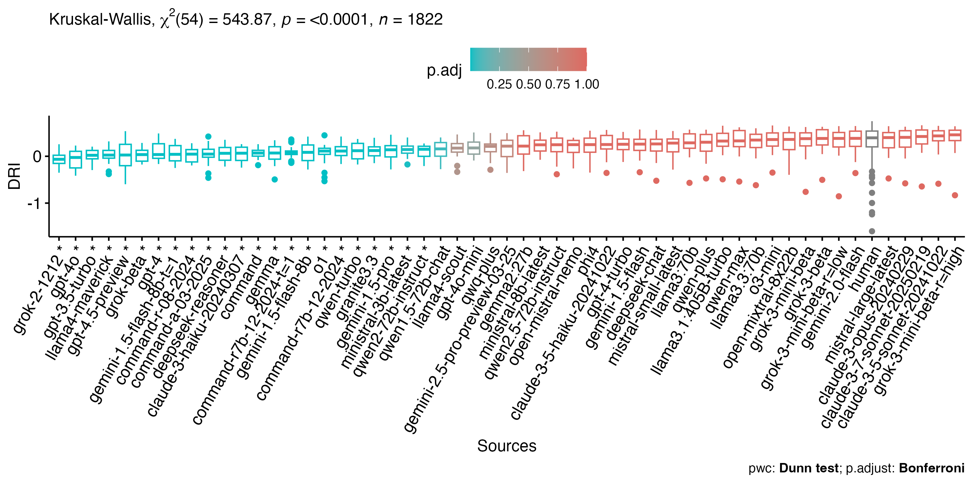
Most LLMs perform as well as humans
Notes:
We found evidence that some LLMs, on average, underperform humans interns of DRI. But we did not find a significant difference between humans and most LLMs.

Slide 6
2. Reasoning models do not seem to reason deliberatively

Slide 7
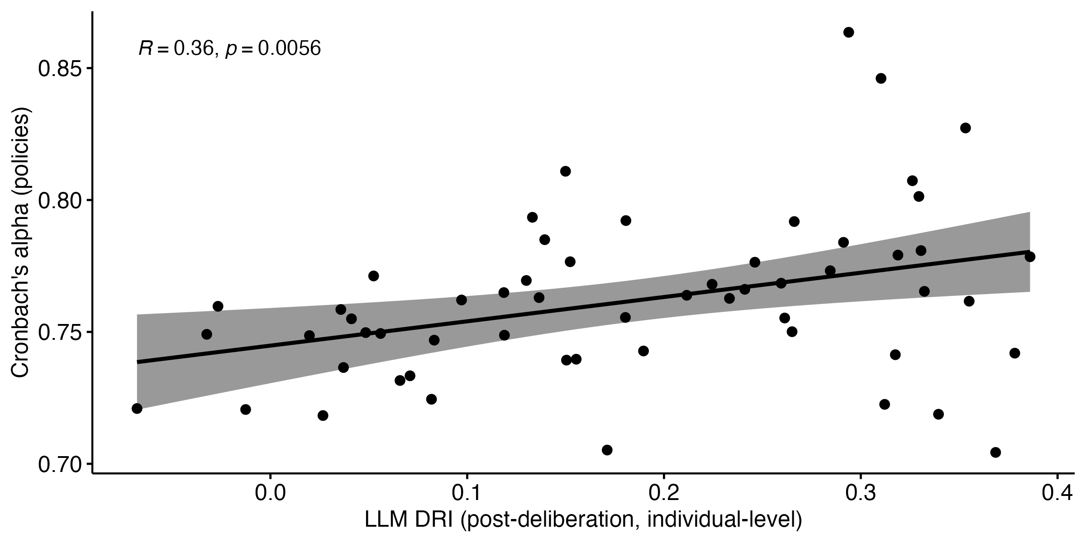
Consistency is correlated with DRI
Notes:
Consistency is correlated with DRI performance.

Slide 8
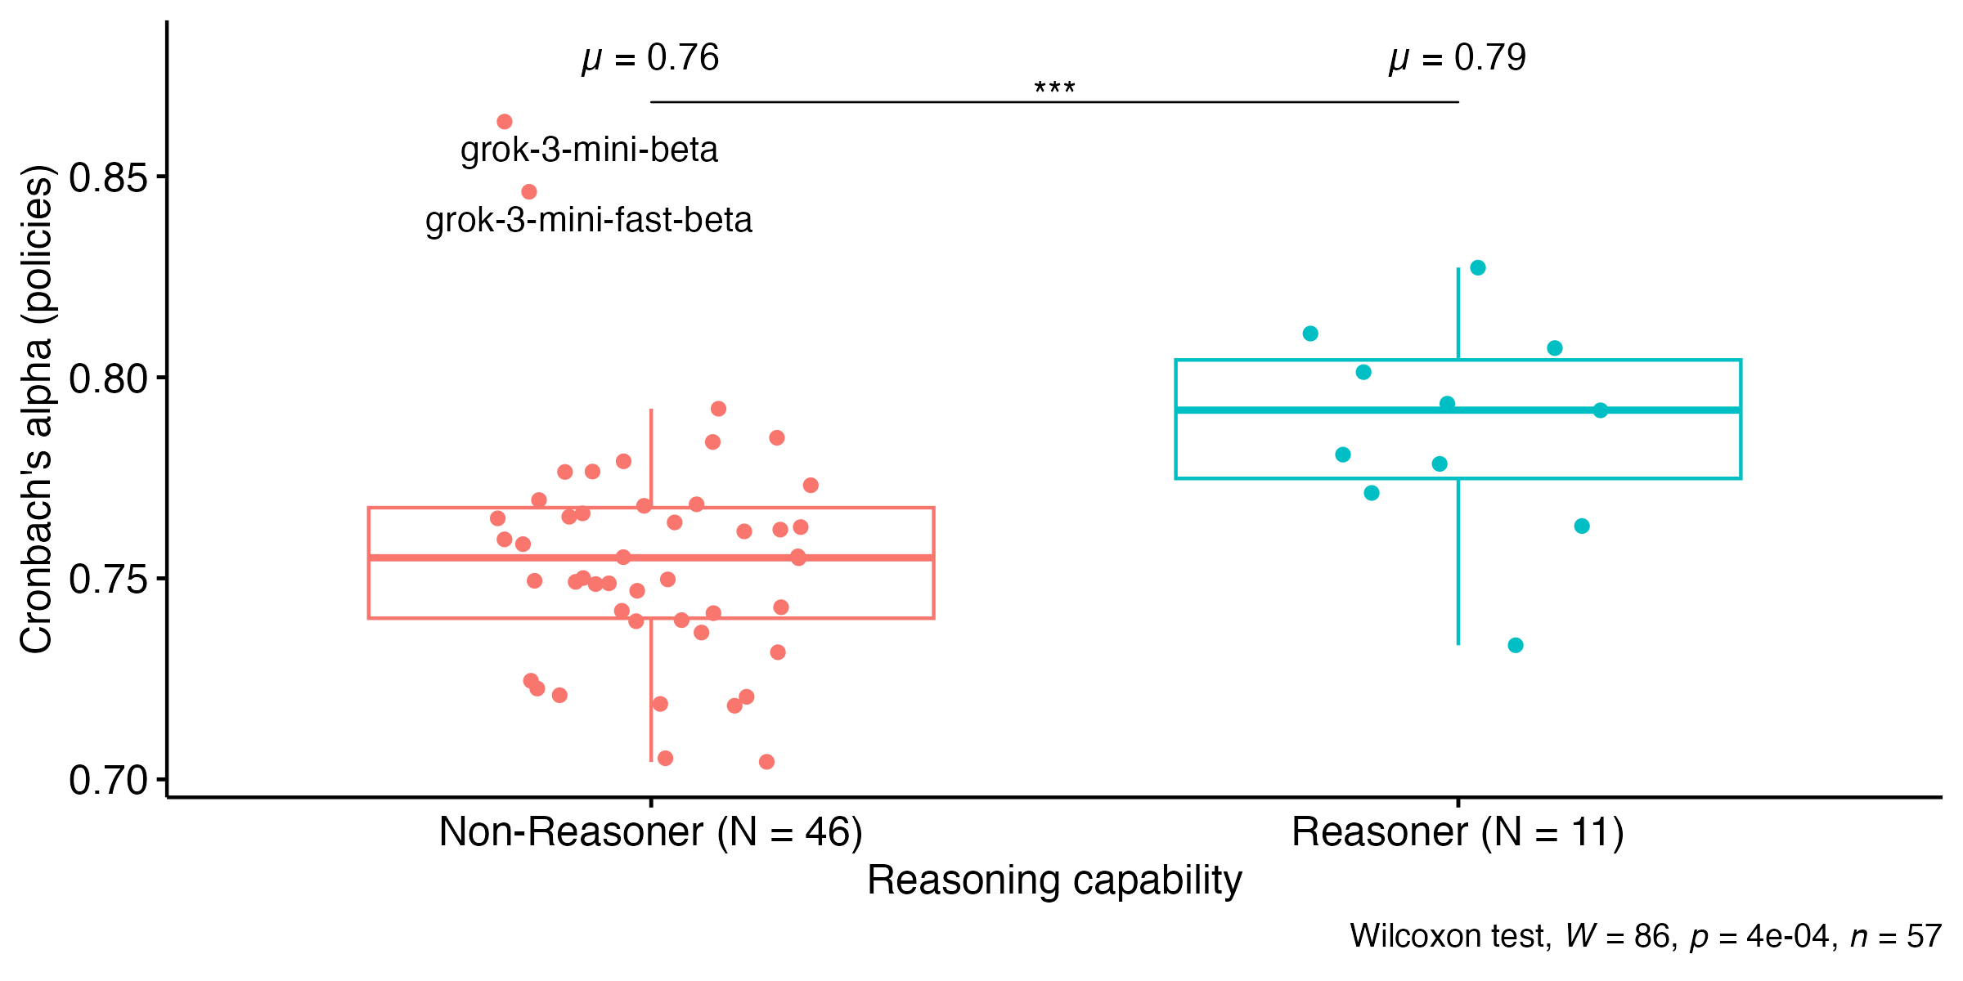
Reasoners are more consistent than non-reasoners
Notes:
We found a non-random difference between reasoners and non-reasoners in terms of consistency.
Consistency is important if we want to use LLMs in real-world deliberations.

Slide 9
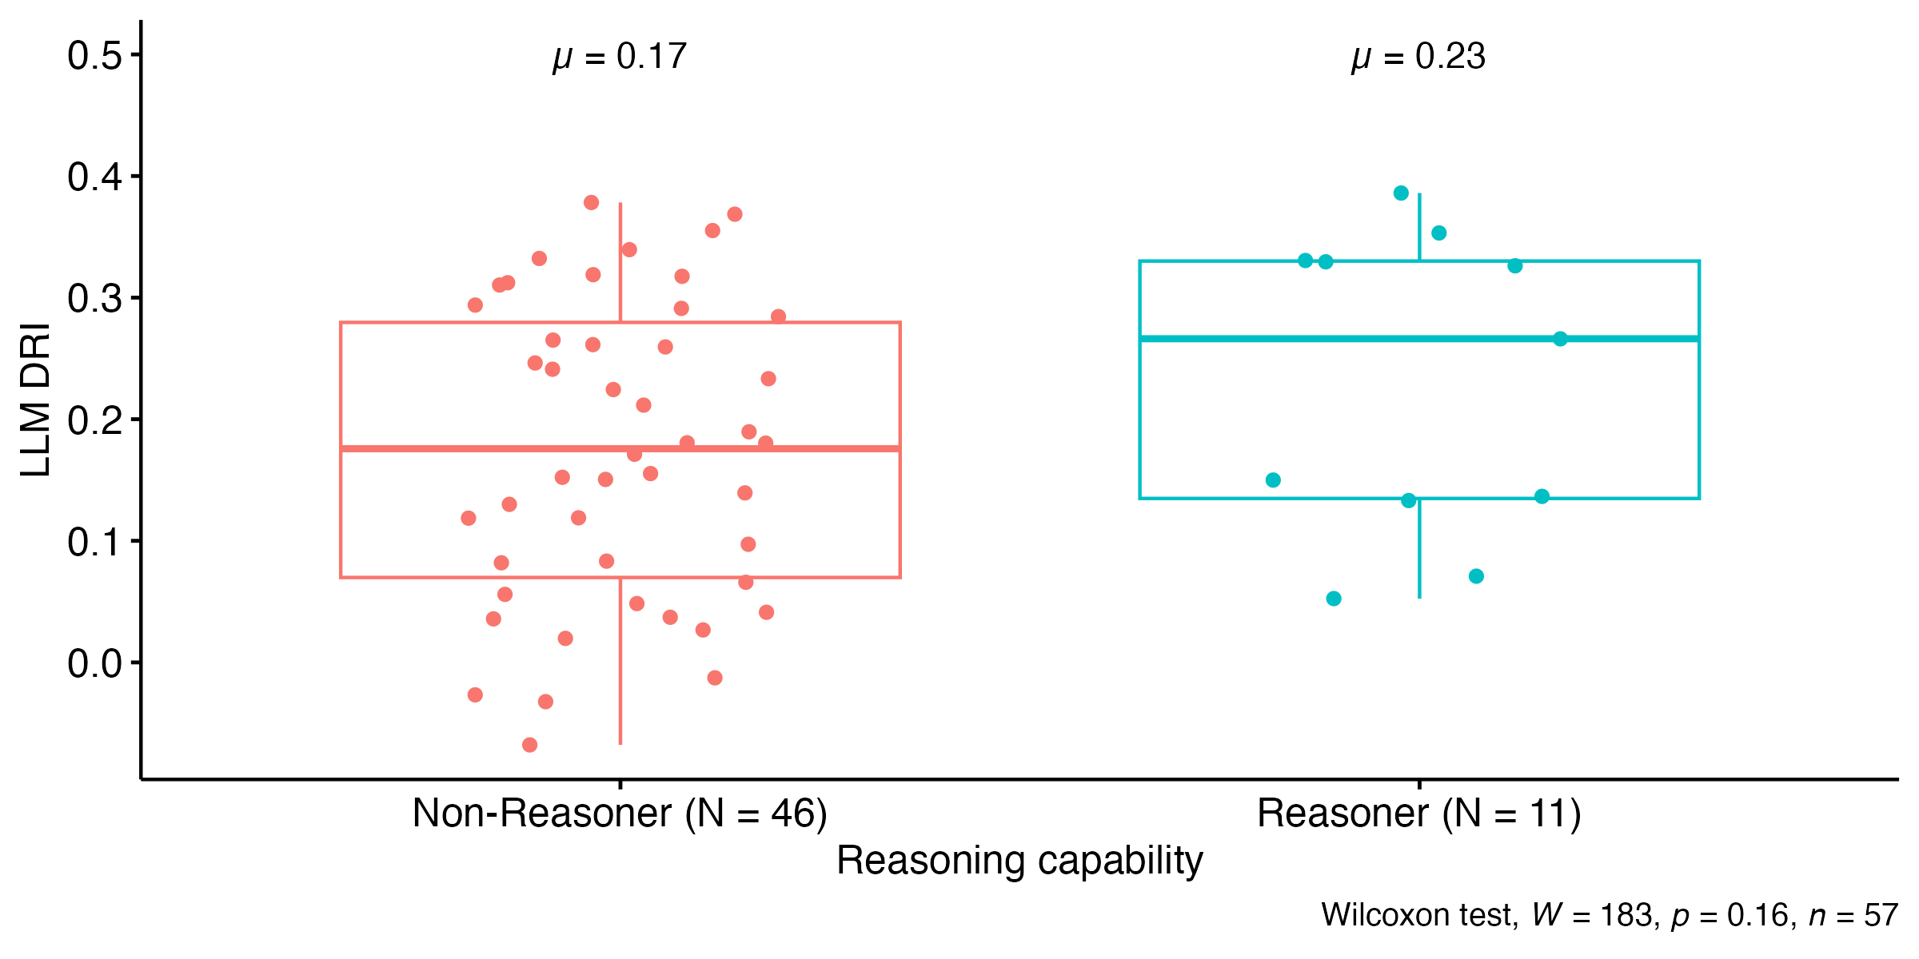
We found no difference in terms of DRI
Notes:
But no difference between reasoners and non-reasoners in terms of their deliberative reasoning capacity.

Slide 10
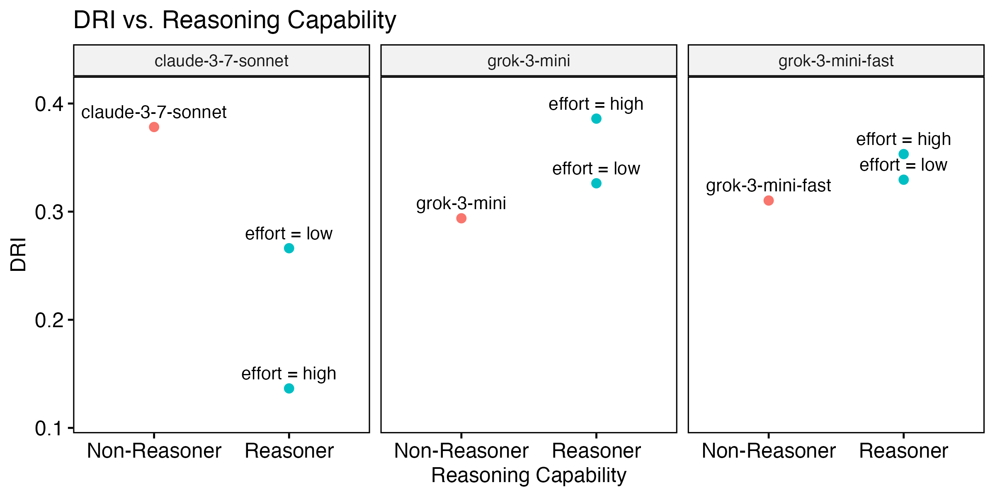
We found inconsistency across models
Notes:
Some reasoning models are more performant than their non-reasoning counterparts (e.g., grok-3-mini models), while others are not (e.g., claude-sonnet)

Slide 11
1. LLMs are promising for emulating human reasoning
2. Reasoning models do not seem to reason deliberatively

Slide 12
DRI Survey
example statements
Considerations [Likert]
It is certain that climate change exists.
Biodiversity is declining worldwide.
If Switzerland reduces its greenhouse gas emissions, it won't make any difference.
Policy Preferences [Ranked]
Leave the policy settings as they are.
Policies that emphasize economic growth over climate change adaptation or mitigation.
Adaptation policies and expenditure. Planning controls and emergency response programs.

Slide 13
Prompts
for collecting LLM DRI survey data
PROMPT_C = """## Instructions:
- Rate each of the {0} [Considerations] below from 1 to {1}, where 1 is strongly \
disagree and {1} is strongly agree.{2}
- In your response, return an ordered list of {0} ratings as integers, one rating \
per line following the format in the [Example output].
- Your response must have exactly {0} lines in total.
- Do NOT include any additional text in your response.
## [Example output]:
1. 1
2. 4
3. 6
4. 3
## [Considerations]:
"""
PROMPT_P = """## Instructions:
- Based on your previous ratings, rank the {0} [Policies] listed below from 1 to {0}, \
where 1 represents the option you support the most and {0} the option you support the least.
- In your response, return an ordered list of {0} ranks as integers, one rank per line \
following the format in the [Example output].
- Your response must have exactly {0} lines in total.
- Do NOT include any additional text in your response.
## [Example output]:
1. 4
2. 1
3. 3
4. 2
## [Policies]:
"""

Slide 14

Iterations
we collected 5-30 survey responses for each LLM
for each iteration, we asked LLMs to:
Rate these considerations…
Based on your ratings, rank these policies…

Slide 15
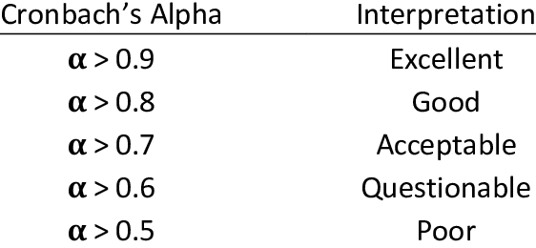
Cronbach’s Alpha
measure of LLM’s internal reliability

