Slide 1
Doxygen
gumingpo@gmail.com
Sep 17, 2016

Slide 2
Reference
http://www.stack.nl/~dimitri/doxygen/index.html

Slide 3
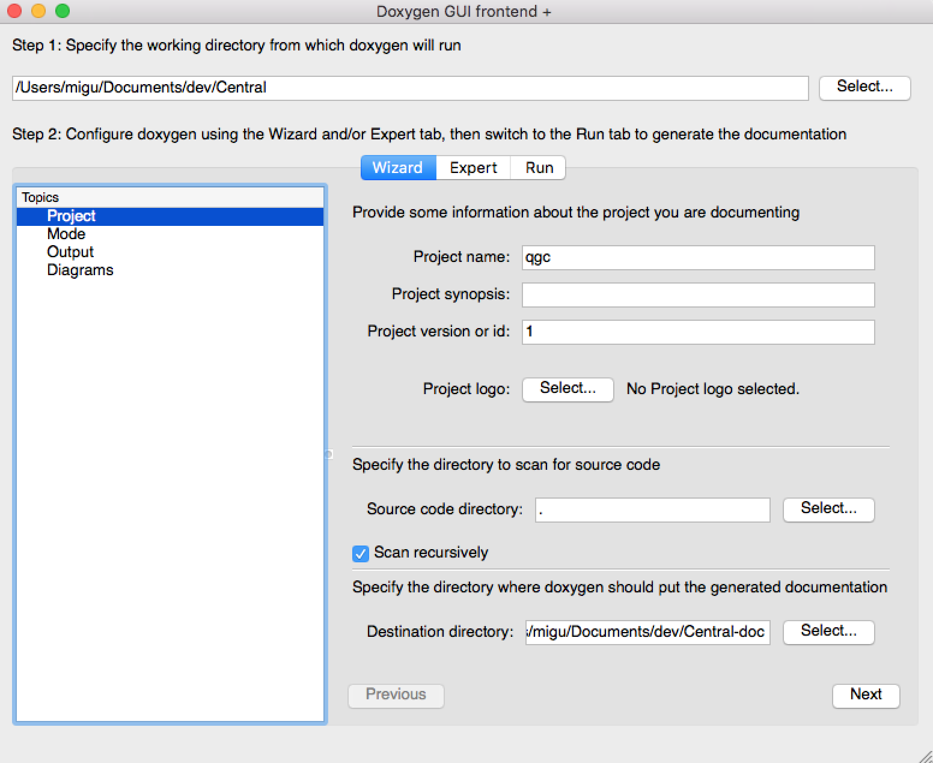
Doxygen wizard

Slide 4
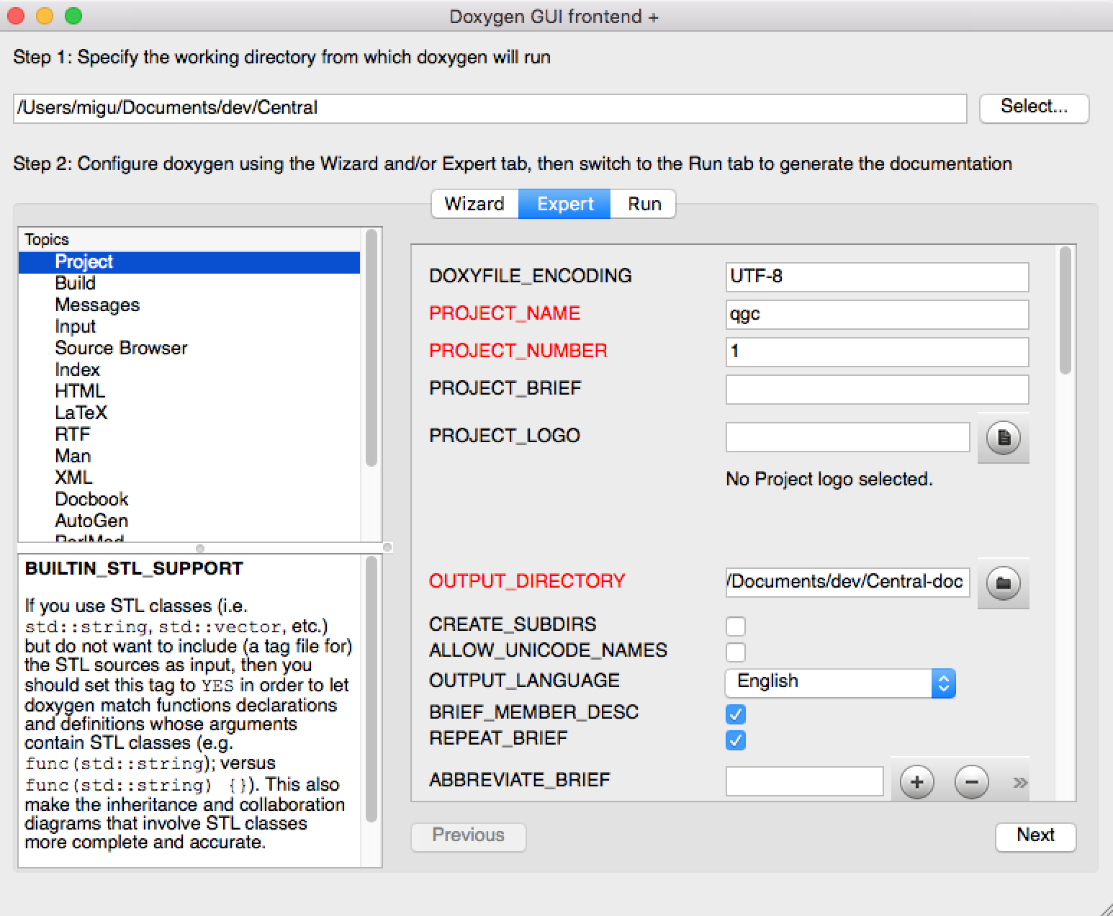
Doxygen expert

Slide 5
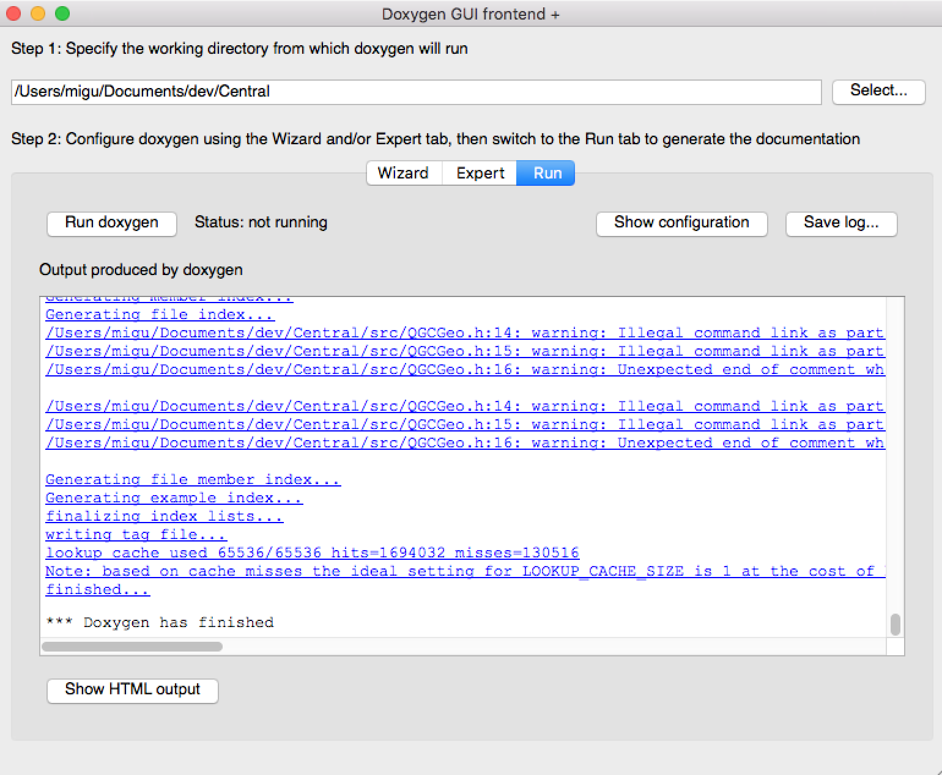
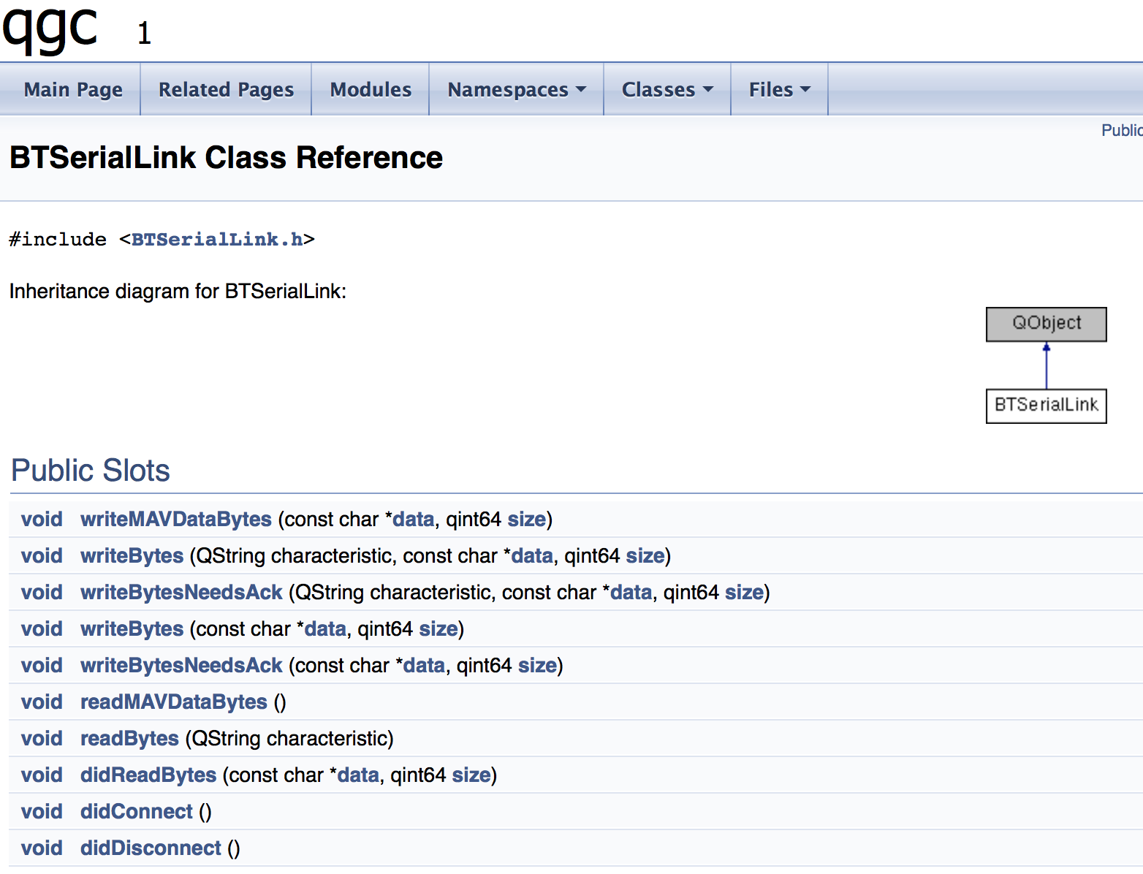
Run doxygen to generate API-doc

