Slide 1
qground
gumingpo@gmail.com
Aug 12, 2016

Slide 2
BoardType
QGCSerialPortInfo
static const struct VIDPIDMapInfo_s { int vendorId; int productId; QGCSerialPortInfo::BoardType_t boardType; const char * boardString; } s_rgVIDPIDMappings[] = {
{ QGCSerialPortInfo::px4VendorId, QGCSerialPortInfo::pixhawkFMUV4ProductId, QGCSerialPortInfo::BoardTypePX4FMUV4, "Found PX4 FMU V4" },
{ QGCSerialPortInfo::px4VendorId, QGCSerialPortInfo::pixhawkFMUV2ProductId, QGCSerialPortInfo::BoardTypePX4FMUV2, "Found PX4 FMU V2" },
{ QGCSerialPortInfo::px4VendorId, QGCSerialPortInfo::pixhawkFMUV2OldBootloaderProductId, QGCSerialPortInfo::BoardTypePX4FMUV2, "Found PX4 FMU V2"},
{ QGCSerialPortInfo::px4VendorId, QGCSerialPortInfo::pixhawkFMUV1ProductId, QGCSerialPortInfo::BoardTypePX4FMUV1, "Found PX4 FMU V1" },
{ QGCSerialPortInfo::px4VendorId, QGCSerialPortInfo::px4FlowProductId, QGCSerialPortInfo::BoardTypePX4Flow, "Found PX4 Flow" },
{ QGCSerialPortInfo::px4VendorId, QGCSerialPortInfo::AeroCoreProductId, QGCSerialPortInfo::BoardTypeAeroCore, "Found AeroCore" },
{ QGCSerialPortInfo::px4VendorId=9900, QGCSerialPortInfo::MindPXFMUV2ProductId = 48, QGCSerialPortInfo::BoardTypeMINDPXFMUV2 = 7,"Found MindPX FMU V2" },
{ QGCSerialPortInfo::threeDRRadioVendorId, QGCSerialPortInfo::threeDRRadioProductId, QGCSerialPortInfo::BoardTypeSikRadio, "Found SiK Radio" },
{ QGCSerialPortInfo::siLabsRadioVendorId, QGCSerialPortInfo::siLabsRadioProductId, QGCSerialPortInfo::BoardTypeSikRadio, "Found SiK Radio" },
{ QGCSerialPortInfo::ubloxRTKVendorId, QGCSerialPortInfo::ubloxRTKProductId, QGCSerialPortInfo::BoardTypeRTKGPS, "Found RTK GPS" }, };

Slide 3
Mavlink over QGC
1. Receive
MAVLinkProtocol.cc receiveBytes() ->
mavlink_msg_heartbeat.h mavlink_msg_heartbeat_decode()
MultiVehicleManager.cc _vehicleHeartbeatInfo()
2. Send mavlink
Vehicle.cc
bool Vehicle::sendMessageOnLink(LinkInterface* link, mavlink_message_t message) {
if (!link || !_links.contains(link) || !link->isConnected()) { return false; }
emit _sendMessageOnLinkOnThread(link, message); return true;
}
Vehicle::_sendMessageOnLink(LinkInterface* link, mavlink_message_t message)

Slide 4
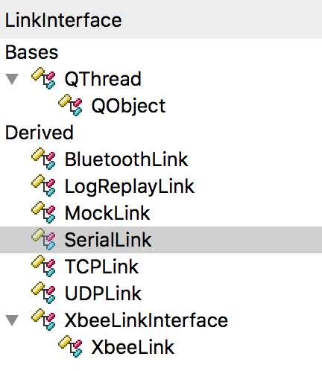
LinkInterface: public QThread
uint8_t _mavlinkChannel
virtual LinkConfiguration* getLinkConfiguration()
public:
virtual QString getName() const = 0
virtual bool isConnected() const = 0;
bool connect(void);
bool disconnect(void);
public slots:
void writeBytesSafe(const char *bytes, int length)
emit _invokeWriteBytes(QByteArray(bytes, length))
virtual void _writeBytes(const QByteArray)
Private slots:
virtual void _writeBytes(const QByteArray) = 0
signals:
void bytesReceived(LinkInterface* link, QByteArray data) //link to MAVLinkProtocol::receiveBytes
void connected()
void disconnected()
writeBytesSafe(const char *bytes, int length) -> emit _invokeWriteBytes(QByteArray(bytes, length)) -> svoid _invokeWriteBytes(QByteArray) -> _writeBytes()
LinkInterface() {
QObject::connect(this, &LinkInterface::_invokeWriteBytes, this, &LinkInterface::_writeBytes);
}
MAVLinkProtocol::_sendMessage(LinkInterface* link, mavlink_message_t message) or
Vehicle::sendMessageOnLink(LinkInterface* link, mavlink_message_t message) -> Vehicle::_sendMessageOnLink(LinkInterface* link, mavlink_message_t message) ->
void writeBytesSafe(const char *bytes, int length) -> emit _invokeWriteBytes(QByteArray(bytes, length))

Slide 5
class SerialLink : public LinkInterface
protected:
QSerialPort* _port; //call it’s close()/open() -> UsbDeviceJNI.open()/close()/setParameters()/startIoManager()/stopIoManager()/write()
private slots:
void _writeBytes(const QByteArray data)
void _readBytes(void)

Slide 6
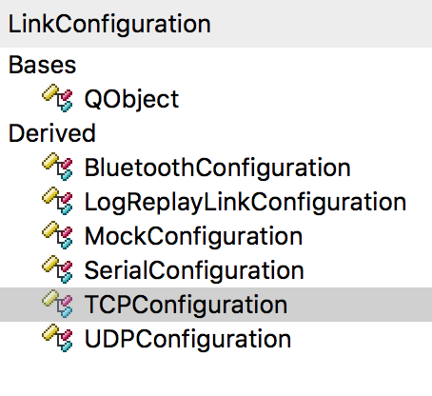
LinkConfiguration
LinkInterface* _link;
TCPConfiguration: default port:5760
UDPConfiguration:14550

Slide 7
LinkManager
MAVLinkProtocol* _mavlinkProtocol
QmlObjectListModel _links;
QmlObjectListModel _linkConfigurations;

Slide 8
Call flow to setup serial connection
main.cc main() ->
QGCApplication* app = new QGCApplication(argc, argv, runUnitTests)
QGCApplication::QGCApplication()
LinkManager::setToolbox(QGCToolbox *toolbox)
LinkManager::_updateAutoConnectLinks(void) //called each 1 second exception firmware-update and shutdown
LinkManager::createConnectedLink(LinkConfiguration* config)
LinkManager::_addLink(LinkInterface* link)
connect(link, &LinkInterface::bytesReceived, _mavlinkProtocol, &MAVLinkProtocol::receiveBytes);

Slide 9
class SerialLink : public LinkInterface
protected:
QSerialPort* _port;
private slots:
void _writeBytes(const QByteArray data) -> _port->write(data)
SerialLink::~SerialLink() -> _disconnect() -> _port->close()
bool SerialLink::_connect(void) -> _hardwareConnect(error, errorString) ->
_port = new QSerialPort(_config->portName());
QObject::connect(_port, &QIODevice::readyRead, this, &SerialLink::_readBytes)
_port->open(QIODevice::ReadWrite)
emit connected();
SerialLink::_readBytes(void) -> _port->read(buffer.data(), buffer.size()) -> emit bytesReceived(this, buffer)
Note: LinkManager::_addLink(LinkInterface* link) ->
connect(link, &LinkInterface::bytesReceived, _mavlinkProtocol, static_cast<void (MAVLinkProtocol::*)(LinkInterface*, QByteArray)>(&MAVLinkProtocol::receiveBytes))

Slide 10
UDPLink
void UDPLink::run()
{
if(_hardwareConnect()) {
exec();
}
if (_socket) {
_deregisterZeroconf();
_socket->close();
}
}
bool UDPLink::_connect(void) -> start(NormalPriority)

Slide 11
class Vehicle : public FactGroup

Slide 12
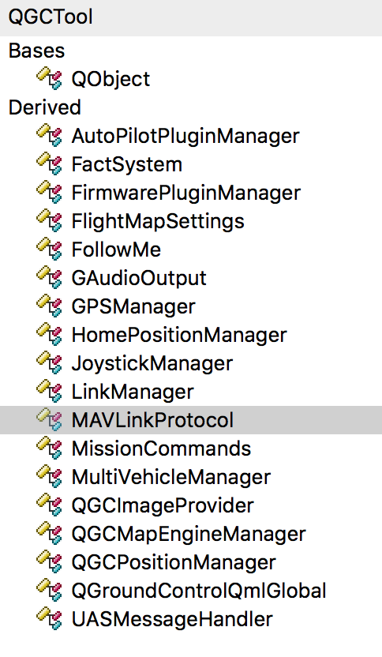
QGCTool and QGCToolbox
1. Setup flow:
QGCApplication::QGCApplication() ->
_toolbox = new QGCToolbox(this) ->
_linkManager = new LinkManager(app);
_mavlinkProtocol = new MAVLinkProtocol(app);
_multiVehicleManager = new MultiVehicleManager(app);
QGCApplication::_initCommon() //register types to be used in qml
2. QGCTool contains
QGCApplication* _app;
QGCToolbox* _toolbox;
3. QGCToolbox contains
AutoPilotPluginManager* autopilotPluginManager(void) { return _autopilotPluginManager; }
FirmwarePluginManager* firmwarePluginManager(void) { return _firmwarePluginManager; }
FlightMapSettings* flightMapSettings(void) { return _flightMapSettings; }
GAudioOutput* audioOutput(void) { return _audioOutput; }
HomePositionManager* homePositionManager(void) { return _homePositionManager; }
JoystickManager* joystickManager(void) { return _joystickManager; }
LinkManager* linkManager(void) { return _linkManager; }
MAVLinkProtocol* mavlinkProtocol(void) { return _mavlinkProtocol; }
MissionCommands* missionCommands(void) { return _missionCommands; }
MultiVehicleManager* multiVehicleManager(void) { return _multiVehicleManager; }
QGCMapEngineManager* mapEngineManager(void) { return _mapEngineManager; }
QGCImageProvider* imageProvider() { return _imageProvider; }
UASMessageHandler* uasMessageHandler(void) { return _uasMessageHandler; }
FollowMe* followMe(void) { return _followMe; }
QGCPositionManager* qgcPositionManager(void) { return _qgcPositionManager; }

Slide 13
*LinkManager
LinkSettings.qml ->
LinkManager::startConfigurationEditing/cancelConfigurationEditing/endConfigurationEditing/createConfiguration/endCreateConfiguration/removeConfiguration/createConnectedLink/disconnectLink
15 seconds timer to check active link
1 second timer to call LinkManager::_updateAutoConnectLinks
LinkManager::createConnectedLink(LinkConfiguration* config) //create & connect
_mavlinkChannelsUsedBitMask:if bit-n is 1, it means it has been occupied by some link which set bit-n to 1
connect(link, &LinkInterface::bytesReceived, _mavlinkProtocol, &MAVLinkProtocol::receiveBytes);
connect(link, &LinkInterface::connected, this, &LinkManager::_linkConnected);
connect(link, &LinkInterface::disconnected, this, &LinkManager::_linkDisconnected);
link->_connect()
Note: all Link shares the same mavlinkProtocol

Slide 14
MavLink heart-beat via MultiVehicleManager.h
Membership:MAVLinkProtocol* _mavlinkProtocol;
1. Send heart-beat
MultiVehicleManager() ->
connect(&_gcsHeartbeatTimer, &QTimer::timeout, this, &MultiVehicleManager::_sendGCSHeartbeat)
void MultiVehicleManager::_sendGCSHeartbeat(void) -> Vehicle::sendMessageOnPriorityLink(message) -> Vehicle::sendMessageOnLink(LinkInterface* link, mavlink_message_t message)
bool sendMessageOnPriorityLink(mavlink_message_t message) { return sendMessageOnLink(priorityLink(), message); } //send mavlink msg to usb-link or other link if any
Vehicle is only added after recevied mavlink-heartbeat from peer
2. Receive heart-beat
MultiVehicleManager::setToolbox() -> connect(_mavlinkProtocol, &MAVLinkProtocol::vehicleHeartbeatInfo, this, &MultiVehicleManager::_vehicleHeartbeatInfo);
MAVLinkProtocol::receiveBytes(LinkInterface* link, QByteArray b) -> MultiVehicleManager::_vehicleHeartbeatInfo() ->
Vehicle* vehicle = new Vehicle(link, vehicleId, (MAV_AUTOPILOT)vehicleFirmwareType, (MAV_TYPE)vehicleType, _firmwarePluginManager, _autopilotPluginManager, _joystickManager);
Notes:
bool Vehicle::sendMessageOnLink(LinkInterface* link, mavlink_message_t message) { if (!link || !_links.contains(link) || !link->isConnected()) { return false; } emit _sendMessageOnLinkOnThread(link, message); return true; } void Vehicle::_sendMessageOnLink(LinkInterface* link, mavlink_message_t message) { // Make sure this is still a good link if (!link || !_links.contains(link) || !link->isConnected()) { return; } // Give the plugin a chance to adjust _firmwarePlugin->adjustOutgoingMavlinkMessage(this, &message); static const uint8_t messageKeys[256] = MAVLINK_MESSAGE_CRCS; mavlink_finalize_message_chan(&message, _mavlink->getSystemId(), _mavlink->getComponentId(), link->getMavlinkChannel(), message.len, message.len, messageKeys[message.msgid]); // Write message into buffer, prepending start sign uint8_t buffer[MAVLINK_MAX_PACKET_LEN]; int len = mavlink_msg_to_send_buffer(buffer, &message); link->writeBytesSafe((const char*)buffer, len); _messagesSent++; emit messagesSentChanged(); }

Slide 15
Link and backed socket
UDPLink is backed by QUdpSocket
TCPLink is backed by QTcpSocket
SerialLink is backed by QSerialPort(Central/libs/qtandroidserialport/src/qserialport.h and Central/libs/qtandroidserialport/src/qserialport_android.cpp)
BluetoothLink is backed by QBluetoothSocket(/Users/migu/Qt5.5.1/5.5/android_armv7/include/QtBluetooth/qbluetoothsocket.h) and android BluetoothAdapter/ BluetoothSocket BluetoothDevice. createRfcommSocketToServiceRecord(service-uuid)
Qt5.5.1/5.5/Src/qtconnectivity/src/bluetooth/qbluetoothsocket_android.cpp

Slide 16
Bluetooth
Scan/Get/Set
Since Qt 5.5, BLE is supported
See “Bluetooth Lower Energy Scanner Example”
See “Bluetooth Low Energy Overview” on QtCreator

Slide 17
QGC- parameters
Vehicle.Vehicle() is called after received heartbeat mavlink-msg from uav
_parameterLoader = new ParameterLoader(this);
connect(_parameterLoader, &ParameterLoader::parametersReady, _autopilotPlugin, &AutoPilotPlugin::_parametersReadyPreChecks);
connect(_parameterLoader, &ParameterLoader::parameterListProgress, _autopilotPlugin, &AutoPilotPlugin::parameterListProgress);
In MainToolBarController.cc, connect(_vehicle->autopilotPlugin(), &AutoPilotPlugin::parameterListProgress, this, &MainToolBarController::_setProgressBarValue) -> MainToolBar.qml progressBar’s width: parent.width * _controller.progressBarValue
ParameterLoader.cc
In Constructor, to call refreshAllParameters(compID:MAV_COMP_ID_ALL = 0) -> mavlink_msg_param_request_list_pack() , see PARAM_REQUEST_LIST ( #21 ), allow 6 seconds to response, retry 4 times if failed
PARAM_REQUEST_READ ( #20 )
MAVLinkProtocol.cc receiveBytes(BTSerialLink* link, QByteArray b) ->
Vehicle.cc _mavlinkMessageReceived() ->
UAS.cc receiveMessage(mavlink_message_t message) -> processParamValueMsg() -> PARAM_VALUE ( #22 )
ParameterLoader.cc _parameterUpdate() ->
emit parameterListProgress((float)(_totalParamCount - readWaitingParamCount) / (float)_totalParamCount) ->
Notes:
Fact* fact = new Fact(componentId, parameterName, factType, this); _mapParameterName2Variant[componentId][parameterName] = QVariant::fromValue(fact);
fact->_containerSetRawValue(value);

Slide 18
FactSystem
class FactSystem : public QGCTool
const char* FactSystem::_factSystemQmlUri = "QGroundControl.FactSystem";
void FactSystem::setToolbox(QGCToolbox *toolbox)
{
QGCTool::setToolbox(toolbox);
qmlRegisterType<Fact> (_factSystemQmlUri, 1, 0, "Fact");
qmlRegisterType<FactPanelController>(_factSystemQmlUri, 1, 0, "FactPanelController");
qmlRegisterUncreatableType<FactGroup>(_factSystemQmlUri, 1, 0, "FactGroup", "ReferenceOnly");
}
PX4FlightModes.qml
PX4SimpleFlightModes.qml
PX4AdvancedFlightModes.qml

Slide 19
qmlRegisterType
FactSystem.cc setToolbox()
qmlRegisterType<Fact> ("QGroundControl.FactSystem", 1, 0, "Fact");
qmlRegisterType<FactPanelController>("QGroundControl.FactSystem", 1, 0, "FactPanelController");
qmlRegisterUncreatableType<FactGroup>("QGroundControl.FactSystem", 1, 0, "FactGroup", "ReferenceOnly");
GQCApplication.cc _initCommon()
qmlRegisterUncreatableType<Vehicle> ("QGroundControl.Vehicle", 1, 0, "Vehicle", "Reference only"); search activeVehicle
qmlRegisterUncreatableType<MissionItem> ("QGroundControl.Vehicle", 1, 0, "MissionItem", "Reference only");
qmlRegisterUncreatableType<MissionManager> ("QGroundControl.Vehicle", 1, 0, "MissionManager", "Reference only");
qmlRegisterType<ParameterEditorController> ("QGroundControl.Controllers", 1, 0, "ParameterEditorController”); see ParameterEditor.qml
qmlRegisterType<APMFlightModesComponentController> ("QGroundControl.Controllers", 1, 0, "APMFlightModesComponentController");
qmlRegisterType<PX4AdvancedFlightModesController> ("QGroundControl.Controllers", 1, 0, "PX4AdvancedFlightModesController");
qmlRegisterType<PX4SimpleFlightModesController> ("QGroundControl.Controllers", 1, 0, "PX4SimpleFlightModesController");
qmlRegisterSingletonType<MavlinkQmlSingleton> ("QGroundControl.Mavlink", 1, 0, "Mavlink", mavlinkQmlSingletonFactory); //define Mavlink-CMDs
VideoStreaming.cc initializeVideoStreaming()
qmlRegisterType<VideoItem> ("QGroundControl.QgcQtGStreamer", 1, 0, "VideoItem");
qmlRegisterUncreatableType<VideoSurface>("QGroundControl.QgcQtGStreamer", 1, 0, "VideoSurface", QLatin1String("VideoSurface from QML is not supported"));
Notes:
QGCApplication.cc _initCommon()
qmlRegisterType<QGCPalette> ("QGroundControl.Palette", 1, 0, "QGCPalette");
qmlRegisterType<QGCMapPalette> ("QGroundControl.Palette", 1, 0, "QGCMapPalette");
qmlRegisterUncreatableType<CoordinateVector> ("QGroundControl", 1, 0, "CoordinateVector", "Reference only");
qmlRegisterUncreatableType<QmlObjectListModel> ("QGroundControl", 1, 0, "QmlObjectListModel", "Reference only");
qmlRegisterUncreatableType<VideoReceiver> ("QGroundControl", 1, 0, "VideoReceiver", "Reference only");
qmlRegisterUncreatableType<VideoSurface> ("QGroundControl", 1, 0, "VideoSurface", "Reference only");
qmlRegisterUncreatableType<MissionCommandTree> ("QGroundControl", 1, 0, "MissionCommandTree", "Reference only”);
qmlRegisterUncreatableType<AutoPilotPlugin> ("QGroundControl.AutoPilotPlugin", 1, 0, "AutoPilotPlugin", "Reference only");
qmlRegisterUncreatableType<VehicleComponent> ("QGroundControl.AutoPilotPlugin", 1, 0, "VehicleComponent", "Reference only");
qmlRegisterUncreatableType<Vehicle> ("QGroundControl.Vehicle", 1, 0, "Vehicle", "Reference only");
qmlRegisterUncreatableType<MissionItem> ("QGroundControl.Vehicle", 1, 0, "MissionItem", "Reference only");
qmlRegisterUncreatableType<MissionManager> ("QGroundControl.Vehicle", 1, 0, "MissionManager", "Reference only");
qmlRegisterUncreatableType<JoystickManager> ("QGroundControl.JoystickManager", 1, 0, "JoystickManager", "Reference only");
qmlRegisterUncreatableType<Joystick> ("QGroundControl.JoystickManager", 1, 0, "Joystick", "Reference only");
qmlRegisterUncreatableType<QGCPositionManager> ("QGroundControl.QGCPositionManager", 1, 0, "QGCPositionManager", "Reference only");
qmlRegisterType<ParameterEditorController> ("QGroundControl.Controllers", 1, 0, "ParameterEditorController”);
qmlRegisterType<APMFlightModesComponentController> ("QGroundControl.Controllers", 1, 0, "APMFlightModesComponentController");
qmlRegisterType<PX4AdvancedFlightModesController> ("QGroundControl.Controllers", 1, 0, "PX4AdvancedFlightModesController");
qmlRegisterType<PX4SimpleFlightModesController> ("QGroundControl.Controllers", 1, 0, "PX4SimpleFlightModesController");
qmlRegisterType<APMAirframeComponentController> ("QGroundControl.Controllers", 1, 0, "APMAirframeComponentController");
qmlRegisterType<AirframeComponentController> ("QGroundControl.Controllers", 1, 0, "AirframeComponentController");
qmlRegisterType<APMSensorsComponentController> ("QGroundControl.Controllers", 1, 0, "APMSensorsComponentController");
qmlRegisterType<SensorsComponentController> ("QGroundControl.Controllers", 1, 0, "SensorsComponentController");
qmlRegisterType<PowerComponentController> ("QGroundControl.Controllers", 1, 0, "PowerComponentController");
qmlRegisterType<RadioComponentController> ("QGroundControl.Controllers", 1, 0, "RadioComponentController");
qmlRegisterType<ESP8266ComponentController> ("QGroundControl.Controllers", 1, 0, "ESP8266ComponentController");
qmlRegisterType<ScreenToolsController> ("QGroundControl.Controllers", 1, 0, "ScreenToolsController");
qmlRegisterType<MainToolBarController> ("QGroundControl.Controllers", 1, 0, "MainToolBarController");
qmlRegisterType<MissionController> ("QGroundControl.Controllers", 1, 0, "MissionController");
qmlRegisterType<FlightDisplayViewController> ("QGroundControl.Controllers", 1, 0, "FlightDisplayViewController");
qmlRegisterType<ValuesWidgetController> ("QGroundControl.Controllers", 1, 0, "ValuesWidgetController");
qmlRegisterType<QGCMobileFileDialogController> ("QGroundControl.Controllers", 1, 0, "QGCMobileFileDialogController");
qmlRegisterType<RCChannelMonitorController> ("QGroundControl.Controllers", 1, 0, "RCChannelMonitorController");
qmlRegisterType<JoystickConfigController> ("QGroundControl.Controllers", 1, 0, "JoystickConfigController");
#ifndef __mobile__
qmlRegisterType<ViewWidgetController> ("QGroundControl.Controllers", 1, 0, "ViewWidgetController");
qmlRegisterType<CustomCommandWidgetController> ("QGroundControl.Controllers", 1, 0, "CustomCommandWidgetController");
qmlRegisterType<FirmwareUpgradeController> ("QGroundControl.Controllers", 1, 0, "FirmwareUpgradeController");
qmlRegisterType<LogDownloadController> ("QGroundControl.Controllers", 1, 0, "LogDownloadController");
#endif
// Register Qml Singletons
qmlRegisterSingletonType<QGroundControlQmlGlobal> ("QGroundControl", 1, 0, "QGroundControl", qgroundcontrolQmlGlobalSingletonFactory);
qmlRegisterSingletonType<ScreenToolsController> ("QGroundControl.ScreenToolsController", 1, 0, "ScreenToolsController", screenToolsControllerSingletonFactory);
qmlRegisterSingletonType<MavlinkQmlSingleton> ("QGroundControl.Mavlink", 1, 0, "Mavlink", mavlinkQmlSingletonFactory);

Slide 20
setContextProperty
joystickManager -> JoystickManager
debugMessageModel -> AppLogModel
autopilot -> PX4AutoPilotPlugin or APMAutoPilotPlugin (refer to Vehicle each other)

Slide 21
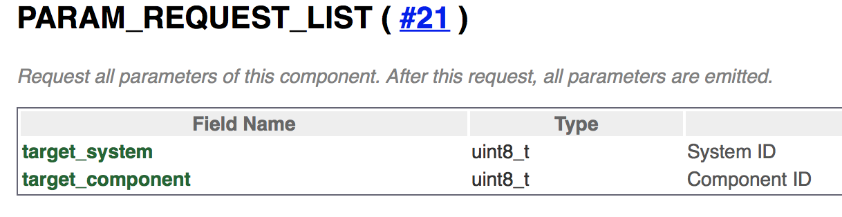
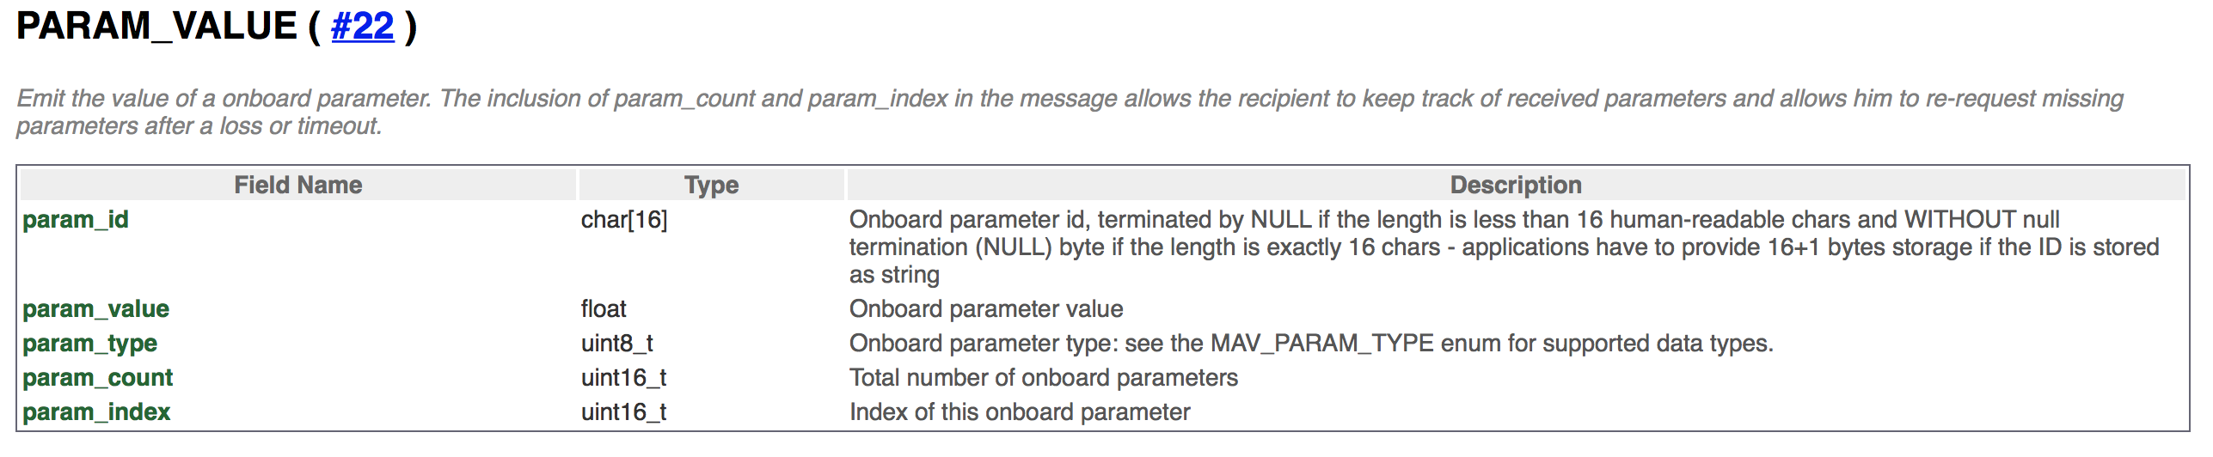
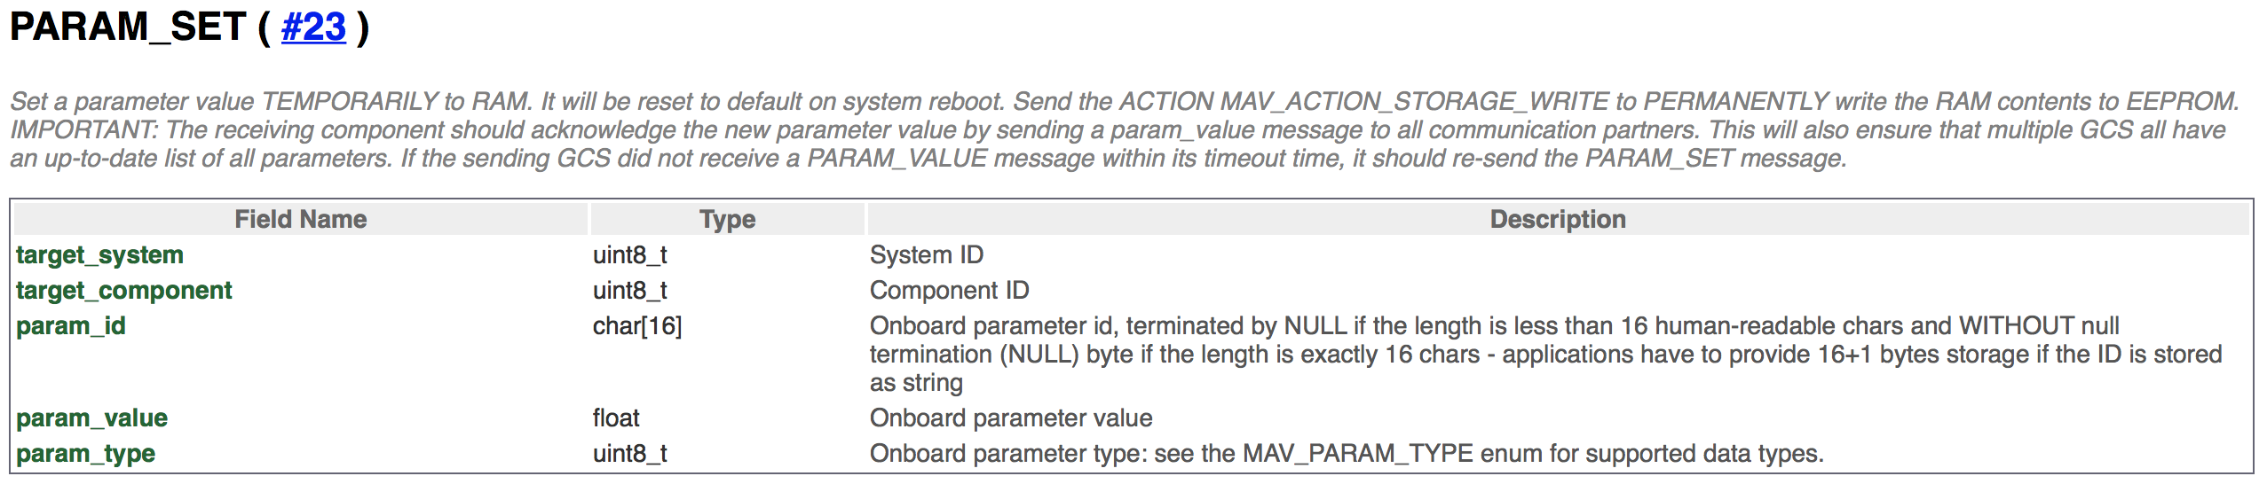
Parameter MAVLink message
Notes:
/Users/migu/Documents/dev/Central/src/QmlControls/ParameterEditorDialog.qml
/Users/migu/Documents/dev/Central/src/FirmwarePlugin/PX4/PX4ParameterFactMetaData.xml
void ParameterLoader::_addMetaDataToDefaultComponent(void)
#23:
void ParameterLoader::_valueUpdated(const QVariant& value)
/Users/migu/Documents/dev/Central/src/FactSystem/ParameterLoader.cc
void ParameterLoader::_writeParameterRaw(int componentId, const QString& paramName, const QVariant& value) {
mavlink_param_set_t p;
mavlink_param_union_t union_value; FactMetaData::ValueType_t factType = _vehicle->autopilotPlugin()->getFact(FactSystem::ParameterProvider, componentId, paramName)->type();
p.param_type = _factTypeToMavType(factType); switch (factType) {
case FactMetaData::valueTypeUint8: union_value.param_uint8 = (uint8_t)value.toUInt(); break; case FactMetaData::valueTypeInt8: union_value.param_int8 = (int8_t)value.toInt(); break; case FactMetaData::valueTypeUint16: union_value.param_uint16 = (uint16_t)value.toUInt(); break; case FactMetaData::valueTypeInt16: union_value.param_int16 = (int16_t)value.toInt(); break; case FactMetaData::valueTypeUint32: union_value.param_uint32 = (uint32_t)value.toUInt(); break; case FactMetaData::valueTypeFloat: union_value.param_float = value.toFloat(); break; default: qCritical() << "Unsupported fact type" << factType; // case FactMetaData::valueTypeInt32: union_value.param_int32 = (int32_t)value.toInt(); break;
} p.param_value = union_value.param_float;
p.target_system = (uint8_t)_vehicle->id();
p.target_component = (uint8_t)componentId; strncpy(p.param_id, paramName.toStdString().c_str(), sizeof(p.param_id)); mavlink_message_t msg;
mavlink_msg_param_set_encode(_mavlink->getSystemId(), _mavlink->getComponentId(), &msg, &p);
_vehicle->sendMessageOnLink(_vehicle->priorityLink(), msg); }

Slide 22
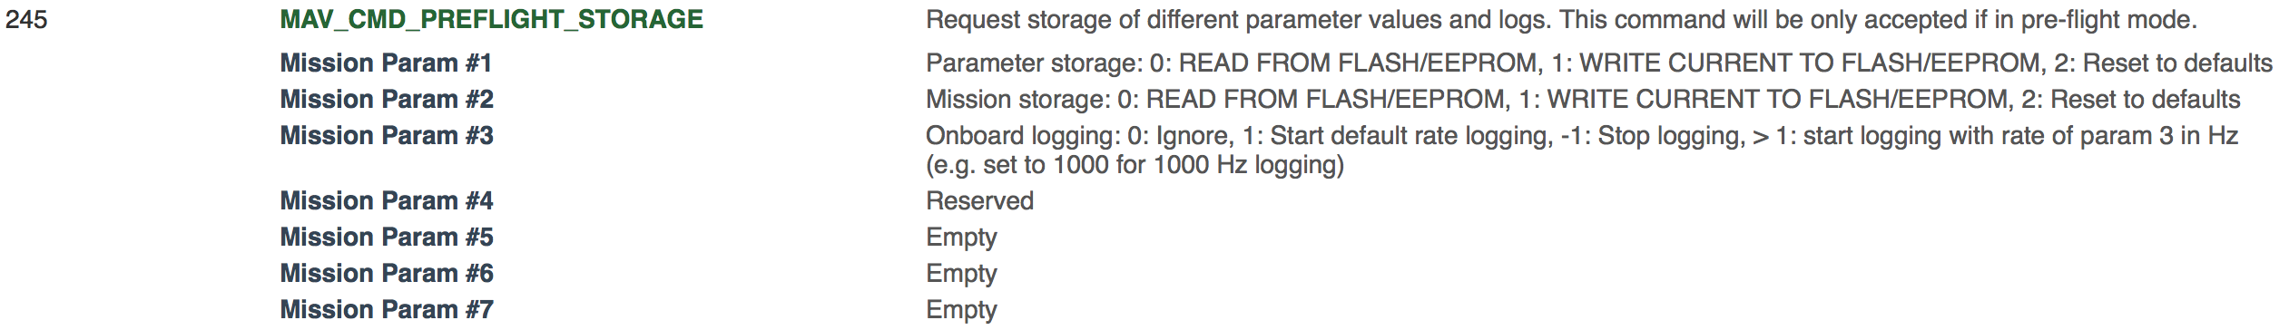
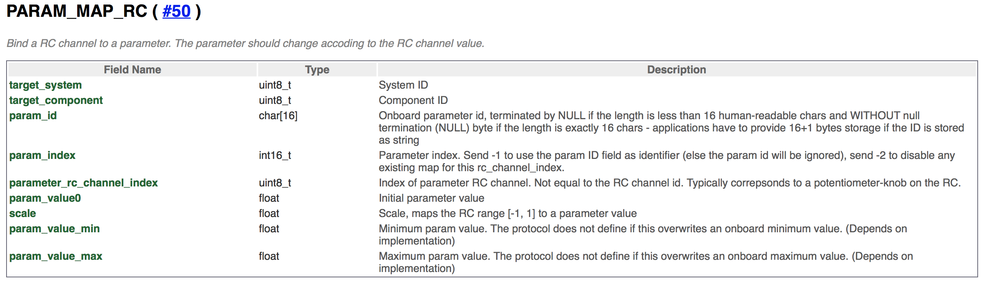
Transfer parameter between memory and storage (#76 Command_Long)
Notes:
/Users/migu/Documents/dev/Central/src/AutoPilotPlugins/AutoPilotPlugin.cc
void AutoPilotPlugin::resetAllParametersToDefaults(void) 2,-1,0,0,0,0,0
/Users/migu/Documents/dev/Central/src/FactSystem/ParameterLoader.cc void ParameterLoader::_saveToEEPROM(void)
1=confirmation, 1, -1, -1, -1, 0, 0, 0

Slide 23
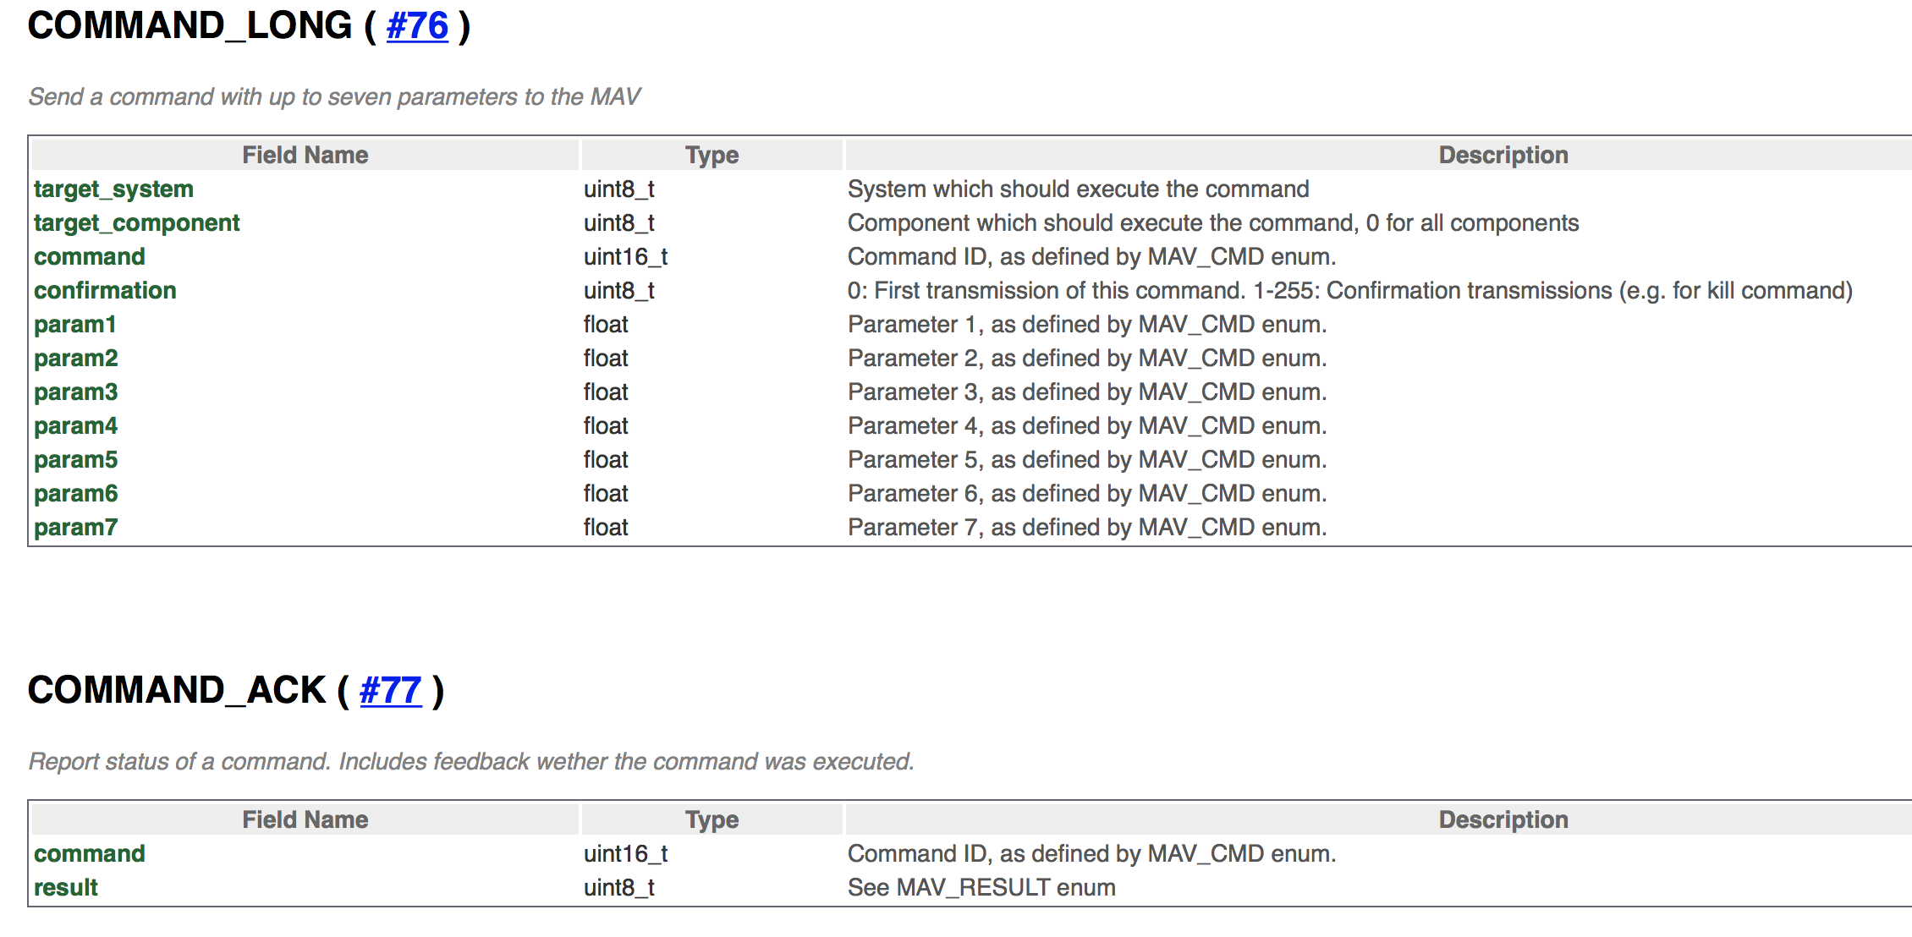
Command

Slide 24
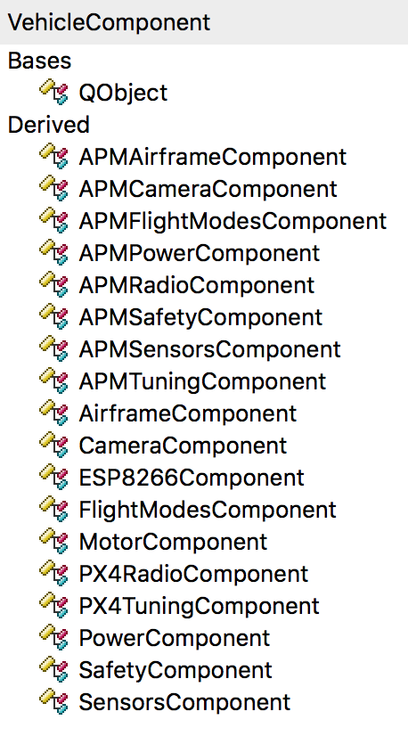
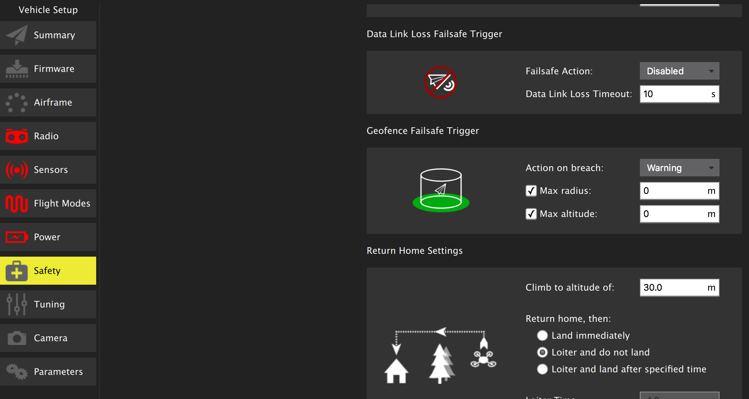
Vehicle Components
AirframeComponent.cc
AirframeComponentSummary.qml
AirframeComponent.qml
AirframeComponentIcon.png
AirframeComponentController.cc

Slide 25
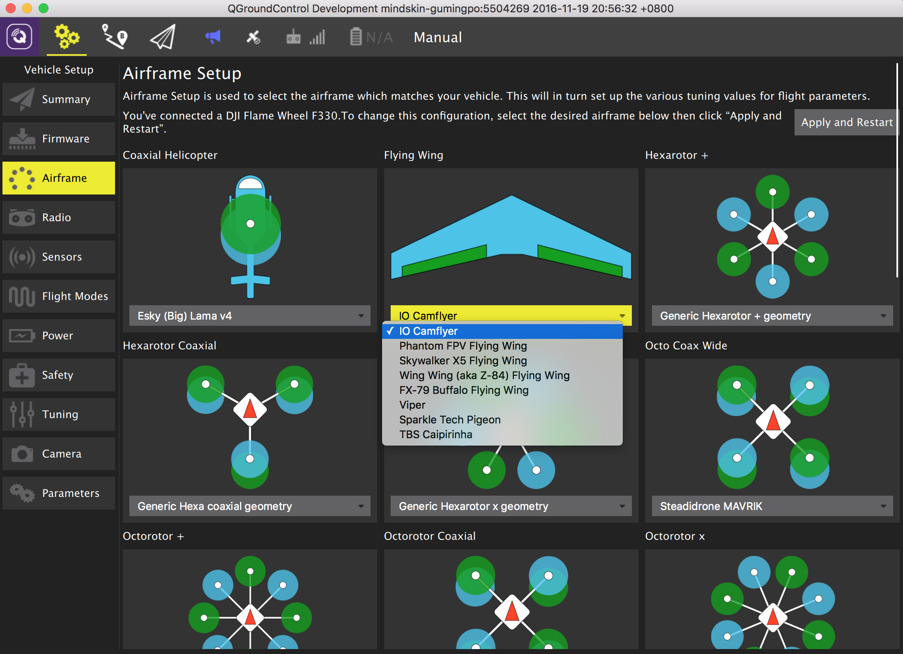
Airframe setup/select
Notes:
/Users/migu/Documents/dev/Central/src/AutoPilotPlugins/PX4/AirframeComponentController.cc
void AirframeComponentController::changeAutostart(void)
{
if (qgcApp()->toolbox()->multiVehicleManager()->vehicles()->count() > 1) {
qgcApp()->showMessage("You cannot change airframe configuration while connected to multiple vehicles.");
return;
}
qgcApp()->setOverrideCursor(Qt::WaitCursor);
Fact* sysAutoStartFact = getParameterFact(-1, "SYS_AUTOSTART");
Fact* sysAutoConfigFact = getParameterFact(-1, "SYS_AUTOCONFIG");
// We need to wait for the vehicleUpdated signals to come back before we reboot
_waitParamWriteSignalCount = 0;
connect(sysAutoStartFact, &Fact::vehicleUpdated, this, &AirframeComponentController::_waitParamWriteSignal);
connect(sysAutoConfigFact, &Fact::vehicleUpdated, this, &AirframeComponentController::_waitParamWriteSignal);
// We use forceSetValue to params are sent even if the previous value is that same as the new value
sysAutoStartFact->forceSetRawValue(_autostartId);
sysAutoConfigFact->forceSetRawValue(1);
}
void AirframeComponentController::_waitParamWriteSignal(QVariant value)
{
Q_UNUSED(value);
_waitParamWriteSignalCount++;
if (_waitParamWriteSignalCount == 2) {
// Now that both params have made it to the vehicle we can reboot it. All these signals are flying
// around on the main thread, so we need to allow the stack to unwind back to the event loop before
// we reboot.
QTimer::singleShot(800, this, &AirframeComponentController::_rebootAfterStackUnwind);
}
}
void AirframeComponentController::_rebootAfterStackUnwind(void)
{
_uas->executeCommand(MAV_CMD_PREFLIGHT_REBOOT_SHUTDOWN, 1, 1.0f, 0.0f, 0.0f, 0.0f, 0.0f, 0.0f, 0.0f, 0);
qgcApp()->processEvents(QEventLoop::ExcludeUserInputEvents);
for (unsigned i = 0; i < 2000; i++) {
QGC::SLEEP::usleep(500);
qgcApp()->processEvents(QEventLoop::ExcludeUserInputEvents);
}
qgcApp()->toolbox()->linkManager()->disconnectAll();
qgcApp()->restoreOverrideCursor();
}

Slide 26
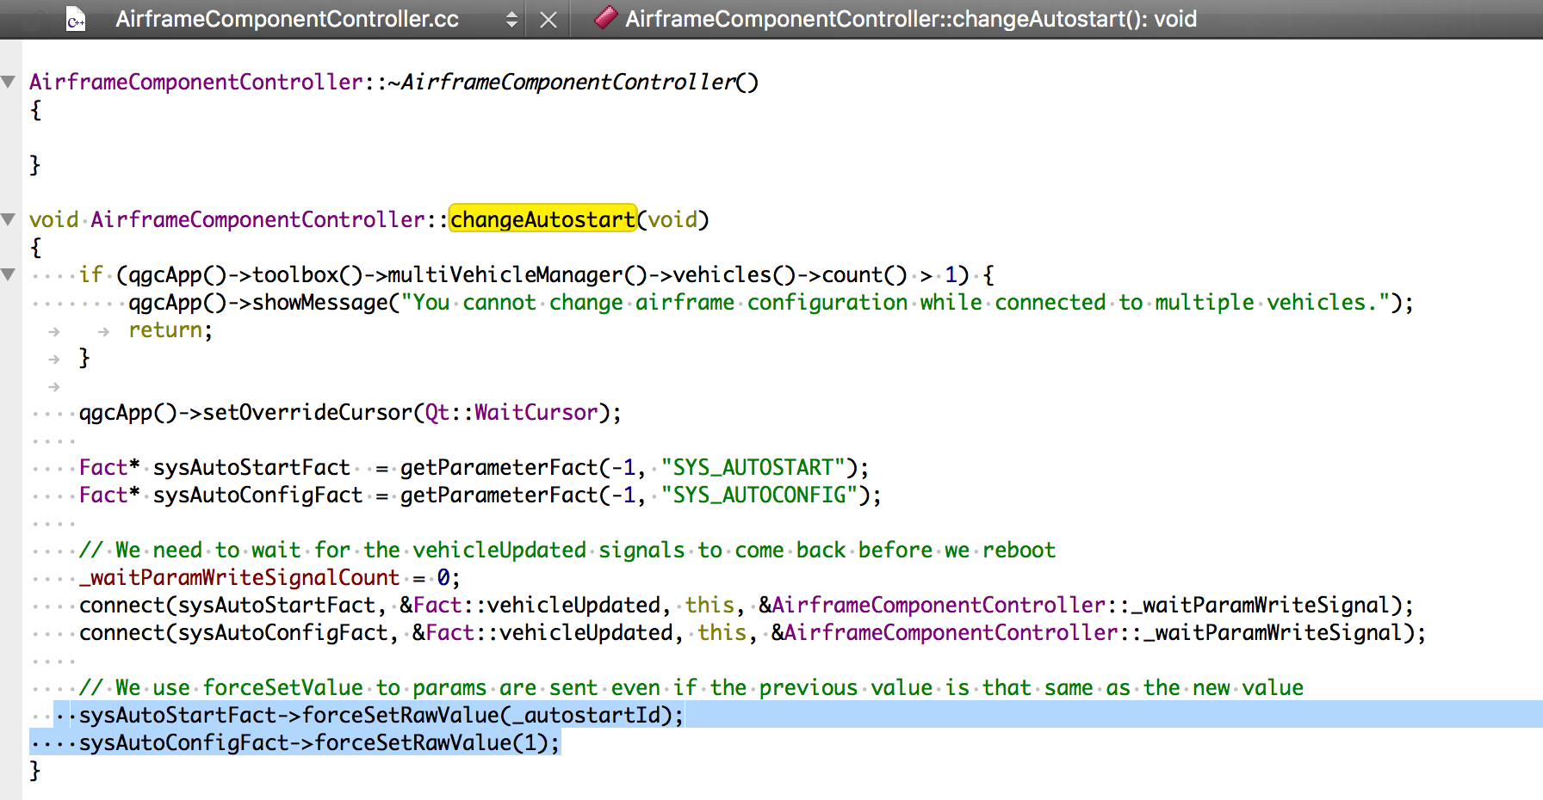
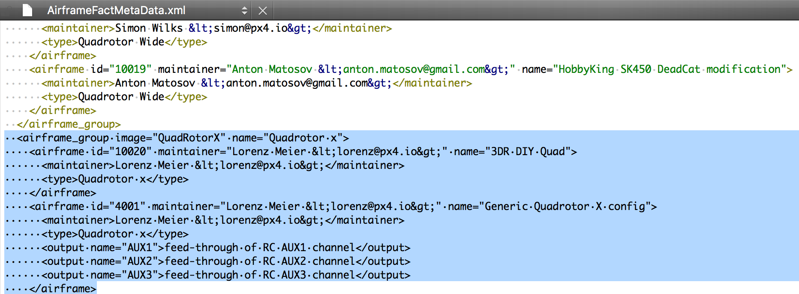
Airframe setup
AirframeComponent.qml/AirframeComponentSummary.qml
VehicleComponent:A vehicle component is an object which abstracts the physical portion of a vehicle into a set of configurable values and user interface.
AirframeComponent:The Airframe VehicleComponent is used to set the SYS_AUTOSTART airframe id.
FlightModesComponent
PowerComponent
System Id -> MAV_SYS_ID
Airframe type -> AirframeComponentController. currentAirframeType
Vehicle -> AirframeComponentController. currentVehicleName
Firmware Version ->
<activeVehicle.firmwareMajorVersion>.
<activeVehicle.firmwareMinorVersion>.
<activeVehicle.firmwarePatchVersion><sactiveVehicle.firmwareVersionTypeString>
SYS_AUTOSTART?
SetupView.qml -> PX4AutoPilotPlugin.vehicleComponents -> AirframeComponent
modelData -> VehicleComponent
AirframeComponent.qml
model -> AirframeComponentController.airframeTypes, modelData -> AirframeType which has properties name, imageResource and airframes (which is list of AirFrame) -> …
-> set SYS_AUTOSTART to selected <airframe id>, and set SYS_AUTOCONFIG to 1, finally call _uas->executeCommand(MAV_CMD_PREFLIGHT_REBOOT_SHUTDOWN, 1, 1.0f, 0.0f, 0.0f, 0.0f, 0.0f, 0.0f, 0.0f, 0)
Note: Load AirFrame, After received heartbeat from UAV, to call PX4AutoPilotPlugin::PX4AutoPilotPlugin() -> PX4AirframeLoader::loadAirframeMetaData -> AirframeFactMetaData.xml -> AirframeComponentAirframes::insert(airframeGroup, image, name, id.toInt())
Airframe id (i.e. SYS_AUTOSTART) = auto-start script index
Notes:
/Users/migu/Documents/dev/Central/src/FirmwarePlugin/PX4/PX4ParameterFactMetaData.xml
<parameter default="0" name="SYS_AUTOSTART" type="INT32">
<short_desc>Auto-start script index</short_desc>
<long_desc>CHANGING THIS VALUE REQUIRES A RESTART. Defines the auto-start script used to bootstrap the system.</long_desc>
<min>0</min>
<max>99999</max>
<reboot_required>true</reboot_required>
<scope>modules/systemlib</scope>
</parameter>

Slide 27
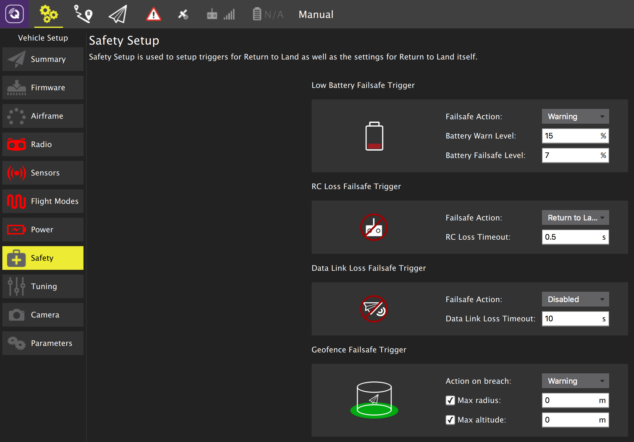
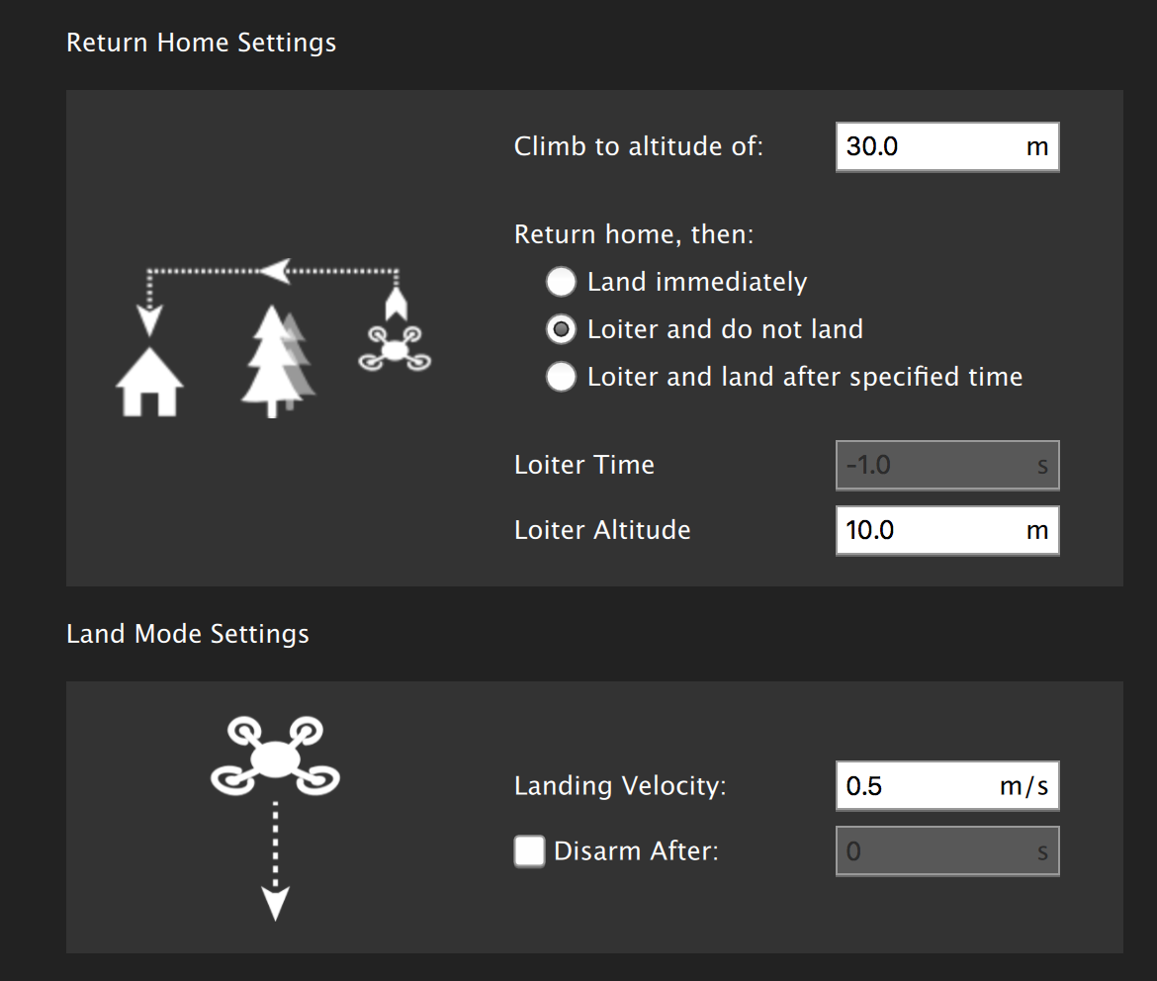
Safety setup
SafetyComponent.cc
SafetyComponent.qml
SafetyComponentSummary.qml
SafetyComponentIcon.png
“RTL min alt” RTL_RETURN_ALT
"RTL home alt” RTL_DESCEND_ALT
“RC loss RTL” COM_RC_LOSS_T
“RC loss action” NAV_RCL_ACT
“Link loss action” NAV_DLL_ACT
Notes:
[Lower-Battery]
“Low battery action” COM_LOW_BAT_ACT
“Battery Warn Level” BAT_LOW_THR
“Battery Failsafe Level” BAT_CRIT_THR
[RC Loss]
“RC Loss Timeout” COM_RC_LOSS_T
“Failsafe Action” NAV_RCL_ACT
[Data Link Losss Failsafe Trigger]
“Data Link Loss Timeout” COM_DL_LOSS_T
“Failsafe Action” NAV_DLL_ACT
[Geofence 地理围栏]
“Max radius” GF_MAX_HOR_DIST
“Max altitude” GF_MAX_VER_DIST
”Action on breach” GF_ACTION
[Return home setting]
“Climb to altitude of” RTL_RETURN_ALT
“Land Immediately” -> RTL_LAND_DELAY = 0
“Loiter and do not land” -> RTL_LAND_DELAY = -1
“Loiter and land after specified time” -> RTL_LAND_DELAY = 60
“Loiter Time” RTL_LAND_DELAY
“Loiter Altitude” RTL_DESCEND_ALT
[Land Mode setting]
“Landing Velocity” MPC_LAND_SPEED
“Disarm After” COM_DISARM_LAND

