Slide 1
Qt for Android
gumingpo@gmail.com
Jun 18, 2016

Slide 2
Deploying an Application on Android
QtActivity.java (e.g. UsbDeviceJni.java for QGround)
QtActivityDelegate.java
public boolean loadApplication(Activity activity, ClassLoader classLoader, Bundle loaderParams) ->
QtNative.loadQtLibraries(loaderParams.getStringArrayList(NATIVE_LIBRARIES_KEY)); -> System.load(libName);
QtNative.loadBundledLibraries(loaderParams.getStringArrayList(BUNDLED_LIBRARIES_KEY), QtNativeLibrariesDir.nativeLibrariesDir(m_activity)); ->Syste.load()
public void onCreate(Bundle savedInstanceState) -> public boolean startApplication() ->
QNative.startApplication()
<meta-data android:name="android.app.lib_name" android:value="-- %%INSERT_APP_LIB_NAME%% --"/>
/Users/migu/Documents/dev/qgroundcontrol/src/main.cc main() ->
QGCApplication.exec() -> QGuiApplication.exec() -> QCoreApplication.exec()
Note:qserialportinfo_android.cpp will call UsbDeviceJni.java ->
QSerialPortPrivate. newDataArrived() -> SerialLink.cc _readBytes() -> MAVLinkProtocol.cc receiveBytes()
BluetoothLink.cc
LinkManager.cc

Slide 3
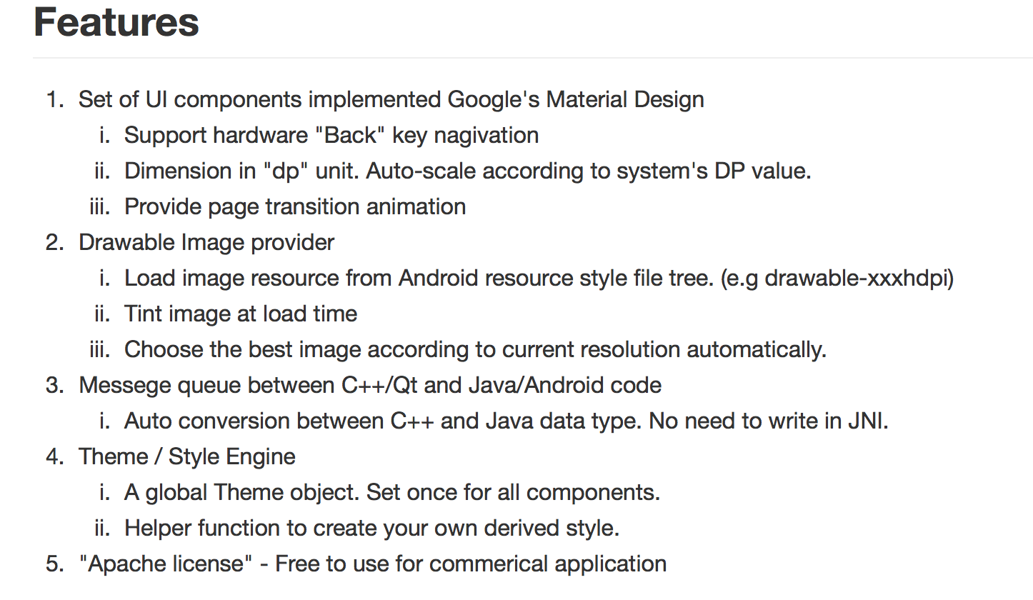
quickandroid
https://github.com/benlau/quickandroid.git

Slide 4
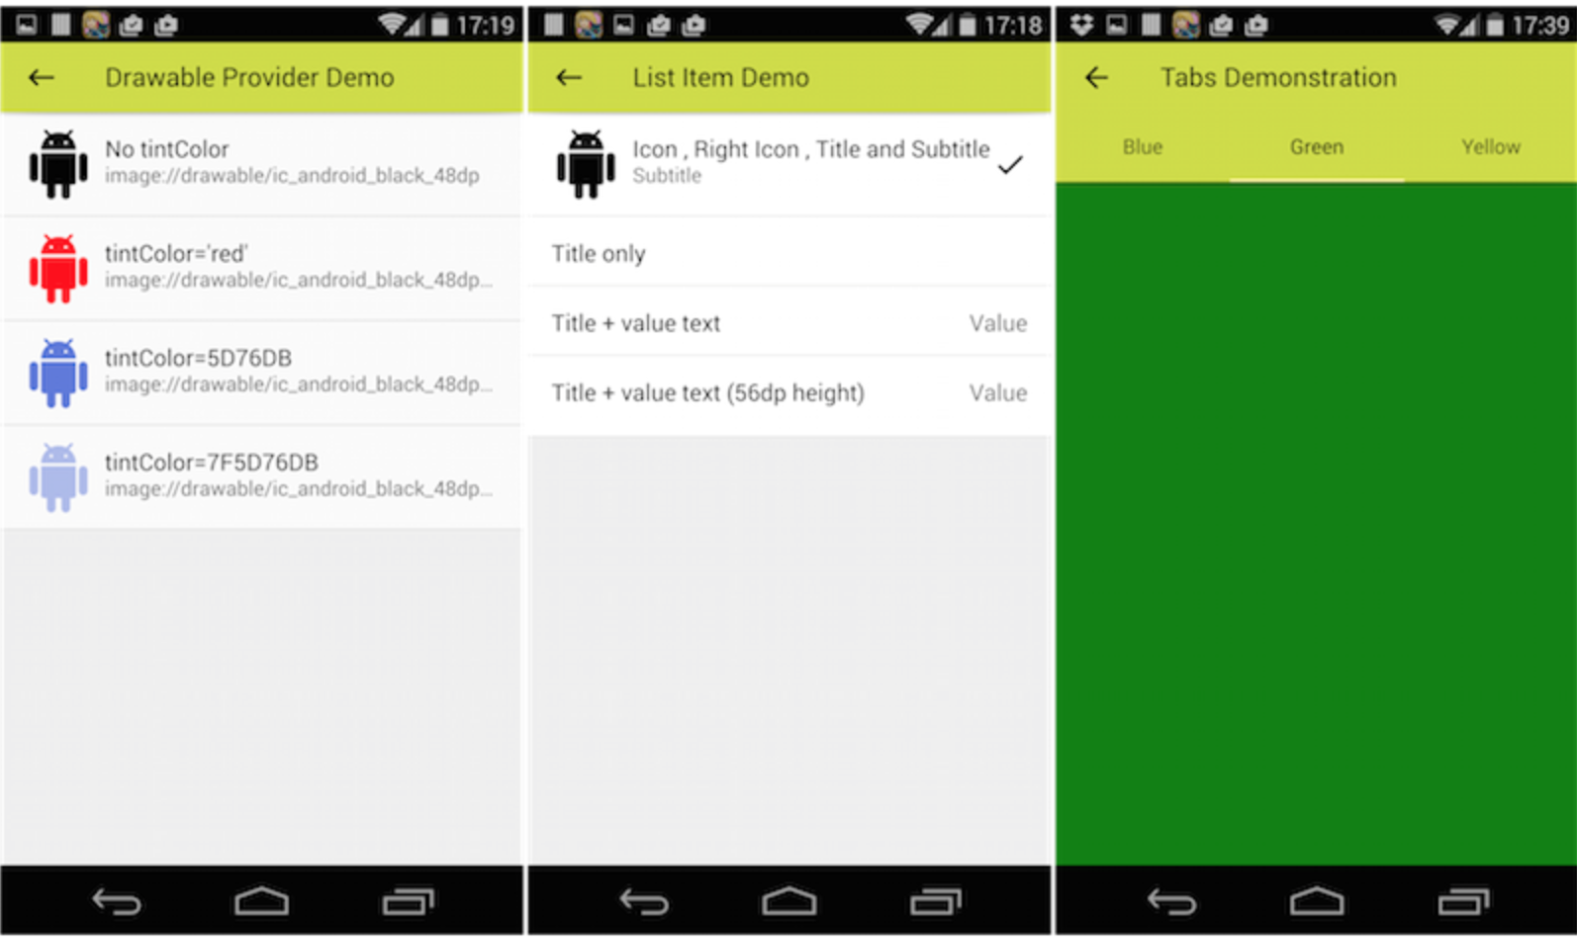

Slide 5
Quickandroid - SystemDispatcher
quickandroid/qaqmltypes.cpp
static QObject *systemDispatcherProvider(QQmlEngine *engine, QJSEngine *scriptEngine) {
QASystemDispatcherProxy* object = new QASystemDispatcherProxy();
return object;
}
class QAQmlTypes { public: QAQmlTypes() { // QADevice is a exception. Won't register by QAQmlTypes. qmlRegisterSingletonType<QASystemDispatcherProxy>("QuickAndroid", 0, 1, "SystemDispatcher", systemDispatcherProvider); qmlRegisterType<QALine>("QuickAndroid.Private",0,1,"Line"); qmlRegisterType<QAMouseSensor>("QuickAndroid.Private",0,1,"MouseSensor");
qmlRegisterSingletonType("QuickAndroid.Private", 0, 1, "TimerUtils", timerProvider); qmlRegisterType<QAImageWriter>("QuickAndroid.Private",0,1,"ImageWriter");
}
}; static QAQmlTypes registerHelper;

Slide 6
Call Android-java from QML
quickandroid/examples/quickandroidexample/notification/NotificationDemo.qml
MouseArea {
anchors.fill: parent
onClicked: {
SystemDispatcher.dispatch("Notifier.notify",{title: "Quick Android Example",message: "Hello!"});
}
}
quickandroid/priv/qasystemdispatcherproxy.h
class QASystemDispatcherProxy : public QObject
{
Q_OBJECT
public:
explicit QASystemDispatcherProxy(QObject *parent = 0);
~QASystemDispatcherProxy();
Q_INVOKABLE void dispatch(QString type, QVariantMap message = QVariantMap());
Q_INVOKABLE void loadClass(QString className);
signals:
void dispatched(QString type , QVariantMap message);
};
quickandroid/priv/qasystemdispatcherproxy.cpp
QASystemDispatcherProxy::QASystemDispatcherProxy(QObject *parent) : QObject(parent)
{
connect(QASystemDispatcher::instance(),SIGNAL(dispatched(QString,QVariantMap)),
this,SIGNAL(dispatched(QString,QVariantMap)));
} //relay QASystemDispatcher.diapatched() signal to QASystemDispatcherProxy then to QML’s onDispatched() slot
void QASystemDispatcherProxy::dispatch(QString type, QVariantMap message)
{
QASystemDispatcher::instance()->dispatch(type,message);
}
quickandroid/qasystemdispatcher.cpp
#define JCLASS_Name "quickandroid/SystemDispatcher"
#define DISPATCH_SIGNATURE "(Ljava/lang/String;Ljava/util/Map;)V"
#define EMIT_SIGNATURE "(Ljava/lang/String;Ljava/util/Map;)V"EndFragment
void QASystemDispatcher::dispatch(QString type, QVariantMap message)
{
#ifdef Q_OS_ANDROID
QAndroidJniEnvironment env;
jstring jType = env->NewStringUTF(type.toLocal8Bit().data());
jobject jData = createHashMap(message);
QAndroidJniObject::callStaticMethod<void>(JCLASS_Name, "dispatch",DISPATCH_SIGNATURE,jType,jData);
#else
#endif
}

Slide 7
Call Android-java from QML (cont.)
quickandroid/java/quickandroid/SystemDispatcher.java
void dispatch(String type,Map message) ->EndFragment
void emit(String name,Map message) {
for (int i = 0 ; i < listeners.size() ; i++ ) {
Listener listener = listeners.get(i);
try {
listener.onDispatched(name,message);
} catch (Exception e) {}
}
jniEmit(name,message);
}EndFragment
quickandroid/examples/quickandroidexample/main.cpp
JNIEXPORT jint JNI_OnLoad(JavaVM* vm, void*) {
// It must call this function within JNI_OnLoad to enable System Dispatcher
QASystemDispatcher::registerNatives();
QAndroidJniObject::callStaticMethod<void>("quickandroid/example/ExampleService","start”, "()V");
return JNI_VERSION_1_6;
}EndFragment
quickandroid/examples/quickandroidexample/android-sources/src/quickandroid/example/ExampleService.java -> SystemDispatcher.addListener to handle type:"Notifier.notify"

Slide 8
Other samples from QML call to Java
quickandroid/QuickAndroid/ImagePicker.qml ->
quickandroid/java/quickandroid/ImagePicker.java
quickandroid.ImagePicker.pickImage or quickandroid.ImagePicker.takePhoto-> //Dispatcher-Type
new Intent(Intent.ACTION_PICK, android.provider.MediaStore.Images.Media.EXTERNAL_CONTENT_URI) ->
QuickAndroidActivity.onActivityResult() ->
SystemDispatcher.onActivityResult() ->
SystemDispatcher.dispatch(ACTIVITY_RESULT_MESSAGE,message) ->
QASystemDispatcherProxy ->
…
quickandroid/QuickAndroid/ImagePicker.qml

