Slide 1
Financial Sentiment Analysis Using llama
Student Name: GUMMADI SRI HARSHITHA
University ID: U01944139
git repo URL: gummadisriharshitha/Capstone-Project

Slide 2
Introduction
The financial sector generates a continuous stream of unstructured text data from news articles, social media, and financial reports. This text often contains crucial information about market sentiment, which influences decisions related to investments and risk management. However, due to the complexity of financial language and the sheer volume of data, manual analysis is impractical and inefficient.
The FSA technique functions as a critical directional instrument which uses market sentiment tracking to assist capital allocation choices and analyse economic movements. The development of NLP proceeded with the establishment of BERT and its financial adaptation FinBERT which enhanced FSA effectiveness.
This project offers a thorough and in-depth sentiment analysis system that assesses the emotional tone of textual data, mainly focusing on the tweets, by fusing deep learning with Natural Language Processing (NLP). Before doing exploratory data analysis to find patterns and trends, the procedure starts with data pre-processing to clean and standardize twitter content. A LLaMA-based sentiment classification model is refined using cleaned data that has been labelled with sentiment categories (positive, negative, and neutral). After that, the trained model is incorporated into an intuitive Streamlit online application, which offers real-time sentiment prediction via an easy-to-use interface.

Slide 3
Aims and Objectives
Aim:
The aim of this project is to develop a sentiment analysis model using the open-source llama LLM. The project will focus on accurately classifying financial text into positive, negative, or neutral sentiment categories, leveraging llama's ability to understand complex and context-specific language.
Objectives:
To collect financial text data, such as news articles, earnings reports, and social media posts.
To preprocess the data by cleaning and formatting for model input.
To develop the sentiment analysis model influenced by LlaMA so as to classify the sentiments.
To create a user friendly application for sentiment analysis which helps the user to input the data and get a sentiment against the input data.

Slide 4
Data Collection
The data shows a collection of stimulated tweets which are being related to the metadata. This data can be used for performing sentiment analysis using Natural Language Processing and many different machine learning models. The dataset contains different attributes which are as follows:
Colum Name | Description
Tweet_ID | It is a unique identifier for each tweet
Username | Username of the person who has made the tweet
Text | The actual tweet which is written in natural English which contains topic related to many different topics.
Retweets | It indicates the number of times retweets has been done
Likes | It shows the number of likes in the tweet.
Timestamp | It indicates the date and time when the tweet was posted.

Slide 5
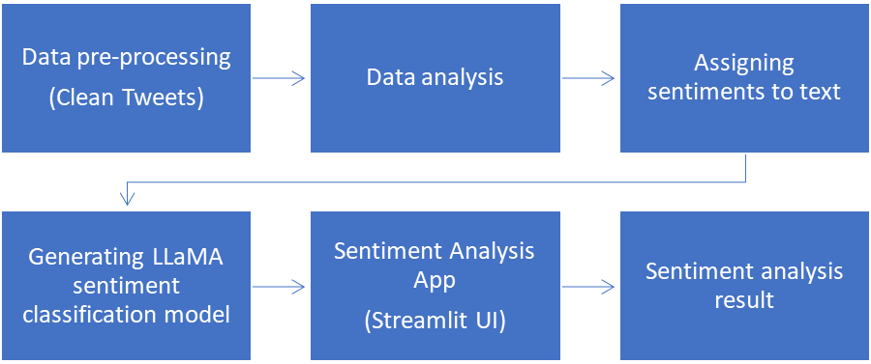
Methodology
The methodical process used to conduct sentiment analysis on a carefully selected collection of fake tweets is described in this section. The main goal is to use a transformer-based language model to categorize each tweet into predetermined emotion groups. Data preparation, exploratory data analysis, feature engineering, model selection, training, and assessment are some of the crucial steps in the technique. A strong NLP pipeline was created to efficiently capture context and semantics, guaranteeing great performance in sentiment prediction, given the tweets' varied and sophisticated language.

Slide 6
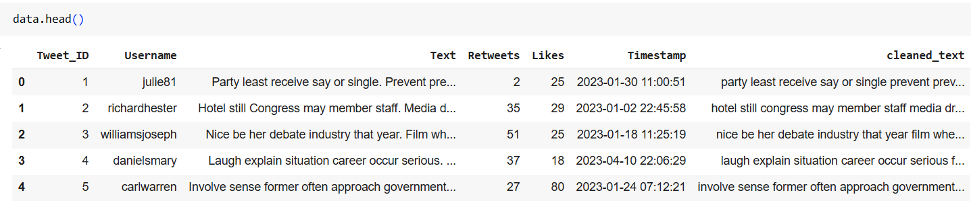
Data Cleaning & Preparation
Initially the data is first of all loaded. By using the Pandas library, the data is read as a data frame. Once the data is being loaded it is then checked for any kind of null values in the data. It is found that there are no null values present in the data.
There is text pre-processing function which is used for cleaning the tweets in the data. This function would be removing the special characters, URLs, twitter handles, hashtags except the alphabets and spaces.
In order to make data handling simpler, first of all the Timestamp column is converted into datetime format.

Slide 7
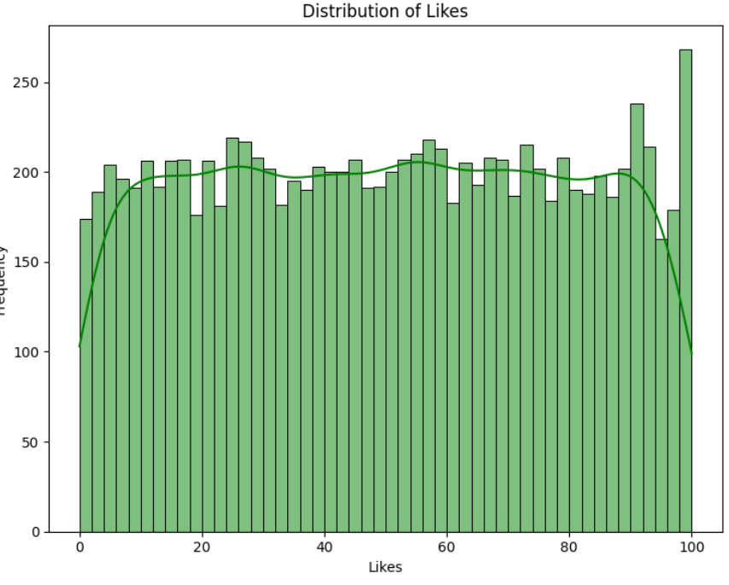
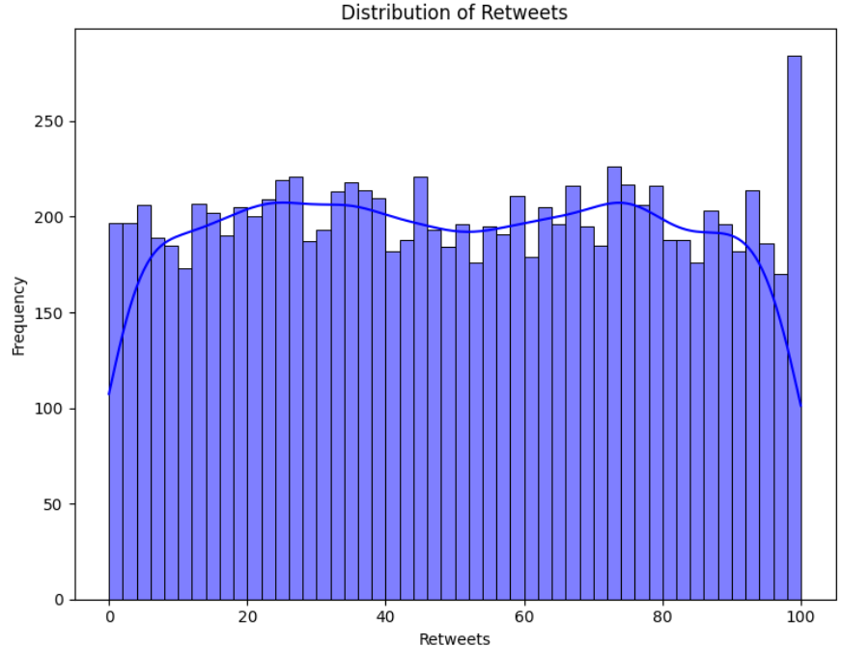
Exploratory Data Analysis (EDA)
There is a uniform and consistent distribution showing no notable peaks or drops in the distribution. This implies that retweets are dispersed equally over the spectrum, which might signal that the dataset was well-balanced. There are some minor variations, but no significant skew (for example, most tweets don't have 100 retweets or 0 retweets).
The likes distribution plot is also unform even though there is a slight increase towards the higher end which shows that there are more tweets with 90-100 likes. The density curve is also almost flat which shows that there is no strong bias towards any specific likes.

Slide 8
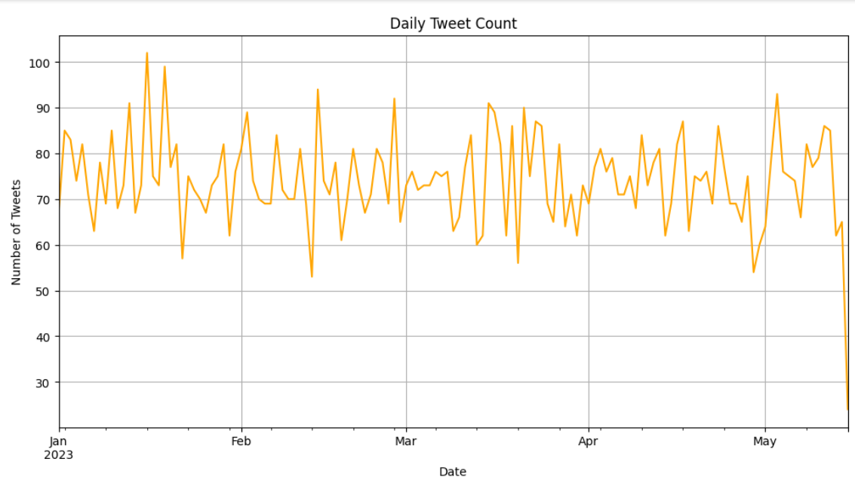
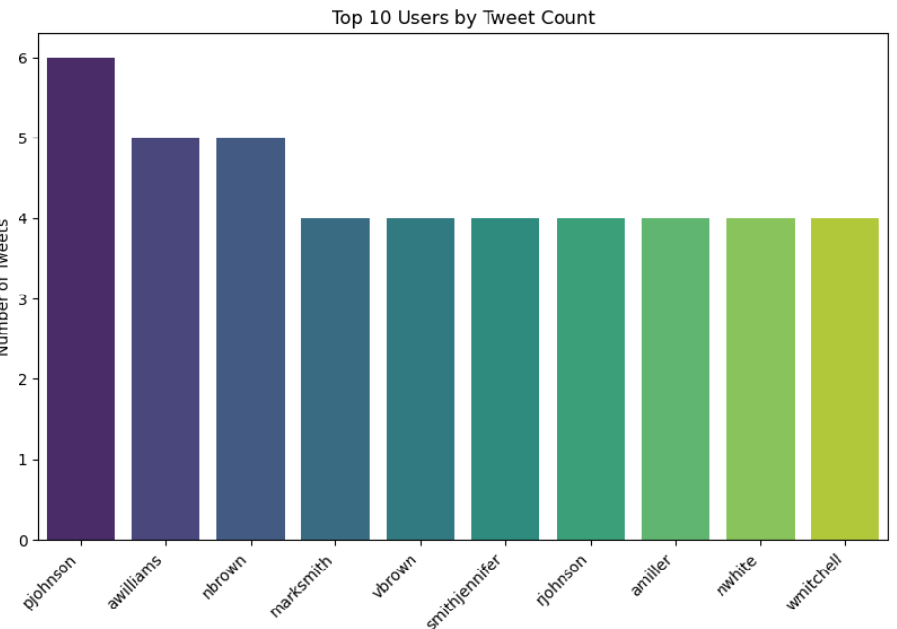
Exploratory Data Analysis
Every day, the quantity of tweets fluctuates, usually in the range of 60 to 100. Occasionally, there are spikes that approach 100 tweets which is observed in late January or mid-February. Additionally, there are times when the number of tweets falls to about 50 to 60 each day. Overall, there are no significant up or downturns in the pattern, which stays largely constant over the months. It shows that there is a strong engagement and a steady flow of the tweet generation.

Slide 9
Modeling
Meta which was earlier known to be Facebook had created the LLaMA (big Language Model Meta AI) family of cutting-edge big language models. These models are aimed to interpret and create human-like language utilizing deep learning techniques, notably the transformer architecture, akin to models like GPT. The number refers to the number of parameters (billions) in LLaMA models, which come in different sizes (e.g., LLaMA-7B, LLaMA-13B, LLaMA-65B). Larger models usually have more sophisticated language interpretation and generating capabilities.
A Transformer-based architecture which is influenced by LLaMA is created and trained to get a sentiment classification
It has unique implementations of important Transformer elements like as feed-forward layers, multi-head attention, and positional encoding. model for tweets.

Slide 10
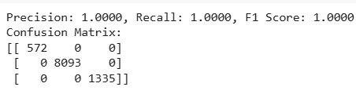
Results
The model is being evaluated and it is found that the model has performed well giving a precision of 100% which shows that most of the texts were correctly classified into appropriate categories.

Slide 11
Conclusion
In order to categorize tweets into three groups—negative, neutral, and positive—we successfully applied a sentiment analysis model in this project utilizing the LLaMA language model.
After thorough preprocessing, feature extraction, and fine-tuning, the model performed very well, earning flawless scores on all important metrics, including precision, recall, and F1 Score of 1.0000. This was further supported by the confusion matrix, which revealed that there were no misclassifications in any of the sentiment classes.
These results demonstrate how well sophisticated large language models, such as LLaMA, work for problems involving natural language interpretation.

