Slide 1
AtliQ doesn't have a lead problem. It has a memory problem.
Recall: sales memory for AtliQ
Capstone 1: AtliQ Sales & CRM Assistant
Yaswanth, AI Product Manager
For Bhavin, Dhaval and Karandeep
Data as of 10 July 2026
Live: code-basics-ai-pm.vercel.app
Notes:
Open with the line on the slide. Everything that follows is evidence for it: AtliQ's leads are fine; what fails is remembering what was said, asked and promised.

Slide 2
On 10 July, 33 clients were waiting on AtliQ
15
0/40
6
$663k
days: median time a waiting client had waited
CRM records with a next follow-up date
live leads not in the CRM at all
known deal value on accounts waiting on us
Nobody was careless. The asks and promises lived in inboxes, WhatsApp, iMessage, Slack and people's heads, so the CRM couldn't show who was waiting.
Source: CRM export (40 rows), 34 emails, 16 meeting notes, 5 channel messages; dataset date 10 Jul 2026
2
Notes:
These four numbers come from cross-referencing every email and note against the CRM. 18 of the 33 had waited two weeks or more. The CRM's next-follow-up column is empty on every single row.

Slide 3
Three deals that show the pattern
FinEdge Bank, $95k
FreshCart, referral
HealthFirst, $30k
Compliance cleared AtliQ on 19 June. The client asked us to confirm a slot for the commercial call. Nobody did.
Referred by Acme, AtliQ's happiest client. We promised a call in May. She chased in June: two other vendors, deciding mid-July.
The board decides on 14 July. Nobody knew until the CEO searched his inbox during the 7 July meeting.
21 days waiting on the biggest deal in the pipeline. CRM still showed last contact in March.
A warm referral going cold, and the referrer's trust with it.
"We find out what's urgent by accident."
3
Notes:
Pick one of these to tell as a story. FinEdge is the most powerful: largest deal, compliance done, client explicitly said don't lose momentum, and three weeks of silence.

Slide 4
What the founders told us
"I answer emails on my phone between meetings and it never gets into the system. By the time I'm at a laptop it's gone."
How selling actually happens
Calls on WhatsApp, RingCentral, FaceTime, Teams, often while commuting
Leads via iMessage, WhatsApp, LinkedIn, Slack Connect, forwards
Logging is delegated by forward; the hand-off drops too
Priority by gut: urgency, budget, competition
Kaizen, the in-house CRM, works. It just never hears about the conversations
"No client should ever wait for a reply."
Sources: internal pipeline review, 2 Jul; office hours with the client, meetings 1 and 2
4
Notes:
Persona: Karandeep, CEO and founder-seller. The second quote became the North Star. The right column is why a pure email integration would miss half the problem.

Slide 5
Five whys: from slow replies to the real cause
Why | Question | Answer from the evidence
1 | Why do clients wait weeks? | Nobody notices a reply or promise is outstanding
2 | Why does nobody notice? | The CRM is stale: 0/40 follow-up dates, wrong stages
3 | Why is the CRM stale? | Logging is a separate laptop task; selling happens on phones
4 | Why not just do it? (agreed in April and July) | Sellers also run the company; context fades in hours
5 | Why does that break everything? | Capture and recall both depend on the busiest people's memory
5
Notes:
Point at row 4: the team has twice agreed to update the CRM same-day, and it failed both times. A discipline fix has been tried. The fix has to be a system that remembers for them.

Slide 6
The founders have no automatic way to capture what clients ask and what they promise, across the channels they actually sell on. So nobody can see who is waiting on AtliQ, or by when.
The problem worth solving
Revenue leaks through unanswered replies, broken promises, missed revisits and unnoticed cross-sells. Not a lead problem. Not a CRM-tool problem.
6
Notes:
This is the root-cause problem statement from the user research worksheet. Pause here; this is the slide to agree on before talking solutions.

Slide 7
Mapping the sales workflow: where it breaks
Step 1
Step 2
Step 3, most painful
Lead arrives
First conversation
Log in CRM
4 of ~15 TechSummit cards logged
Notes stay in the seller's head
Skipped; Meridian entered twice
Step 4, most painful
Step 5
Step 6
Follow up, answer asks
Proposal and demo
Negotiate and close
33 accounts waiting on us
AgroLink proposal due today, not started
Competitors invisible in the CRM
Step 7
Step 8
Step 9
Grow the account
Revisit parked deals
Pipeline review
8 cross-sells never logged
Quantia Q2 revisit missed
~2 hours reconciling inboxes
Full board: Capstone1_Yaswanth_OpportunityMap (PDF, PNG, Miro CSV)
7
Notes:
The Miro board has the full grid: human actions, tools, pain points with dot votes, and the AI card per step. Steps 3 and 4 collected the most votes, and they are the two the solution targets first.

Slide 8
Scoring 14 AI opportunities: impact x feasibility
Opportunity | AI capability | Score | Decision
'Who is waiting on us' queue + daily list | Extraction + rules | 25 | Build v1
Capture every channel; extract asks, promises, dates | LLM extraction | 20 | Build v1
CRM update proposals with evidence | Extraction + rules | 20 | Build v1
Priority score using the CEO's own rules | Rules | 20 | Build v1
Grounded follow-up drafts | Generation | 16 | Build v1
Proposal and security-questionnaire drafts | RAG + generation | 8-12 | Later (v2)
Auto-record WhatsApp and FaceTime calls | Speech-to-text | 4 | Not now: consent
Agent that sends follow-ups by itself | Agentic | 9 | Rejected: risk
8
Notes:
Impact means effect on client wait time and revenue from known pipeline. Feasibility weighs data, tech maturity and risk. Win-probability prediction scored 3: 40 records with no outcome history would just be noise.

Slide 9
What Recall should do, and what it must never do
Should
Must never
Remember every ask, promise and date, with the exact words
Tell each owner daily who is waiting and why
Draft replies from facts in the thread only
Propose CRM updates for a person to approve
Say "I can't find that" instead of guessing
Send anything to a client by itself
Write to Kaizen without approval
Invent prices, dates or technical answers
Mark a deal Won before it is signed
Record calls covertly, or replace Kaizen
9
Notes:
The 'never' list is what makes this safe for a founder-led brand. The founders keep the voice and the record; Recall keeps the memory.

Slide 10




Recall remembers every conversation, so the founders don't have to
Capture
Remember
Rank
Act
Email, notes, WhatsApp, iMessage, Slack, call summaries, a 30-second voice memo
AI pulls out asks, promises, dates, budget, competitors, with the exact quote
Who is waiting on you today, ordered by your own rules, with the reason
Draft the reply; approve CRM updates in one screen. You send, you approve
10
Notes:
Recall sits between the channels and Kaizen. It doesn't replace the CRM; it feeds it. The next three slides are the working prototype.

Slide 11
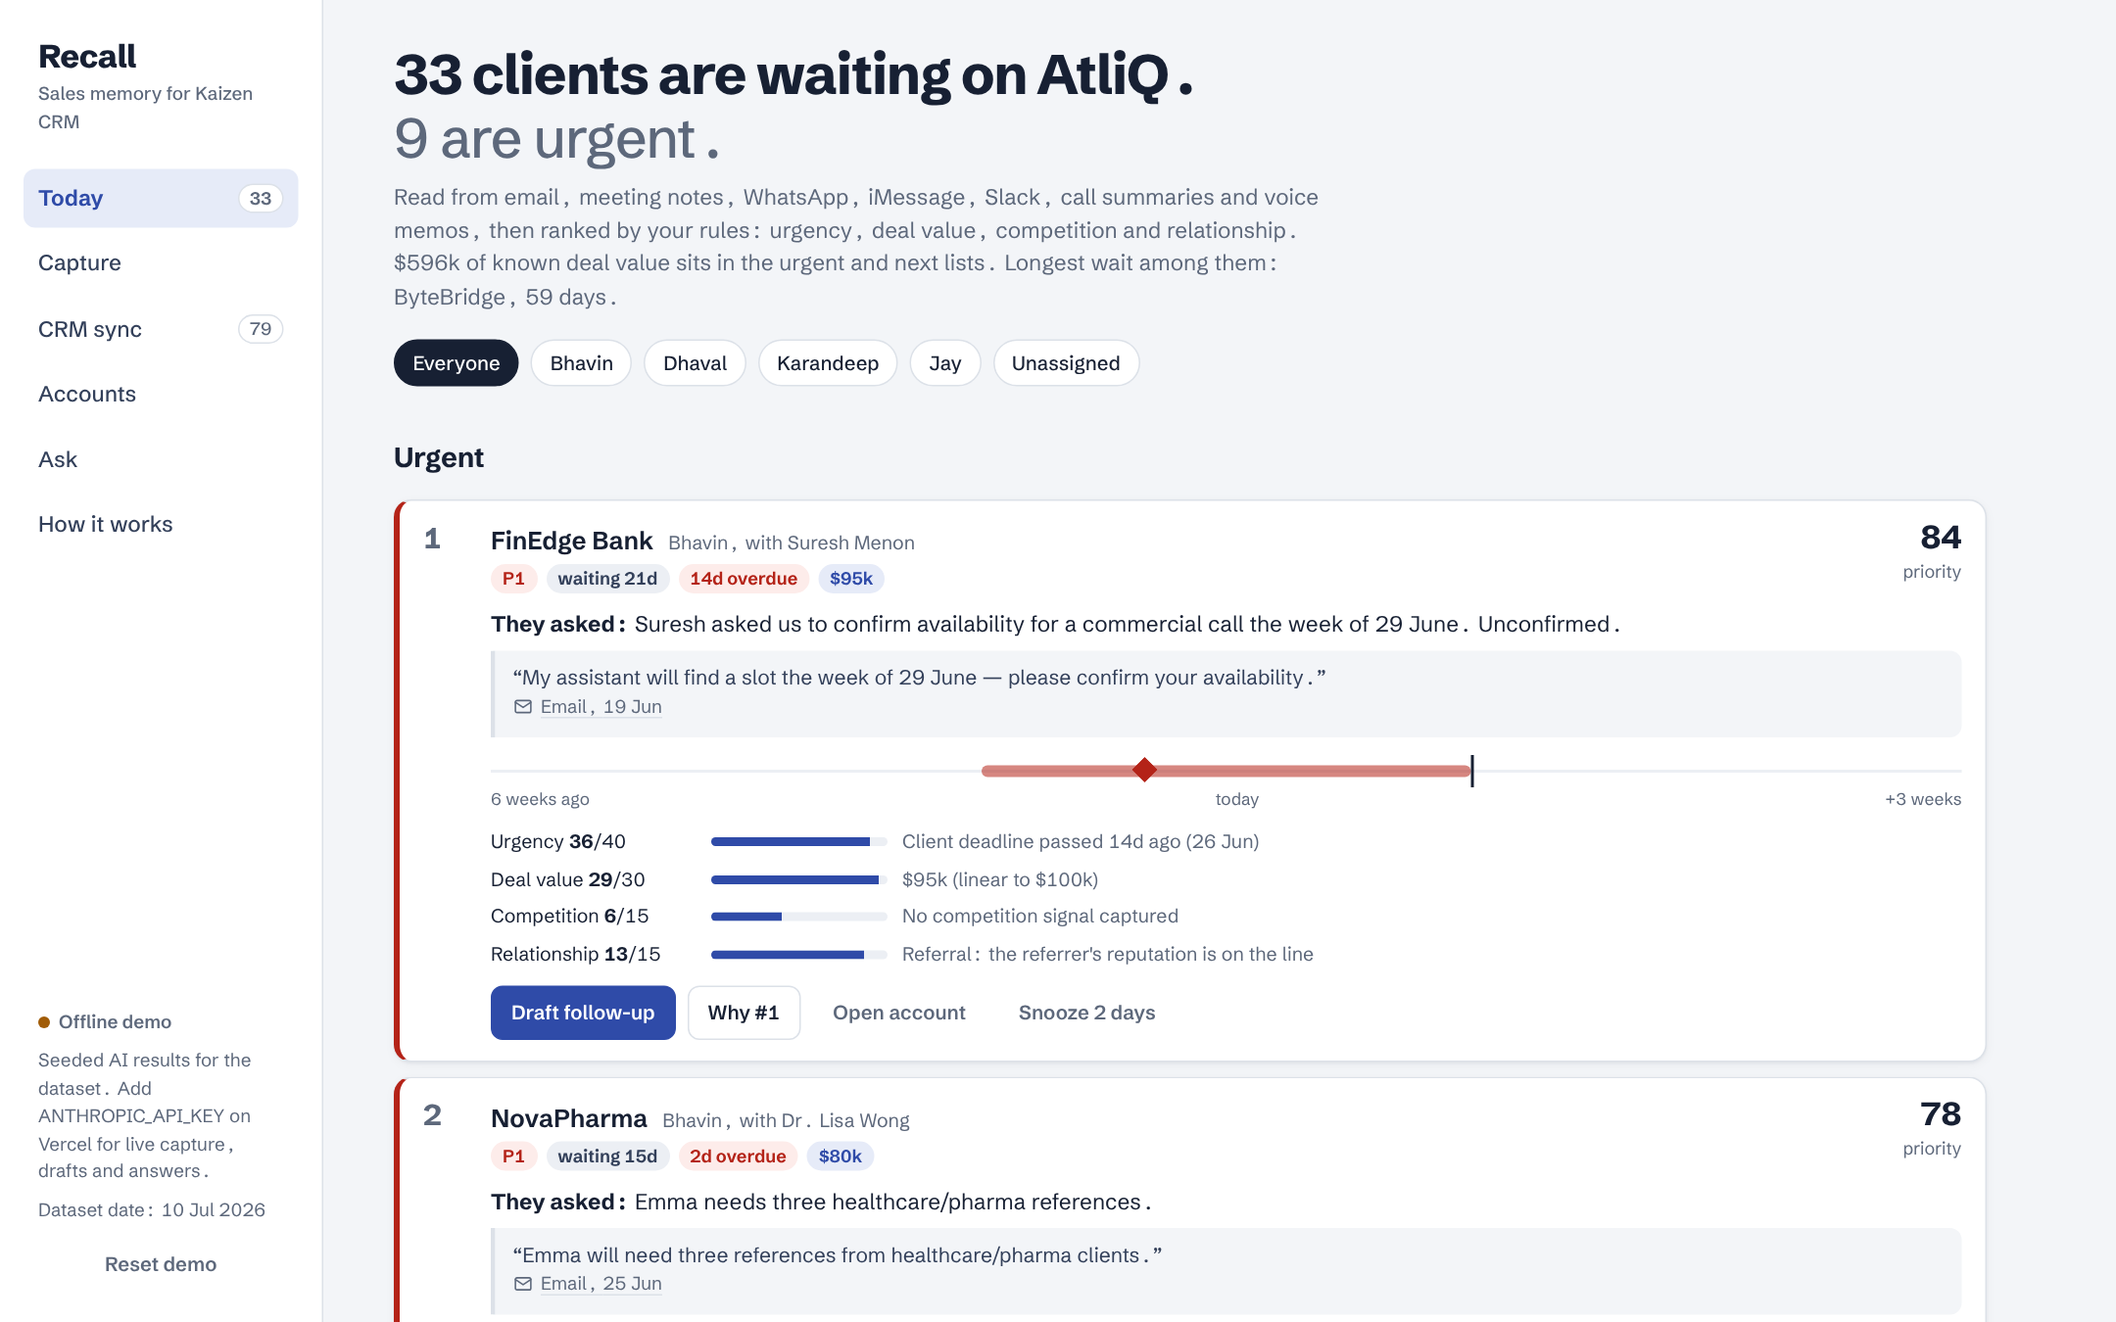
Today: who is waiting on you
Every client with an open ask or promise, ranked. Each line shows the client's exact words and the source.
The wait bar shows how long they've waited and where the deadline sits. "Why #1" opens the score.
FinEdge ranks first: deadline passed, $95k, a referral.
11
Notes:
In the demo: filter to Bhavin, then open the FinEdge draft. Show that the draft leaves the time slots as a bracket because Recall can't know his calendar.

Slide 12
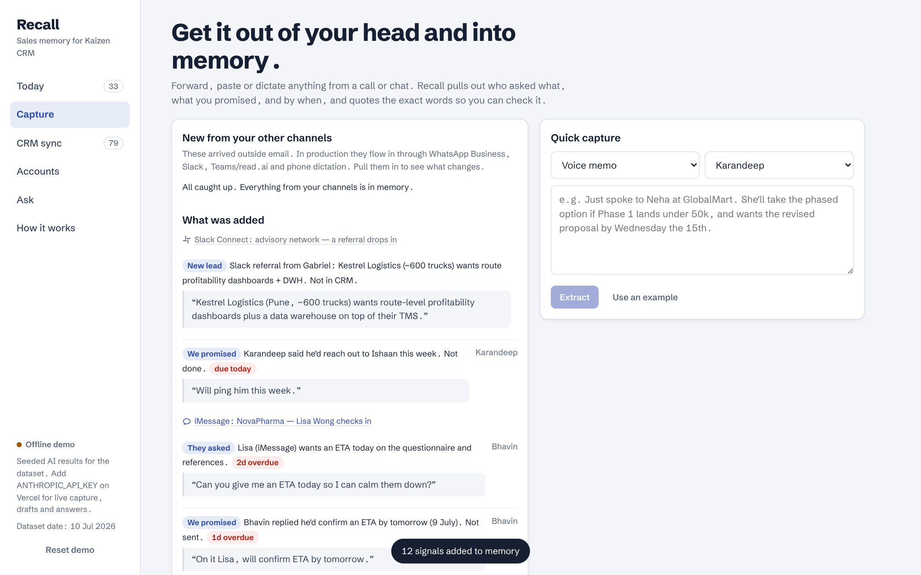
Capture: the on-the-go call, solved
A voice memo after a WhatsApp call, an iMessage, a Slack referral: pulled in, read, and turned into dated items with quotes.
Karandeep's drive-home memo moved VoltEnergy's TCO deadline to 14 July and logged LoopMart's budget.
12
Notes:
WhatsApp and FaceTime calls can't be recorded, so we don't try. A 30-second voice memo after the call is the capture path, and it costs nothing.

Slide 13
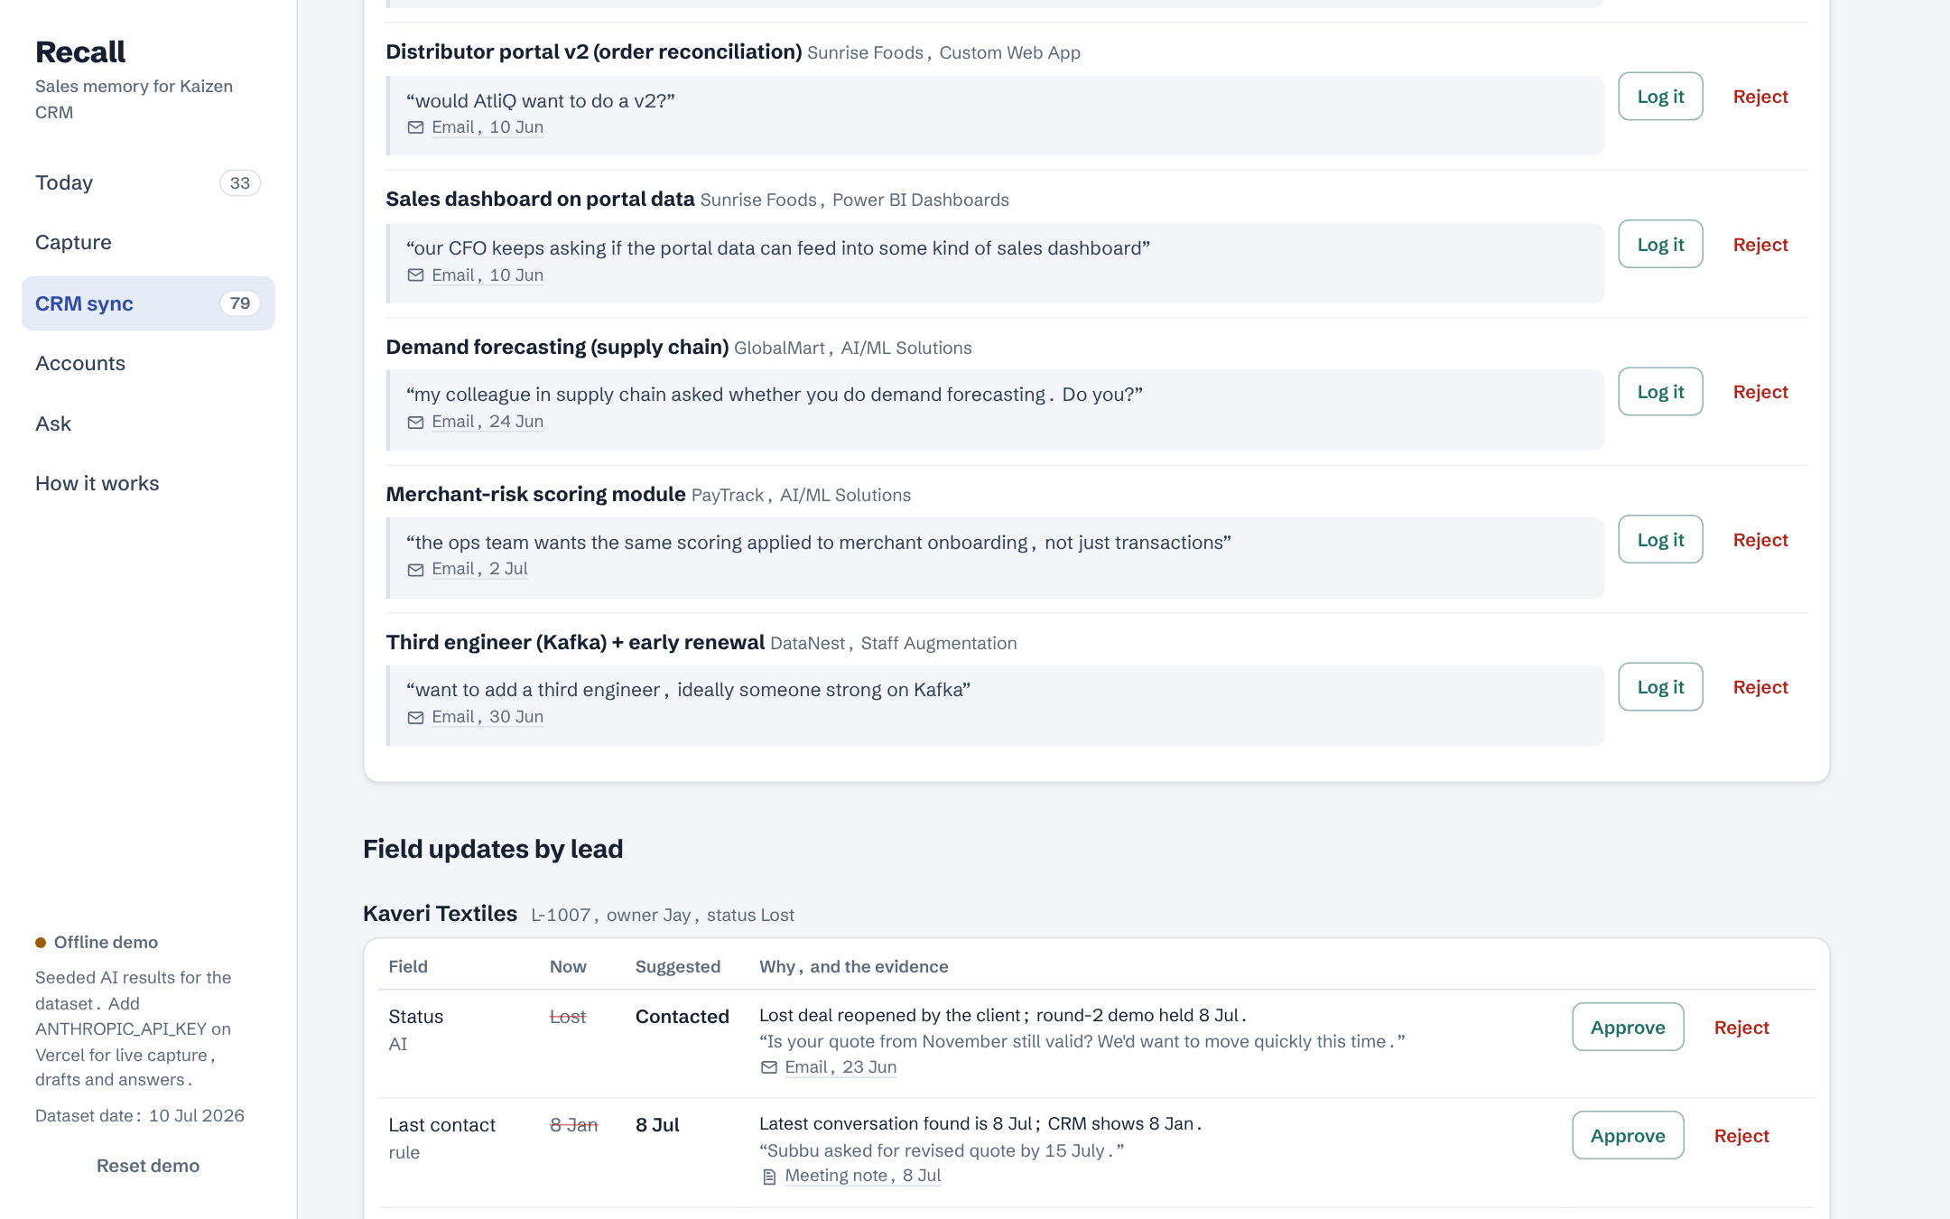
CRM sync: Kaizen kept honest
Every suggested change shows old value, new value, the reason and the client's words. Nothing is written until a person approves.
CRM up to date: 0% today, 97% after approving the suggestions. Plus 6 missing leads, 2 duplicates and 8 cross-sells.
13
Notes:
Kaveri is the example to show: the CRM says Lost, but the client wrote back after the cheaper vendor failed. Recall proposes reopening it, quoting his email. Export produces the updated CRM file and a change log.

Slide 14
The ranking is your gut, written down
40
30
15
15
Urgency
Deal value
Competition
Relationship
Client deadlines, days waiting, promises due
Linear to $100k; a bigger deal can outrank a sooner one
Close rival: act fast. Far cheaper rival: stop chasing
Existing clients and referrals protected
Test: the founders' own 7 July shortlist (FinEdge, NovaPharma, ShopSwift, Meridian, HealthFirst) lands at #1, #2, #8, #10 and #11 of 33. No model decides rank, so every rank can be explained.
Rules from client meeting 2: "cost, urgency, and the competition I'm feeling"
14
Notes:
SteelCore is the counter-example: a freelancer quoted under a third of our price, so by the CEO's own rule it drops to the 'gone quiet, consider closing' list instead of nagging him.

Slide 15

The AI does one narrow job. Rules and people do the rest
Channels
Small, fast model
Code, no model
Stronger model
A person
Messages, notes, memos
Quote check, rank, dates
Draft replies, answer questions
Sends, approves
Extract signals with quotes
The provider is one setting. The prototype on Vercel runs on Gemini's free tier (Flash-Lite to extract, Flash to write), which is fine because the dataset is synthetic. Production uses Claude Haiku and Sonnet on a paid tier that doesn't train on client data.
15
Notes:
Free-tier Gemini content may be used by Google to improve its products, so it is for synthetic data only. Haiku for extraction because it's high volume and schema-bound; the quote check in code makes the cheaper model safe. Sonnet only where a client will read the output or reasoning spans several conversations.

Slide 16
North Star: no client waits more than two days
% of client asks and AtliQ promises closed within 2 business days
under 20% to 90%
Layer | Metric | Target
Business outcome | Win rate on proposals; revenue from referrals, cross-sells, revived deals | +10 pts in 2 quarters
Output | Median days a client waits; CRM up to date | 15 to 2 days; 0% to 90%
Trust | Drafts sent; CRM suggestions approved | 60%+; 85%+
Guardrail | Ungrounded items, auto-sends, unapproved writes | Zero, always
16
Notes:
The North Star is the CEO's own definition of success. It measures the root cause directly, moves within weeks, and leads win rate and revenue, which are slower to move.

Slide 17
Risks, and the guardrail for each
Risk | Guardrail
AI invents an ask or a date | Quote or drop it: code checks every quote word for word; dates come from evidence
Wrong message reaches a client | Recall never sends; send stays blocked until every [gap] is filled by a person
CRM corrupted by automation | Approval per change; AI judgements never bulk-approved; change log
Deal stage changed too early | Won only on signature; Lost reopens only on the client's own words
Ranking nobody trusts | Plain rules with a visible breakdown; no demographic inputs
Privacy and consent | Minimum context per call; no covert recording; personal details not stored
17
Notes:
Kill switch: if any message is sent without a human, or any CRM write lacks an approval, capture and drafts switch off and the list goes read-only.

Slide 18
It works on AtliQ's data, for about $26 a month
152/152
33/33
$5.82
extracted quotes found word for word in their source
waiting clients found; 6/6 missing leads; 2/2 duplicates
AI cost per month at ~60 messages a day, plus $20 hosting
Gold labels come from the dataset's ground-truth notes, which the AI never sees. The seeded extraction was built with the whole dataset in view, so a live model run (about $0.02) is the gate before alpha. One saved $20k deal pays for 60+ years of running cost.
Pricing: Anthropic and Vercel pricing pages, checked 14 Oct 2026. Details in the cost estimation sheet
18
Notes:
Be upfront that the 100% numbers measure the engine, not an unseen model. That honesty is the point: the eval harness exists, and the live run is the first gate in the rollout.

Slide 19
Rollout: earn trust one gate at a time
By 28 Oct
16-27 Nov
December
Q1 2027
Live eval
Alpha: CEO
Beta: 4 sellers
Full release
Dataset + 50 real messages. Gate: recall 90%+
Gate: 8 of 10 daily top items right
Gate: North Star 70%+, zero incidents
Kaizen write-back. Gate: 90% for 4 weeks
What we need from you
An API key, access to 50 real messages for the eval, an hour a week from Karandeep in alpha, and a decision on how iMessage and personal WhatsApp should reach Recall.
19
Notes:
Close on the ask. And the reminder: this week alone, ShopSwift's SOW, HealthFirst's board, NovaPharma's questionnaire and Meridian's budget review are all live. That is the cost of waiting.

