Slide 1
Do We Really Know that the WTO increases Trade?
Andrew K. Rose
NBER and CEPR

Slide 2

Question
What is the effect of the multilateral system on international trade?
Answer
GATT and WTO have negligible effect
GSP has a large positive effect (doubles trade)

Slide 3
The Line
Answer to title question is negative:
We don’t really know the WTO increases (or the GATT increased) trade!

Slide 4

Technical Summary
  Use ordinary bilateral “gravity” model of trade
Also use aggregate data with same results
Large panel data set: annual data 1948-1999 for 178 “countries”
Find effects of GATT/WTO membership in one/both countries are economically small, often negative, statistically insignificant
  GSP does affect trade, so methodology/data not to blame
Robust results

Slide 5
Motivation
Many believe that trade is enhanced by multilateral system
  Part of reason why trade has grown faster than income?
WTO’s objective:
  “Its main function is to ensure that trade flows as smoothly, predictably and freely as possible.”

Slide 6
WTO quotations:
“… The achievements of the system are well worth celebrating. Since the General Agreement on Tariffs and Trade began operating from Geneva in 1948, world merchandise trade has increased 16 fold … world trade now grows roughly three times faster than merchandise output … this advance ranks among the great international economic achievements of the post-world war era …”
“The past 50 years have seen an exceptional growth in world trade. Merchandise exports grew on average by 6% annually. Total trade in 2000 was 22-times the level of 1950. GATT and the WTO have helped to create a strong and prosperous trading system contributing to unprecedented growth.”

Slide 7
Literature

Slide 8
Gravity Model
ln(X_{ijt}) = β₀ + β₁lnD_{ij} + β₂ln(Y_{i}Y_{j})_{t} + β₃ln(Y_{i}Y_{j}/Pop_{i}Pop_{j})_{t} + β₄Lang_{ij} + β₅Cont_{ij}
+ β₆Landl_{ij} + β₇Island_{ij} +β₈ln(Area_{i}Area_{j}) + β₉ComCol_{ij} + β₁₀CurCol_{ijt}
+ β₁₁Colony_{ij} + β₁₂ComNat_{ij} + β₁₃CU_{ijt} + β₁₄FTA_{ijt,} + Σ_{t}φ_{t}T_{t}
+ γ₁Bothin_{ijt} + γ₂Onein_{ijt} + γ₃GSP_{ijt} + ε_{ijt}
where i and j denotes trading partners, t denotes time.
Estimation: OLS with year effects, robust standard errors
Parameters of Interest: γ₁, γ₂, and γ₃

Slide 9
Data Set
Trade data from IMF’s Direction of Trade
  Real US $
  178 trading entities, most global trade covered
  1948-1999 (with gaps)
  Average (4 measures of) bilateral exports and imports
PWT, WDI, IFS for population, GDP
CIA’s website

Slide 10
Multilateral Data
WTO website for GATT/WTO accession
Began in 1948 (covered 32 entities)
  1960: 50 “contracting parties”
  1970: 90c
  1990: 112
  Now: 158 with 29 “observers”
GSP bilateral preferences from UN’s Operation and Effects of the Generalized System of Preferences
  Interpolate from 1974, 1979, 1984 (data imperfect)

Slide 11
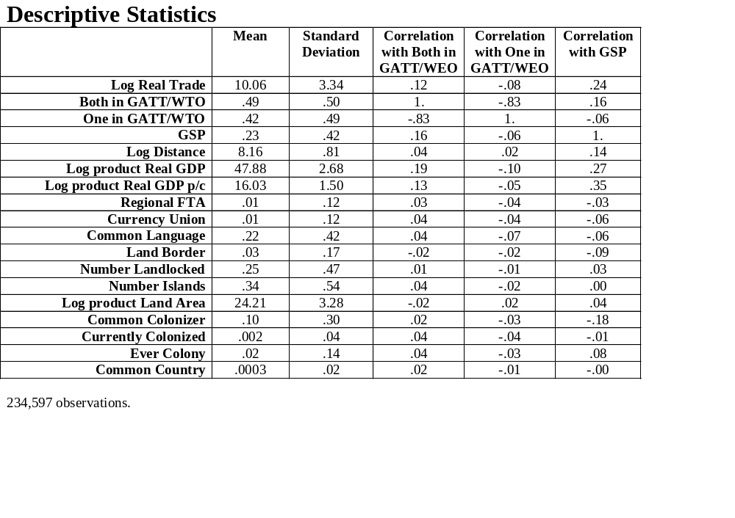

Slide 12
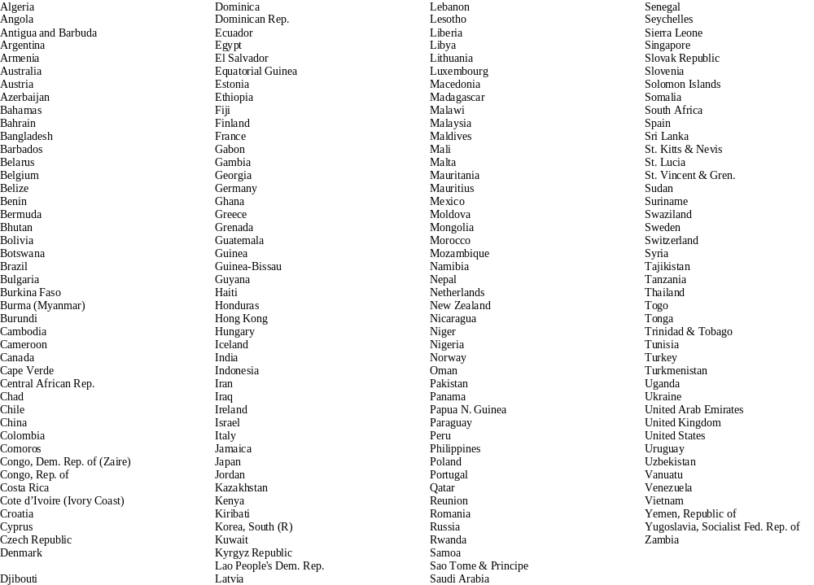

Slide 13
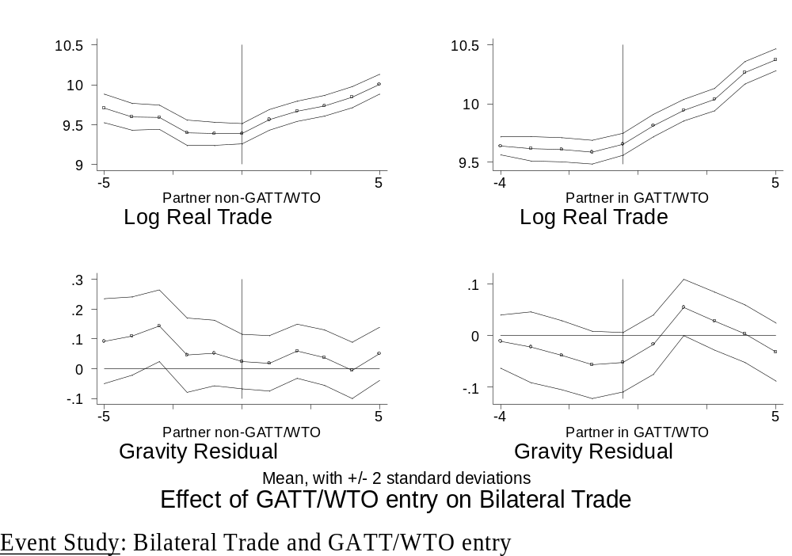

Slide 14
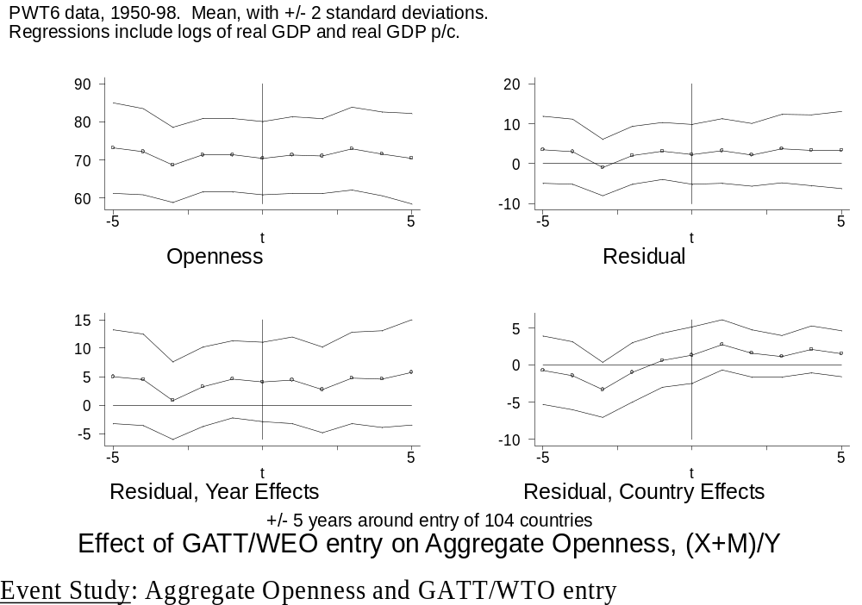

Slide 15
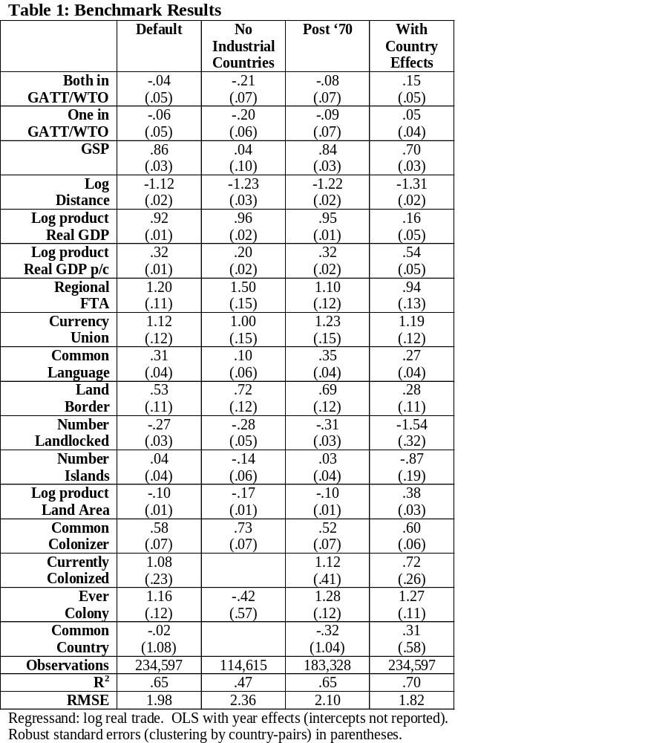
Notes:
Model works well
GATT/WTO membership has small effects
GSP has big effect
Robustness

Slide 16
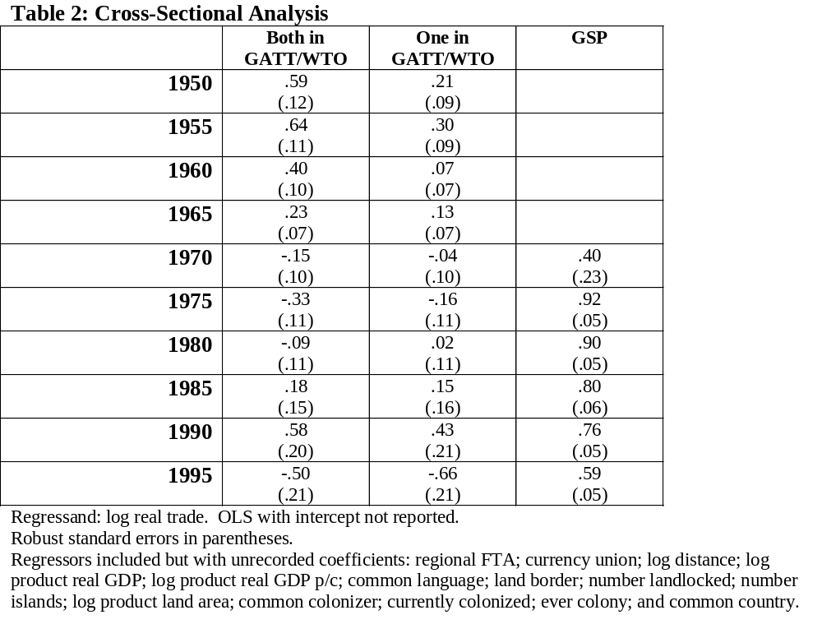

Slide 17
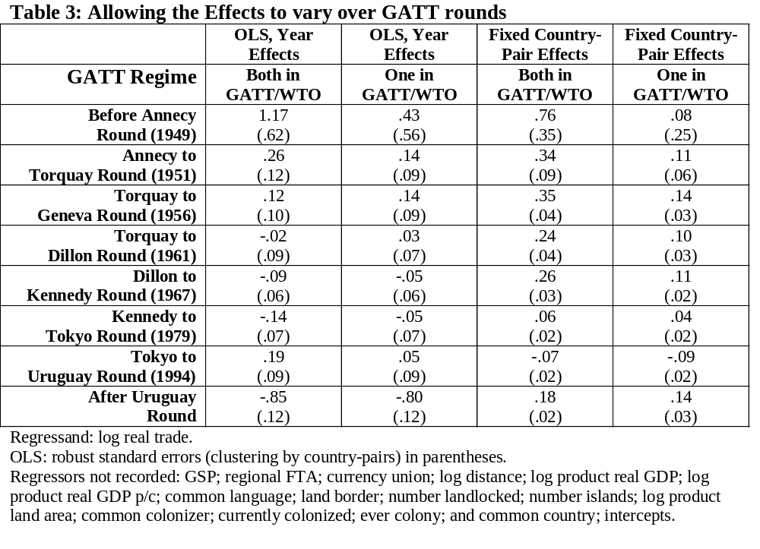

Slide 18
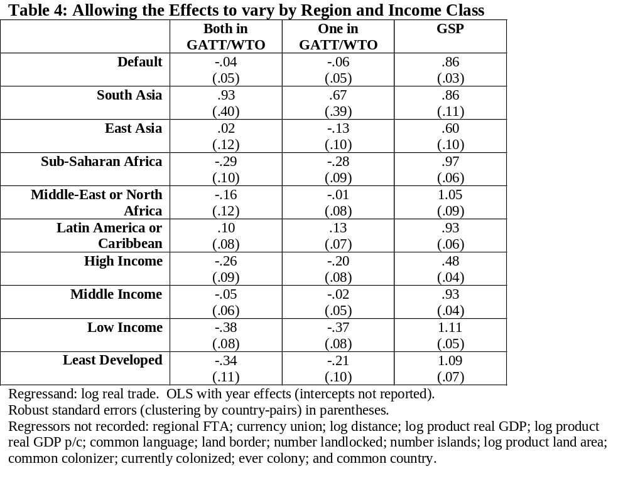

Slide 19
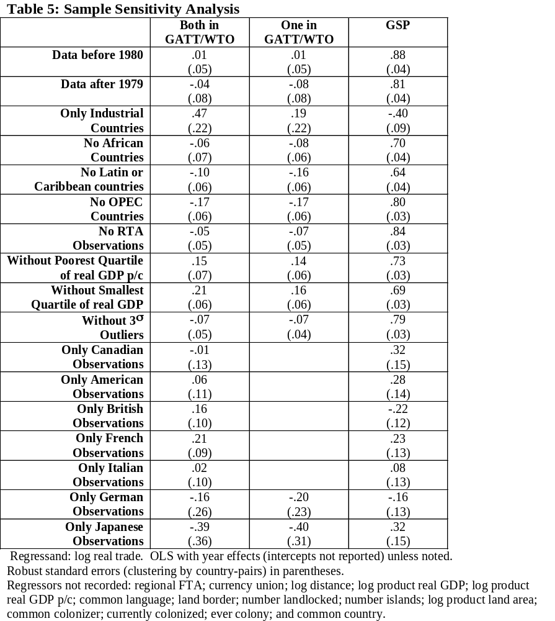

Slide 20
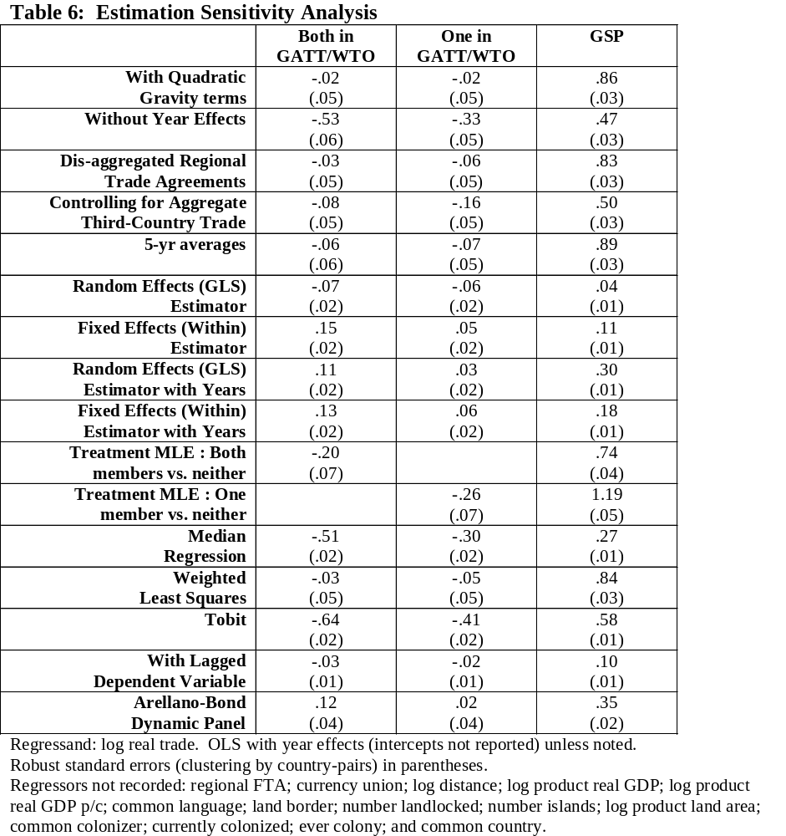

Slide 21
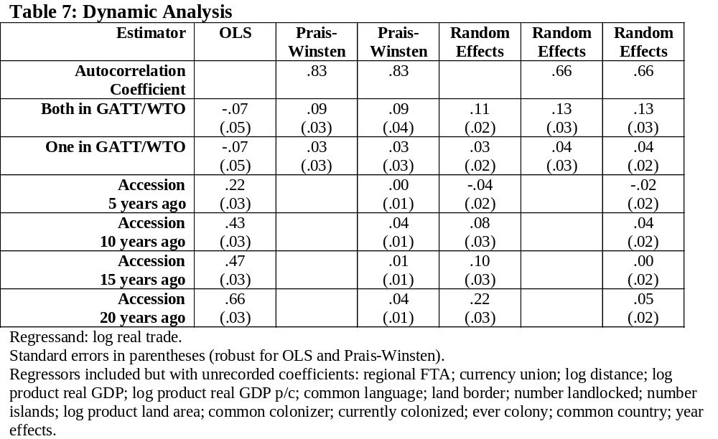

Slide 22
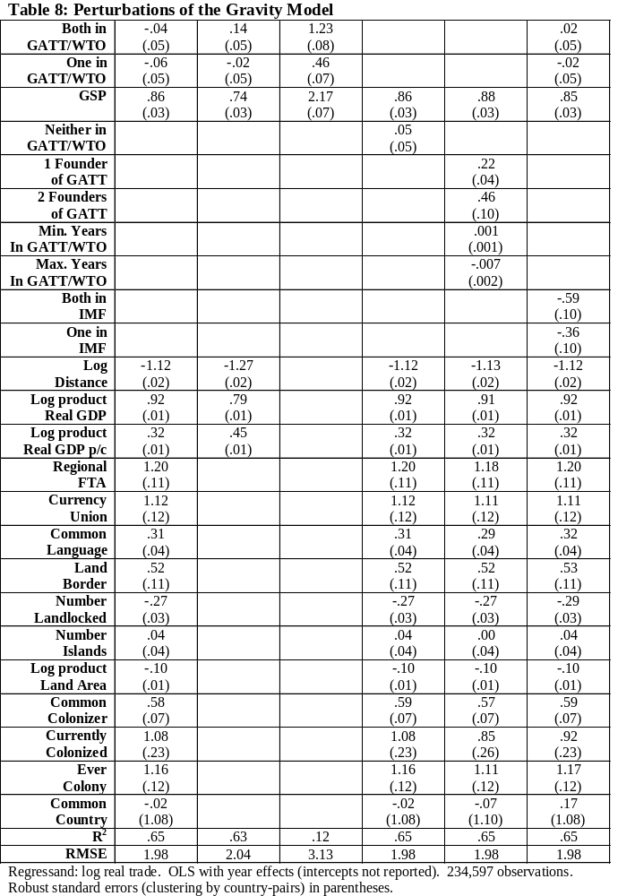

Slide 23
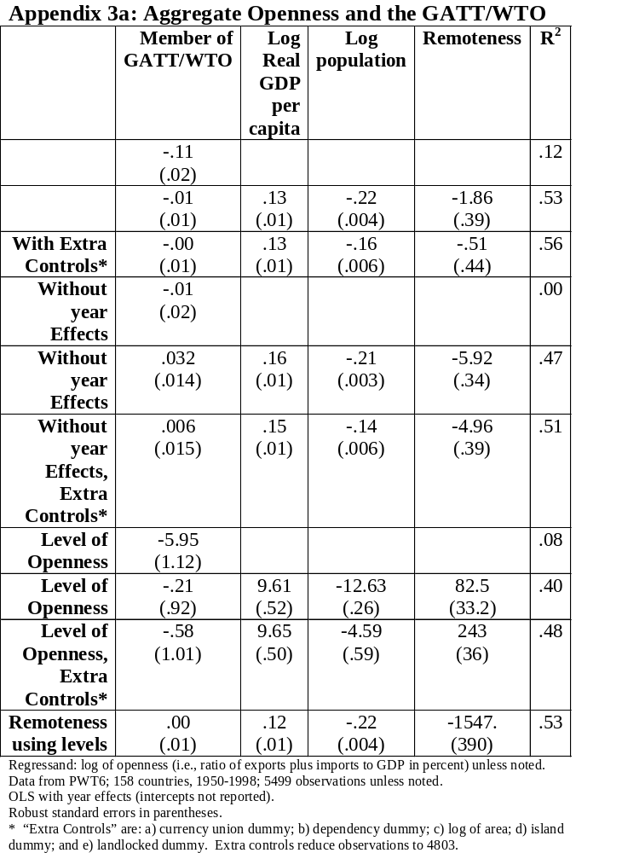

Slide 24
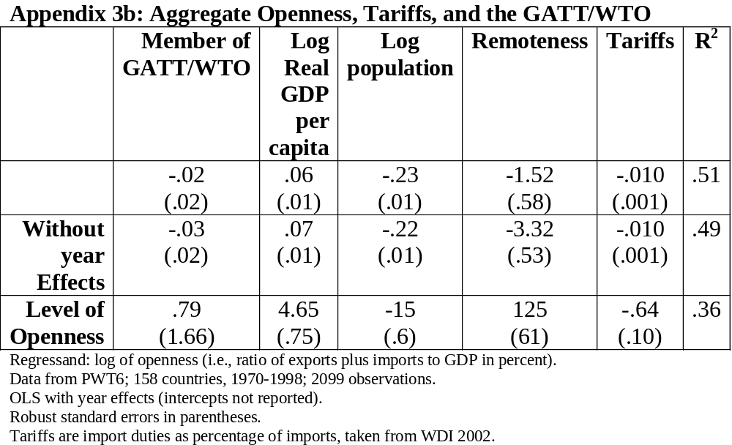

Slide 25
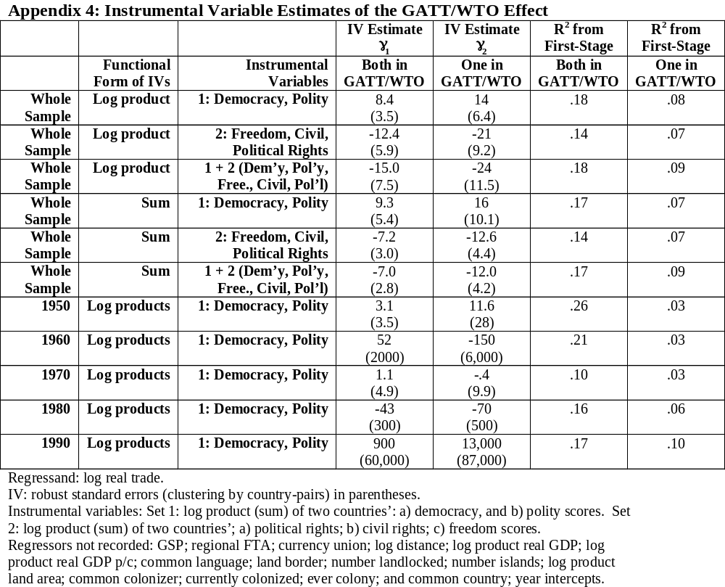

Slide 26
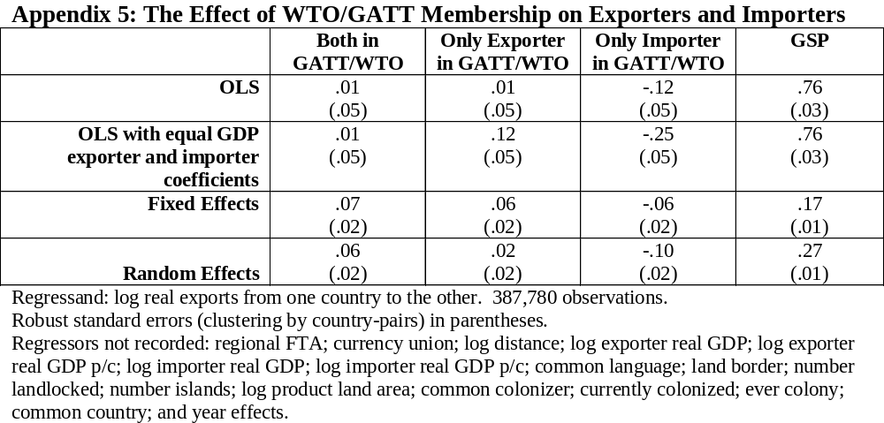

Slide 27
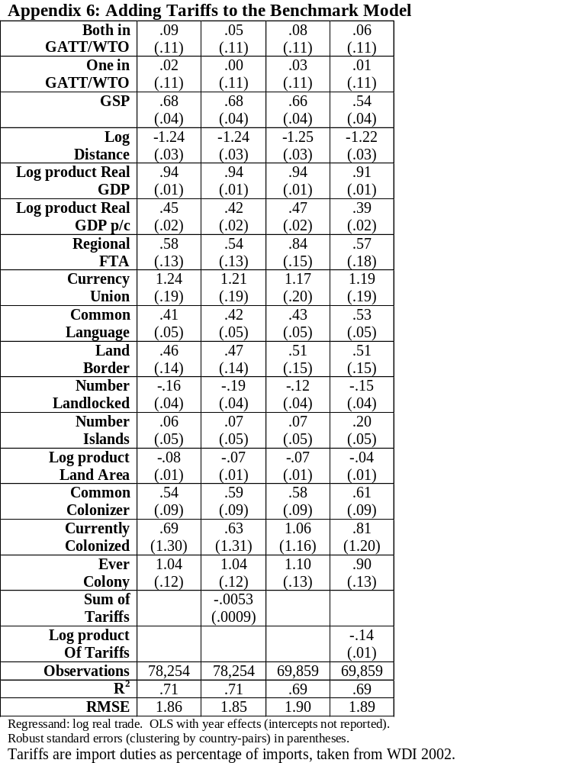

Slide 28
Appendix 7: Other Measures of Trade Policy in the Benchmark Model
Appendix 7: Other Measures of Trade Policy
Both in GATT/WTO
-.39
(.14)
-.76
(.14)
-.46
(.13)
.11
(.20)
.15
(.20)
-.10
(.12)
-.09
(.12)
One in GATT/WTO
-.55
(.14)
-.77
(.14)
-.57
(.14)
-.12
(.16)
-.14
(.15)
-.16
(.11)
-.15
(.11)
GSP
.52
(.04)
.46
(.03)
.48
(.04)
N/a
N/a
.10
(.11)
.12
(.11)
Sum of Economic Freedom Indices
-.76
(.03)
Sum of IEF Trade Policy sub-indices
-.23
(.01)
Sum of Dollar’s Price Distortions
1.52
(.35)
Sum of Black Market Premia
-.11
(.04)
Observations
21,935
21,935
21,935
7,412
7,412
26,912
26,912
Regressand: log real trade. OLS with year effects (intercepts not reported).
Robust standard errors (clustering by country-pairs) in parentheses.
Regressors not recorded: regional FTA; currency union; log distance; log product real GDP; log product real GDP p/c; common language; land border; number landlocked; number islands; log product land area; common colonizer; currently colonized; ever colony; and common country.

Slide 29
More Technical Issues
Reverse Causality biases coefficients up
Little measurement error with respect to accession dates
Little evidence of trade diversion (or creation!)
Missing trade data: Heckman’s “treatment methodology”
  Also missing output: possibly more serious

Slide 30
Summary of Different Estimates
80 estimates of γ₁
Mean: .05
Median: .02
39 negative
4 greater than .69 (doubling)
  1 w/o gravity, other 3 insignificant at .01
71% t-statistics<2.5

Slide 31
Why Has Trade Grown Faster than Income if not GATT?
Different question but possibly:
  Higher productivity in tradables
  Falling transport costs
  Regional trade associations
  Converging tastes
  Changing factor endowments
  Growing liquidity

