Slide 1
HAVOIPOWERPOINT
RC Project
장건수 진홍엽

Slide 2
HAVOIPOWERPOINT
INDEX
1.
구성도
2.
WEB
3.
GUI
4.
네번째 목차를 적으시오.

Slide 3
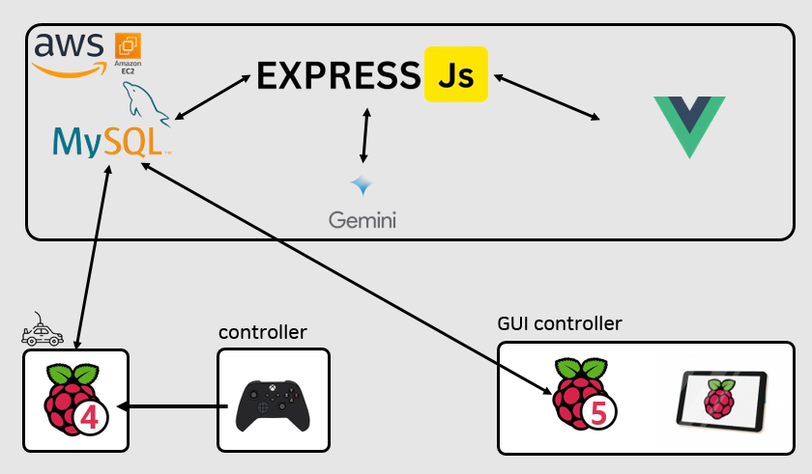
HAVOIPOWERPOINT
구성도

Slide 4

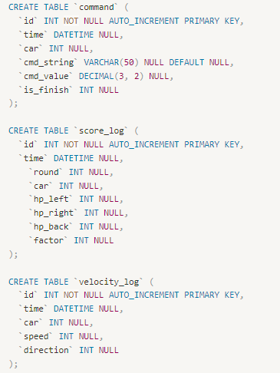
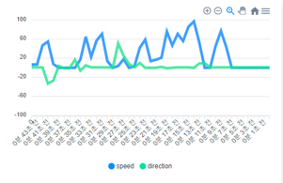

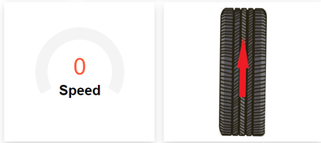
HAVOIPOWERPOINT

Slide 5




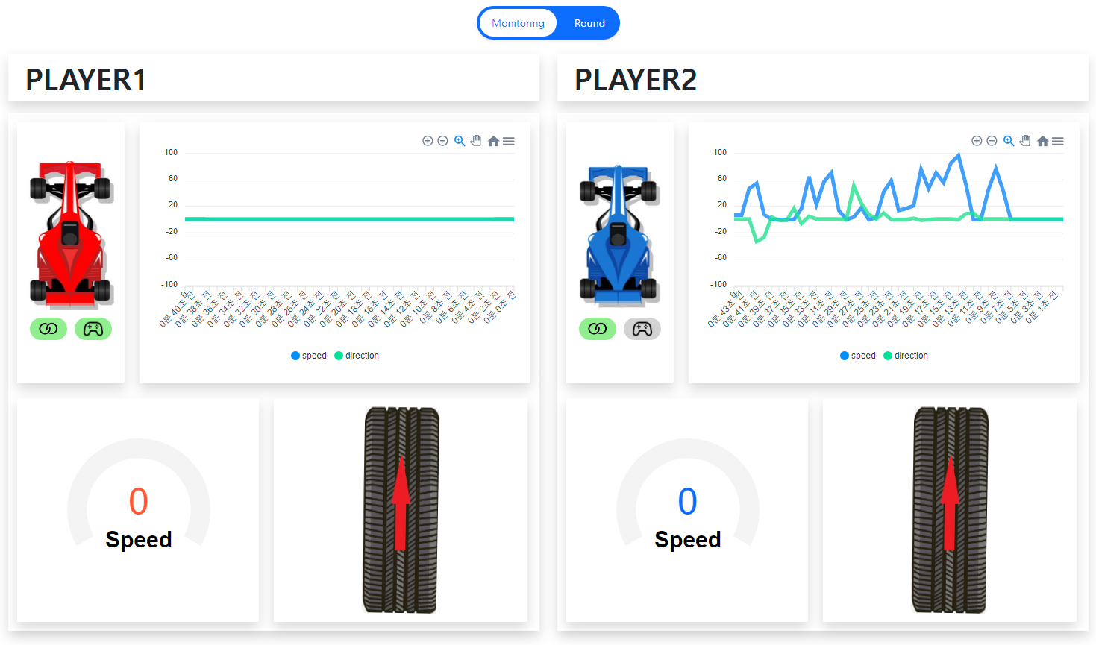

HAVOIPOWERPOINT
WEB
ApexChart

Slide 6
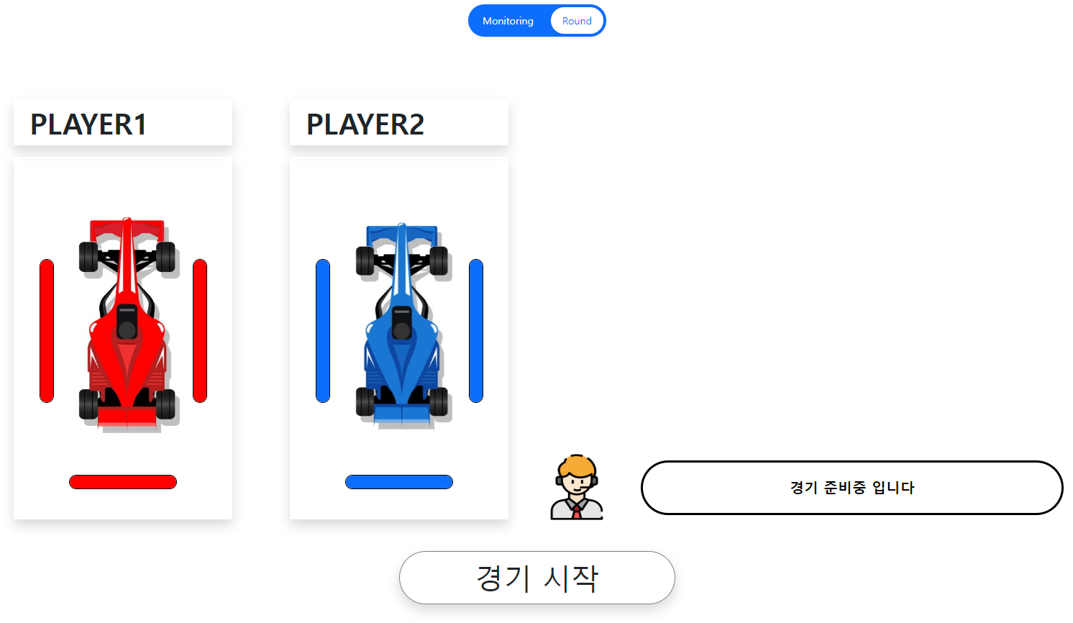

HAVOIPOWERPOINT
WEB

Slide 7

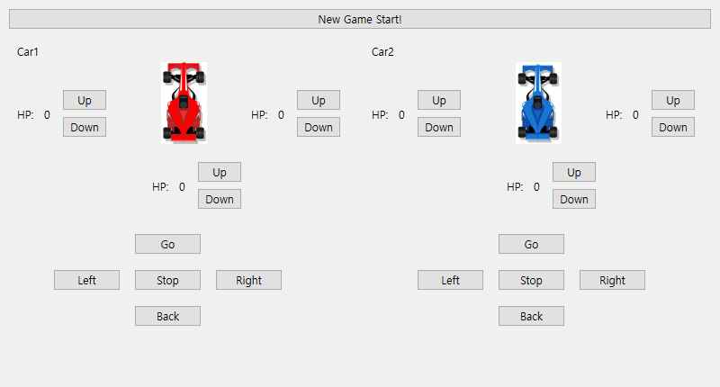
HAVOIPOWERPOINT
GUI

Slide 8
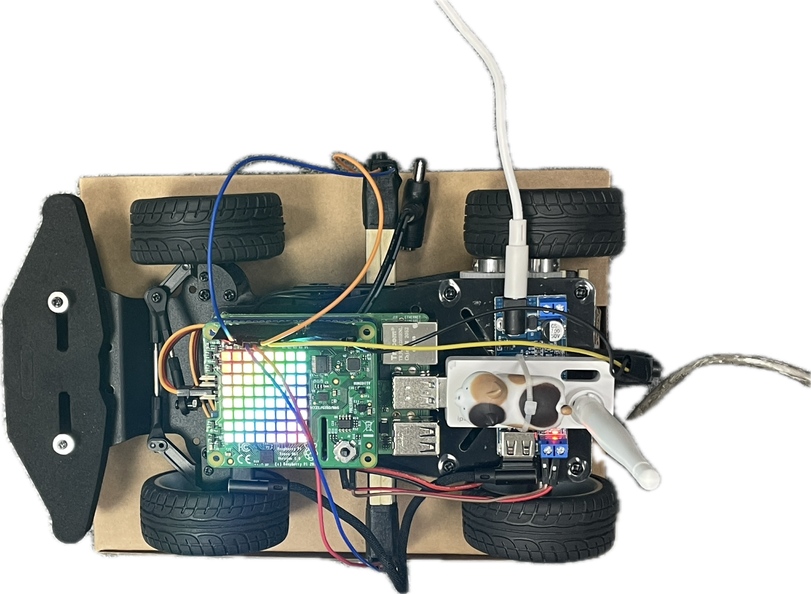

HAVOIPOWERPOINT
RC car
차량 정보
DB UPDATE
Button
Interrupt
Xbox controller
- evdev
차량 움직임

Slide 9
HAVOIPOWERPOINT
감사합니다 : )

