Slide 1
Wellbore Geology Prediction

Slide 2
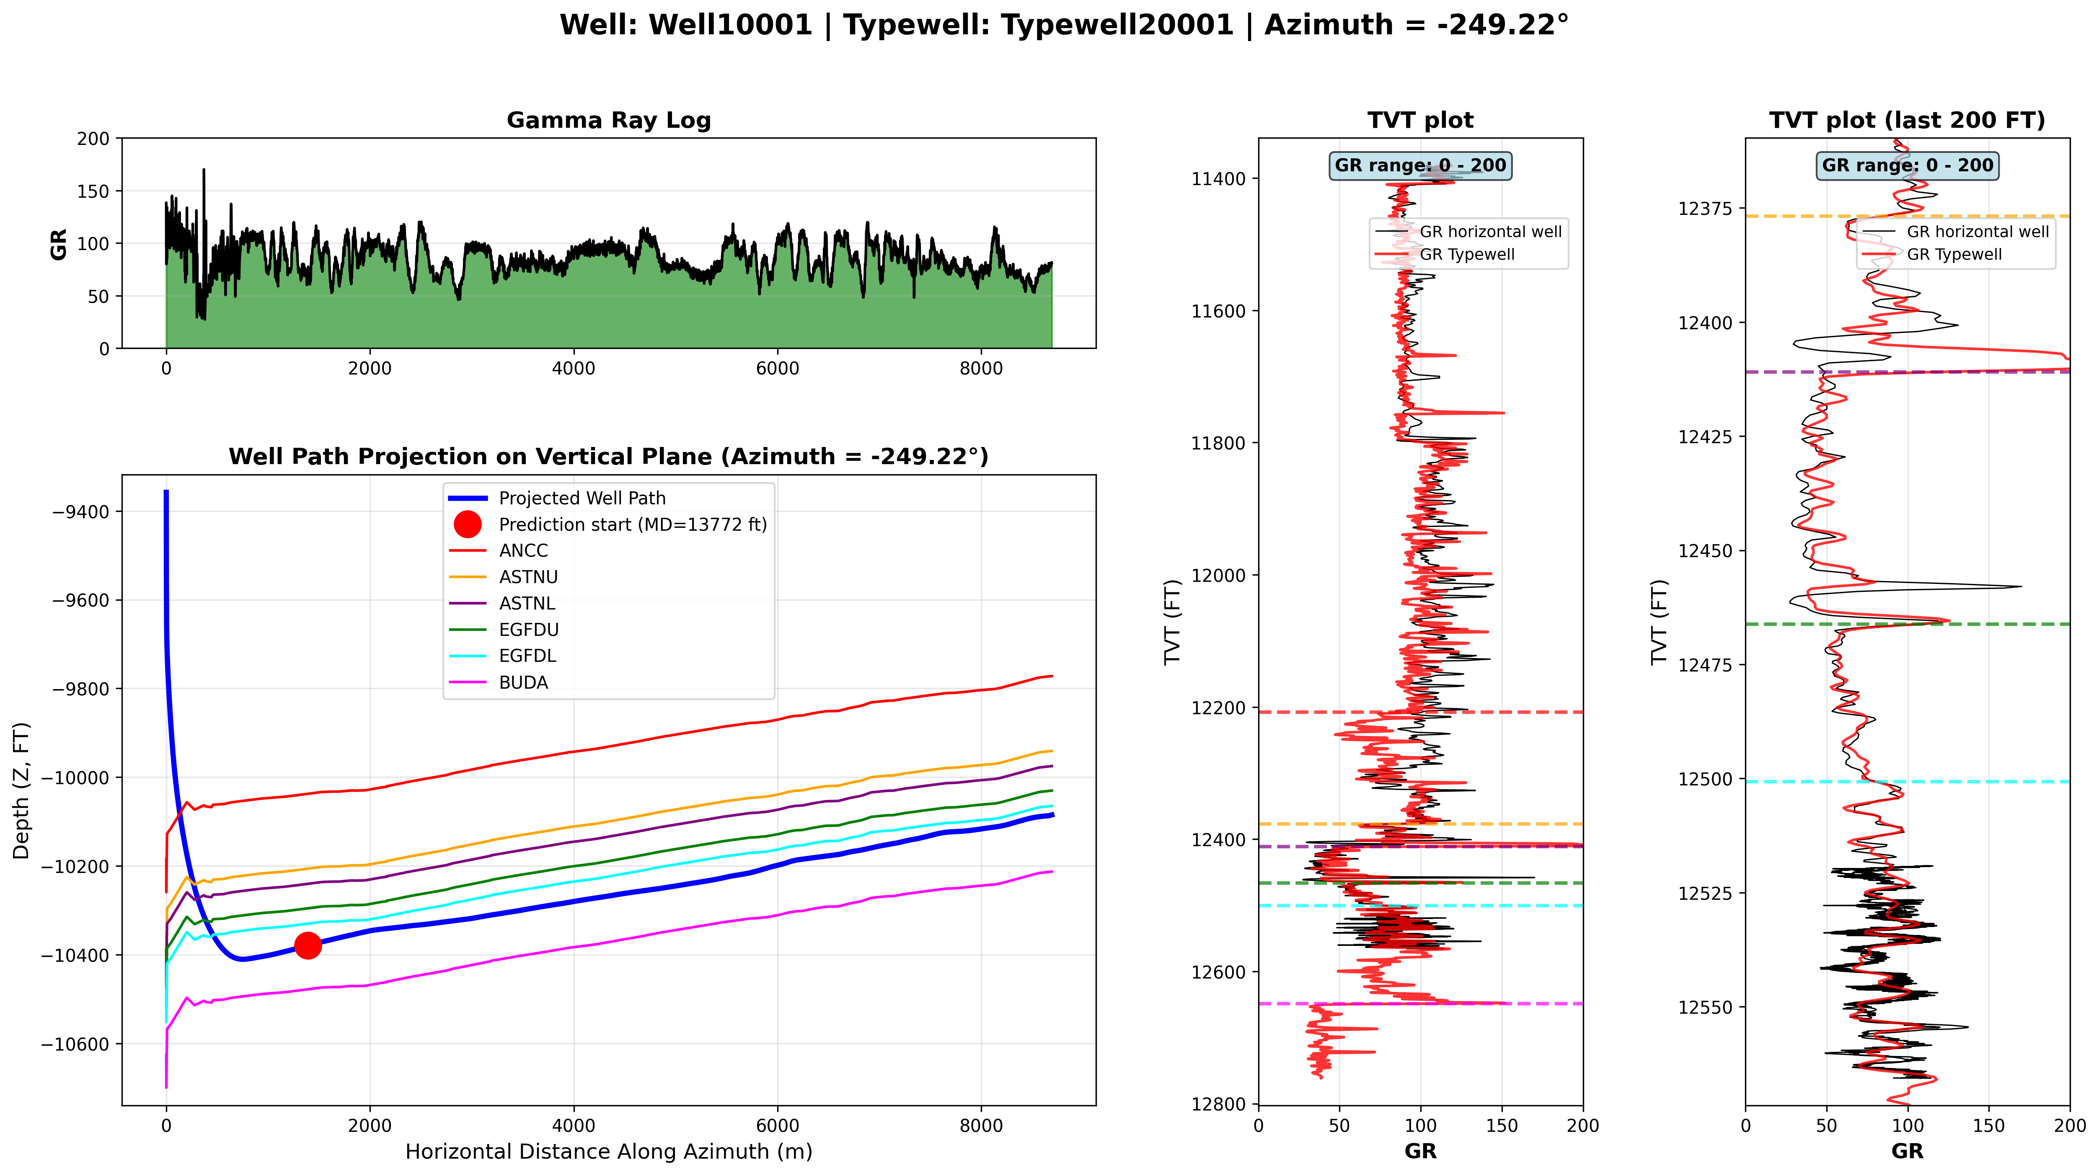
Data Available
Zoomed in TVT plot
Each well has two CSV files:
Well1XXXX__horizontal_well.csv – horizontal well data
Well1XXXX__typewell__Typewell2XXXX.csv – Typewell (vertical well data)

Slide 3
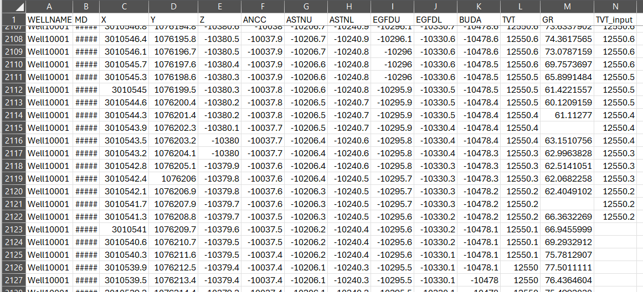
Horizontal Well Data
Well10001__horizontal_well.csv file
TVT (geology of the wellbore) must be predicted. This value is provided only for the training dataset
Top depth of each geological formation (provided only in the training dataset)
Provided for training and for prediction
Units: feet
MD – measured depth (well length)
XYZ – coordinates of each point of the well
GR – GR – gamma ray values measured at each point of the horizontal well (some values may be NaN)
TVT – geology values (see next slide)
TVT_input – same geology values available until the Prediction Start (PS) point

Slide 4
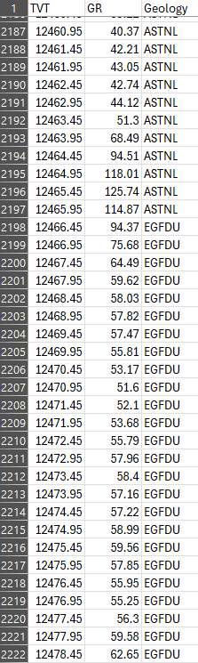
Vertical (Typewell) Well Data
Well10001__typewell__Typewell20001.csv file
Typewell assigned to Horizontal well
Each horizontal well is assigned one typewell
Units: feet
TVT – true vertical thickness (depth in the vertical well)
GR – Gamma Ray Values measured at each point of the vertical well
Geology – name of geological layer

Slide 5
Goal: get TVT values from GR data
TVT value for typewell (vertical well) is always known
TVT values for the horizontal well are known until the Prediction Start (PS) point
The goal is to calculate TVT values beyond the PS point using XYZ and GR from the horizontal well and TVT and GR from the typewell

Slide 6
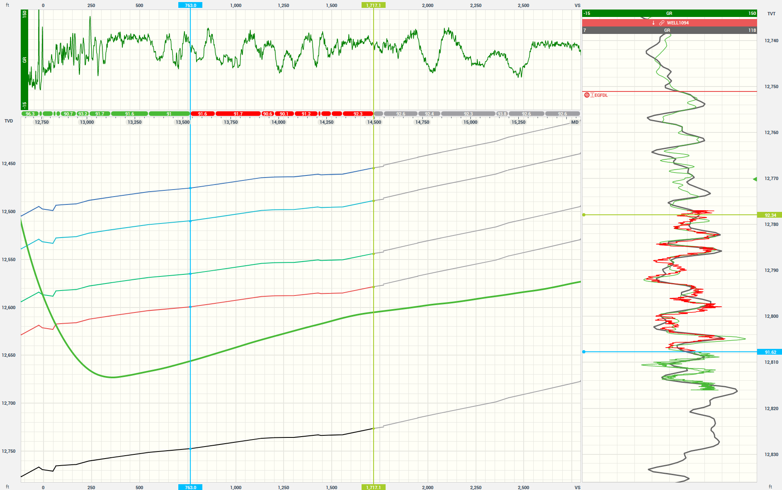
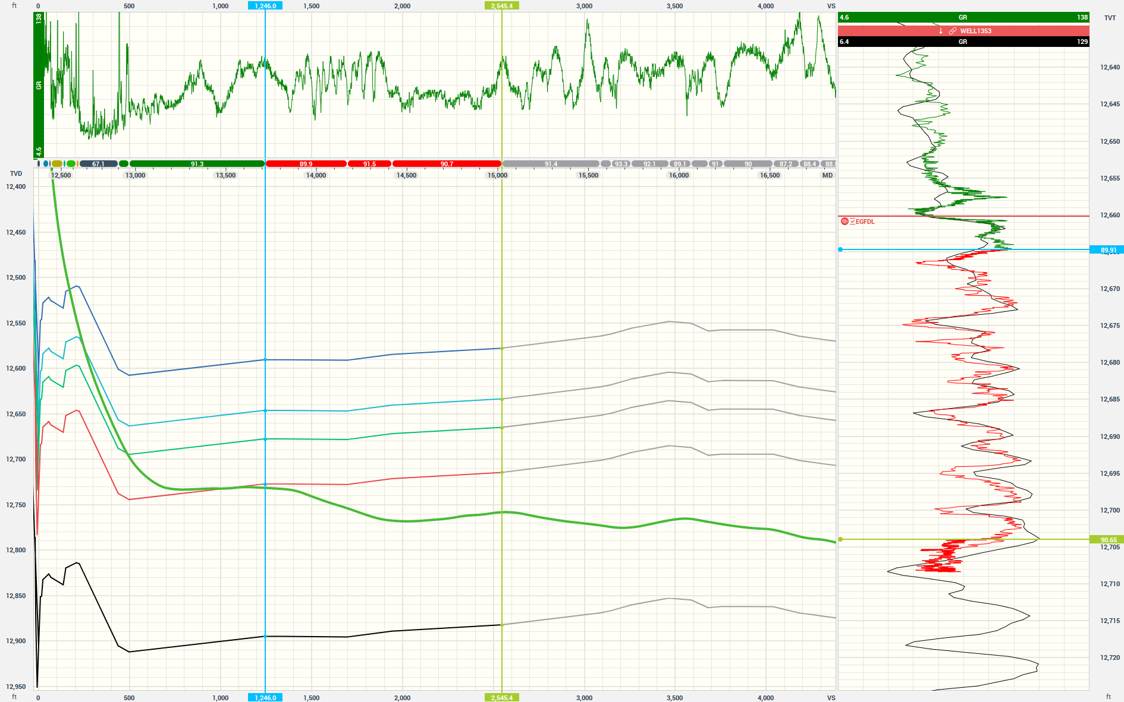
Goal: get TVT values from GR data
Gamma Ray (GR)
GR projected on TVT track
GR signature matches Typewell GR
TVT is decreasing
TVT is decreasing
GR projected on TVT track
GR signature matches Typewell GR
TVT is increasing
TVT is increasing

Slide 7
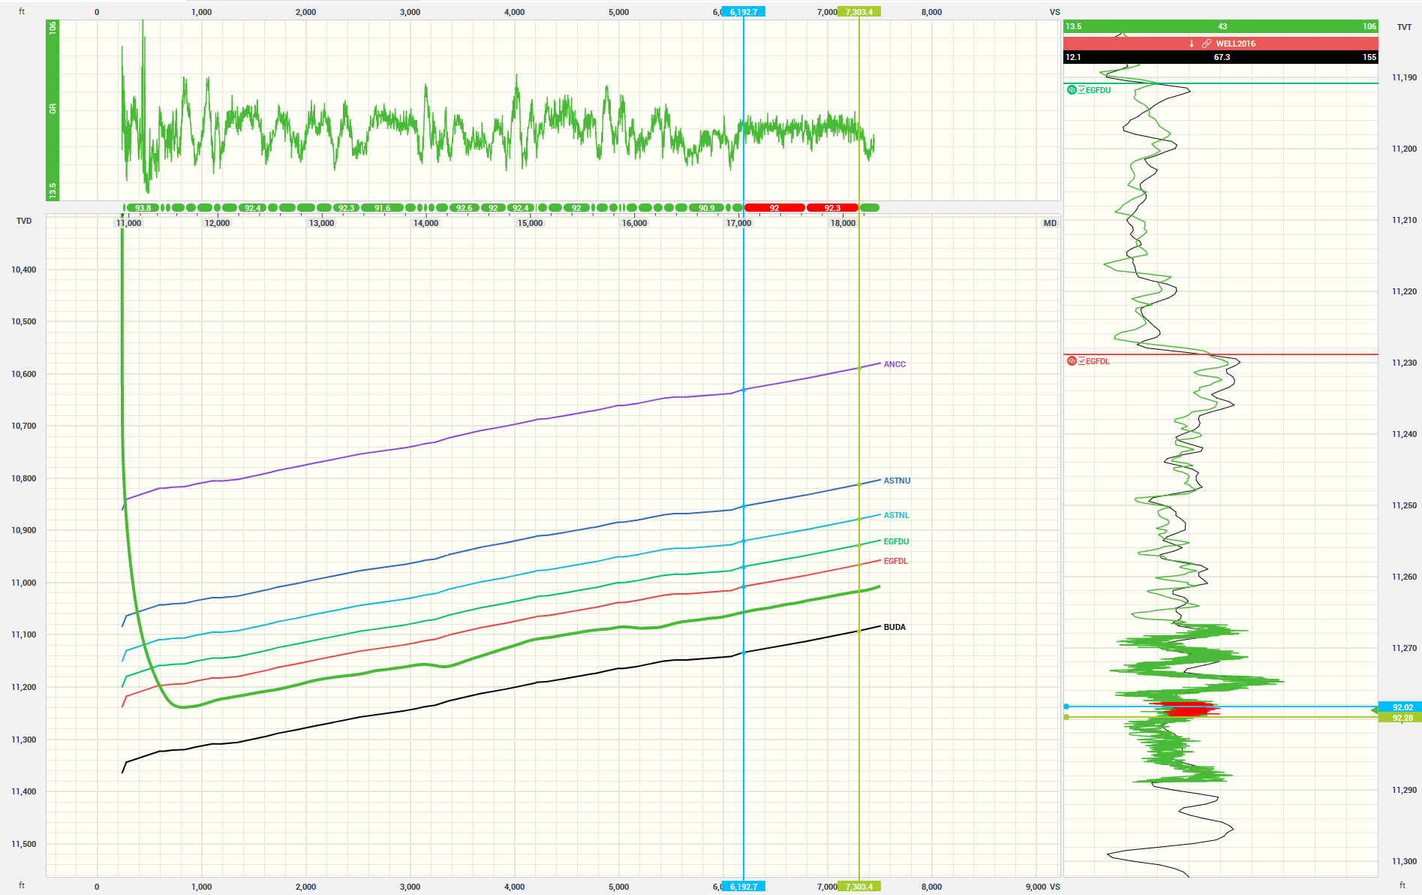
Goal: get TVT values from GR data
TVT constant
TVT decr
TVT incr
GR projected on TVT track
GR signature is constant
TVT is constant

Slide 8
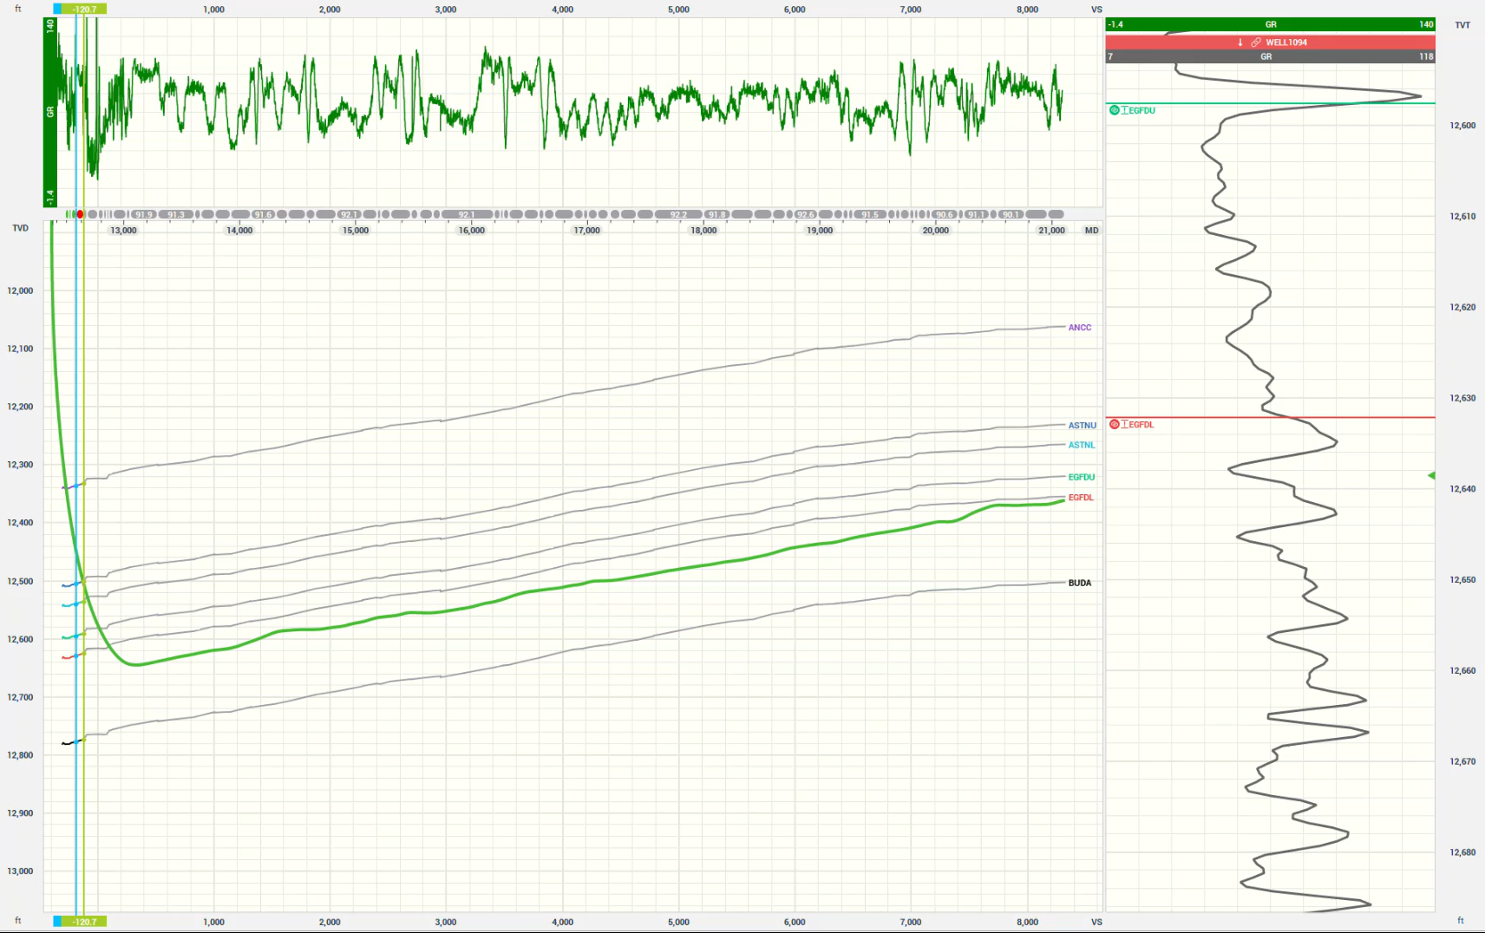
Understanding TVT from Gamma Ray data
TVT scale
VIDEO: GR behavior helps us understand the TVT (geology) along each portion of the horizontal well

Slide 9
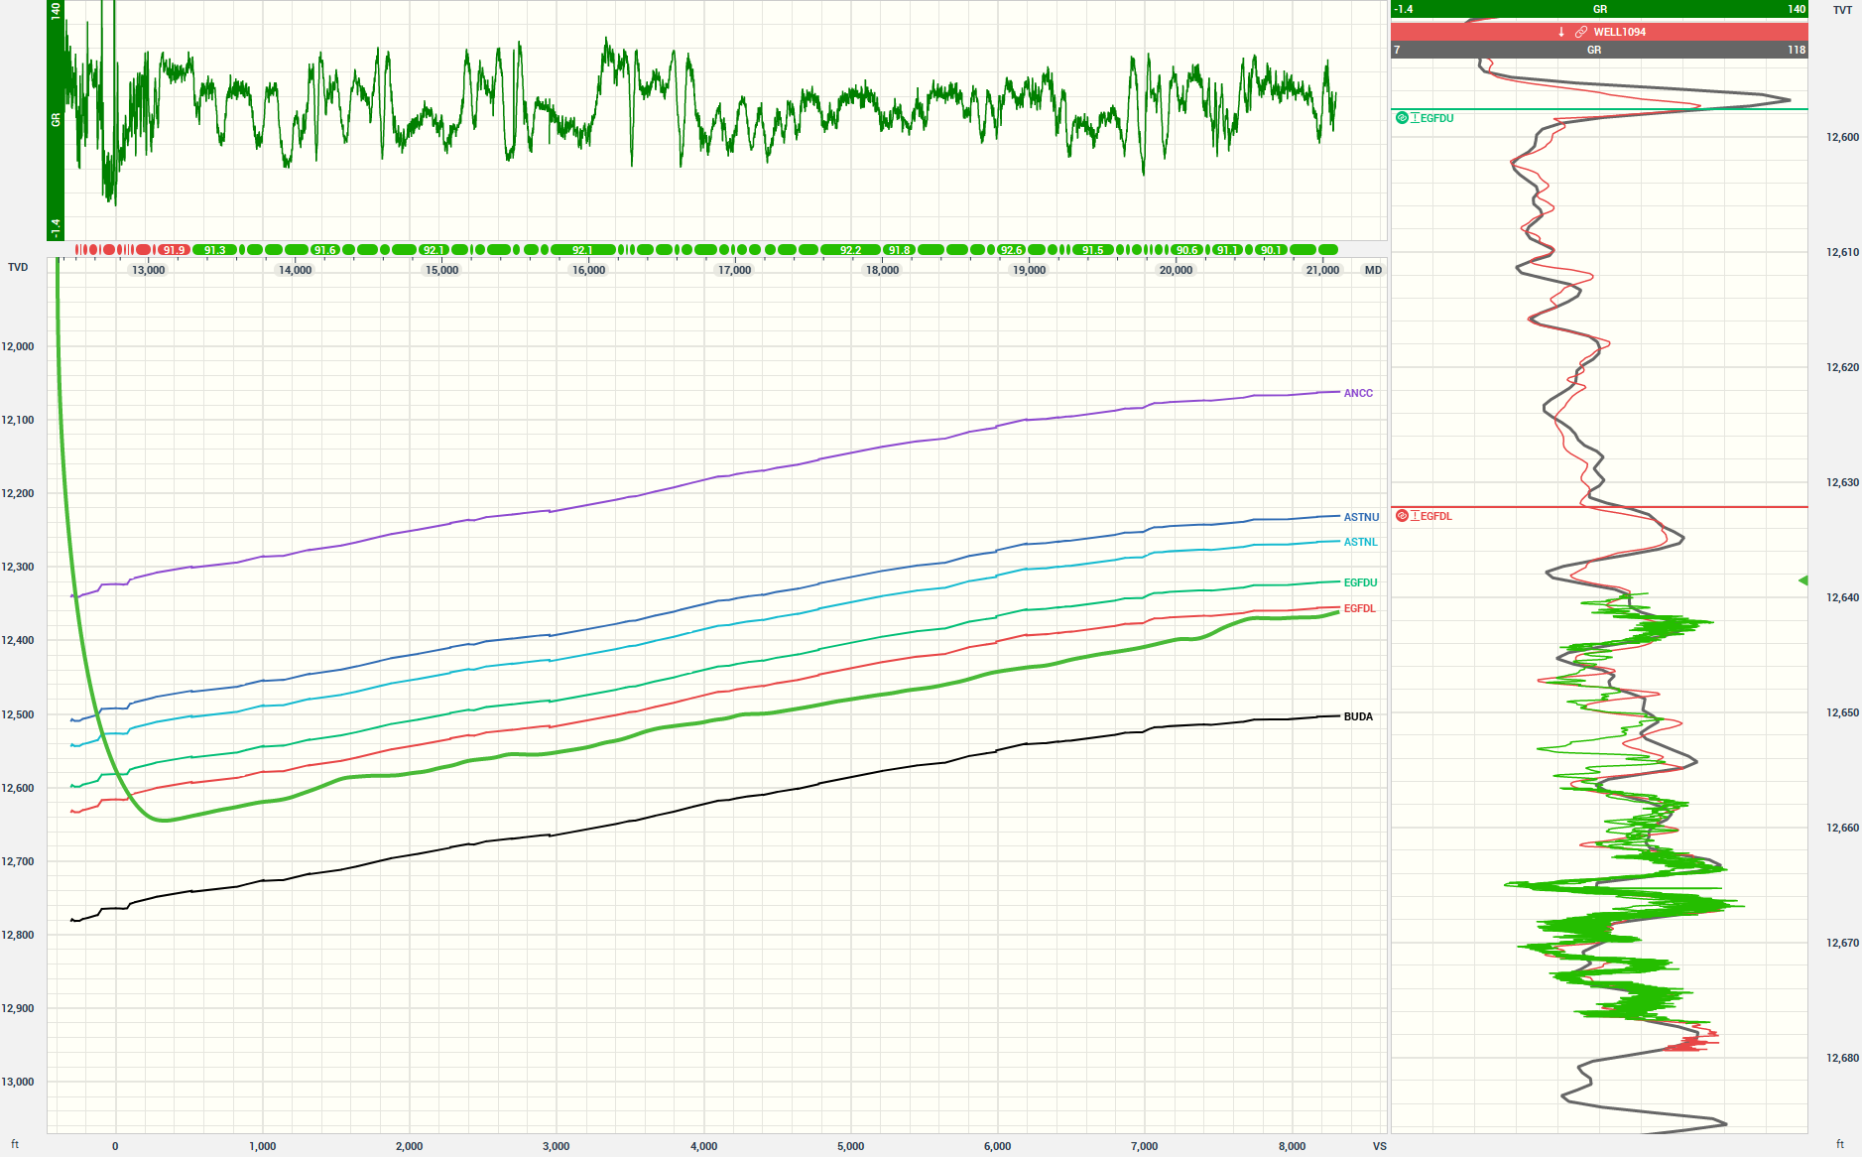
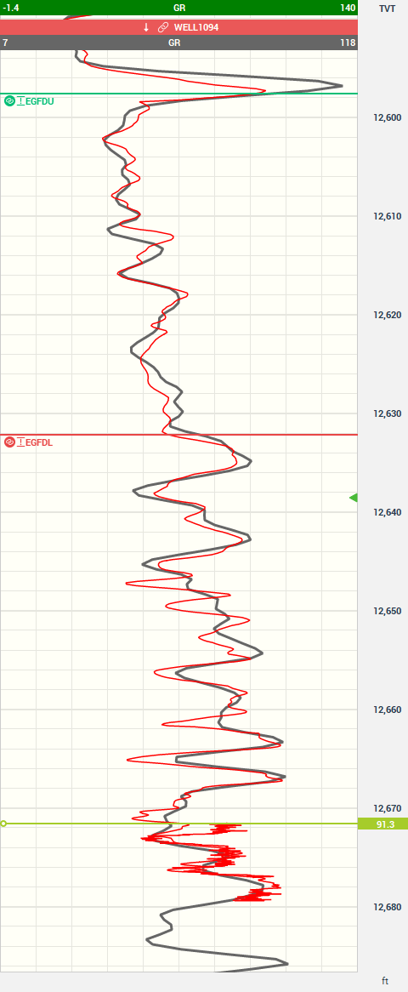
Gamma ray in the horizontal well has better resolution
Gamma Ray (GR)
Typewell GR
Well Path
GR before PS
TVT scale
GR after PS
Prediction Start (PS)
GR from the vertical well has better resolution than GR from the typewell
The green GR correlates better with the red GR than with the typewell GR (black)
It may be better to use GR data from the horizontal well before the PS point, combined with deeper TVT data, to correlate the rest of the lateral

Slide 10
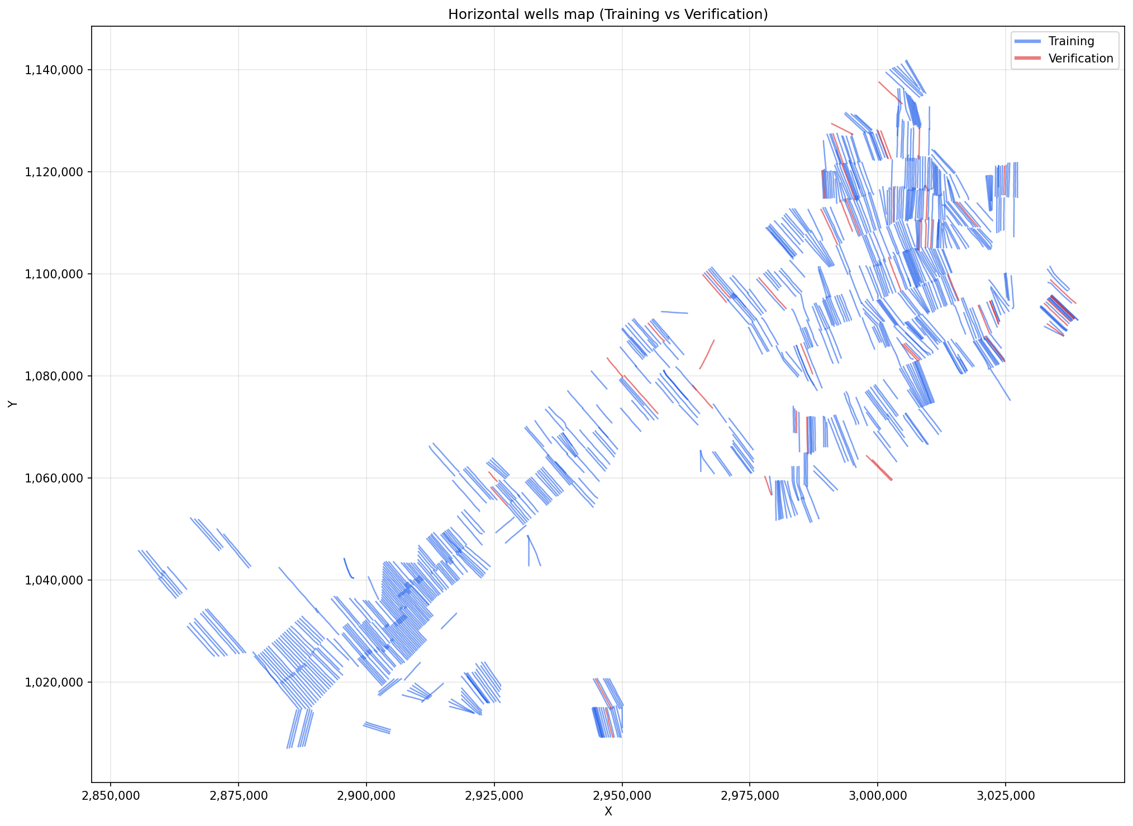
Map view of all training and validation wells

Slide 11
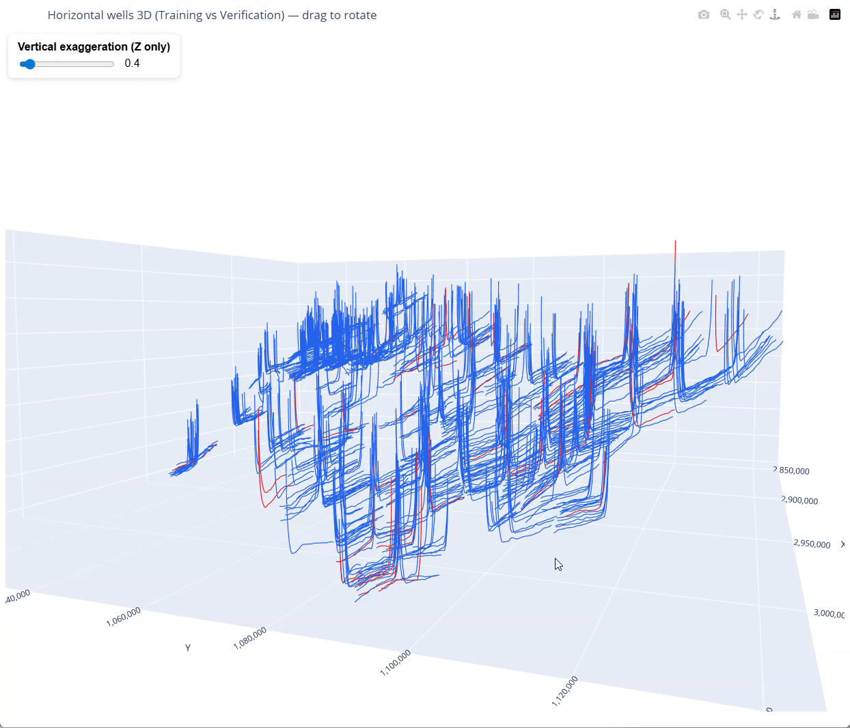
3D view of all training and validation wells

Slide 12
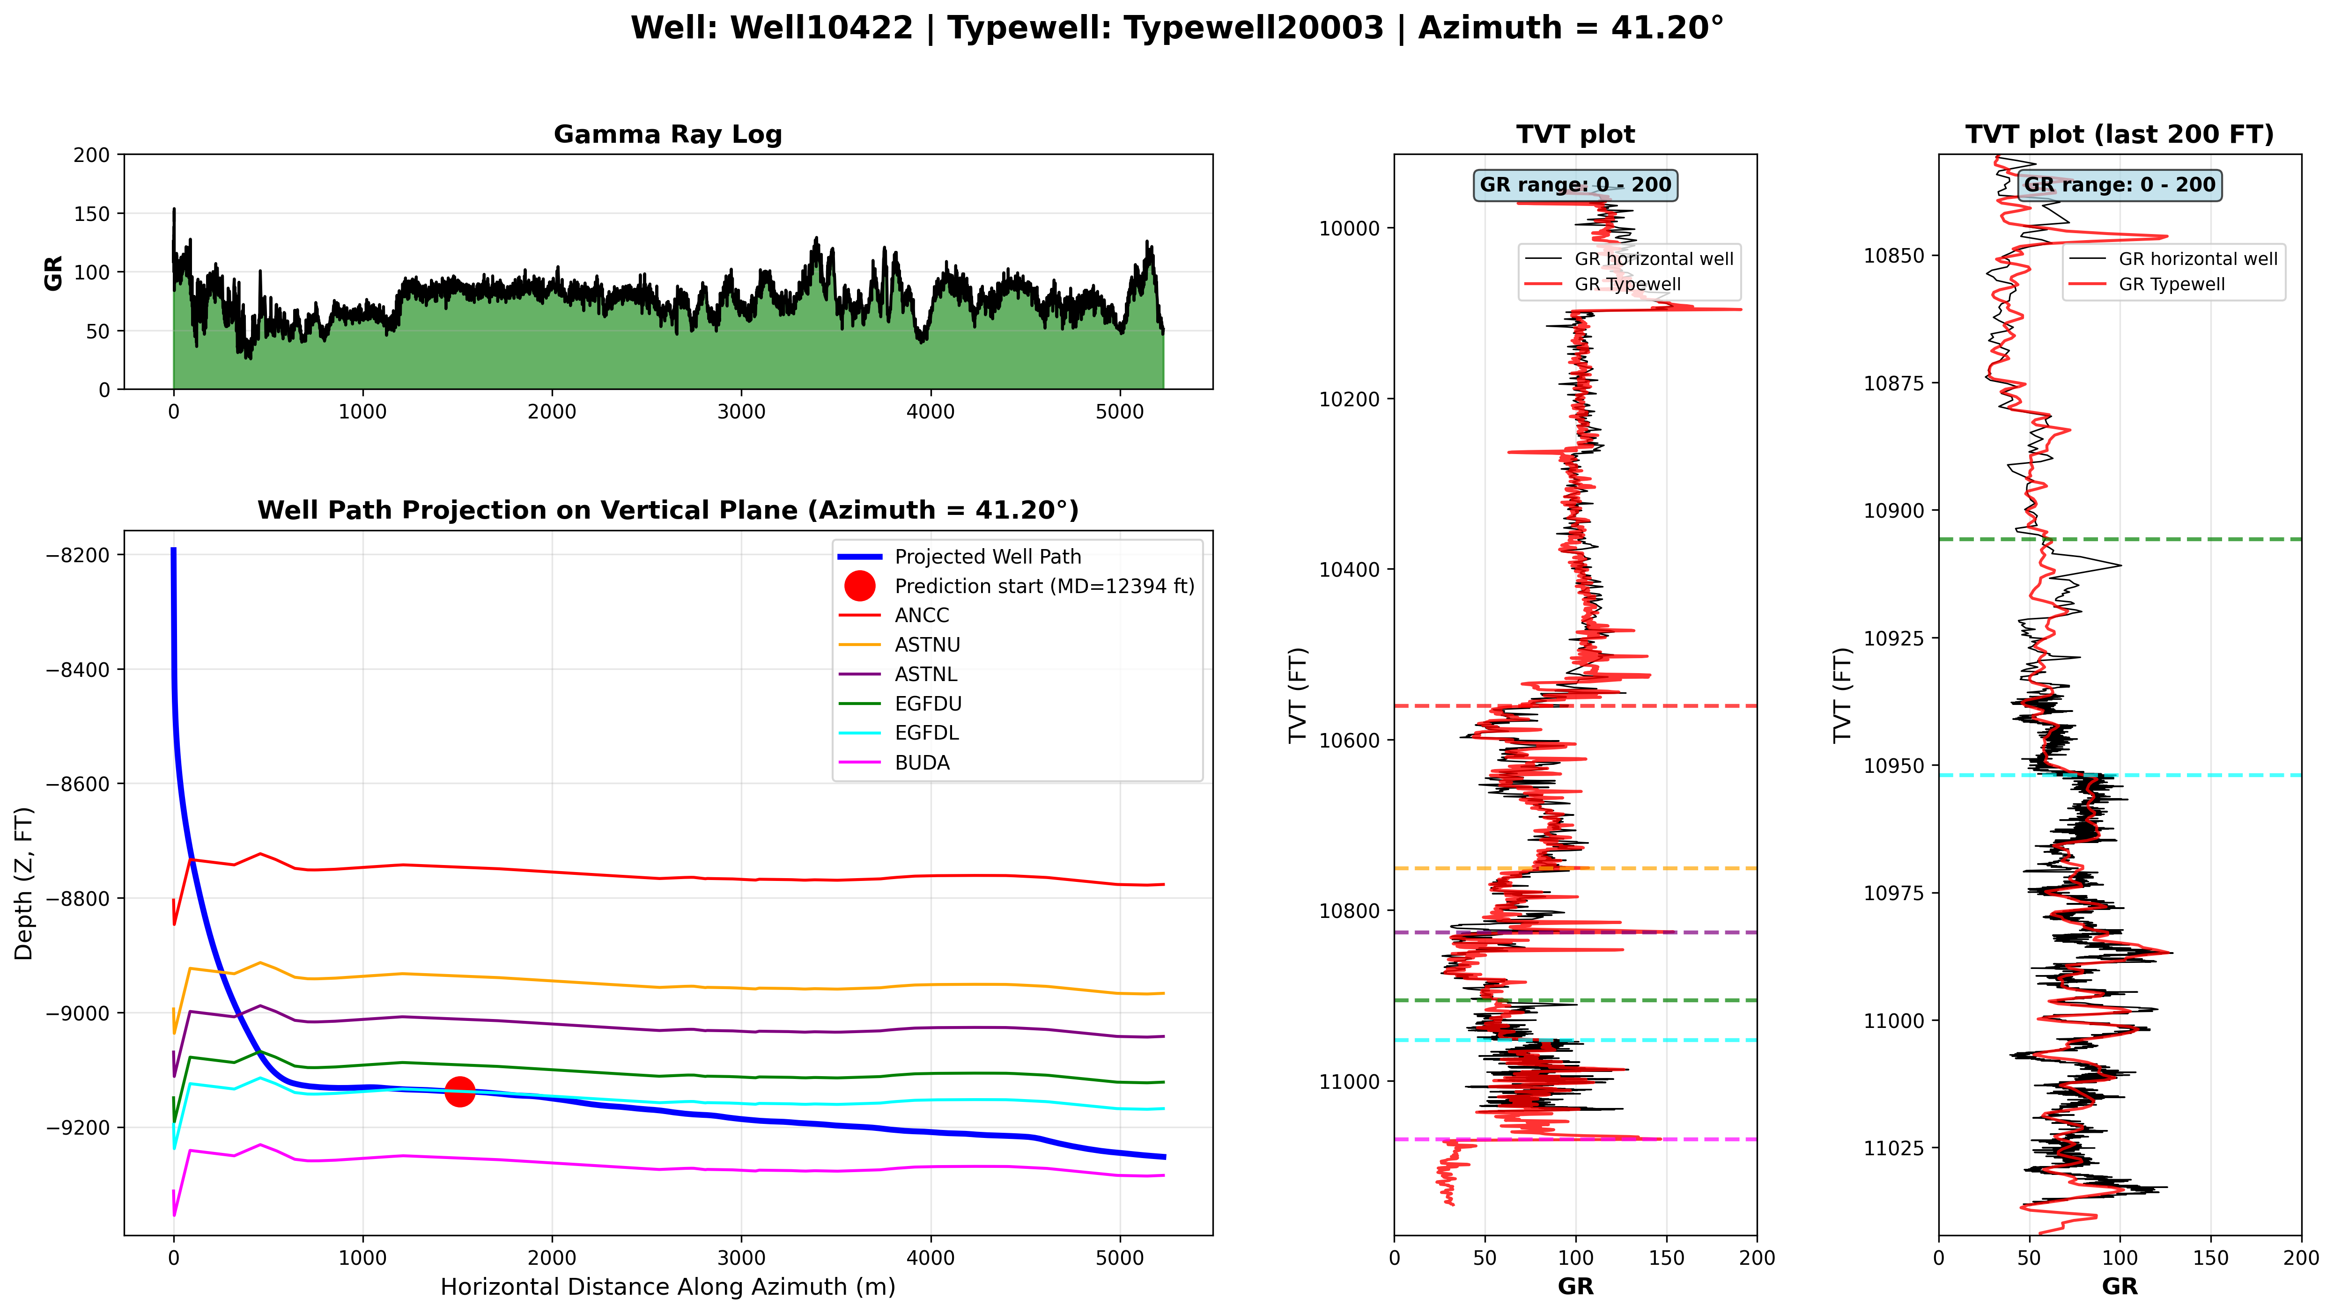
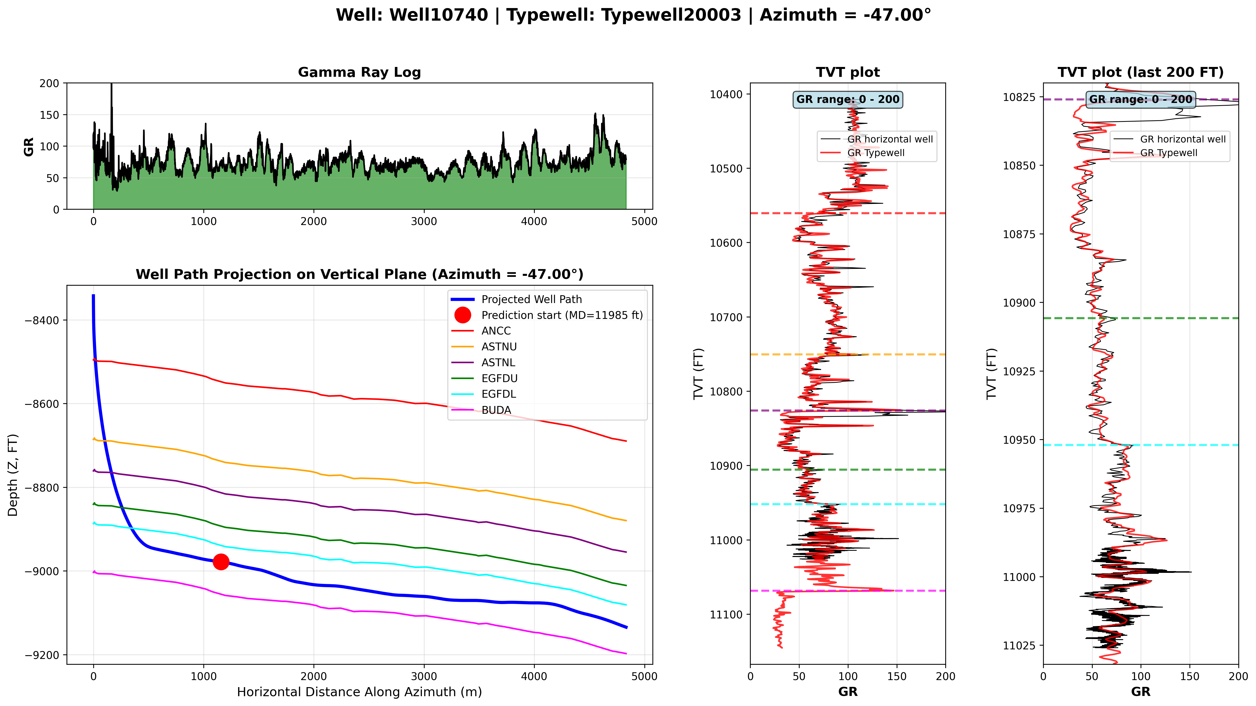
The geology of an offset well can help predict the geology of the current well
Geology is almost flat
Geology is dipping in this direction
Geology is dipping
The azimuth of horizontal drilling affects the expected geology dip

Slide 13
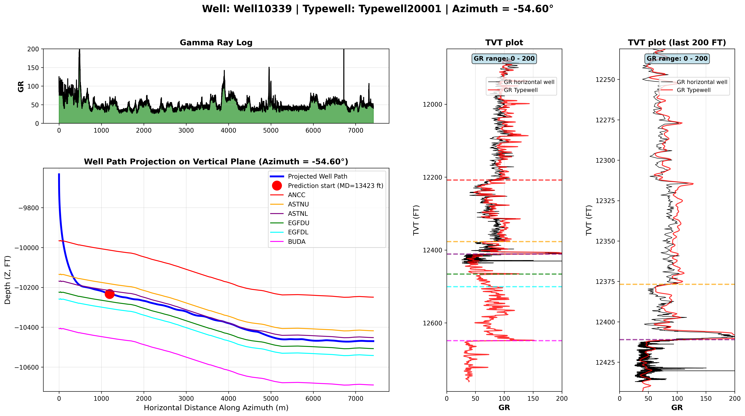
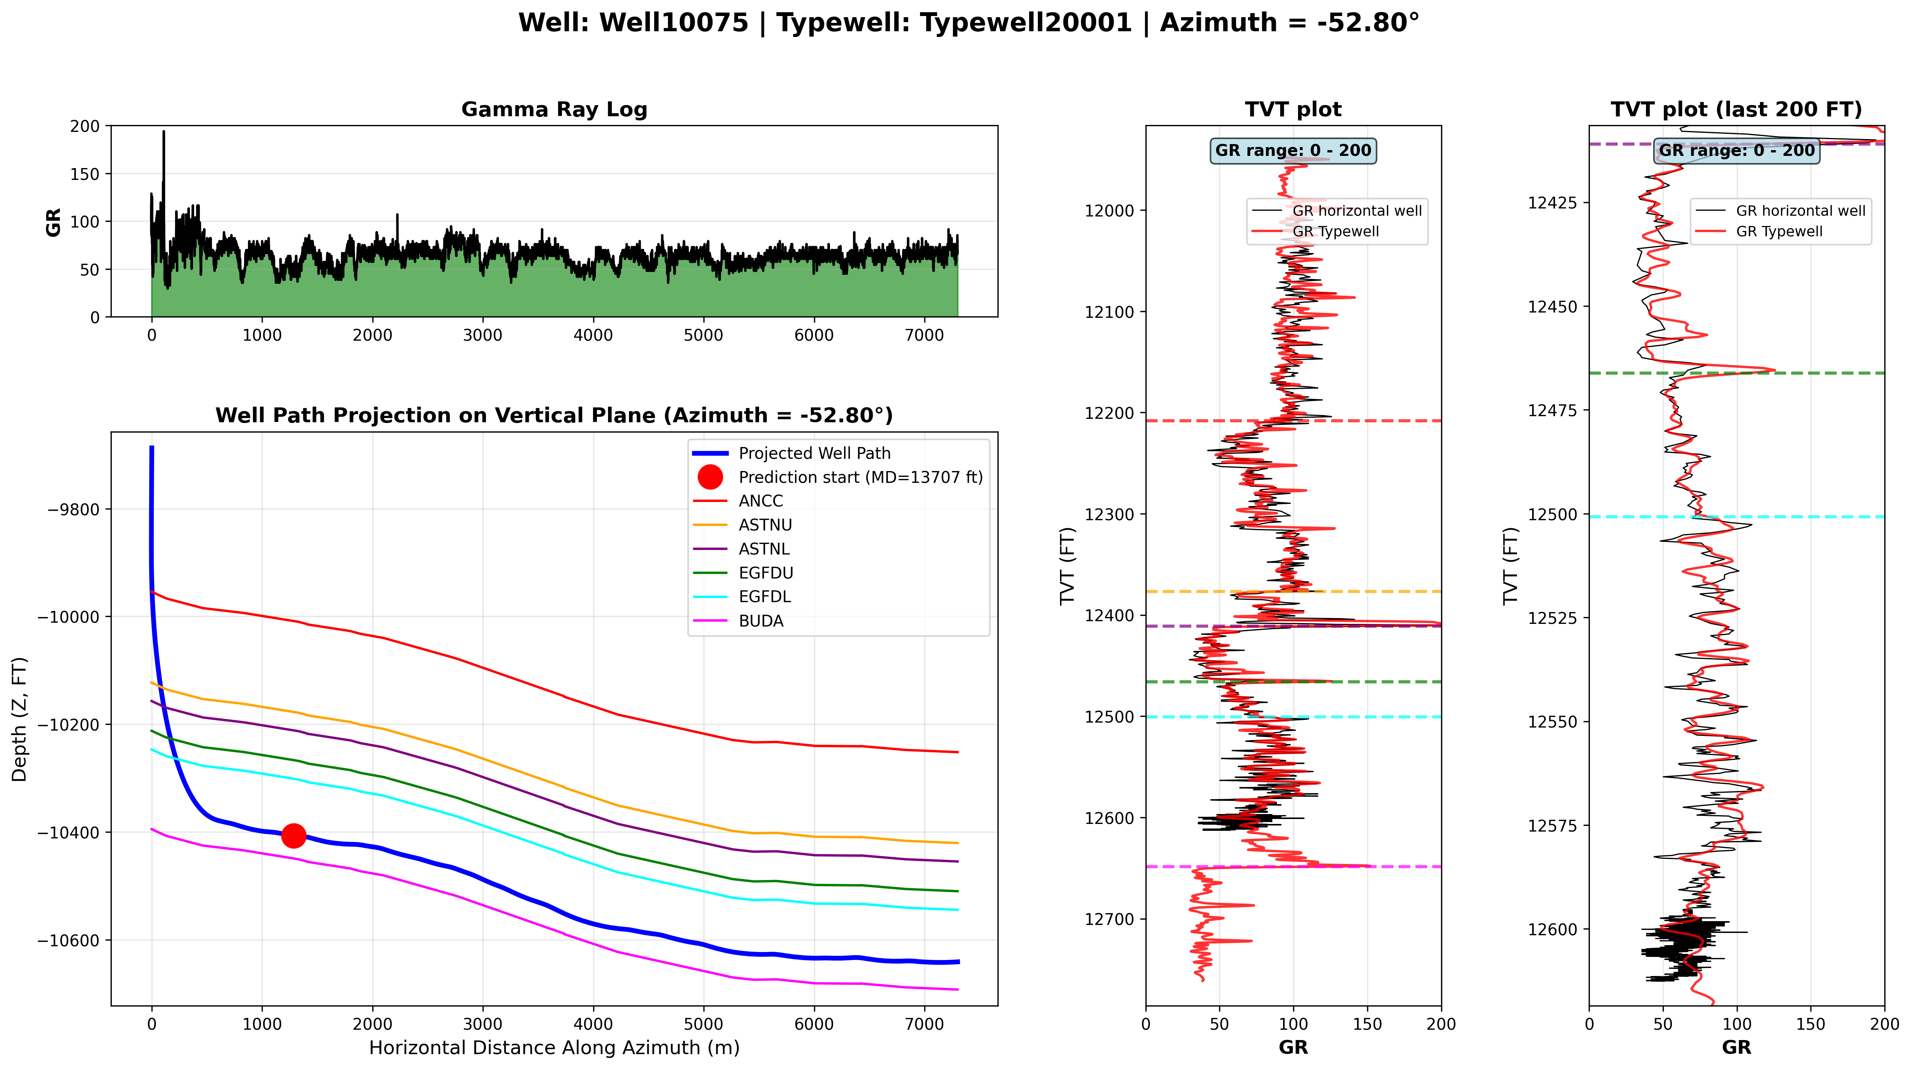
The geology of an offset well can help predict the geology of the current well
Dip
Flat
Dip
Flat
Geological dips behave similarly in neighboring wells

Slide 14
How to evaluate Prediction quality
Each horizontal well has a TVT values that need to be predicted (one foot step)
dTVT = manualTVT-predictedTVT for each point that is predicted
Prediction quality is measured as the RMSE of all dTVT values

