Slide 1
Digital Portfolio
STUDENT NAME : GUNASEKAR. V
REGISTER NO AND NMID: 212400937/8615B1EC452A4A69B0B41BA58258D2FE
DEPARTMENT: BCA
COLLEGE: PRINCE SHRI VENKATESHWARA ARTS AND SCIENCE COLLEGE

Slide 2

Engaging Techniques for Visual Communication in Presentations
Project Title
DIGITAL PORTFOLIO

Slide 3
AGENDA
1.Problem Statement
2.Project Overview
3.End Users
4.Tools and Technologies
5.Portfolio design and Layout
6.Features and Functionality
7.Result and Screenshot
8.Conclusion

Slide 4
Problem statement
Many students and aspiring web developers lack a professional online presence to showcase their skills, projects, and contact information. This portfolio aims to provide a clean, interactive, and responsive web interface for displaying personal achievements and technical expertise.

Slide 5
Project overview
This project is a personal portfolio website for GUNASEKAR V, a BCA student and aspiring front-end developer. It provides an engaging way to display personal information, technical skills, projects, and contact details. The portfolio features modern UI design with hover effects, responsive layout, and a simulated contact form submission.

Slide 6
Who are the end users?
Potential employers or recruiters
College professors or mentors
Fellow developers and collaborators
Anyone interested in viewing GUNASEKAR V’s web development skills and projects

Slide 7
PORTFOLIO DESIGN AND LAYOUT
Hero Section: Full-width banner with the developer’s name and tagline
About Me Section: A brief personal introduction and career interests
Skills Section: Highlights technical skills like HTML, CSS, JavaScript with hover animation
Projects Section: Displays projects with images, titles, and descriptions in card format
Contact Section: Contact form for sending messages and direct links to email and GitHub

Slide 8
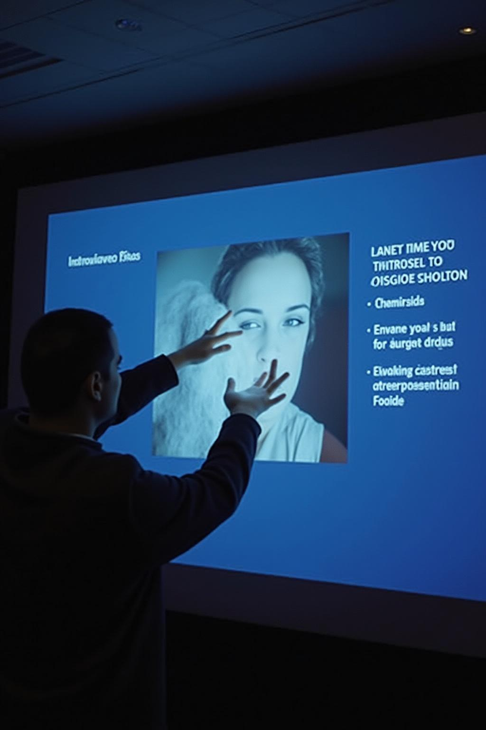
FEATURES AND FUNCTIONALITY
Responsive Layout: Adapts to different screen sizes
Interactive Skills & Projects: Hover effects for skill and project cards
Contact Form Simulation: Alerts the user when a message is "sent"
Navigation Friendly: Easy-to-read sections with smooth scroll potential (can be enhanced with JS)
External Links: Direct links to email and GitHub profile

Slide 9
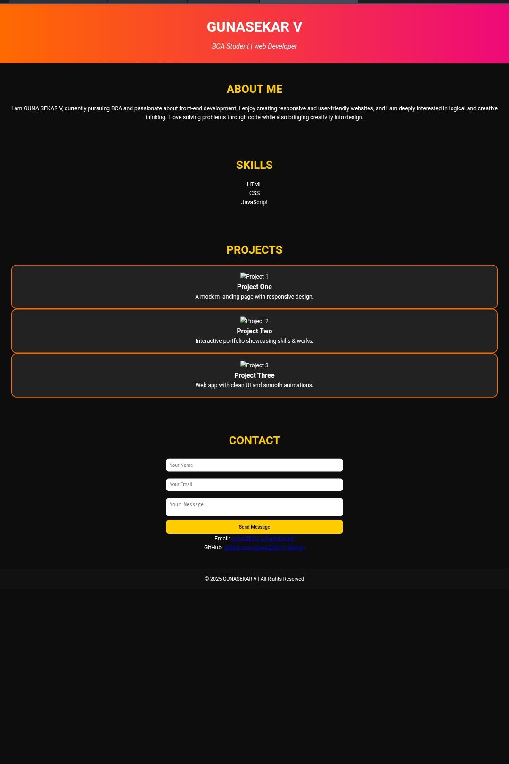
RESULT AND SCREEN SHOT

Slide 10
Github link
https://guna200111-design.github.io/TNSDC-FWDA-DP-GUNASEKAR/

Slide 11
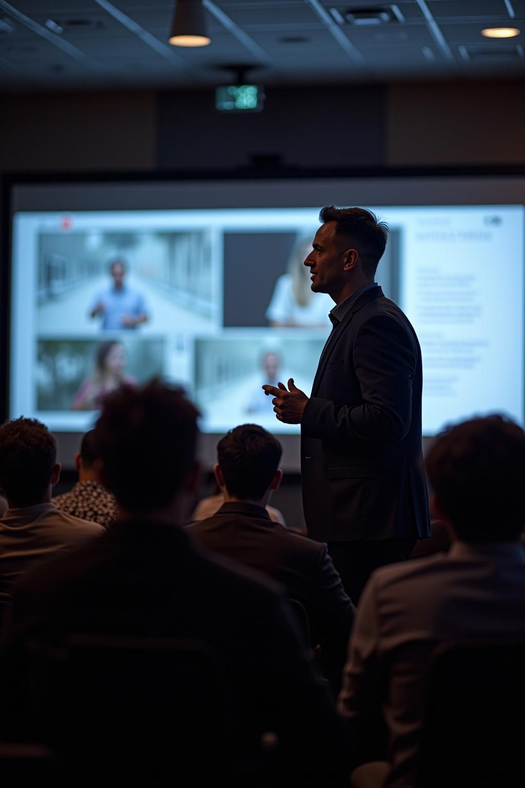
CONCLUSION
The portfolio project successfully showcases GUNASEKAR V’s skills and projects in a professional and interactive way. It serves as a personal branding tool for job applications and networking. The website is easy to navigate, responsive, and visually appealing, providing a strong online presence for a budding front-end developer.

