Slide 1
Lankalapalli Guna
B.Tech CSE (AI), IIITDM Kancheepuram
Interested in problem solving, DSA, and backend systems

Slide 2
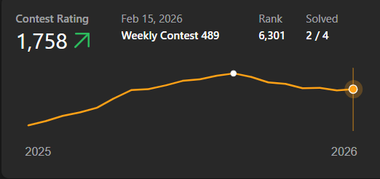
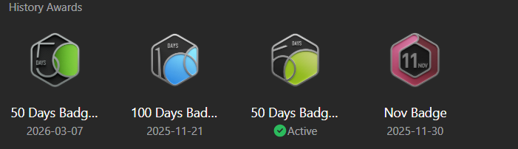
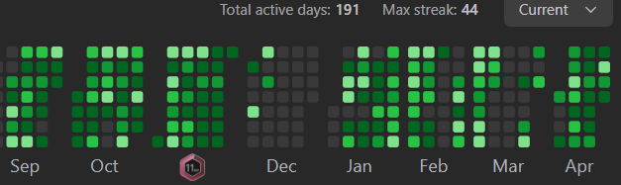
Competitive Programming
Main strength
LeetCode Knight - rating 1810, Top 7.9%
600+ problems solved across platforms
LeetCode: 250+ | CodeChef: 200+ | Codeforces: 150+
Rank 374 in CodeChef Starters
120+ day streak

Slide 3
Experience in CS Club
Edith Wing
Joint Core Member in Edith Wing
Conducted sessions on Arduino and basic hardware topics
Explored the hardware side out of curiosity
Worked with the team to organize sessions and engage students

Slide 4
Projects & Skills
Grocery Delivery App - full stack app with APIs, payments, scalable backend
QuickChat - real-time messaging using WebSockets
Languages: C++, Python, JavaScript
Core: Data Structures & Algorithms
Backend: Node.js, Express
Databases: MongoDB, PostgreSQL
Tools: Git, AWS basics

Slide 5
Motivation
Genuinely interested in competitive programming
I enjoy solving problems and improving over time
Consistent practice has helped me stay disciplined
I want to contribute to contests, sessions, and peer learning
Looking to grow while contributing to the club

