Slide 1


Experian’s ConfluenceGPT
- Global Hackathon FY25
Presented by:
Gunashekar Chenna
PrabhuTeja Patel

Slide 2
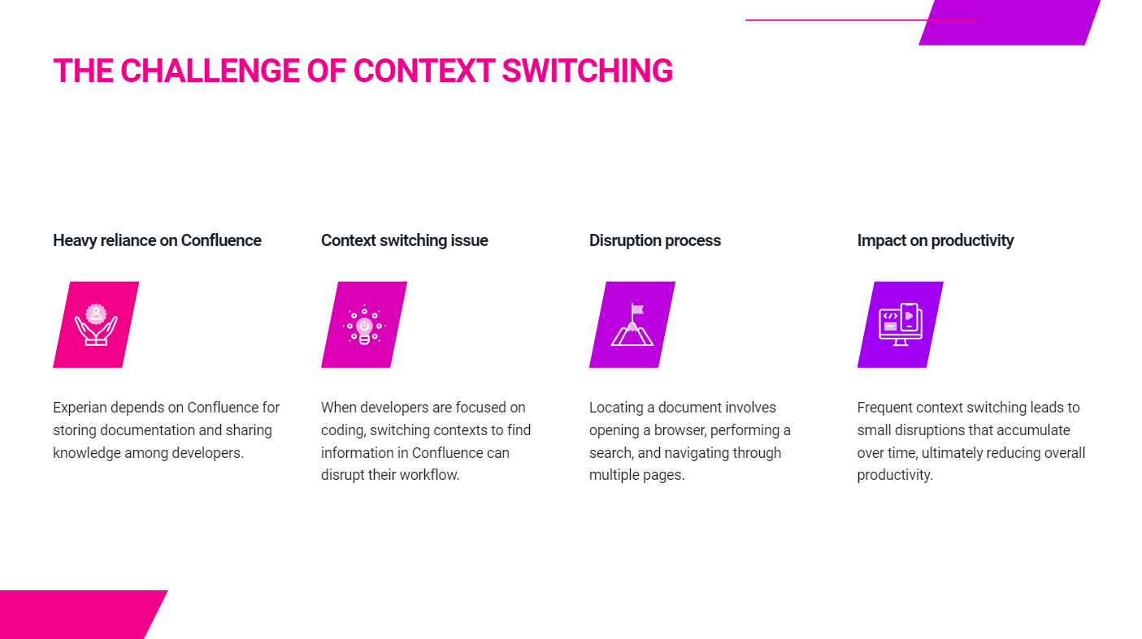

Slide 3
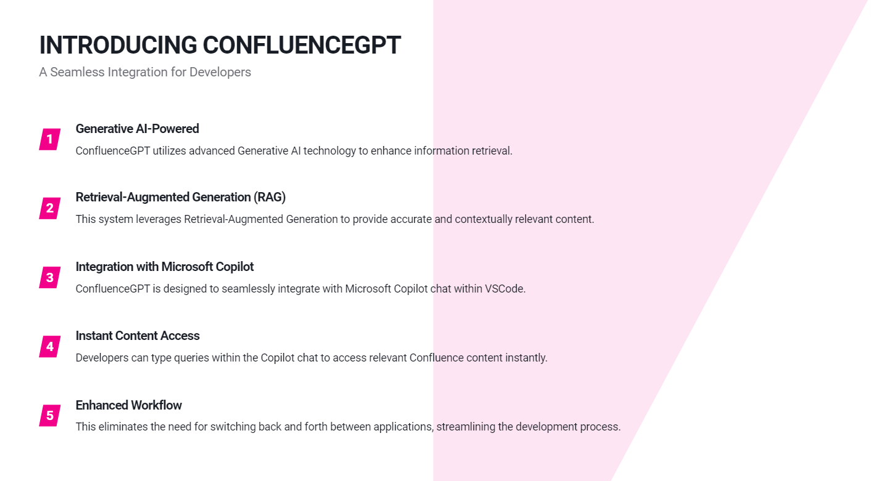


Slide 4
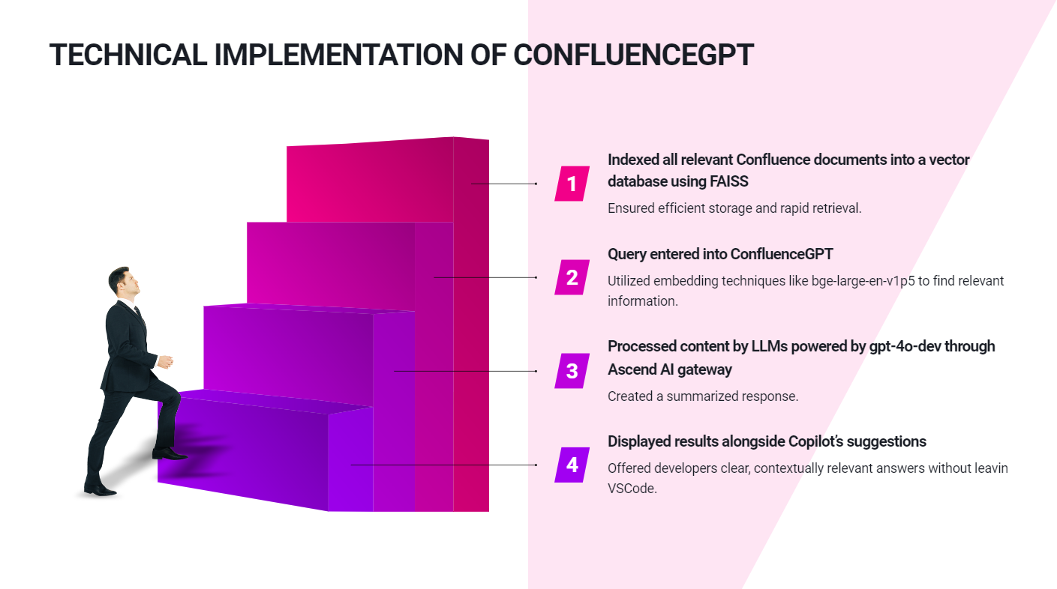

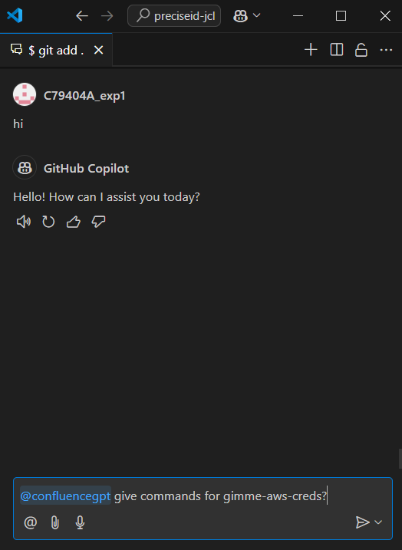

Slide 5
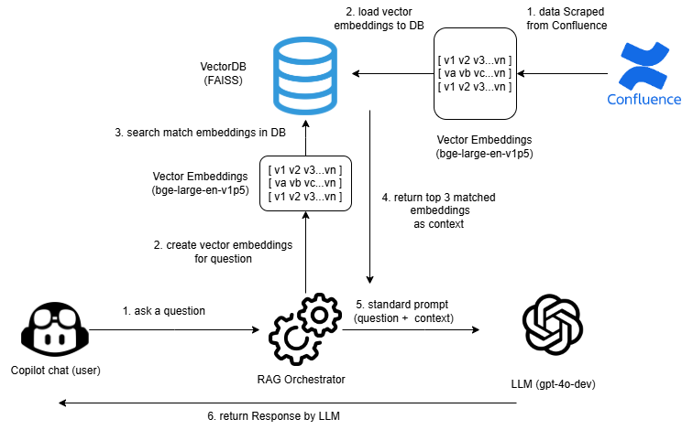
Architecture:

Slide 6
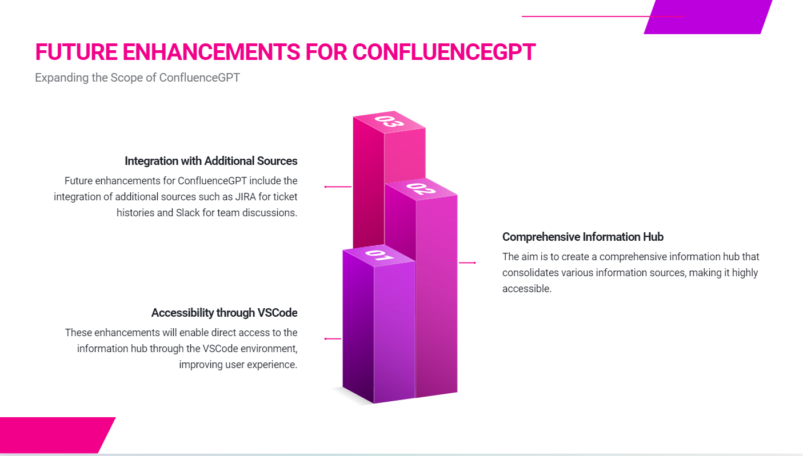
** We plan to extend this extension for compatibility with other IDEs as well.

Slide 7
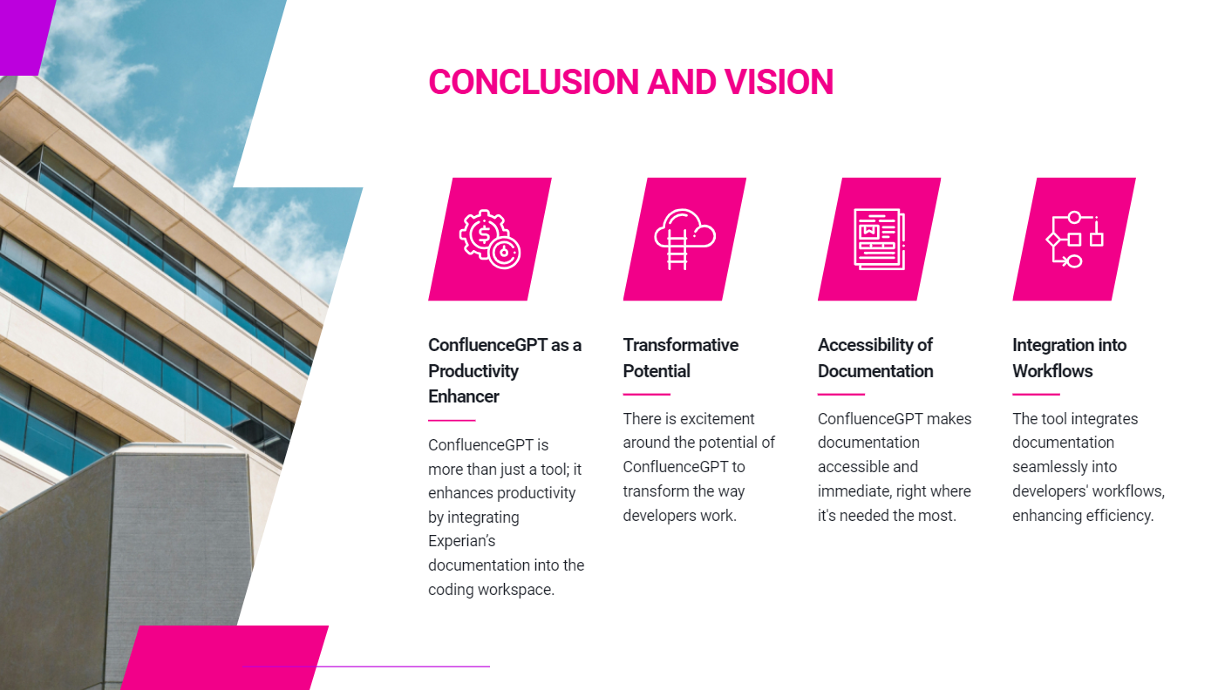

Slide 8

Signing off: Guna, and Prabhu

