Slide 2
Dashboard Drive: Mapping Out the US Car Market with Interactive Visualizations
Presented by Gunadheep Sakthivel

Slide 3
Contents
Introduction
Dataset
Methodology
Insights
Future Work
Conclusion

Slide 4
Introduction
In the ever-changing US automotive business, knowing market dynamics, consumer preferences, and regional variances is critical. My initiative, "Dashboard Drive," aims to explore the complexities of the US car market using interactive visualizations based on a vast dataset obtained from credible platforms.
Using innovative data visualization tools, we want to uncover trends, preferences, and correlations in the automotive scene, empowering stakeholders with actionable information.

Slide 5
Dataset
Source: The dataset is sourced from AUCTION EXPORT.com(Kaggle) and comprises information on 28 brands of clean and used vehicles available for sale in the US market.
Features: It includes 12 features such as price, years (registration year), brand, model, color, state/city (location), mileage, VIN (Vehicle Identification Number), title status (clean or salvage), lot number, and condition.
Scope: The dataset offers insights into the pricing trends, popular brands and models, geographic distribution, and condition of vehicles in the US market.
The data analysis of the US Cars dataset caters to a diverse audience, including automotive industry professionals seeking market insights and competitive intelligence, financial analysts interested in assessing market performance and investment opportunities

Slide 6
Methodology
Data Pre-Processing:
Data Loading: Import dataset into Pandas DataFrame using read_csv function.
Handling Missing Values: Address missing values through imputation or removal.
Removing Unnecessary Columns: Omit irrelevant columns to enhance dataset clarity.
Handling Zero Values: Replace zero values in relevant columns (e.g., 'price') for data accuracy.
Data Transformation: Conduct necessary transformations (e.g., scaling) to optimize data quality.

Slide 7
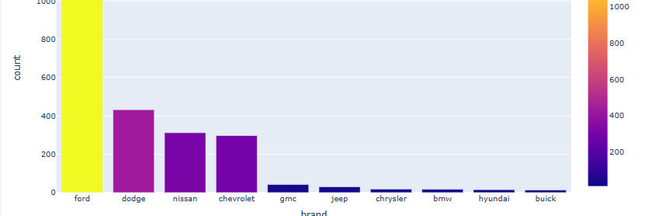
Visualization
Bar charts show how large brands dominate the market.

Slide 8
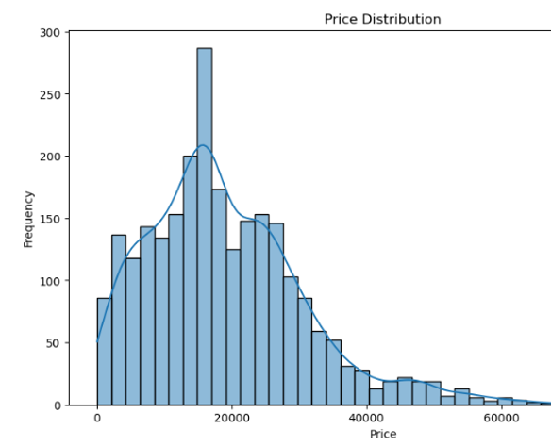
Visualization
Histograms demonstrate the distribution of vehicle prices, highlighting outliers and common price ranges.

Slide 9
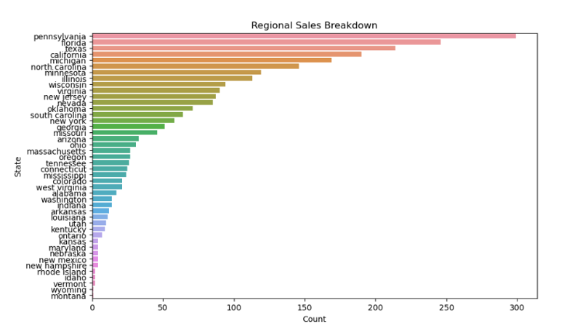
Visualization

Slide 10
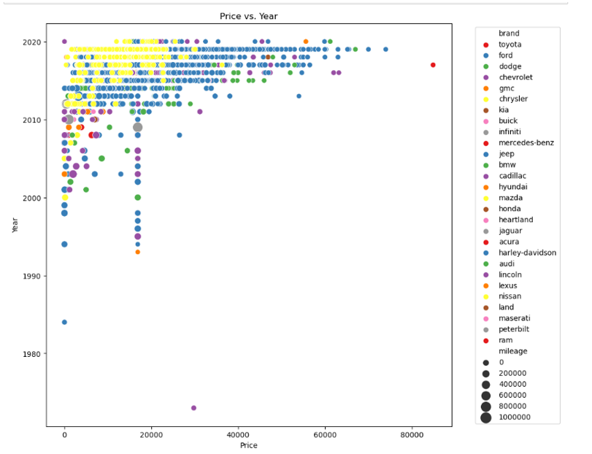
Visualization
The scatter plot depicting Price vs. Year provides a comprehensive overview of how the prices of vehicles vary based on their year of registration, with additional insights garnered from the brand and mileage size representations.
The average price has steadily increased over the past decade.

Slide 11
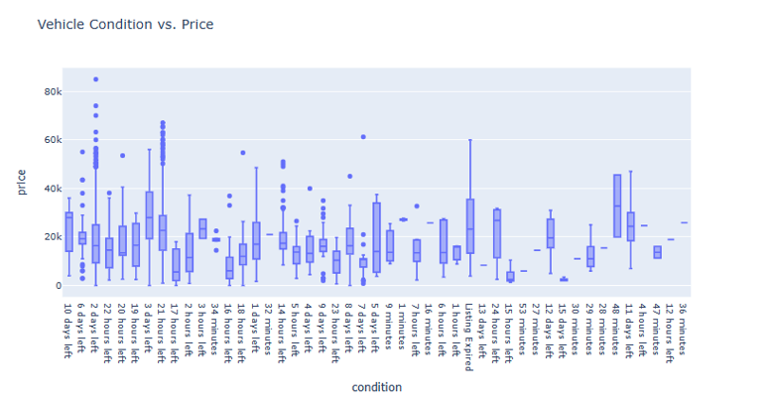
Visualization

Slide 12
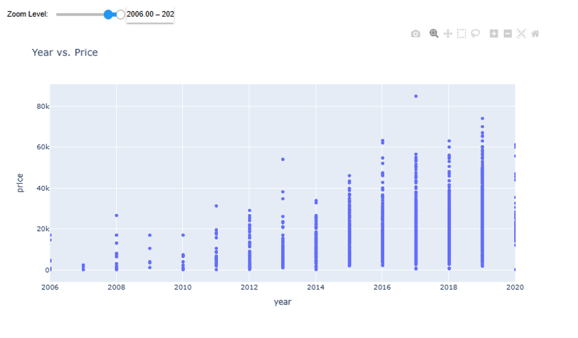
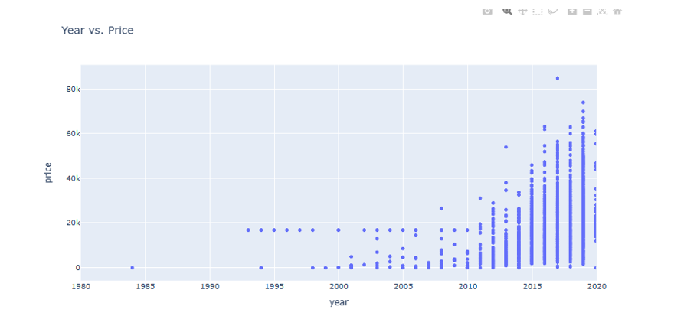
Visualization

Slide 13
Insights
Brand Influence: Different brands have varied price trends, with some charging larger fees regardless of the year of registration. Luxury companies typically sustain higher price points throughout multiple model years than mainstream manufacturers. Pricing within the same brand may also vary depending on factors such as model popularity, market demand, and brand repute.
Price Distribution: The bulk of automobiles fall into a given price range, with a few outliers reflecting luxury models that attract higher costs.
Regional Sales Breakdown: States such as Florida, Georgia, and New Jersey have larger car sales, demonstrating that preferences differ between areas.
Car Price vs. Condition: Cars with a clean title typically attract greater prices than those with salvage titles, highlighting the importance of vehicle condition in pricing.

Slide 14
Conclusion
"Dashboard Drive" provides a thorough examination of the US automobile business, utilizing interactive graphics to understand complex facts. By identifying trends and patterns, our initiative provides stakeholders with vital insights for effectively navigating the dynamic automotive landscape. Through rigorous research and visualization, we give a road map for informed decision-making and strategic planning in the automobile industry.

Slide 15
Thank You!

