Slide 1
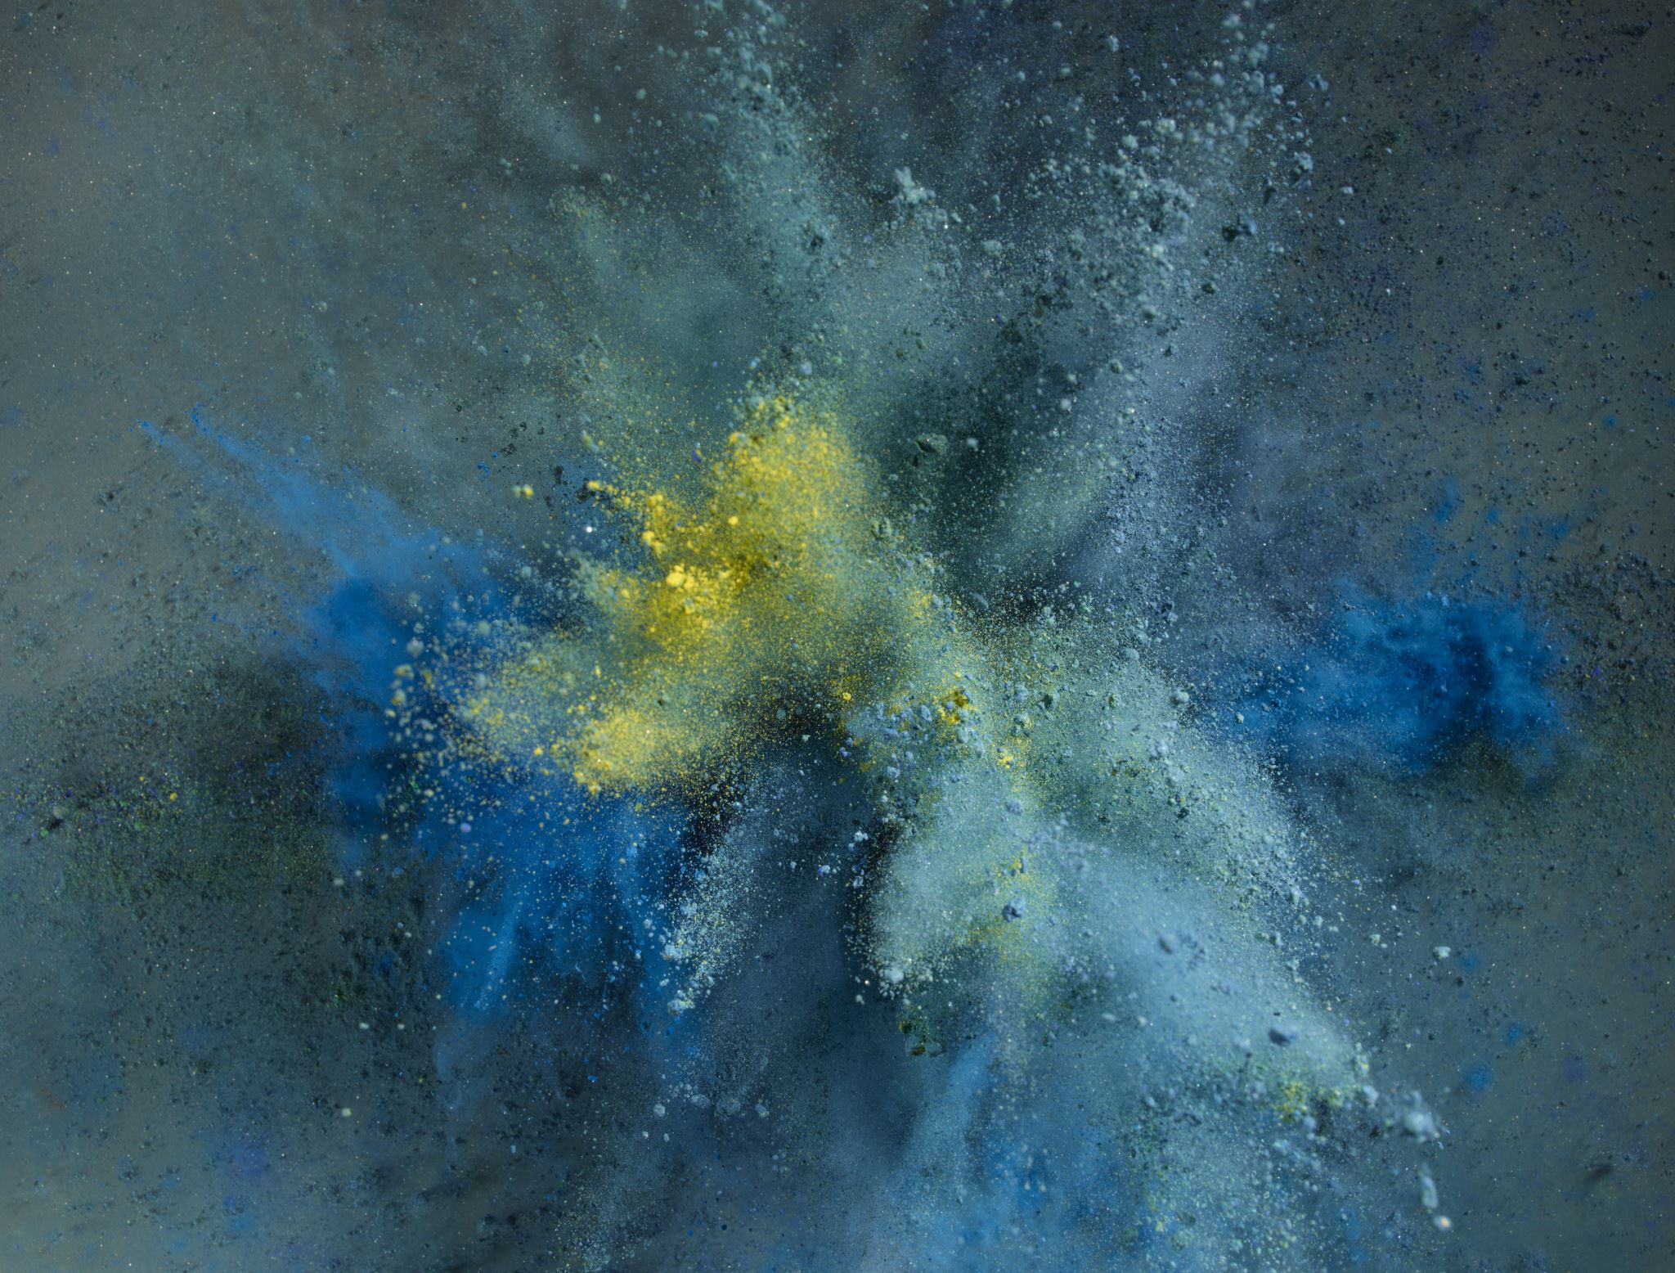
Game The Earth
RAMIRO GUNADY - Aplikasi sisi client (03082180067)
JEFFRY (03082180065) - Desain

Slide 2
LATAR BELAKANG

Slide 3
TUJUAN PENELITIAN

Slide 4
METODOLOGI PENGEMBANGAN SOFTWARE

Slide 5
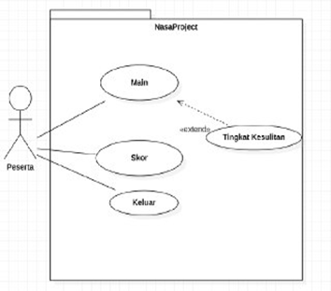
Use case diagram

Slide 6
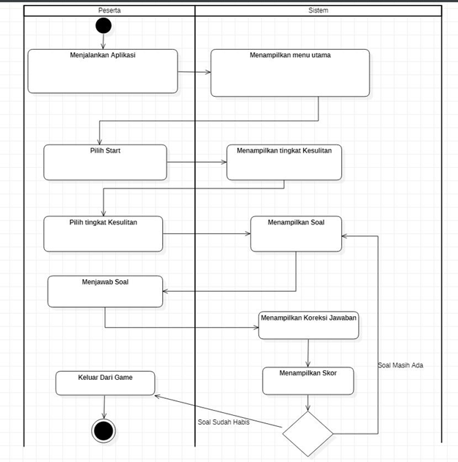
ACTIVITY diagram

Slide 7
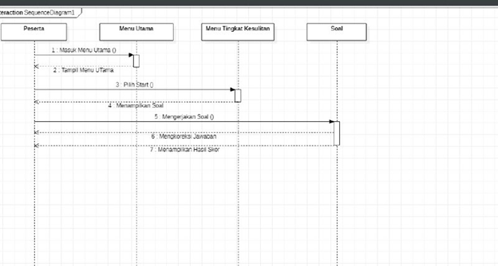
Sequence diagram

Slide 8
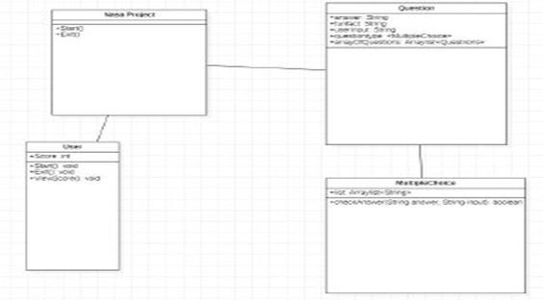
Class diagram

Slide 9
KESIMPULAN & SARAN

