Slide 1
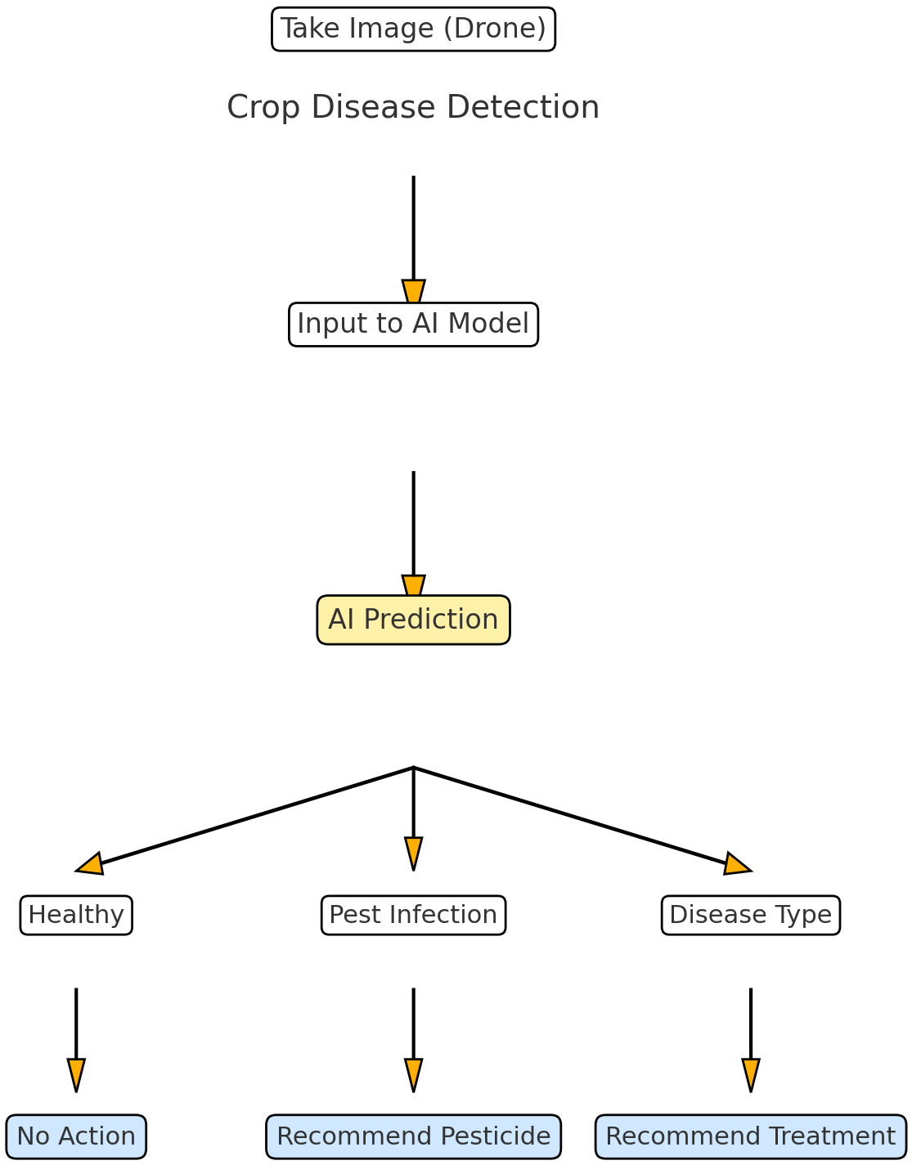

Crop Disease Detection
Prediction
Call to Action

Slide 2
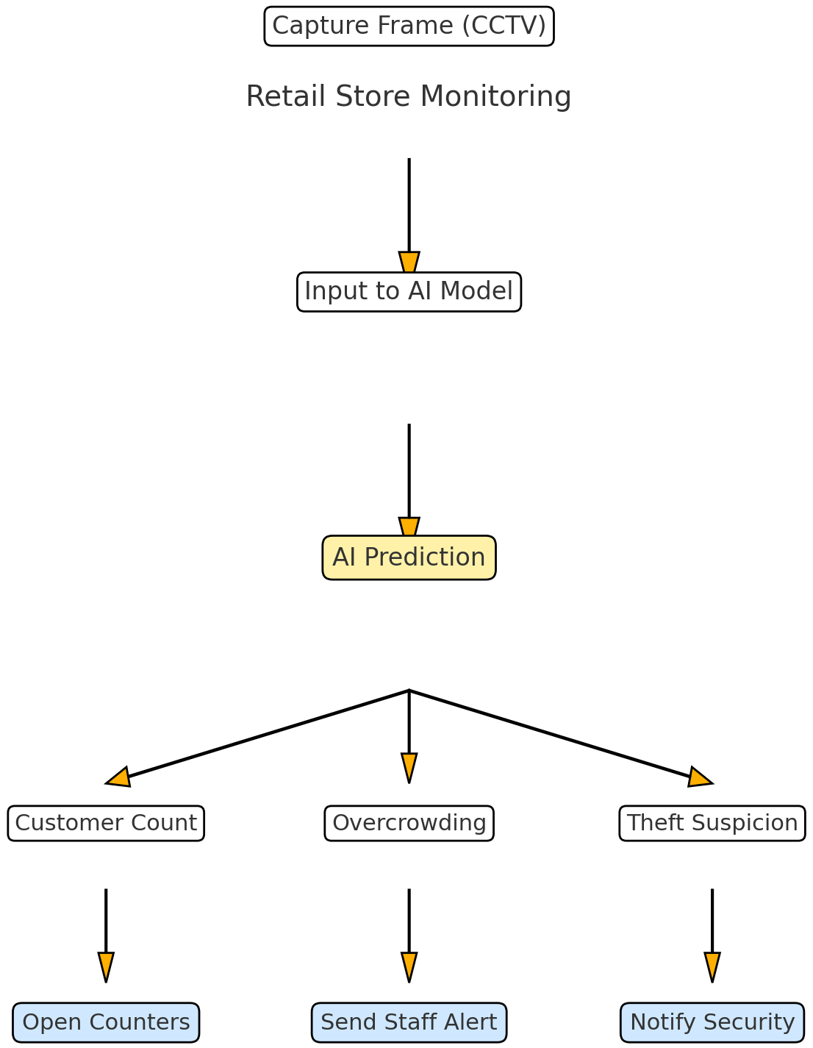
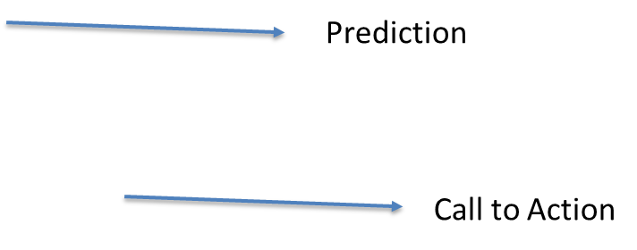
Retail Store Monitoring

Slide 3
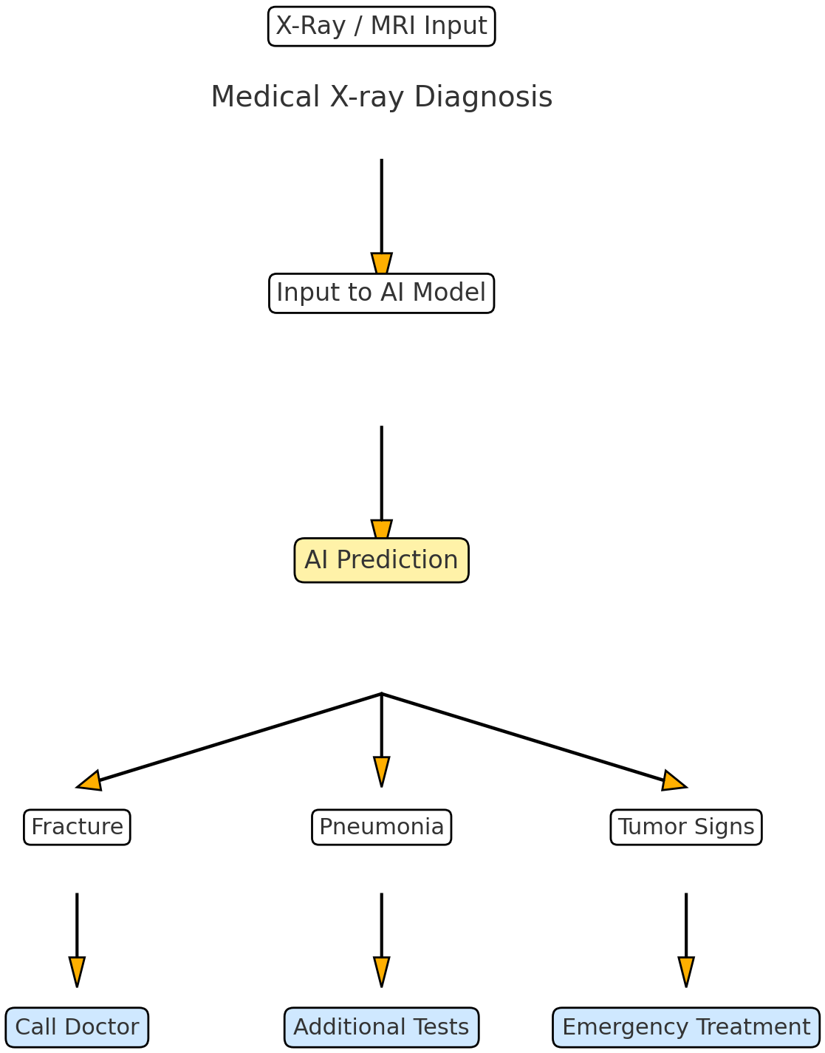
Medical X-ray Diagnosis

Slide 4
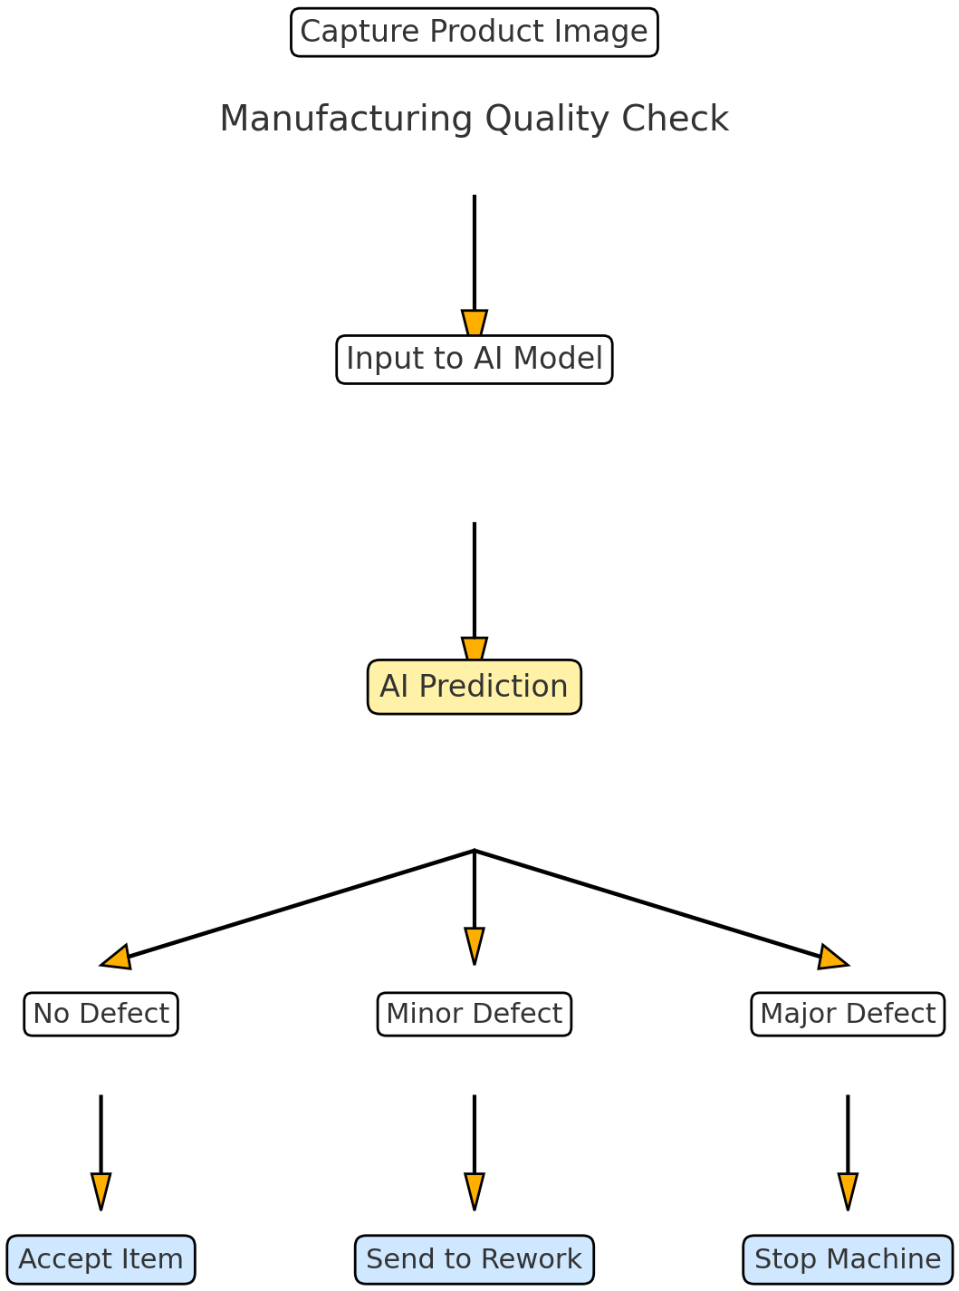
Manufacturing Quality Check

Slide 5
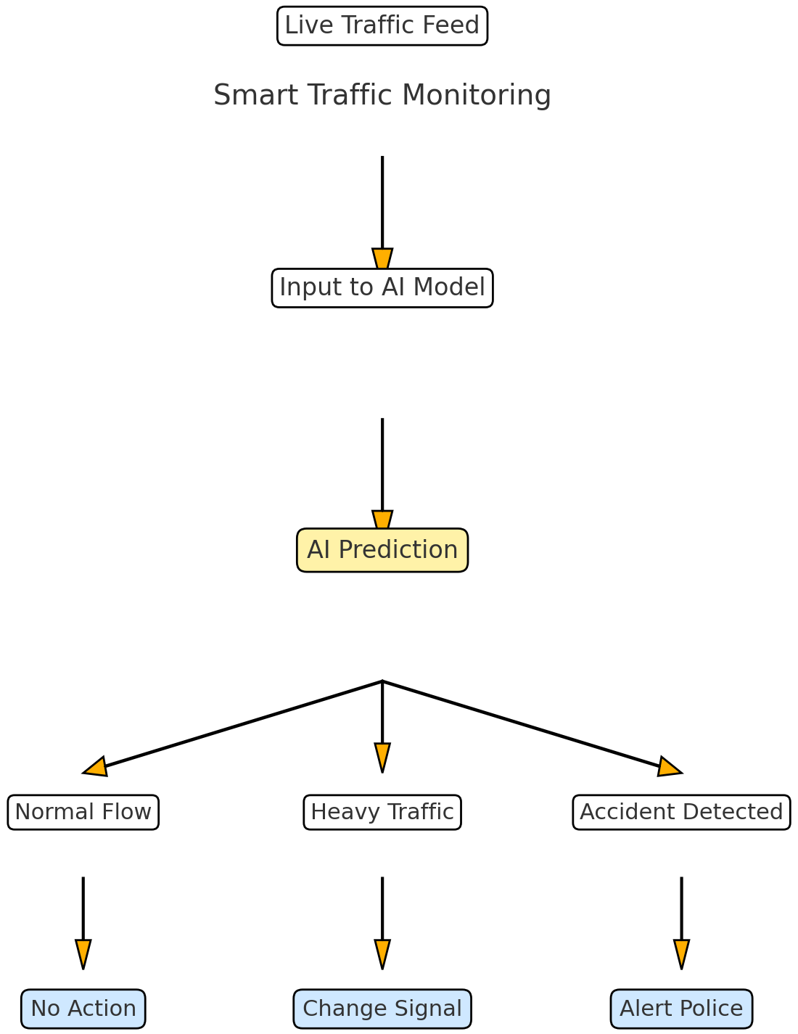
Smart Traffic Monitoring

