Slide 1
October 11 2017
nWave – Auto Architect and Augmented Estimation Tool
TEAM 1 - Jitendra, Lakshya, Niranjan, Prashanth, Sameet, and Srikanth

Slide 2
Introduction & Theme
Team proposed individual Ideas and shortlisted Augmented Estimation and Auto Architect to show case in this forum.
Auto Map
Auto Code Creation
Code Generator from Mapping Spec.
Cognitive RFP Processor
Augmented Estimation
Auto Architect
Analyze
1. What are inputs required ?
2. How analysis could be driven ?
Enrich
1. How historical data is enriched ?
2. How rules can be updated?
Adaptation
1. How learning model can adapt to newer needs ?
2. How self-learning can be enabled?
Optimization
Control
1. How learning model can be corrected ?
2. How optimizations can be driven?
1. How to control the model for maximum accuracy and minimal errors (de-risk)?
2. How to make it available for low cost and high value?
We further aligned on Thinking through below pointers to define the Model.

Slide 3
Augmented Estimation – Niranjan & Prashanth

Slide 4
What is Augmented Estimation?
What is the Idea for ?
To provide Augmented Estimation App to understand the requirement documents in natural language and provide the estimations for SDLC phases. To build an App to provide the estimations to the RFP solution based on predefine trained models and templates feeds from different technology practices with in IPM.
AS IS and TO BE Scenario
AS IS:
As of now IPM practice is using the predefined estimation templates and need to feed information about the interface details, complexity factors and assumptions to get SDLC estimations for specific solutions.
TO BE:
To upload the interface details / Talk to an App with requirement details on high level to provide the estimations
App provides assumptions with detail estimations for overall proposal/CR with minimum understanding on the requirements
To implement augmented App to get estimation for the solution based on Key intents/notes as technologies
Applying Natural language processing and use trained model based on previous engagements
Advantages
Natural language processing of problem statement and involved parties for integration in to get the estimations.
Time Saving to get estimations. Self learning model for new type of connectors/protocols
Provides estimations with confidence level to decide. Easy extendable model for new technologies with updated training models
Validation of Estimations is feasible

Slide 5
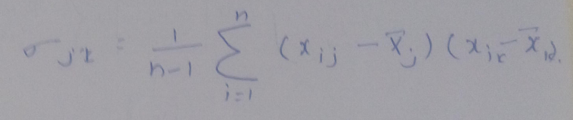
Augmented Estimation – Story Line
Can you provide estimations for file transfer from source XYZ to target ABC?
Step 1
Step 2
NLP
Extracts keywords
Intents to search in Estimation Model
ChatBot
Email
Template
Excel
Query
Query
Builder
Training Key Words
Estimation
Trained Set on Intents
Intent Key Words
File Transfer
Step 3
Covariance Matrix Obtain EugenVectors and EugenValues
X^{t} => {X1,X2,X3,X4,X5} = => {Interface name, Complexity, Classification, Operation Type, Pattern} Covariance Matrix
Step 4
E.g. 500X5 Matrix
1. Interface | 2. Complexity | 3.Classification | 4. Operation Type | 5. Pattern
File Transfer | High | SFTP | New | Request/Reply
File Transfer | Medium | SFTP | Reuse | One Way
DB Adapter | High | Oracle | New | Transaction
… | … | … | … | …
Eugen Vector | Interface | Complexity | Classification | Format
 | File Transfer | High | SFTP | SOAP-XML
 | File Transfer | Medium | SFTP | CSV
 | … | … | … | …
E.g. Rows: 500
Summary
NLP
Intent from Unstructured Data
PCA
Estimated Values with Confidence
Eugen Value = {5,4,2,4,5}
Query

Slide 6
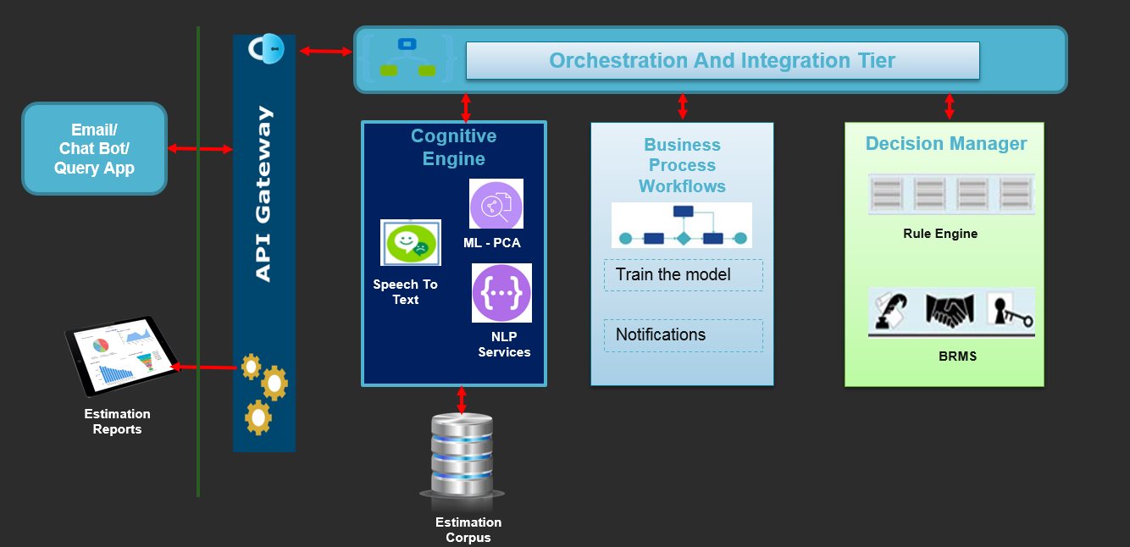
What is Pseudo Logic behind it?
Process Flow

Slide 7
Augmented Estimation - Highlights
What kind of Historical Data is required ?
Estimation templates from different practices/technologies
Help from the SME/Architects on different technologies to train the model
Data and factors for driver estimation details
Consider the complexity , Interface with protocol for integration/Driver related details
Technology Suggestions
Python
Scikit learn - PCA
Tensor Flow
Eclipse PyDev
How it will benefit EAS-IPM?
Get the estimations for solution based on Natural language within minutes
Provide assumptions and risks based on the technologies and methodologies use for a new project proposal
Extended to new technologies by retrain the model as incremental with minor configurations
By mining the historical estimation we can get an accurate estimate
By not over estimating, ensure probability of winning deals and by not under estimating, ensure that the project does not go to red status
Ability to create augmented model for estimation based on historical data, and continuous adaptation for self-learning
This model relies on Supervised Learning. Unsupervised learning is the next step.

Slide 8
Auto Architect - Jitendra

Slide 9
What is Auto Architect ?
What is the Idea for ?
The idea is to develop a machine learning application which will automatically come up with hardware specification, technology stack and a suitable architecture. This will dramatically reduce the number of hours spent on coming up with architectural suggestions
AS IS and TO BE Scenario
In the current world, once we get a green signal to commence with a project, we have to bring in a group of architects to decide upon the technology stack, the architecture and the hardware specification. This results into lots of effort. Also, the solution may or may not be up to mark due to subjective human element.
Post implementation of this Idea, the time and resources taken to come up with the overall architectural specification will reduce drastically. It will be lot more consistent due to reduction in subjective element.

Slide 10
Auto Architect – Story Line
Hardware Sizing:
Transaction Types - In/Out (Batch, Real time)
Transaction Volume
Maximum Message Size
Number of Environments
Cloud / On Premise
Security / Data Standards
Architecture Inputs:
Biz. Transaction Types
Expertise
Environment Implementation
External to Enterprise Consumers
Channels to Integrate
Systems to Integrate – Enterprise, Custom, and Legacy
Cloud Applications to Integrate
Training Data
Auto Architect
Hardware Predictor
Technology/Architecture Specification Predictor
Trained Model
(LDA or QDA based)
Next step -
Self-learn for Predictive Maintenance
Trained Model
(Linear Regression)
Auto Architect
(Trained Model)
New Input
(Hardware Sizing/Architecture Inputs)
Architecture Options (N) with related confidence probability
Hardware Capacity Numbers (1)
Hardware Predictor
Technology/Architecture Specification Predictor

Slide 11
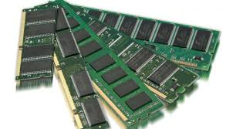
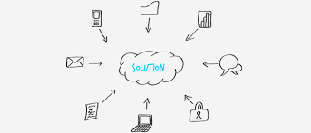
Auto Architect – Example
Outcome
Hardware Capacity Numbers (1)
RAM = Beta0 + Beta1*Maximum Message Size + Beta2 * Transaction Type + Beta3 * Total messages in process at a given time
If response is not in accepted limits, polynomial model could be better fit
Using cross validation technique, one can find out best model fit
RAM~Max.Message Size + Transaction Type + Total Messages in a Process at a given time
Hardware Predictor
(Linear Regression)
Forward Stepwise / Backward Stepwise Selection
Outcome
Architecture Options (N) with related confidence probability
Output is a value between 0 and 1 indicating Confidence rate
Model uses Bayes’ theorem and uses prior probability along with some assumption of type of distribution to predict the posterior probability
Architecture Inputs:
Biz. Transaction Types
Expertise
Environment Implementation
External to Enterprise Consumers
Channels to Integrate
Systems to Integrate – Enterprise, Custom, and Legacy
Cloud Applications to Integrate
Find Model Parameters
or Beta Values
Architecture/Technology Stack Predictor
Use LDA (Linear Discriminant Analysis) or QDA (Quadratic Discriminant Analysis)

Slide 12
Auto Architect - Highlights
How it will benefit EAS-IPM?
Change of approach from mining for best architecture to pick and customize as relevant for ask
Architects to invest time productively in detailing the required blocks than building from scratch
Hardware sizing estimate made easy based upon different Technology options and inputs
What kind of Historical Data is required?
Different reference architectures for various Integration Scenarios – On Prem. and Cloud
Integration Patterns and Complexities involved
Suitable technologies for Integration Stack considering Internal and External Enterprise Consumers
Technology Suggestions
R
MASS library (for regression, LDA or QDA)
R Studio

Slide 14
Appendix

Slide 15
Augmented Estimation – Approach - PCA
What kind of Learning Model need to be built ?
PCA Algorithm for supervise learning model
The main idea of principal component analysis (PCA) is to reduce the dimensionality of a data set consisting of many variables correlated with each other, either heavily or lightly, while retaining the variation present in the dataset, up to the maximum extent. The same is done by transforming the variables to a new set of variables, which are known as the principal components (or simply, the PCs) and are orthogonal, ordered such that the retention of variation present in the original variables decreases as we move down in the order. So, in this way, the 1st principal component retains maximum variation that was present in the original components. The principal components are the eigenvectors of a covariance matrix, and hence they are orthogonal.
Importantly, the dataset on which PCA technique is to be used must be scaled. The results are also sensitive to the relative scaling. As a layman, it is a method of summarizing data. Imagine some wine bottles on a dining table. Each wine is described by its attributes like colour, strength, age, etc. But redundancy will arise because many of them will measure related properties. So what PCA will do in this case is summarize each wine in the stock with less characteristics.
Intuitively, Principal Component Analysis can supply the user with a lower-dimensional picture, a projection or "shadow" of this object when viewed from its most informative viewpoint.

Slide 16
Augmented Estimation – Approach - PCA
Standardize the data.
Obtain the Eigenvectors and Eigenvalues from the covariance matrix or correlation matrix, or perform Singular Vector Decomposition.
Sort eigenvalues in descending order and choose the k eigenvectors that correspond to the k largest eigenvalues where k is the number of dimensions of the new feature subspace (k≤d).
Construct the projection matrix W from the selected k eigenvectors.
Transform the original dataset X via W to obtain a k-dimensional feature subspace Y.
Covariance Matrix
The classic approach to PCA is to perform the eigen decomposition on the covariance matrix Σ, which is a d×d matrix where each element represents the covariance between two features. The covariance between two features is calculated as follows:
Example
Inputs => [Co Variance Matrix] => Eigen Vector {Key-Value Pairs} and Eigen Value
1. Input – Training Model and Questions
2. Eigen Vector – E.g. Key: File Adapter with High Complexity Value: Interface Type (Fine Grained etc.)
Eigen Value – Estimation (Time)

Slide 17
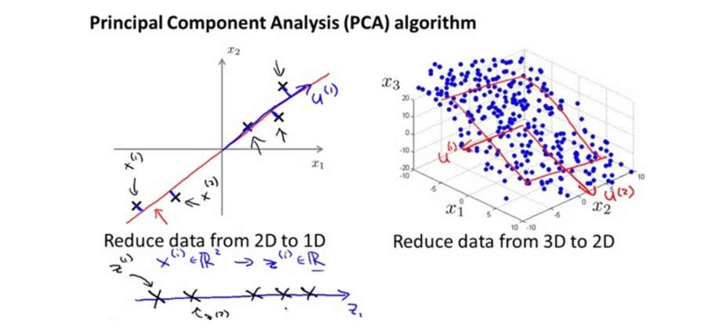

Augmented Estimation – Approach - PCA
What kind of Learning Model need to be built ?
Note that Var[X1] = Cov[X1,X1] and Var[X2] = Cov[X2,X2]
This is the final step where we actually form the principal components using all the math we did till here. For the same, we take the transpose of the feature vector and left-multiply it with the transpose of scaled version of original dataset.
NewData = FeatureVectorT x ScaledDataT
Here, NewData is the Matrix consisting of the principal components, FeatureVector is the matrix we formed using the eigenvectors we chose to keep, and ScaledData is the scaled version of original dataset
(‘T’ in the superscript denotes transpose of a matrix which is formed by interchanging the rows to columns and vice versa. In particular, a 2x3 matrix has a transpose of size 3x2)

Slide 18
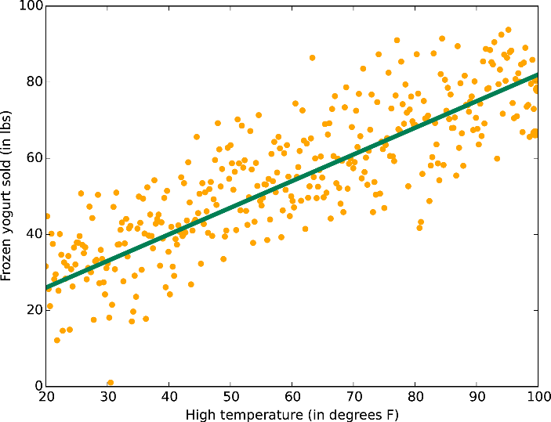
Auto Architect – Linear Regression
Linear Regression
As such, linear regression was developed in the field of statistics and is studied as a model for understanding the relationship between input and output numerical variables, but has been borrowed by machine learning.
Linear regression is a linear model, e.g. a model that assumes a linear relationship between the input variables (x) and the single output variable (y). In case, the relationship is non-linear then we can use “Polynomial Regression” which is a similar variant of Linear Regression.
The method basically comes up with a list of parameters which identify the contribution of each variable to the outcome/response. Once, we have these parameters, we can use them to make future predictions. Also, these parameters help us in interpreting the model and understand
The method basically comes up with a list of parameters which identify the contribution of each variable to the outcome/response. Once, we have these parameters, we can use them to make future predictions. Also, these parameters help us in interpreting the model and understand the business. The diagram on the right is an example of coming up with such parameters and fitting the line to the data points. This line then can be used to make future predictions.

Slide 19
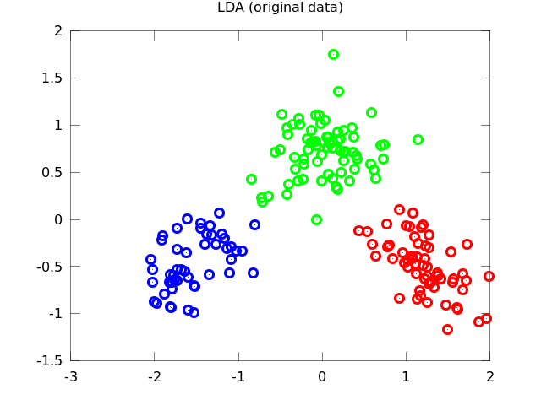
Auto Architect - LDA
LDA – Linear Discriminant Analysis
LDA is one of the classical classification algorithms which performs very well when there are more than two classes to predict. LDA looks for a linear combination of features which give us a great advantage in explaining the relationship between the variables and the response.
The reason I think LDA would be better is because
Not expecting too many features.
The number of historical samples would be substantially
higher than the number of features.
It shall provide the related confidence probability of the prediction
If the relationship between the data and the response appears to be
linear, then we can use QDA (Quadratic Discriminant Analysis,
non linear version of LDA).

