Slide 1
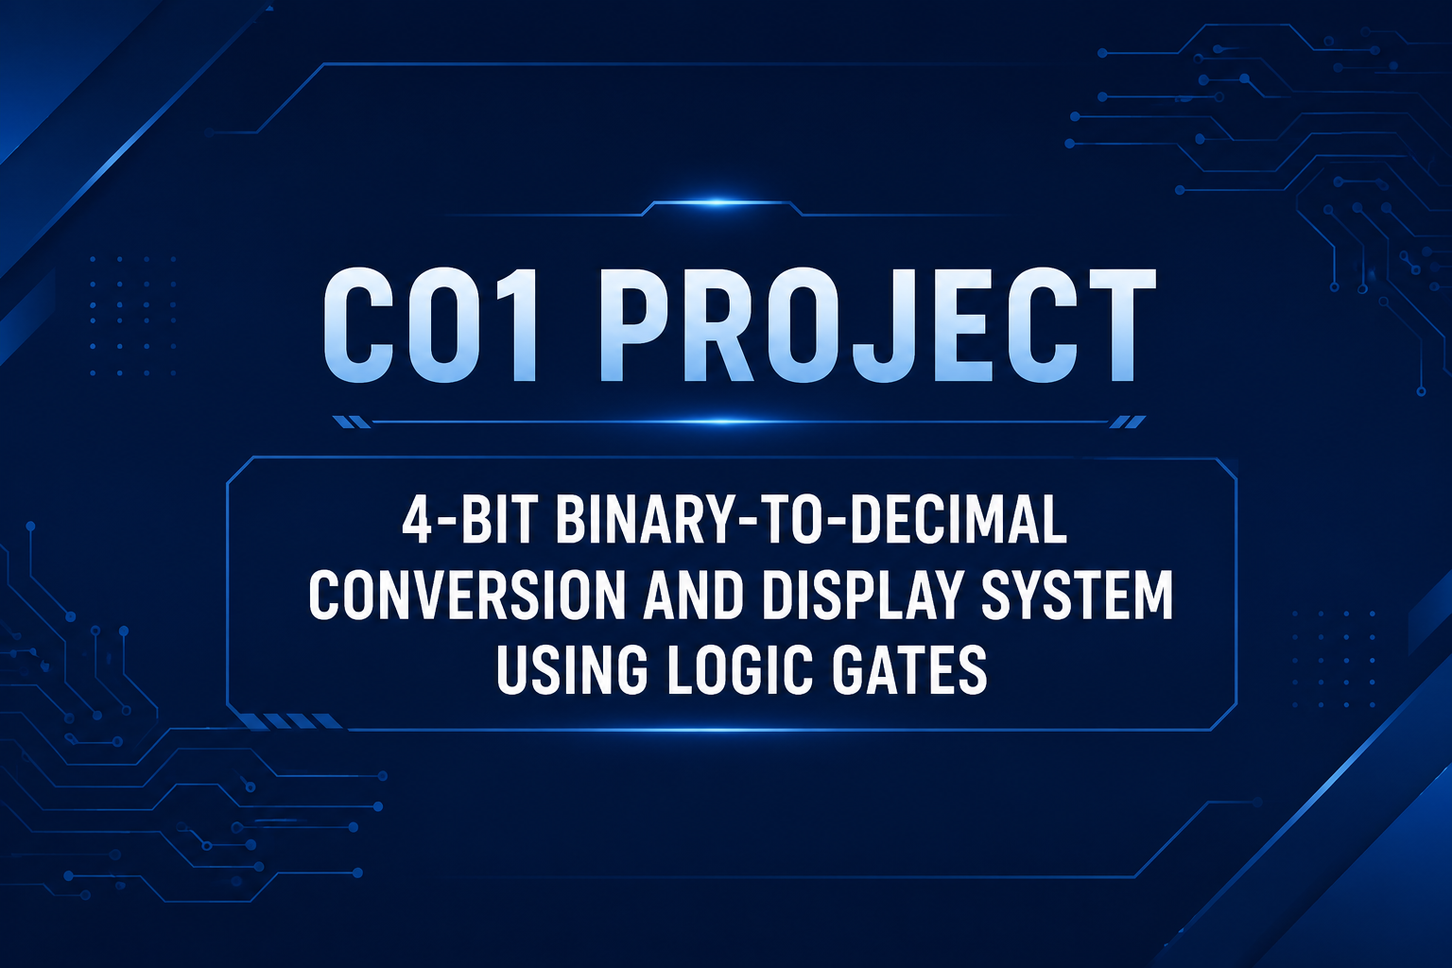

Slide 2
Introduction
Understanding binary input and decimal display
• Binary numbers use only two digits: 0 and 1.
• Digital systems naturally process information in binary form.
• A 4-bit input can represent values from 0 to 15.
• Converting the binary value for display makes the result easier for people to read.
• This project demonstrates the conversion and display process using digital logic.
2

Slide 3
Problem Statement & Objectives
Problem: Design a digital circuit that accepts a 4-bit binary input and produces the corresponding decimal output for display.
• Accept 4-bit binary input using B3, B2, B1 and B0.
• Convert the input into its corresponding decimal value.
• Implement the required logic using gates.
• Display the result using a 7-segment display.
• Simulate and test the circuit in Logisim.
3

Slide 4
Working Principle
Binary input is processed and then presented as a readable decimal display
4-BIT INPUT
B3 B2 B1 B0
LOGIC GATE
CIRCUIT
Conversion
Logic
DECIMAL
OUTPUT
0–15
7-SEGMENT
DISPLAY
Visual
Output
Examples
0000 → 0 • 0001 → 1 • 0101 → 5 • 1001 → 9
1010 → 10 • 1011 → 11 • 1111 → 15
4

Slide 5
Logic Circuit Design
Logisim-style implementation using four input switches, logic blocks and a 7-segment display
B3
B2
B1
B0
8
7-SEGMENT DISPLAY
Logic
Gate 1
Logic
Gate 2
Logic
Gate 3
Logic
Gate 4
OUTPUT / DECIMAL
LOGIC
Circuit concept: B3–B0 are processed by combinational logic to generate the required display signals.
5

Slide 6
Truth Table
All possible 4-bit inputs and their decimal values
Binary Input | Decimal Value
0000 | 0
0001 | 1
0010 | 2
0011 | 3
0100 | 4
0101 | 5
0110 | 6
0111 | 7
1000 | 8
1001 | 9
1010 | 10
1011 | 11
1100 | 12
1101 | 13
1110 | 14
1111 | 15
6

Slide 7
Simulation & Results
Testing the circuit in Logisim
Input: 0000
Decimal: 0
PASS
Input: 0101
Decimal: 5
PASS
Input: 1001
Decimal: 9
PASS
Input: 1111
Decimal: 15
PASS
• Binary input is provided through switches.
• Logic gates process the input combination.
• The resulting decimal value is represented on the display.
• Multiple input combinations are tested against expected values.
7

Slide 8
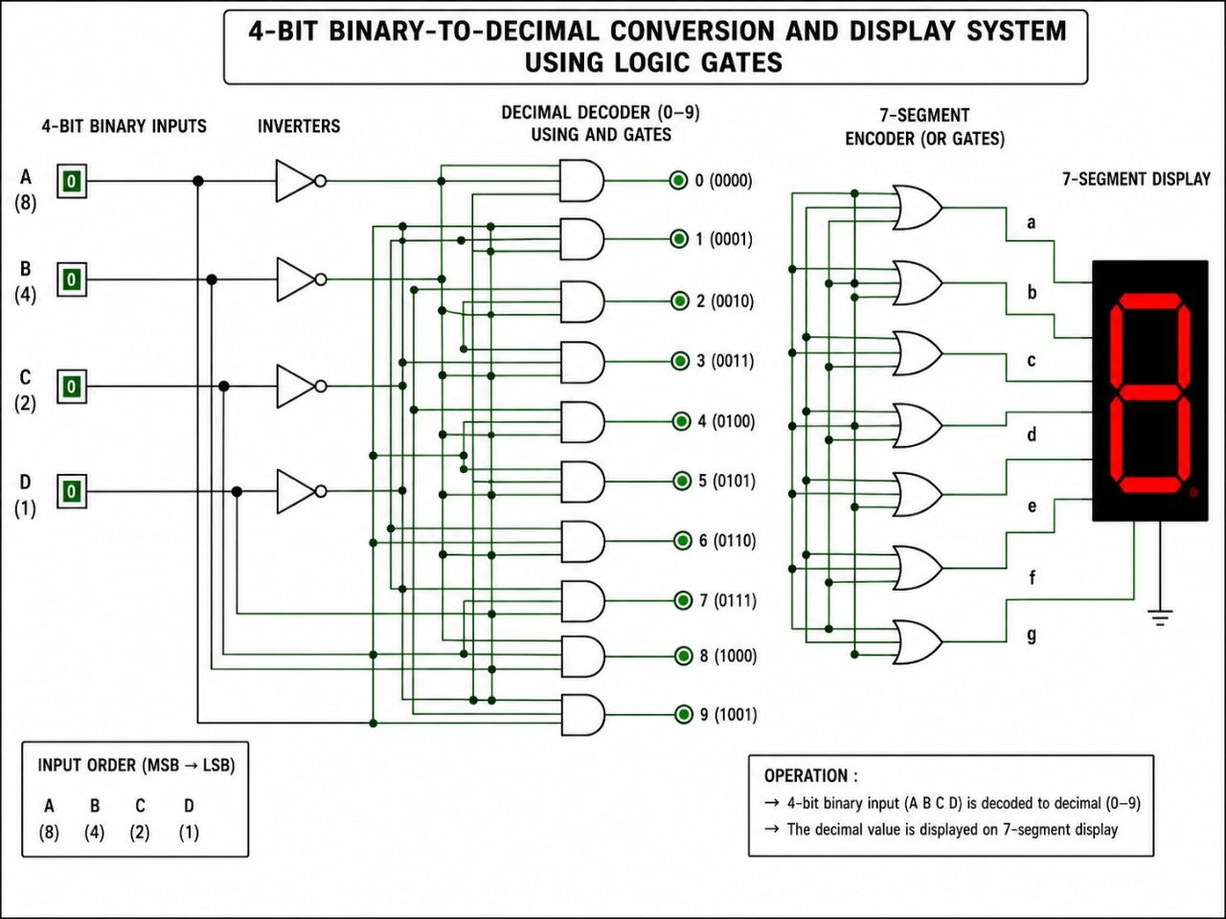

Slide 9
CONCLUSION & FUTURE SCOPE
Conclusion
• Designed a 4-bit binary conversion and display system.
• Demonstrated combinational logic and digital gates.
• Verified representative inputs through simulation.
• Provides an intuitive decimal representation of binary data.
Future Scope
• Larger-bit binary inputs
• BCD conversion and multi-digit displays
• FPGA implementation
• Microcontroller integration
• Real-time digital display systems

Slide 10
THANK YOU
E.YASWANTH2620030377
LOKESH-2620030368
GUNA NANDINI-2620030427
HAMISINI-2620030382

