Slide 1

Department of Electronics and Communication Engineering
DETECTION AND CLASSIFICATION OF DIABETIC RETINOPATHY THROUGH HEMORRHAGES SEGMENTATION USING CNN
Presented By
P. LOKANADHA VENKATA SAI (A21126512110)
G. SAI HARSHA VARDHAN (A21126512087)
MD. ABDUL REHAMAN BAGI (A21126512204)
V. CHANDRA SHEKAR (A21126512125)
Guided by
Mrs. G. INDIRA DEVI
ASSISTANT PROFESSOR,
ECE, ANITS.

Slide 2
ABSTRACT
Diabetic retinopathy (DR) is a complication of diabetes that can damage both the retina and other small blood vessels throughout the body. Hemorrhages are symptoms that occurs in the moderate stage of DR. Accurate and reliable detection of Hemorrhages in colour fundus images has great importance for DR screening. This project investigates 2D CNN algorithm approach for detecting retinal hemorrhages using the APTOS 2019 Blindness Detection dataset. This implementation process involves five stages. During the first stage, the input image is pre-processed by CLAHE, secondly optic disc identification & removal is performed by Contour detection and thresholding techniques, third stage is blood vessel segmentation using the Frangi Filter, fourth stage is hemorrhages segmentation by contour detection, and final stage is CNN classification. The results obtained by this approach are 97%-accuracy, 95%-sensitivity, 98%-specificity, and 97%-precision.

Slide 3
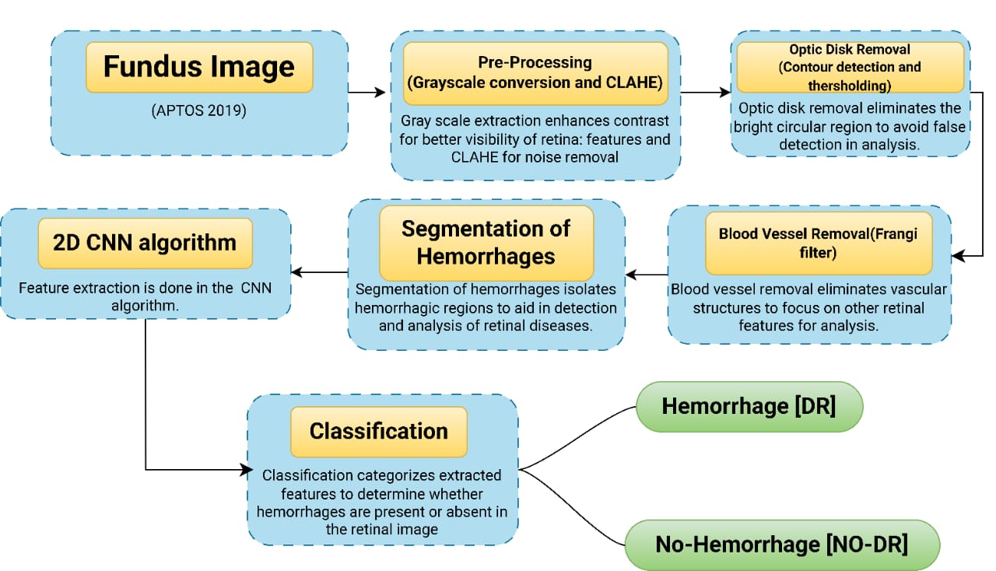
METHODOLOGY

Slide 4
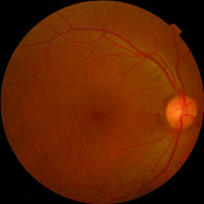
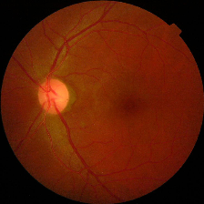
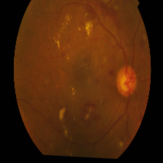
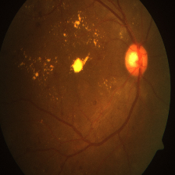
FUNDUS IMAGES (APTOS-2019 DATASET)
Asia Pacific Tele-Ophthalmology Society 2019 Blindness Detection (APTOS 2019 BD) dataset comprises 3292 samples gathered from several people in India.
These Fundus images were taken over an extended period of time in a variety of situations and conditions.
Out of 3292, 1487 images are with lesion(Hemorrhages) and 1805 images with no Hemorrhages images.
Dataset link: https://www.kaggle.com/datasets/mariaherrerot/aptos2019
Some of the Images are
A) No Hemorrhages
B) Hemorrhages

Slide 5
PRE-PROCESSING
1
Image Conversion
2
Image Resizing
1
1
Images may need to be resized to a standard size for consistent processing and analysis across different patients and datasets.
Changes each image’s size to 224x224 pixels.
The acquired images are typically in color format. They are converted to grayscale to simplify processing and focus on relevant features.
3
CLAHE
Contrast Limited Adaptive Histogram Equalization (CLAHE) is a powerful image enhancement technique that improves local contrast in retinal images.

Slide 6
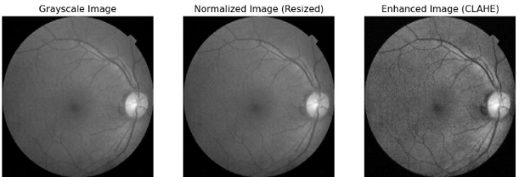
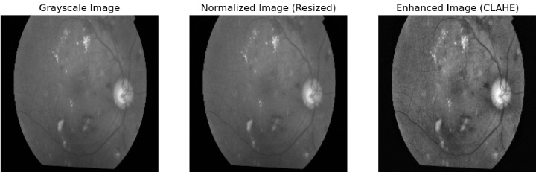
OUTPUT OF PRE-PROCESSING
Images with
No Hemorrhages
Images with
Hemorrhages

Slide 7
OPTICAL DISK REMOVAL
Thresholding and Morphology: A binary threshold is applied to highlight the optic disk, followed by morphological operations with a large kernel to clean up noise and refine the detected region.
Contour Detection: It removes optic disk specifically neglect other features.
Mask Inversion: Inverts the mask to isolate the optic disc area.
Bitwise Operations: Performs logical operations (AND, OR, NOT, etc.) on images and masks.

Slide 8
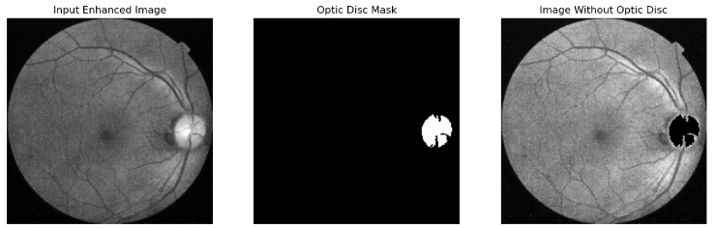
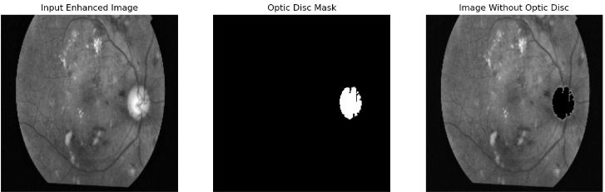
OUTPUT OF OPTIC DISC REMOVAL

Slide 9
BLOOD VESSEL ENHANCEMENT AND REMOVAL
Frangi Filter (Frangi Vessel Filter): The frangi() function is likely referring to the Frangi filter, a technique used for vessel enhancement in images. It is specifically designed to highlight tubular structures like blood vessels in medical images.
Threshold-based segmentation: By converting the input image into a binary image, isolating regions based on intensity values (pixels above 127 become white, others become black).
Morphological Operations: Morphological operations are essential tools in image processing for refining binary images, such as segmented masks of blood vessels. These operations are typically used to remove noise, fill gaps, and enhance the overall structure of segmented objects.

Slide 10

Frangi Filter for Vessel Enhancement
The Frangi filter is a specialized filter designed to enhance blood vessels in retinal images, making them easier to detect and analyze.
1
2
The filter is applied to the pre-processed image, enhancing the visibility of blood vessels by emphasizing their elongated shapes.
The Frangi filter enhances the contrast between vessels and surrounding tissue, facilitating accurate segmentation and analysis of vessel characteristics.
3

Slide 11
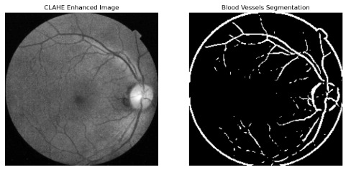
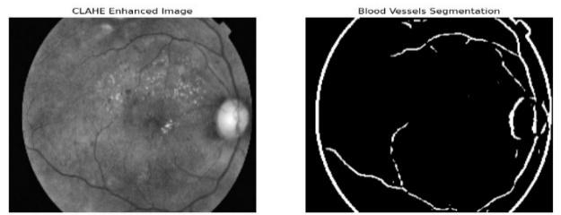
Mask Creation and Inversion: A mask for the blood vessels is created by setting the pixels in the binary vessel image (where vessel intensity is greater than 0) to 255. Then, the mask is inverted to prepare for removing the vessels.
Bitwise Operations: Used to isolate and remove the vessels from the image using the mask.
OUTPUT OF BLOOD VESSELS SEGMENTATION

Slide 12
SEGMENTATION OF HEMORRHAGES
Enhancement: To improve the visibility of hemorrhages and make them easier to segment. Cleaner and more prominent segmentation of hemorrhages.
Thresholding: To separate hemorrhagic regions (dark) from the background. A binary image where hemorrhagic areas are white (255), and the background is black (0).
Contour: To identify the boundaries of connected hemorrhagic regions.Precise delineation of the hemorrhagic areas, which can be used to create a refined mask or analyze individual regions.

Slide 13
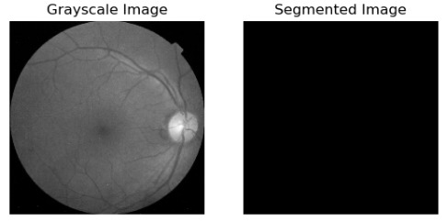
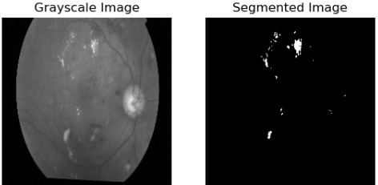
OUTPUT OF HEMORRHAGES SEGMENTATION
Fig1: Input Image with No Hemorrhages​ output
Fig2: Input Image with Hemorrhages​ output

Slide 14
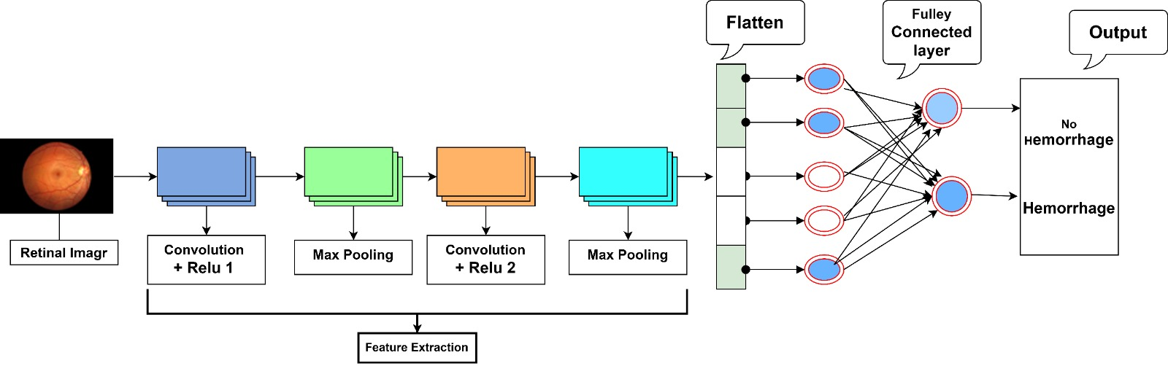
Classification and CNN Algorithm:

Slide 15
2D CNN ALGORITHM:
Convolutional layer:
Applies 32 filters of size 3x3 to detect patterns in the image.
Convolution is a mathematical operation used to extract the features of an image.
Feature enable image processing such as bluring, edge detection etc.
Example:
1 3 5 7 9 0
3 5 7 9 1 2
5 7 9 1 2 4
7 9 1 2 4 6
1 2 4 0 3 8
0 3 8 2 4 0
0 1 0
1 0 1
0 1 0
20 28 16 22
28 16 20 10
17 24 6 13
17 11 11 16

Slide 16
MAX POOLING LAYER:
Reduces Complexity of the image data by down.
Sampling the feature maps.
It focuses on essential details and maintain the overall pattern or Structure.
Reduces the Spatial Size of the image.
Takes 2x2 window and selects the max value in the region.
Now, it's reduces computation and helps in generalization.
Example:
3 2 0 0
0 7 1 3
5 2 3 0
0 9 2 3
7 3
9 3
Max value

Slide 17
Flattening Layer:
Converts the 2D Feature maps into a 1D Vector to Pass into the Fully Connected Layer.
Example:
3
7
3
6
8
5
7
6
3 6 7
7 8 6
3 5 7
7

Slide 18
Dense Layer:
Dense Layer is a Fully-Connected layer(with 128 neurons).
Extracts high-level Features from the flattened image data.
Dense is a output layer.
'1' Specifies that there is a single neuron in this output layer.
Sigmoid maps the input values to a range between 0 and 1.
Dropout layer:
Randomly drops 50% of neurons during training.
Prevents overfitting and helps generalization.

Slide 19
Dataset(Hemorrhages)
Dataset | Dimension in Pixels | Data |  | Training set | Test set
HM & NON-HM | 244×244 | HM(1487) | NO_HM(1805) | 2633(80%) | 659(20%)
Confusion Matrix Details
True Positive (TP): Indicates that HEMORRHAGES is correctly predicted.
True Negative (TN):Indicates that NO- HEMORRHAGES is correctly predicted.
False Positive (FP) :Indicates that NO- HEMORRHAGES is erroneously predicted as HEMORRHAGES.
False Negative(FN):Indicates that HEMORRHAGES is erroneously predicted as NO- HEMORRHAGES.

Slide 20
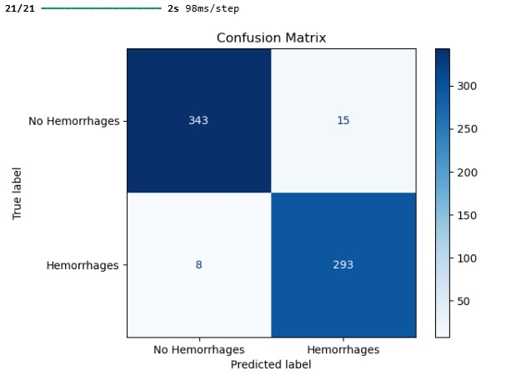
Confusion matrix(Testing Images)
TP | 293
TN | 343
FP | 15
FN | 8
The total count from the confusion matrix values is:
TP+TN+FP+FN=659 (20% testing set)

Slide 21
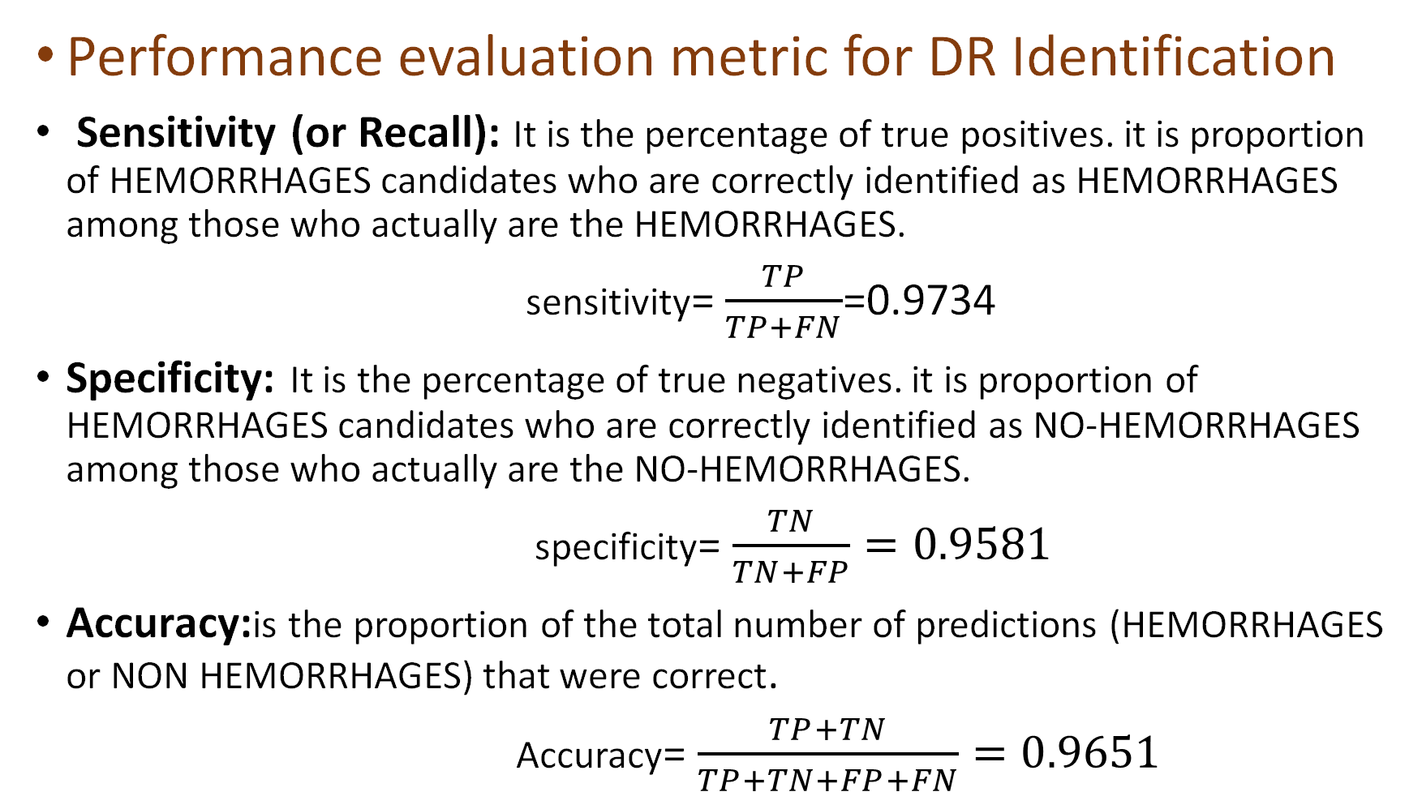
Performance evaluation metric for DR Identification
Sensitivity (or Recall): It is the percentage of true positives. it is proportion of HEMORRHAGES candidates who are correctly identified as HEMORRHAGES among those who actually are the HEMORRHAGES.
sensitivity= $\frac{TP}{TP+FN}$=0.9734
Specificity: It is the percentage of true negatives. it is proportion of HEMORRHAGES candidates who are correctly identified as NO-HEMORRHAGES among those who actually are the NO-HEMORRHAGES.
specificity= $\frac{TN}{TN+FP}=0.9581$
Accuracy:is the proportion of the total number of predictions (HEMORRHAGES or NON HEMORRHAGES) that were correct.
Accuracy= $\frac{TP+TN}{TP+TN+FP+FN}=0.9651$

Slide 22
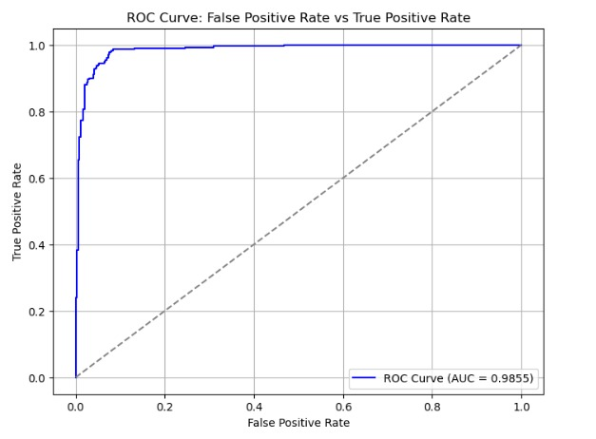
ROC ANALYSIS
True positive rate (TPR) against false positive rate (FPR) can be measured,
Where,
TPR =TP/(TP+FN)=0.9855
FPR = FP/(FP+TN)=0.0145
All possible combinations of TPR and FPR compose a ROC space.

Slide 23
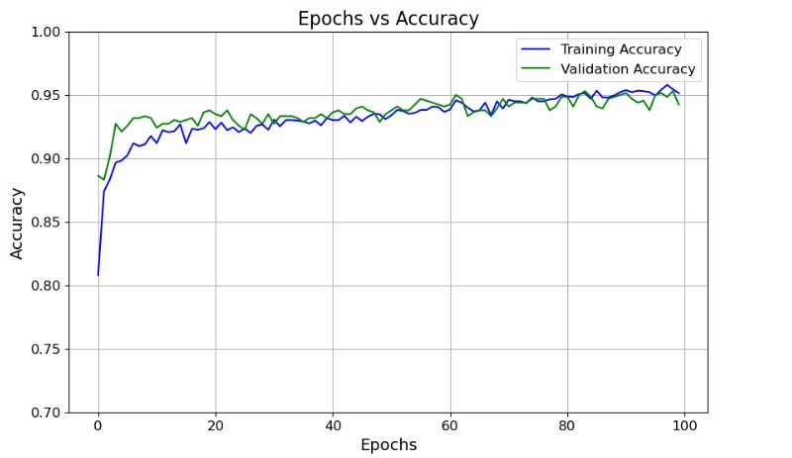
EPOCHS ANALYSIS
An epoch curve refers to a graph that shows the performance of a model (e.g., accuracy or loss) over multiple epochs during training.
Epoch: A single pass of the entire dataset during model training.
The curve helps monitor progress, such as:
Decreasing loss: Indicates the model is learning.
Increasing order : May suggest overfitting or a need

Slide 24
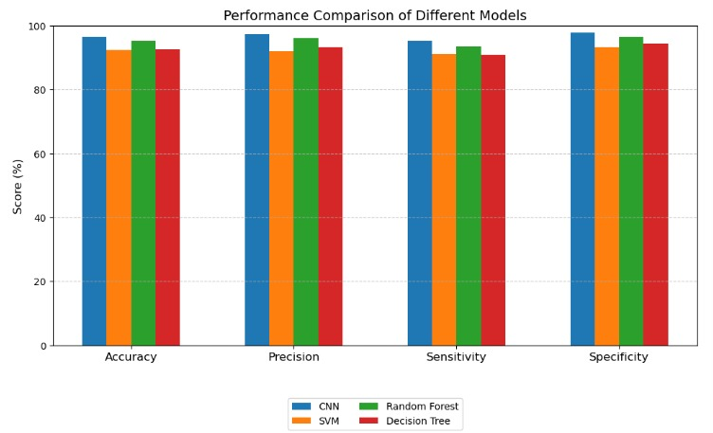
Comparison of different Techniques:

Slide 25
Classification Report of Training Set:
 | Precision | Recall | F1 - Score | Support
0 | 0.97 | 0.96 | 0.97 | 1447
1 | 0.95 | 0.96 | 0.96 | 1186
Accuracy |  |  | 0.96 | 2633
Macro avg. | 0.96 | 0.96 | 0.96 | 2633
Weighted avg. | 0.96 | 0.96 | 0.96 | 2633
Classification Report of Test Set:
 | Precision | Recall | F1 - Score | Support
0 | 0.97 | 0.93 | 0.95 | 358
1 | 0.92 | 0.96 | 0.94 | 301
Accuracy |  |  | 0.94 | 659
Macro avg. | 0.94 | 0.94 | 0.94 | 659
Weighted avg. | 0.94 | 0.94 | 0.94 | 659

Slide 26
Current Progress
Obtained the required result.
Submitted to conference in 11th International Conference On Smart Computing and Communication(ICSCC 2025).
50% Documentation is completed.

Slide 27
Monthly Work plan
Month | Activity | Status
July | Literature review and Abstract finalization | Completed
August | Study about methodology | Completed
September | Collection of Dataset & Study | Completed
October | Working on project code | Completed
November | Implementation | Completed
December | Testing | Completed
January | Paper Communication | Completed
February | Rough copy preparation and Submission | Completed
March | Final document preparation & Submission

Slide 28
CONCLUSION
This project proposes a CNN based model to successfully detect and classify retinal hemorrhages. This method consists of a structured pipeline composed of image preprocessing, optic disc removal, blood vessel segmentation, segmentation of hemorrhages feature extraction and finally classification. 97%-Accuracy, 95%-Sensitivity, 98%-Specificity, and 97%-Precision are obtained. The results of confusion matrix and ROC curve analysis showed the highest discriminatory power of proposed model with AUC as 0.9910 (99.10%) thus almost represents almost optimal. Moreover, the classification accuracy, precision, recall, and specificity of CNN are better than the SVM,Random forest,Decision tree, resulting in confirmation of the importance of CNN in medical image analysis.

Slide 29
Thank you…...

