Slide 1
A Framework for prevention and detection of Insider attacks in cloud Infrastructure
By
T.Gunasekhar,
Research Scholar,
Dept of CSE,
K L University
Under the Supervision of
Dr.K.Thirupathi Rao,
Professor, Dept of CSE,
K L University
17/03/17

Slide 2
Abstract
Cloud computing is an evolutionary model that allows cloud consumer to request resources with on-demand service and utilize the resources using pay per usage model.
Due to this flexibility, the cloud computing enforcing enormous security threats. As per the Computer Security Alliance, an insider threat is a major threat in cloud computing environment.
This threat greatly affects the data integrity and confidentiality of cloud consumer applications, services, or data. This work focuses on insider attacks on consumer virtual machines and proposed a framework that enforces data integrity and confidentiality, minimal TPM operations, and reduced and verifiable trusted computing base.
Our experimental results shows that customized TrustVisor hypervisor performing well and it can prevent the insider attacks in cloud environment.
T Gunasekhar, K L University
17/03/17
2

Slide 3
Contents
Introduction
Security issues in cloud computing
Literature review
Problem Definition
Objectives
Trustworthy Framework
Results and Discussions
Conclusion
Future work
T Gunasekhar, K L University
17/03/17

Slide 4
Introduction
Cloud computing is a model for enabling convenient, on-demand network access to a shared pool of configurable computing resources (e.g., networks, servers, storage, applications, and services)
It can be rapidly provisioned and released with minimal management effort.
It provides high level abstraction of computation and storage model.
It has some essential characteristics, service models, and deployment models.

Slide 5
Definition
Virtualization is the ability to run multiple operating systems on a single physical system and share the underlying hardware resources*
It is the process by which one computer hosts the appearance of many computers.
Virtualization is used to improve IT throughput and costs by using physical resources as a pool from which virtual resources can be allocated.

Slide 6
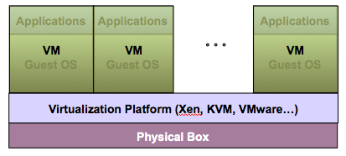
Virtualization Architecture
A Virtual machine (VM) is an isolated runtime environment (guest OS and applications)
Multiple virtual systems (VMs) can run on a single physical system

Slide 7
Hypervisor
A hypervisor, a.k.a. a virtual machine manager/monitor (VMM), or virtualization manager, is a program that allows multiple operating systems to share a single hardware host.
Each guest operating system appears to have the host's processor, memory, and other resources all to itself. However, the hypervisor is actually controlling the host processor and resources, allocating what is needed to each operating system in turn and making sure that the guest operating systems (called virtual machines) cannot disrupt each other.

Slide 8
Virtualization in Cloud Computing
Cloud computing takes virtualization one step further:
You don’t need to own the hardware
Resources are rented as needed from a cloud
Various providers allow creating virtual servers:
Choose the OS and software each instance will have
The chosen OS will run on a large server farm
Can instantiate more virtual servers or shut down existing ones within minutes
You get billed only for what you used

Slide 9
Virtualization Security Challenges
The trusted computing base (TCB) of a virtual machine is too large.
TCB: A small amount of software and hardware that security depends on and that we distinguish from a much larger amount that can misbehave without affecting security*
Smaller TCB → more security
*Lampson et al., “Authentication in distributed systems: Theory and practice,” ACM TCS 1992

Slide 10
Cloud computing appealing but still concerns
Many companies can reduce costs using CC services
But, customers still concerned about security of data
Data deployed to CC services can leak out
17/03/17
T Gunasekhar, K L University
10
Notes:
- As recent surveys have revealed, by resorting to cloud computing services, many companies can greatly reduce costs by offloading data and computation to these services.
Simultaneously, many are still hesitant due to outstanding security threats that raise concerns among customers.
Among the most important ones is the potential for data to leak out. This is the threat we’re addressing
10

Slide 11


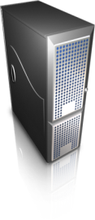
Potential data leakage at the provider site
Customer pay virtual machine (VM) to compute data
E.g., Amazon EC2
Privileged user with access to VM state can leak data
Accidentally or intentionally
Customer
Privileged
User
Computation & data
Provider
T Gunasekhar, K L University
17/03/17
11
Notes:
- Users allocate virtual machines at some cloud service provider to run their computation – e.g. Amazon EC2.
- Typically they also use some storage service for persistence.
- Potential risk of confidentiality violation: a user with enough privileges to access the infrastructure can access data in the VM memory or in storage and leak data
-This can be the result of some operation performed by a system administrator, accidentally but also intentionally.
- So, what can users do to protect their data?
11

Slide 12
Issues with current VMM
No protection from privileged user
E.g., XenAccess
Support operations that export VM state
Migration, suspension, etc.
Large trusted computing base (TCB)
Guest VM1
Guest VMn
…
VMM
Privileged User
Hardware
Node
17/03/17
12
Notes:
-Existing VMMs have important limitations that prevent us from using them directly to solving our problem.
- The figure represents the typical software stack with the VMM managing the resources of the guest VMs and a privileged used setting up the VMM.
The first limitation of state of the art VMMs is the lack of protection of guest virtual machines from privileged users.
For example, in Xen, we can use a VM introspection library called Xenacess allows a process executed by the administrator of the machine to map arbitrary memory pages and intercept IO of the VMs.
-The second issue, these VMMs provide operations such as migration and suspension that export the state of the VM state of the VM outside its physical memory and can easily be used to access the VM memory.
-Finally, current VMMs still rely on large trusted computing bases, which include, for example the drivers. In the case of Xen a full operating system (Dom0). VMMs with bigger TCB have higher probability to have bugs. To implement a trusted VMM that can convince about its security properties, we believe it’s fundamental to reduce the TCB.
So, our goal is to design and implement a trusted VMM.
12

Slide 13
Challenges:
Secure memory management
Prevent guest VM inspection & keep TCB small
Provide narrow interface for launching, migration, etc.
Migration ensure destination is trusted
Efficient
Possible research: limit TCB to memory management
Guest VM1
Guest VMn
…
VMM
Memory Management
Privileged
User
Hardware
Node
17/03/17
13
Notes:
First of all, the VMM should be able to prevent memory inspection by a privileged user, while at the same time we must minimize the TCB. A challenge here is to put device drivers outside the TCB because drivers can access physical memory using the DMA interface. One solution we are investigating is to use a IOMMU.
Second, the VMM should still provide a narrow interface that allows launching, migration and other operations in a way that it does not compromise the confidentiality of the guest VMs and limits the management operations.
In addition, the VMM has to guarantee that migration is only allowed to nodes inside the perimeter and running a trusted VMM.
Also, it’s crucial that these changes do not severely impact the performance of the VMs, since it’s goal is to be deployed by real service providers.
Finally, one possible research direction we are exploring is to see whether or not it is possible to further limit the TCB to the memory management operations of the VMM.
But, all of this is future work.
13

Slide 14
Need solution to secure the computation state
Encryption can secure communications and storage
But, encryption is ineffective for computation
Raw data kept in memory during computation
Provider benefits from providing a solution
17/03/17
T Gunasekhar, K L University
14
Notes:
Encryption would be the first approach.
While encryption can be used to secure communications and storage, it’s not effective is data needs to be computed, as it is the case of data processed by a VM.
The reason being, the raw data must be kept in memory in order for the processor can compute it. At this point, data can be directly inspected from the memory.
Thus, there’s the need for a solution to protect the confidentiality of the computation
At the same time, the service provider has incentives to minimize the risks of data leakage. By doing so, it can offer more security guarantees and attract more customers.
14

Slide 15
TRUSTED CLOUD COMPUTING PLATFORM
Goal: Make computation of virtual machines confidential
Deployed by the service provider
Customer can verify that computation is confidential
17/03/17
T GUNASEKHAR, K L University
15
Notes:
-We present Trusted Cloud Computing Platform
This is our goal:
-build a system to make the computation of a customer’s virtual machines confidential from privileged users of the cloud provider.
-we rely on the cooperation of the service provider who deploys it on the service backend.
-provides customers the ability to verify that the system is deployed, and therefore can check that their computation is confidential at that service provider.
Before diving into the details, let me first clarify the model and assumptions we make.
15

Slide 16
Literature review
[1] Seshadri, A., Luk, M., Qu, N., and Perrig, A. (2007). SecVisor: A Tiny Hypervisor to Provide Lifetime Kernel Code Integrity for Commodity OSes. In Proceedings of Twentyfirst ACM SIGOPS Symposium on Operating Systems Principles, SOSP ’07, pages 335– 350, New York, NY, USA. ACM.
Summary:
SecVisor is a small code base hypervisor for commodity systems.
Objectives
Protecting an operating system from advanced attacks such as kernel rootkits.
A reduced trusted computing base to permit formal validation
Reduced external interface to minimize the attack surface
This concept not working with the cloud platforms
17/03/17
T Gunasekhar, K L University

Slide 17
Literature Review
[2] Srivastava, A., Raj, H., Giffin, J., and England, P. (2012). Trusted VM snapshots in untrusted cloud infrastructures. In Proceedings of the 15th international conference on Research in Attacks, Intrusions, and Defenses, RAID’12, pages 1–21, Berlin, Heidelberg. Springer-Verlag.
Summary:
Hyper Shot is a hypervisor-level mechanism designed to obtain trustworthy virtual machine snapshots.
Objectives
Relocating the snapshot feature into the hypervisor
A higher privilege level of execution guarantee
Removing the privileged user to reduce the TCB
Not concerned with the confidentiality threats
17/03/17
T Gunasekhar, K L University

Slide 18
Literature Review
[3] Murray, D., Milos, G., and Hand, S. (2008). Improving xen security through disaggregation. In Proceedings of the fourth ACM SIGPLAN/SIGOPS international conference on Virtual execution environments, VEE ’08, pages 151–160, New York, NY, USA. ACM
Summary:
They propose the size of the interface and the size of the TCB state space as a complement
Objectives
A TCB comprised of the hypervisor
The lines of code used for interface sanitizing code
Security sensitive operations to a special-purpose VM
This solution does not assure data integrity and Confidentiality
17/03/17
T Gunasekhar, K L University

Slide 19
Literature Review
[4] Steinberg, U. and Kauer, B. (2010). NOVA: a microhypervisor-based secure virtualization architecture. In Proceedings of the 5th European conference on Computer systems, EuroSys ’10, pages 209–222, New York, NY, USA. ACM.
Summary:
The NOVA approach is based on a micro hypervisor architecture instead of the most common monolithic approach used in solutions such as the Xen hypervisor and the Linux Kernel- based Virtual Machine (KVM).
Objectives
To reduce the trusted computing base
Alternative approach to the virtualization of computational resources
NOVA does not target the malicious insider threat
17/03/17
T Gunasekhar, K L University

Slide 20
Literature Review
[5]Sailer, R., Jaeger, T., Valdez, E., Caceres, R., Perez, R., Berger, S., Griffin, J. L., and Doorn, Leendert van (2005). Building a MAC-Based Security Architecture for the Xen Open-Source Hypervisor.
Summary:
The sHype hypervisor security architecture implements a mandatory access control policy-based reference monitor for the Xen hypervisor.
Objectives
To use formal security policies that control the sharing of resources between virtual machines through the use of a reference monitor.
A malicious administrator can attack this solution because they are responsible for defining the policies that state which security mechanisms should be deployed.
17/03/17
T Gunasekhar, K L University

Slide 21
Literature Review
[6] Zhang, F., Chen, J., Chen, H., and Zang, B. (2011). Cloudvisor: retrofitting protection of virtual machines in multi-tenant cloud with nested virtualization. In Proceedings of the Twenty-Third ACM Symposium on Operating Systems Principles, SOSP ’11, pages 203–216, New York, NY, USA. ACM.
Summary:
CloudVisor is yet another different secure virtualization architecture where a featherweight hypervisor is placed between the virtual machine monitor and the hardware.
Objectives
Data Confidentiality and Integrity
Trusted boot
CloudVisor incurs serious performance penalties, in some cases over 22%, when compared with the Xen hypervisor.
17/03/17
T Gunasekhar, K L University

Slide 22
Literature Review Summary
Solution | Confidentiality | Integrity | TCB | Cloud | Insider Threat
SecVisor | ✔ | ✔ | ✔ | ✘ | ✘
HyperShot | ✘ | ✔ | ✘ | ✔ | ✘
Dom0 Disaggregation | ✔ | ✔ | ✔ | ✔ | ✘
NOVA | ✘ | ✘ | ✔ | ✔ | ✘
sHype | ✔ | ✔ | ✘ | ✔ | ✘
CloudVisor | ✔ | ✔ | ✔ | ✔ | ✔
Xoar | ✘ | ✔ | ✔ | ✔ | ✘
VMGuard | ✘ | ✔ | ✘ | ✔ | ✘
Min-V | ✘ | ✘ | ✔ | ✔ | ✘
T Gunasekhar, K L University
17/03/17

Slide 23
The threat model:
User with root privileges
Providers require staff with privileged access to the system
E.g., maintenance of software and workload
User with full privileges on any machine
Configure, install and run software, remotely reboot
Setup attacks to access VM state
17/03/17
T Gunasekhar, K L University
23
Notes:
-To our knowledge, cloud providers need the assistance of staff to administer the system:
-- Manage the software, the workloads, resource management, etc.
-To do these operations, this staff requires privileged access to the system.
In our threat model, we assume that the attacker can be one of such users, with full privileges on any machine.
With such privileges, he has full control over the machine: reconfigure the machine, install and run arbitrary software, reboot, and so on.
It’s easy to see that, such a user has full freedom to violate the VM confidentiality in numerous ways.
What about the hardware?
23

Slide 24
Rely on provider to secure the hardware
Access to hardware can bypass any sw-based protections
E.g., cold boot attacks
Leverage security protections deployed by providers
E.g., physical security perimeter, surveillance
These protections can mitigate hw-based attacks
17/03/17
T Gunasekhar, K L University
24
Notes:
-If one has access to the hardware, he can bypass any software based protections and inspect the content of the memory.
-Techniques such as cold boot attacks, have been shown to be successful at extracting information from the memory.
-Fortunately, providers already deploy strict security protections to the hardware. They enforce security perimeters, with surveillance and restricted access policies.
-Because these attacks based on the hardware are more complex, require time, and require physical access to the host we believe that these protections would suffice to detect and prevent these attacks before being successful.
Therefore, in our threat model, the attacker cannot perpetrate hw-based attacks.
24

Slide 25
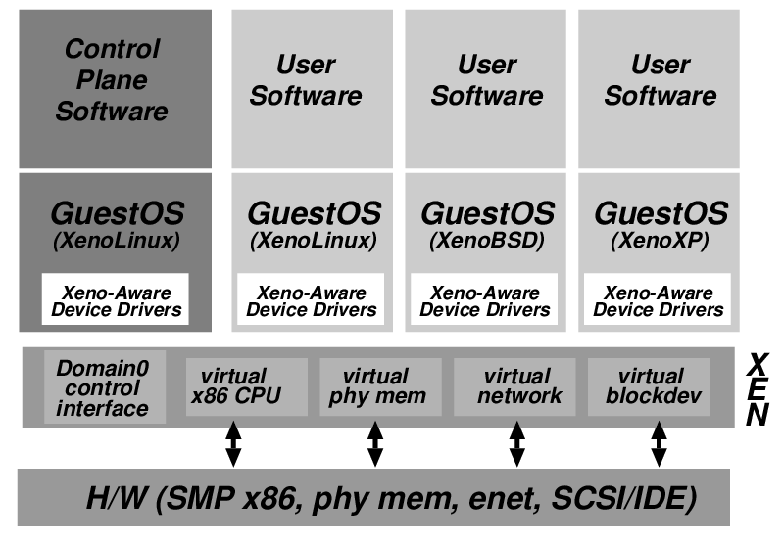
Xen and the Threat Model
Management VM – Dom0
Guest VM – Dom
Dom0 may be malicious
Vulnerabilities
Device drivers
Careless/malicious
administration
Dom0 is in the TCB of DomU because it can access the memory of DomU, which may cause information leakage/modification

Slide 26
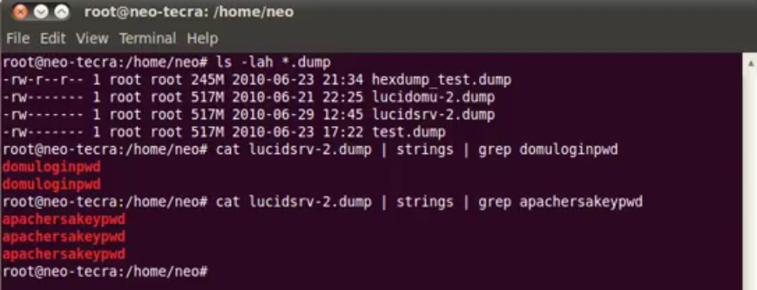
Attack pattern

Slide 27
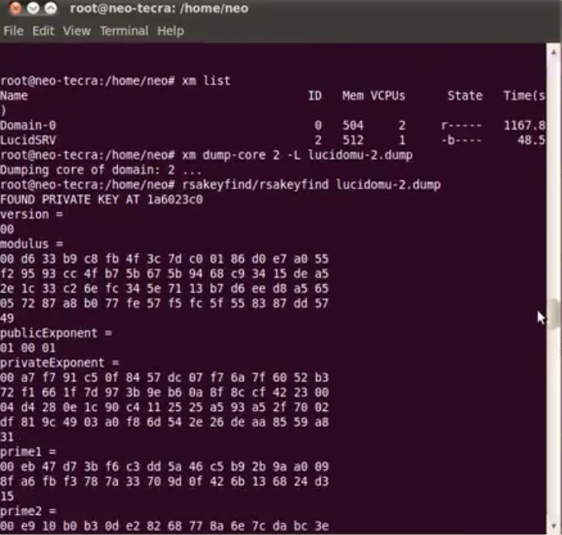
Attack concept

Slide 28
Objectives
Isolated execution environment for data integrity and confidentiality
Reduced Trusted Computing Base(TCB)
Minimal Trusted Platform Operations
Verifiable Trusted computing Base
17/03/17
T Gunasekhar, K L University

Slide 29
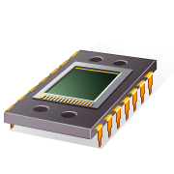

Trusted computing techniques
are a good start
Trusted computing platforms
Remote party can identify the software stack on host
Trusted Platform Module (TPM)
Secure boot
Remote attestation
Trusted
Computing
Platform
Trusted
Software
TPM
Remote attestation
17/03/17
29
Notes:
Trusted computing techniques are a good place to start.
Essentially, a trusted computing platform is an ensemble of hardware and software components running on some host.
Their most interesting property is that they indicate to a remote user which configuration – both hw and sw – the host has booted.
To enforce these properties, TPs implement mechanisms of secure boot and remote attestation.
A crucial component in the implementation of these mechanisms is the TPM, a hardware chip now present in commodity hardware.
If the software guarantees its own integrity, then the remote party can identify then through attestation the software that is actually running on the machine until it gets rebooted. This property is very interesting.
Next, I’ll present our proposal to extend this approach in order to make computation of cloud services confidential.
29

Slide 30
Proposed Trustworthy Framework
Guest VM1
Guest VM2
Guest
VMn
PAL
PAL
…
PAL
Node controller
Customer
TrustVisor
Crypto
TEE
TPM Emulator
Hardware
TPM
I/O devices
Node

Slide 31
TRUSTVISOR
Which Developed on XMHF architecture
Provides a safe execution environment of security sensitive code blocks
It protects sensitive code and data in untrusted cloud platforms from malware
e.g kernel level rootkits
It leverages commodity x86 hardware virtualization with support of device exclusion and nested page tables to enforce MMU-based protection itself and application level security sensitive code blocks from untrusted OS ,applications and malicious DMA capable devices.
This reduces the trusted computing base and interface in order to reduce the attack surface

Slide 32
TRUSTVISOR
It employs a two level mechanism to integrity measurement.
First level mechanism employed is systems physical TPM
Second level is implementation of Micro-TPM
Micro TPM executes as a part of the TrustVisor, thereby alleviating the adverse performance impact of frequent usage of DRTM
Commercial VMM as TCB may ruling out the possibility of formal verification with known techniques
TrustVisor hypervisor provides set of libraries to develop a Piece of application logic that isolates the memory from host OS

Slide 33
Objective: Data Confidentiality
Security Sensitive code Blocks( PAL)
TrustVisor has three execution modes
a) Host mode b) Legacy OS c) Secure Guest Mode Mode
App
App
App
PAL
PAL
PAL
Untrusted Legacy OS
Untrusted Legacy OS
Untrusted Legacy OS
TrustVisor
TrustVisor
TrustVisor
Notes:
TrustVisor memory protections from the perspective of executing code.
In host mode, TrustVisor is executing in response to a trap or hypercall, and may manipulate the state of a PAL, or the untrusted legacy OS or applications.
In legacy guest mode, TrustVisor isolates PAL state and its own memory regions from the untrusted legacy code.
In secure guest mode, a PAL is executing, and TrustVisor isolates it from the memory regions of TrustVisor and the untrusted legacy OS and applications.
33

Slide 34
Objective : data integrity
Integrity Measurement Architecture
Developed by IBM to measure platform integrity
Data integrity can be verified by using TPM’s remote attestation mechanism
Customer request the platform integrity from the cloud provider
The provider respond with integrity measure of the platform
Consumer will send the IM to trusted third party to verify the integrity of the target platform
Third party verifies the IM with previous IM, if it matches then the platform is trusty. Otherwise, third sends false positive signals or response to the consumer.
Based on the trusted third party input, VM can be launch and execute.

Slide 35
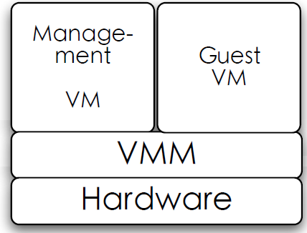
Reduced trusted computing base
Smaller TCB
Actual TCB
Notes:
We divide TrustVisor’s code into four parts. The debug code provides printf and serial console functions which are not required on a production system. The initialization code is the initialization portion described in §5.2.1, which is measured by SKINIT and initializes the protected environment. Finally, the runtime code is responsible for providing the guarantees for PALs as described in §4. We further divide the runtime code into core functionality (including TrustVisor’s basic NPT-based protection framework, PAL management, and parameter marshaling), µTPM, RSA librari
35

Slide 36
Objective: Minimal TPM operations
Micro-TPM
The software µTPM interface that TrustVisor exposes to PALs includes the following TPM-like functions:
HV_Extend for measuring code and data,
HV_GetRand for obtaining random bytes,
HV Seal and HV Unseal for sealing and unsealing data based on measurements, and
HV_Quote to attest to measurements in µPCR

Slide 37
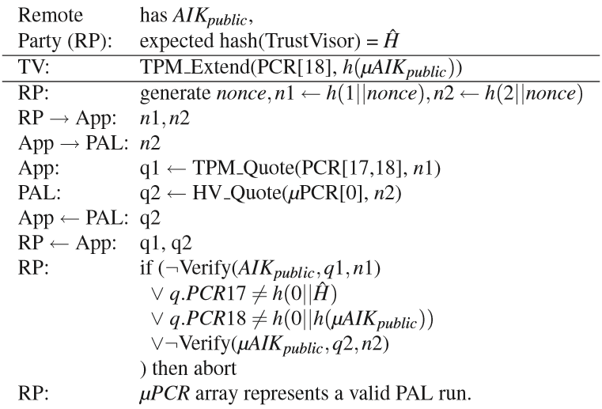
Objective: verifiable trusted computing base- remote attestation

Slide 38
Secure VM launch
Service Provider
Cloud
Manager
Nodes
7. VM Decryption key
4. Request IM
8. Launch VM
3. Request VM Launch
Privileged
User
5. Signed IM
1.Request VM Launch
Customer
6. Verify trustworthiness
2. Send server address
38
Notes:
- So, here’s a big picture summarizing the parties involved.
-The provider offers an elastic VM service. We were inspired by Eucalyptus to understand the architecture of these systems. Eucalyptus is an open-source system providing similar interface to EC2’s. We show a simplified description of its components.
-The provider keeps one or mode clusters with nodes for hosting the guest VMs. Each node runs a virtual machine monitor, typically Xen, on top of which the VMs run.
The cloud manager manages the entire service – e.g., decide how to assign VMs to physical hosts – and also provides a frontend to the customer.
In the backend, the provider enforces a security perimeter protecting the hardware components.
Essentially, customers interact with frontend in order to launch VMs – among other management tasks – and, once the VM is running, the customer can access it directly through standard tools such as ssh.
Privileged users can access any of the components remotely with root privileges. Potentially, this user can inspect the content of the customer VMs in many possible ways by interfering with the components of the system.
How can we then design a system that guarantees the confidentiality of VMs under these assumptions?
38

Slide 39
Implementation
Host OS: Ubuntu 12.04 LTS with kernel 3.0.1.2
Hypervisor: TrustVisor
Disable DMA
Uses SKINIT instruction to provide Dynamic Root of Trust Measurement
Initializes secure boot with tboot

Slide 40
Grub loader
title CentOS with TrustVisor
rootnoverify (hd0,1) # should point to /boot
kernel /init-x86.bin serial=115200,8n1,0x3f8
module /hypervisor-x86.bin.gz
modulenounzip (hd0)+1 # should point to where grub is installed

Slide 41
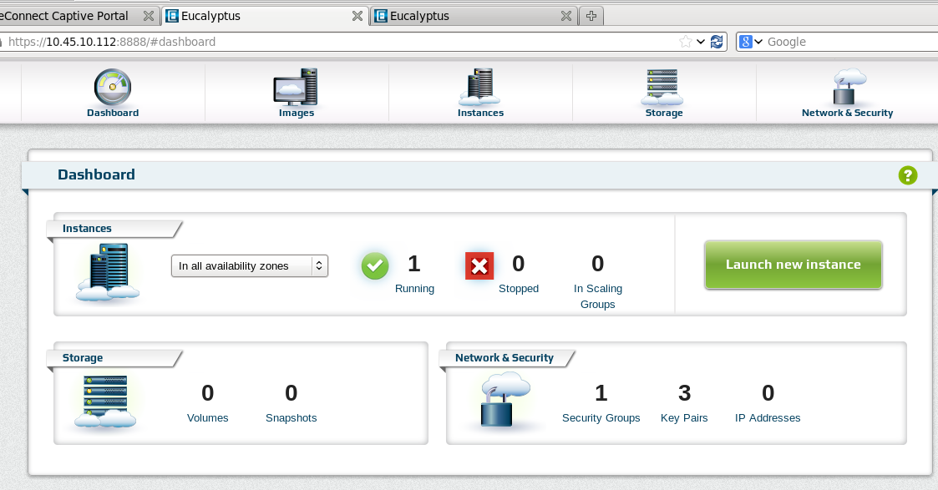
Eucalyptus Cloud

Slide 42
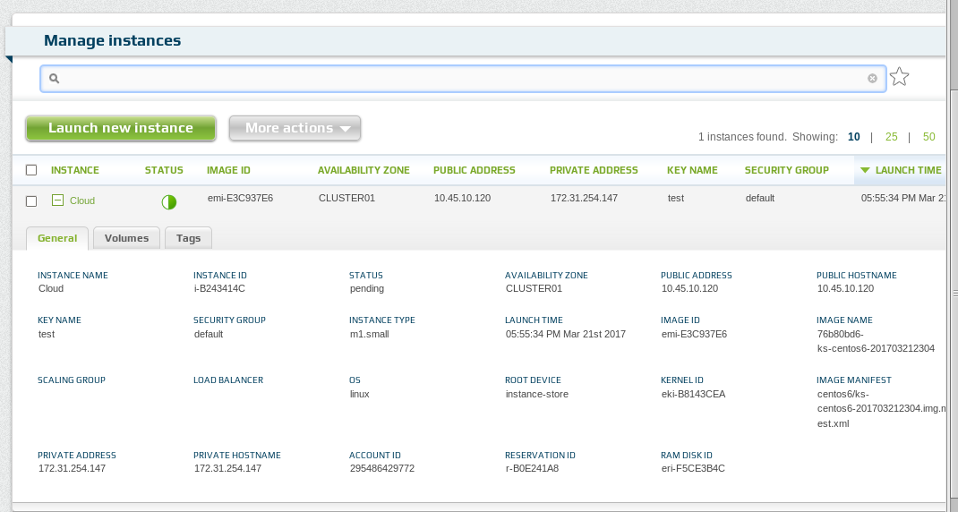
Launched VM Details

Slide 43
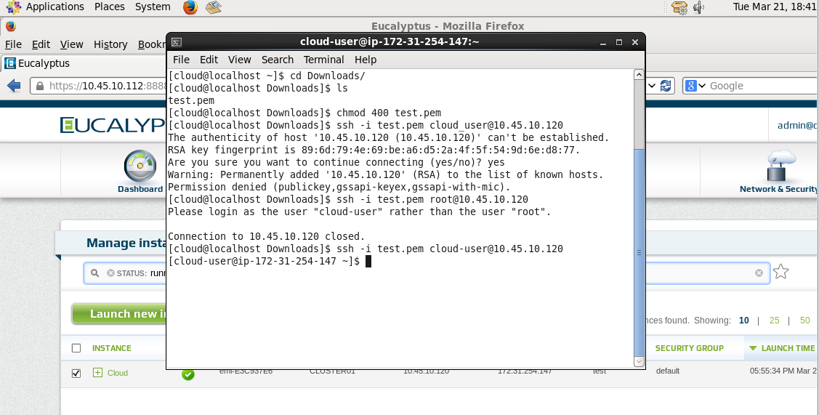
Cloud user logging

Slide 44
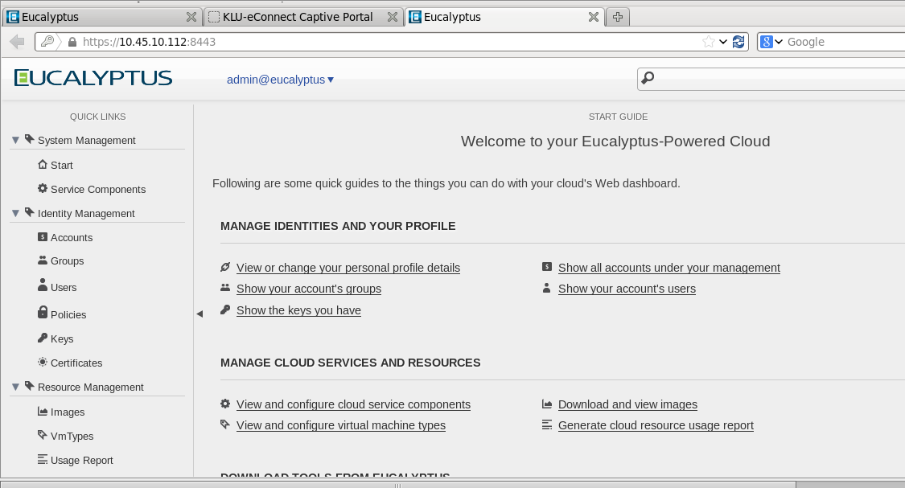
Admin Console

Slide 45
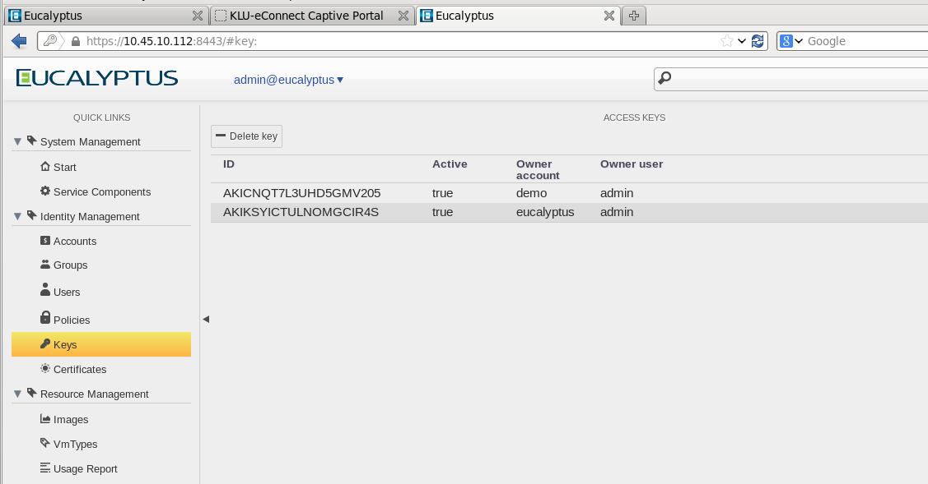
User Keys with Admin

Slide 46
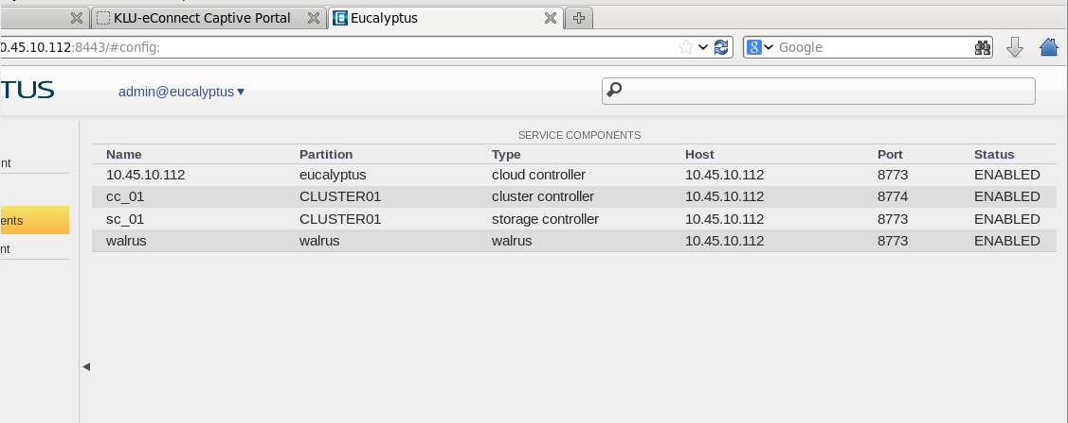
Eucalyptus components

Slide 47
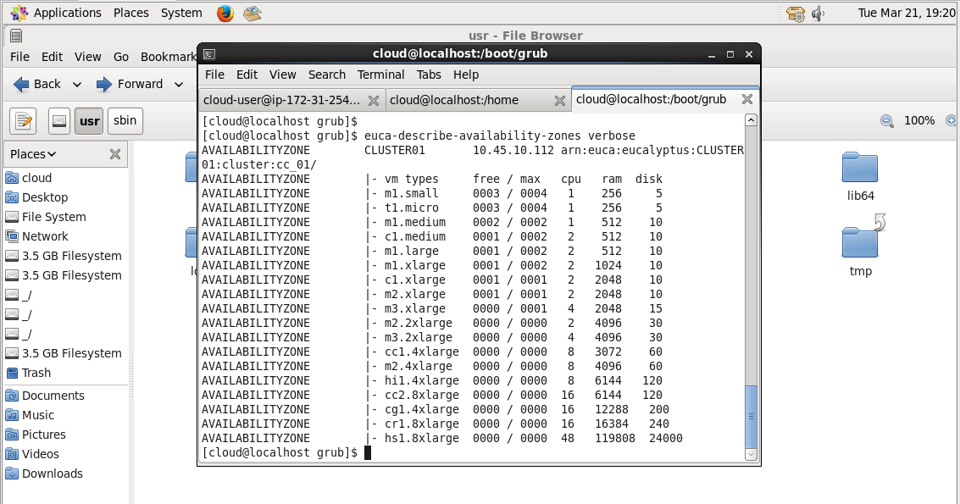
Cluster Availability Zones

Slide 48
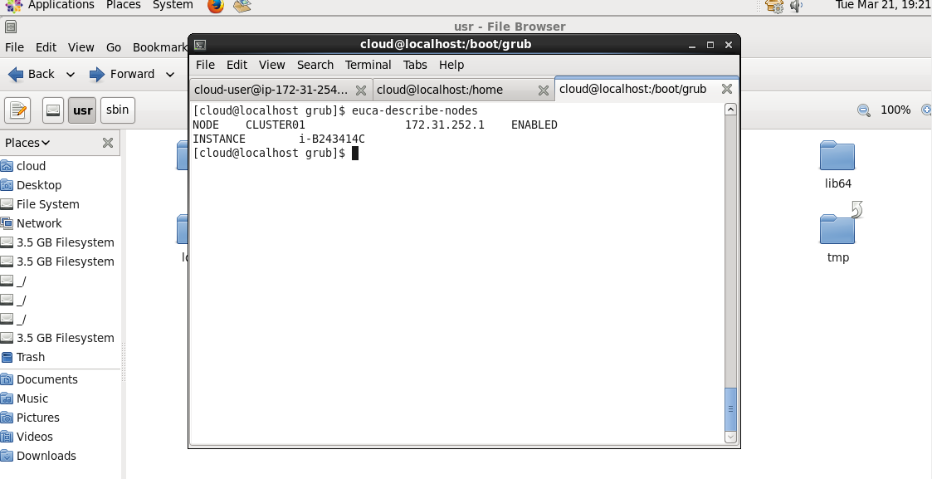
Nodes Running

Slide 49
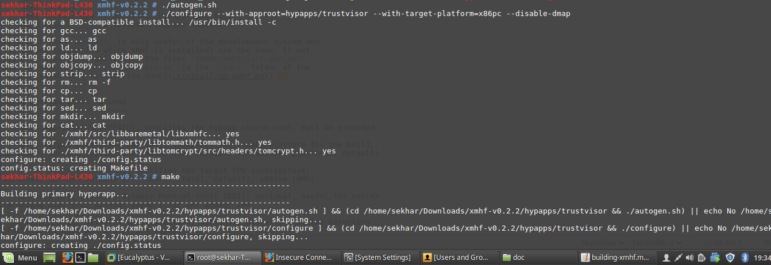
Hypervisor Building

Slide 50
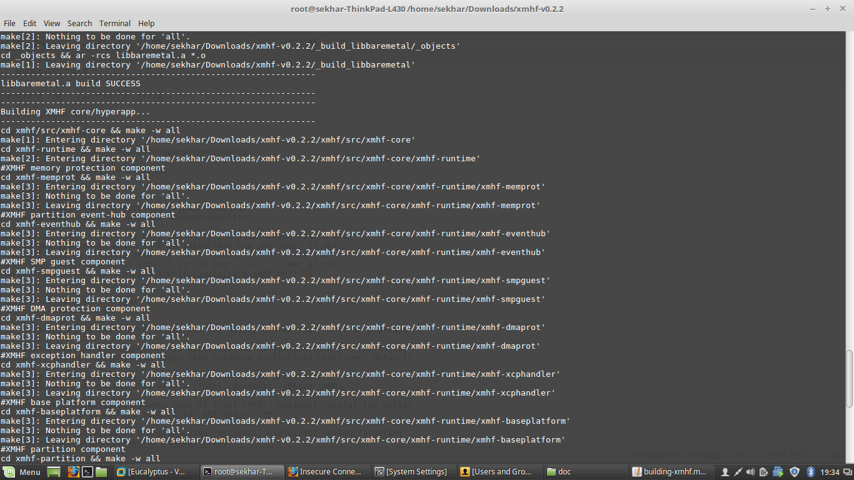
Hypervisor building

Slide 51
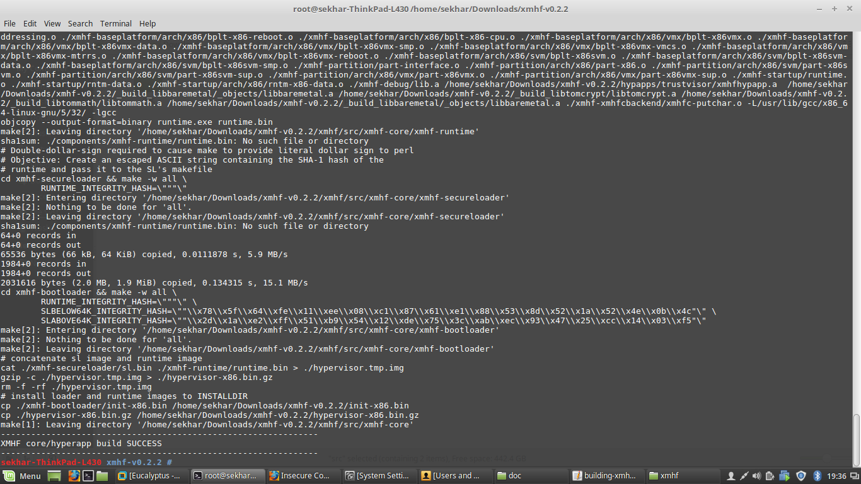
Hypervisor build

Slide 52
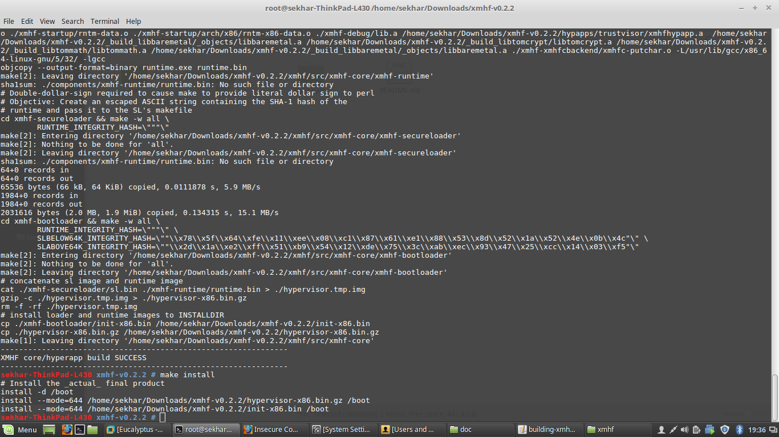
Hypervisor installation

Slide 53
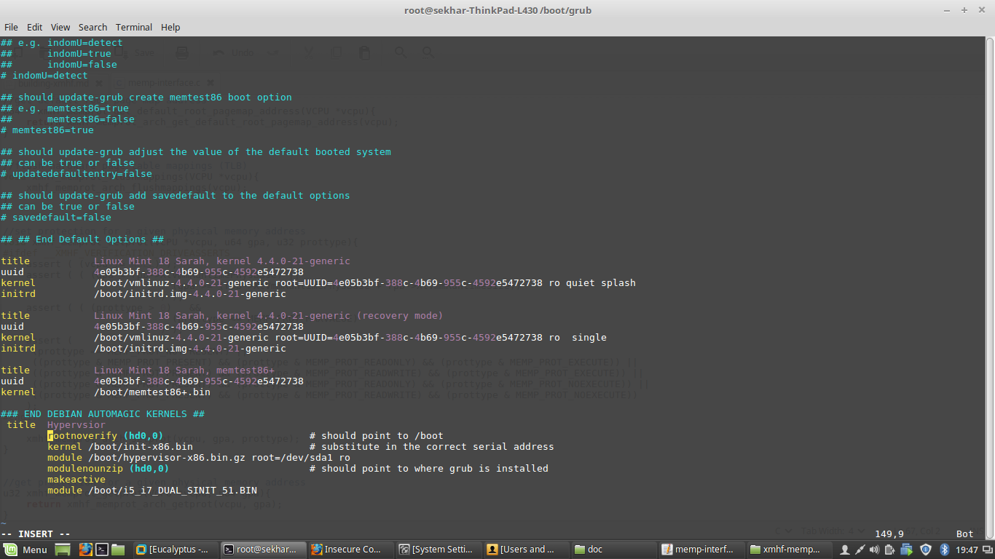
Grub edit

Slide 54
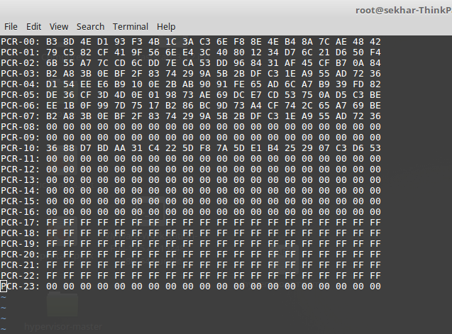
Platform Configuration Registers

Slide 55
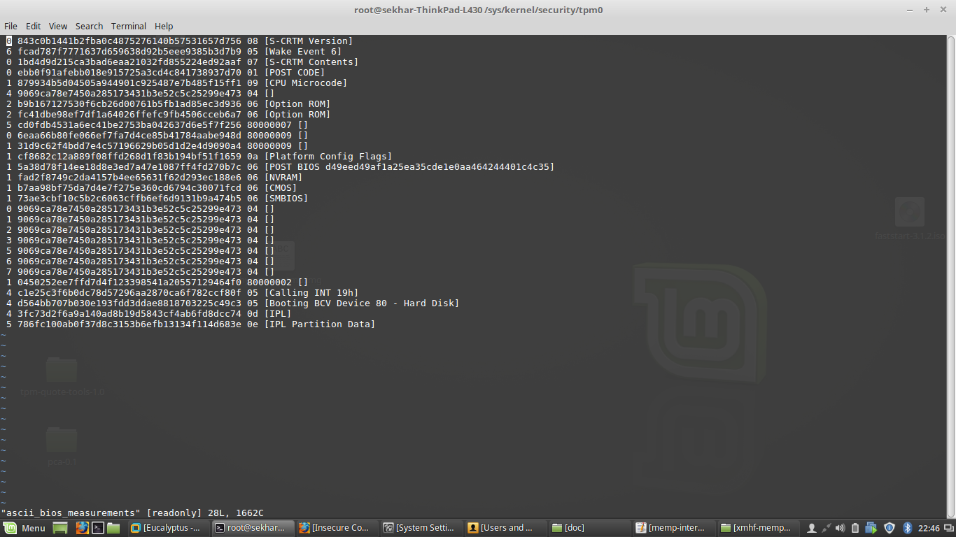
Integrity Measurement Architecture

Slide 56
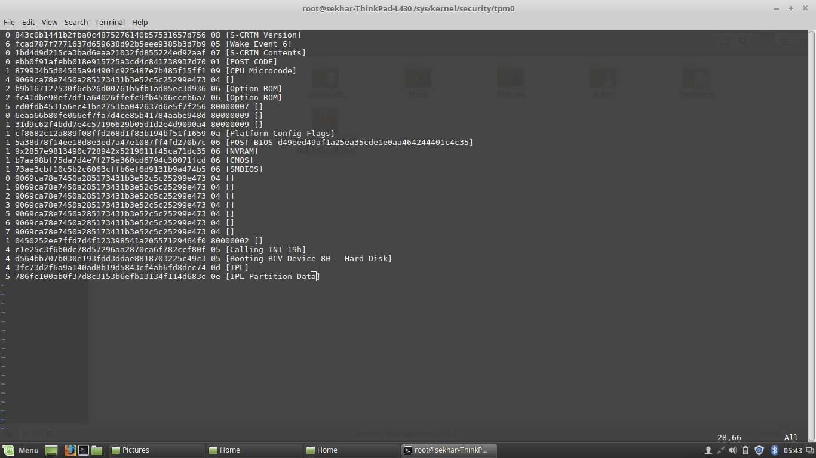
IMA- modified

Slide 57
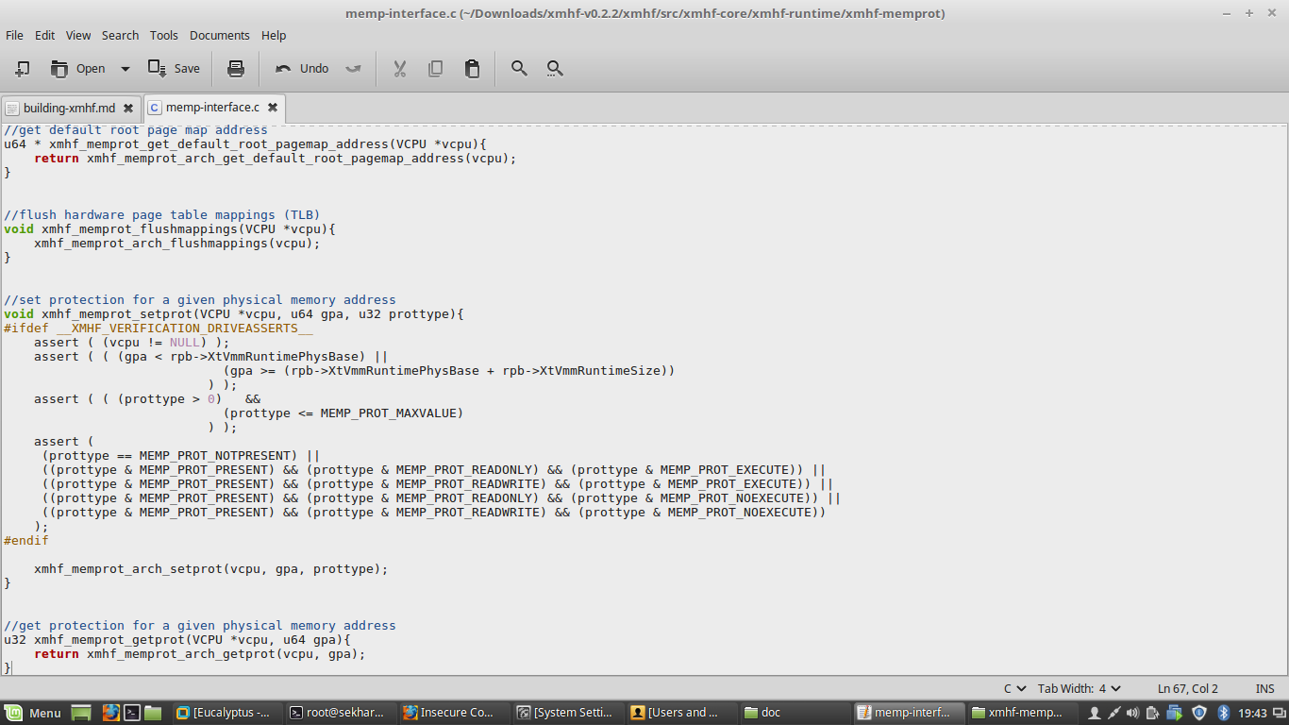
Hypervisor Memory Protection code

Slide 58
RESULTS AND DISCUSSIONS
 | Extend | Seal | Unseal | Quote
Linux with Xen | 24066 | 358102 | 1008654 | 815654
TGVisor | 533 | 11.7 | 12.6 | 21000
TrustVisor | 527 | 9.2 | 12.4 | 18020
TrustVisor operations
17/03/17
T Gunasekhar, K L University
58

Slide 59
Results and Discussions
Trusted Computing Base
Hypervisor | Hypapp | XMHF core | Total
TrustVisor | 3939 | 6018 | 9957
TGVisor | 9138 | 6018 | 15156
LockDown | 9391 | 6018 | 15409
XTRec | 3500 | 6018 | 9518
SecVisor | 2200 | 6018 | 8218
17/03/17
T Gunasekhar, K L University
59

Slide 60
Trusted Computing Base

Slide 61
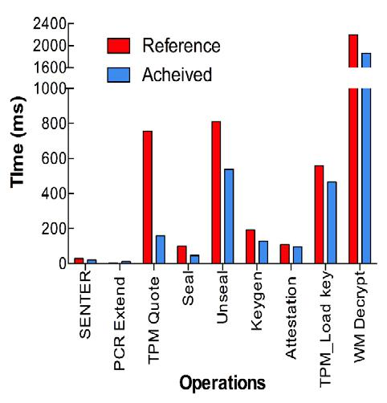
Results and Discussions
Reduced TPM commands on Node controller
17/03/17
61

Slide 62
Results and Discussions
Native Linux with Xen | TGVisor | SecVisor | Lockdown | Proposed
518.1 | 172.1 | 240.5 | 298.3 | 169.8
T Gunasekhar, K L University
17/03/17
62

Slide 63
Conclusion:
Trusted Cloud Computing Platform
Deployed Trusted VMM in cloud infrastructure to provide trust over the cloud platform
Prevent inspection of computation state at the service provider site
Allows customers to verify that computation is secure
Deployed with cooperation of the cloud provider
17/03/17
T Gunasekhar, K L University
63
Notes:
-To conclude: in this talk I presented …
Our next steps will be implementation of a prototype and integration with Eucalyptus.
63

Slide 64
Future Work
Implement this concept in various open source cloud software's
Develop a trusted computing platform for secure communication among the consumer and provider.
Implement this concept in Internet of Things(IoT)

Slide 65
References
[1]Xing, Yuping, and Yongzhao Zhan. "Virtualization and cloud computing." Future Wireless Networks and Information Systems. Springer Berlin Heidelberg, 2012. 305-312.
[2]Seshadri, Arvind, et al. "SecVisor: A tiny hypervisor to provide lifetime kernel code integrity for commodity OSes." ACM SIGOPS Operating Systems Review. Vol. 41. No. 6. ACM, 2015.
[3] Sempolinski, Peter, and Douglas Thain. "A comparison and critique of eucalyptus, opennebula and nimbus." Cloud Computing Technology and Science (CloudCom), 2010 IEEE Second International Conference on. Ieee, 2010.
[4]Sailer, Reiner, et al. "Design and Implementation of a TCG-based Integrity Measurement Architecture." USENIX Security Symposium. Vol. 13. 2004.
[5].Lonea, Alina Madalina, Daniela E. Popescu, and Octavian Prostean. "A survey of management interfaces for eucalyptus cloud." Applied Computational Intelligence and Informatics (SACI), 2012 7th IEEE International Symposium on. IEEE, 2012.
[6] Nurmi, Daniel, et al. "The eucalyptus open-source cloud-computing system." Proceedings of the 2009 9th IEEE/ACM International Symposium on Cluster Computing and the Grid. IEEE Computer Society, 2009.
[7]Nurmi, Daniel, et al. "Eucalyptus: an open-source cloud computing infrastructure." Journal of Physics: Conference Series. Vol. 180. No. 1. IOP Publishing, 2009.
[8] Rad, ShayanZamani, Mohammad KazemAkbari, and MortezaSargolzaiJavan. "Present the Challenges in Eucalyptus Cloud Infrastructure for Implementing Virtual Machine Migration Technique and Provide a Solution for Solve the Challenges." P2P, Parallel, Grid, Cloud and Internet Computing (3PGCIC), 2012 Seventh International Conference on. IEEE, 2012.
[9] Kinney, Steven L. Trusted platform module basics: using TPM in embedded systems. Newnes, 2006.
[10]Jain, Lavina, and Jayesh Vyas. Security Analysis of Remote Attestation. CS259 Project Report, 2008.

Slide 66
Thanks! Questions?
Contact:
T Gunasekhar
tgunasekhar@kluniversity.in
17/03/17
T Gunasekhar, K L University
66

