Slide 1

DAIMLER TRUCK VISUALIZATION Presented by: Ashika Avula (800972702) Bhanu Sri Karumanchi (800954730) Guna Chandrika Paturi (800962470) Manali Ghosh (800954095)

Slide 2
Tasks defined through visualization:
We select different tasks based on different data sets:
Shortages table: we choose this dataset to find out which item must be given highest priority by studying the item code frequency.
Location table: we choose OPR_NAME to detect where the truck is on the line of manufacturing
Cries on the line: we choose this data set to find_insp_team and Resp_insp_team frequency to get the performance of the teams(higher frequency indicates poor performance).
Paints table: we choose repaint requests frequency to detect performance of the paint department.

Slide 3
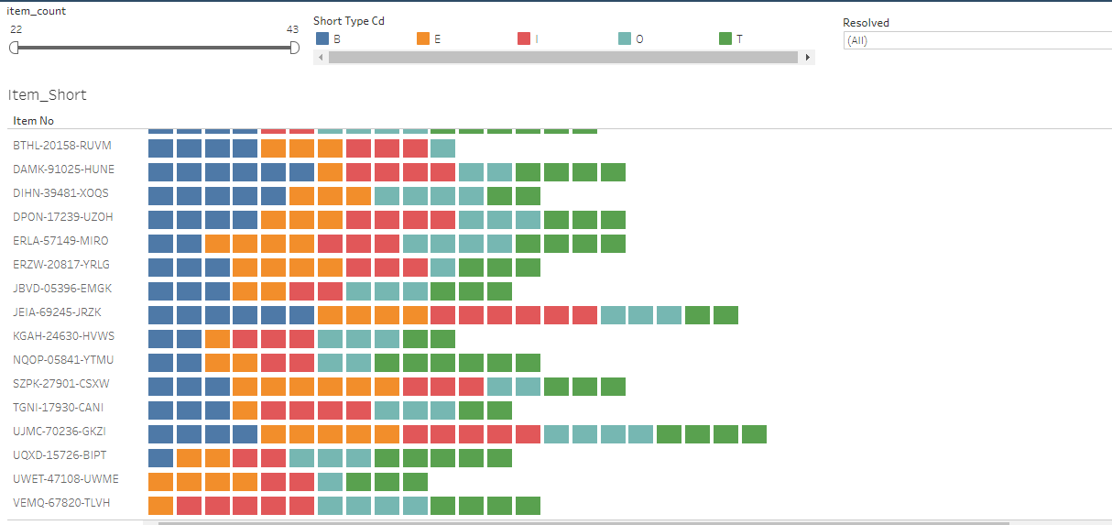
This visualization shows the different types of shortage type per item no to study which item must be given highest priority.

Slide 4
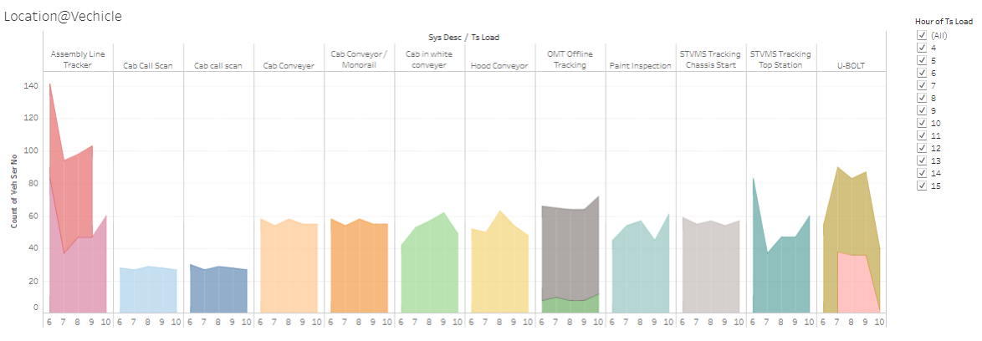
In this visualization, we choose OPR_NAME to detect where the truck is on the line of manufacturing

Slide 5
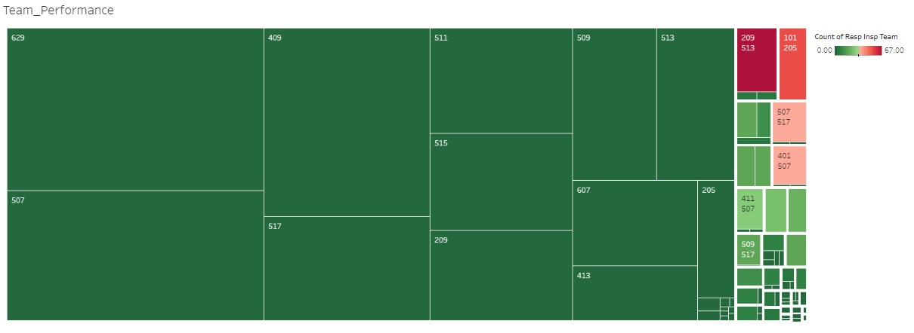
In this visualization, we choose found_insp_team and Resp_insp_team frequency to get the performance of the teams. (more frequency indicates poor performance).

Slide 6
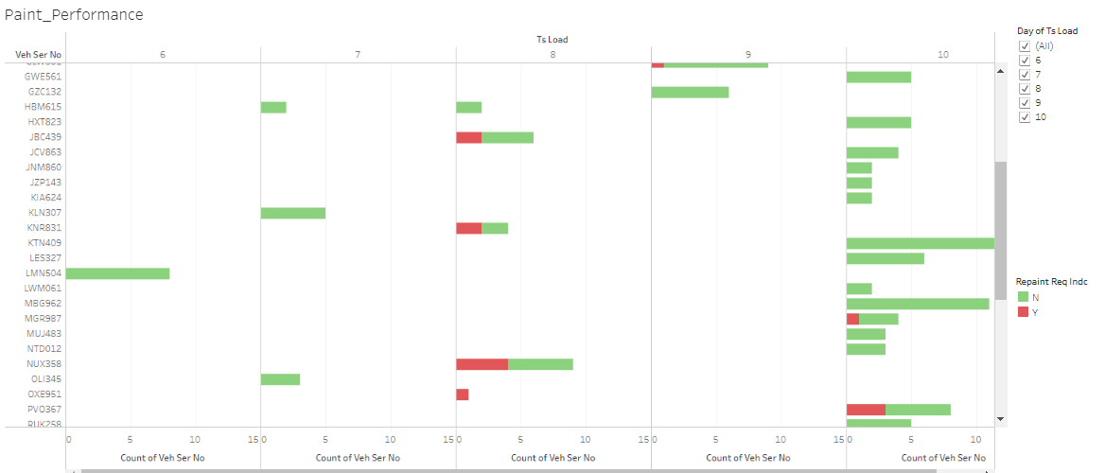
In this visualization, we choose repaint requests frequency to detect performance of the paint department.

Slide 7
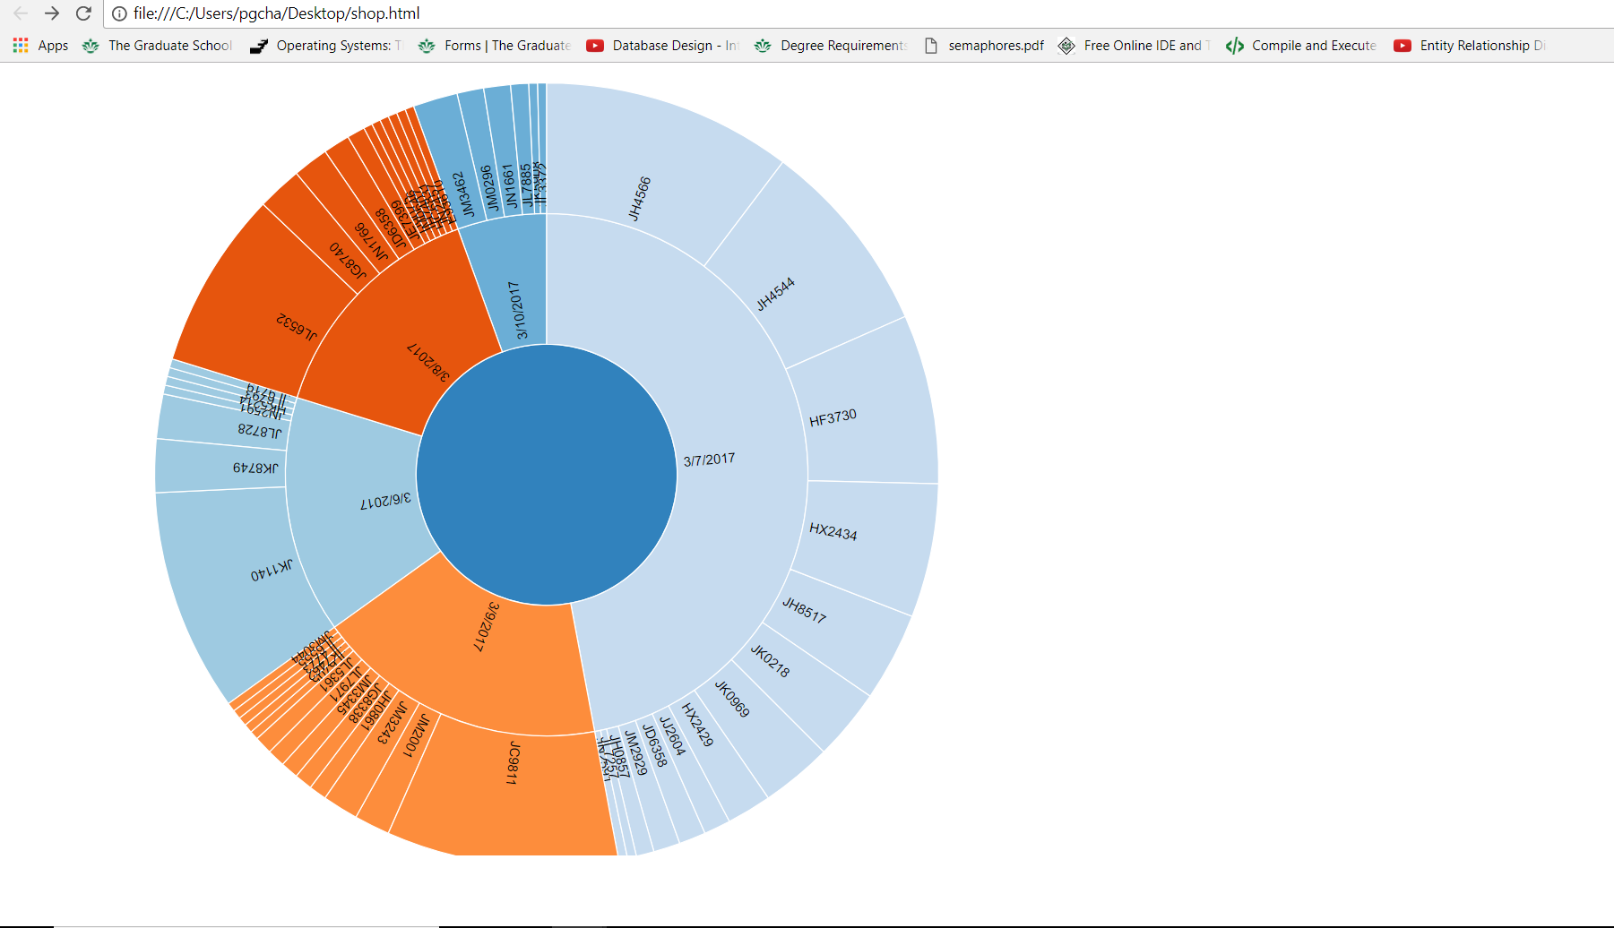
In this visualization,We can analyze day wise shop calls(Using D3).

Slide 8
Thank you!

