Slide 1
Student Activity Management System
Project Managers: Guna Chandrika
Raija Shareen
Project Supervisor: Venkata Sai Krishna Reddy
SQL Programmers: Matthew Goodman
Venkata Sai Krishna Reddy
Guna Chandrika
WEB/PHP Developers: Vinutna Gannu
Raija Shareen
Report Writers: Malcolm Lipscomb
Vinutna Gannu

Slide 2
Overview
Problem: Solution-Scope of project.
Business rules, Assumptions.
Implementation.
Screenshots : Database, UI
Conclusion, Future scope.

Slide 3
So What’s The Problem?
Student’s Perspective:
Follow-up on events happening on campus.
Online Registration for an event
View their respective Advisor.
Advisor’s Perspective :
Track of events on campus.
Students and their attendance count
Update Events.

Slide 4
Business Rules
Students attend from zero to many events. Events have from zero to many students.
An event can be listed in one and only one category. A category can have one to many events
Difference in user privileges.
Students have one and only one Advisor (Faculty). Advisors (Faculty) have one to many students.

Slide 5
Assumptions
If a student registers for an event, assume student would be attending the event.
Only Advisor has all CRUD permissions.
Student has only view permission on events.
Determine the success of an event based on the number of students participated.

Slide 6
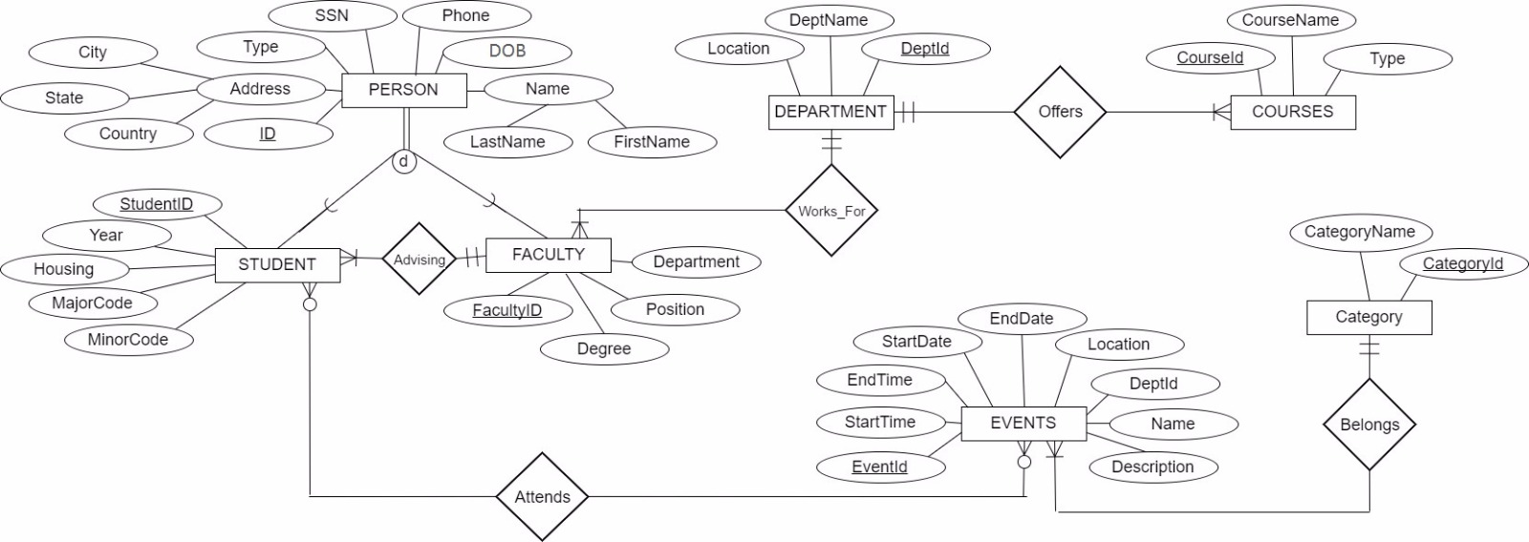
Enhanced Entity Relationship Diagram

Slide 7
Implementation
Database
Student activity management system
Tables
9 tables in normalized form
Student module
Advisor module
Web implementation:
Web Languages used
php,HTML,CSS,javascript,bootstrap.
Advanced
implementations
Joins,triggers, Stored Procedures queryoptimizing with indexing

Slide 8
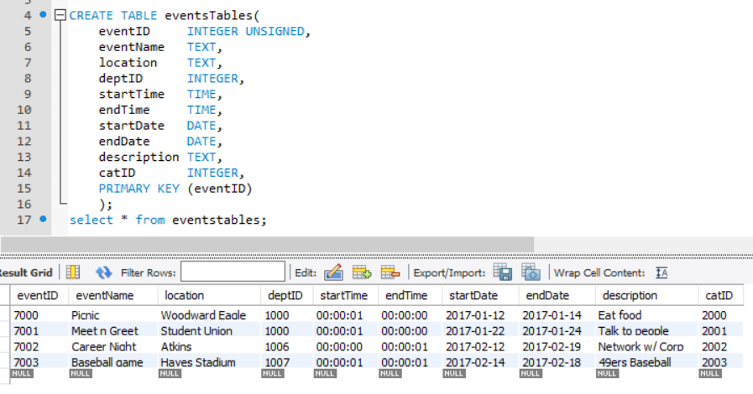
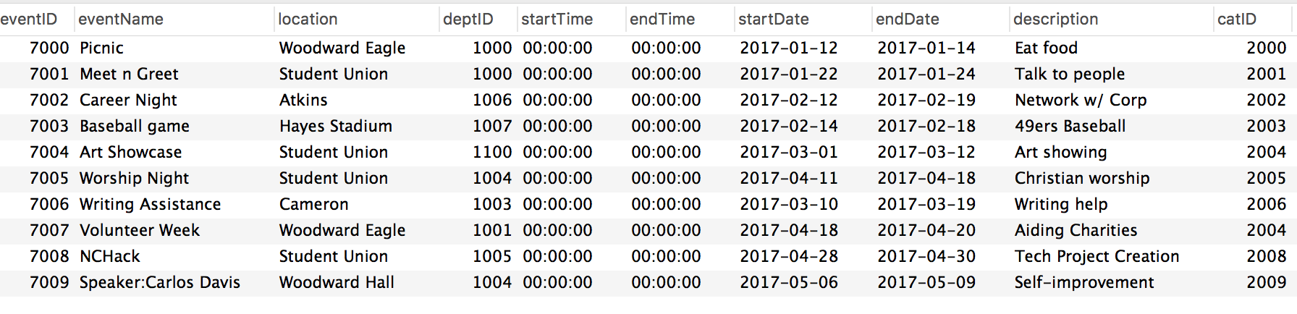
Table - Events
For instance , eventsTable was created as follows:

Slide 9
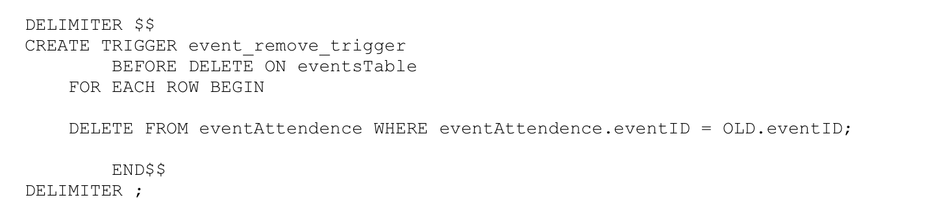
Trigger
We have implemented a trigger which gets activated before we perform deletion on events Table.

Slide 10
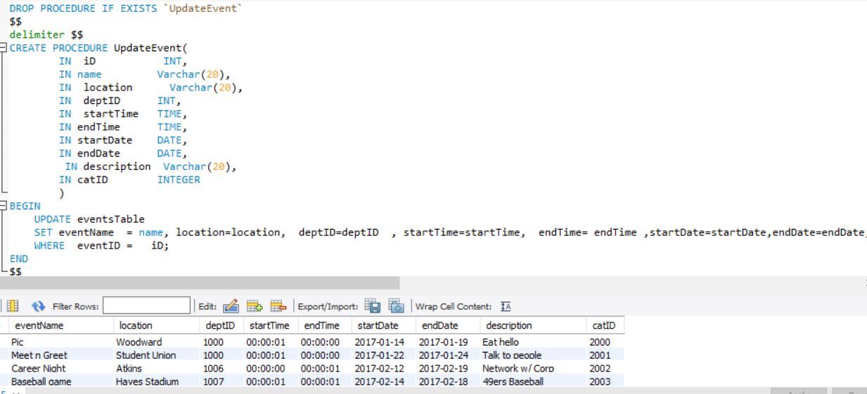
Stored Procedure update on events

Slide 11
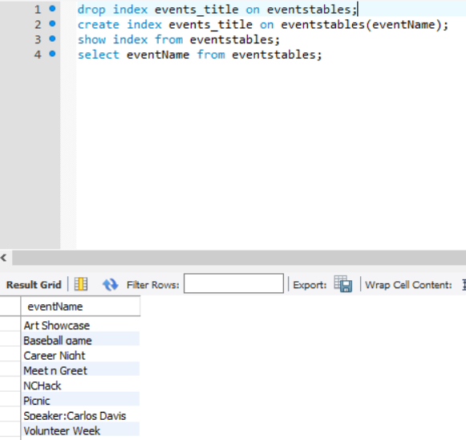
Indexing Indexing on events name

Slide 12
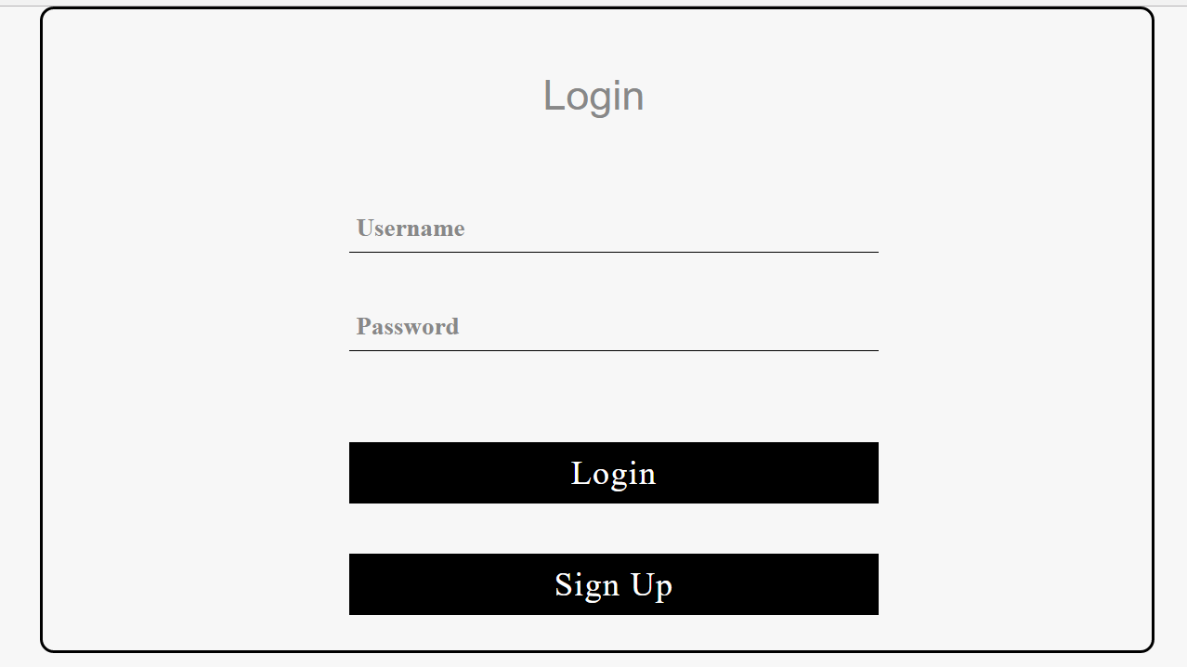
Screenshots: sign in

Slide 13
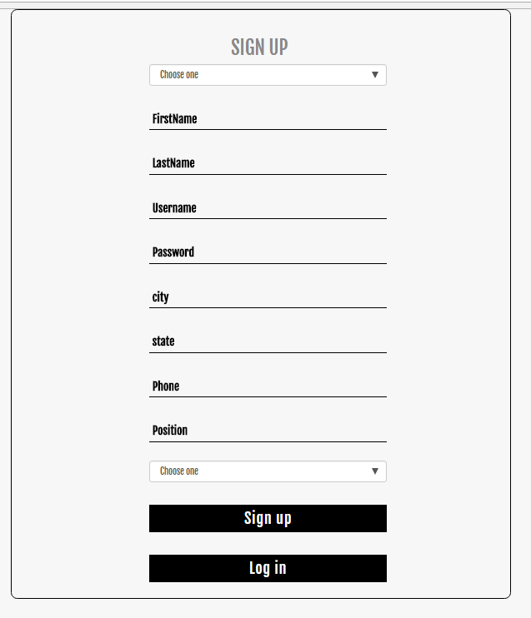
Sign up

Slide 14
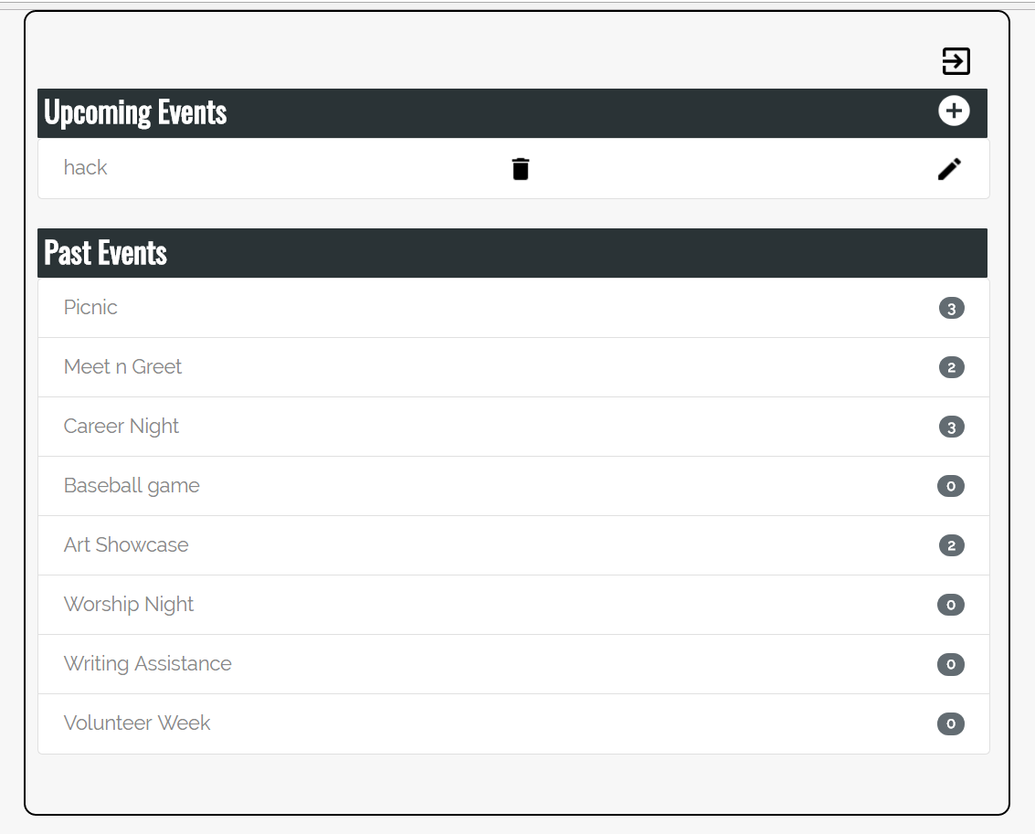
Advisor’s Home

Slide 15
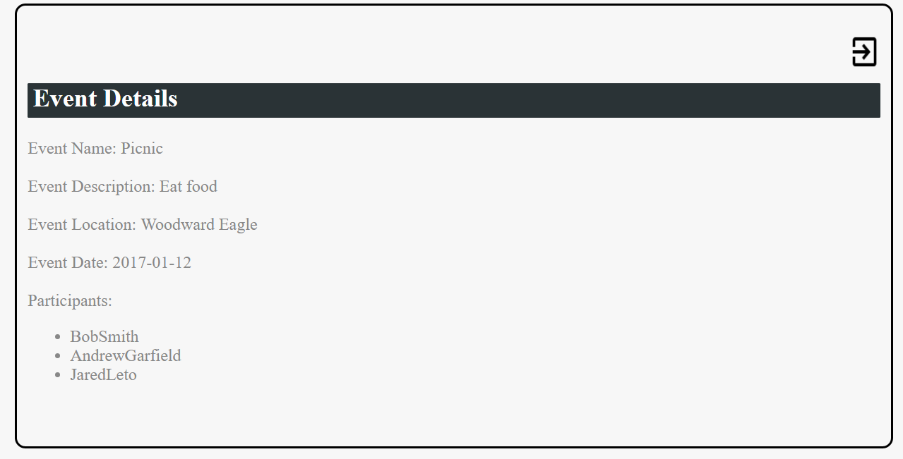
Event Details

Slide 16
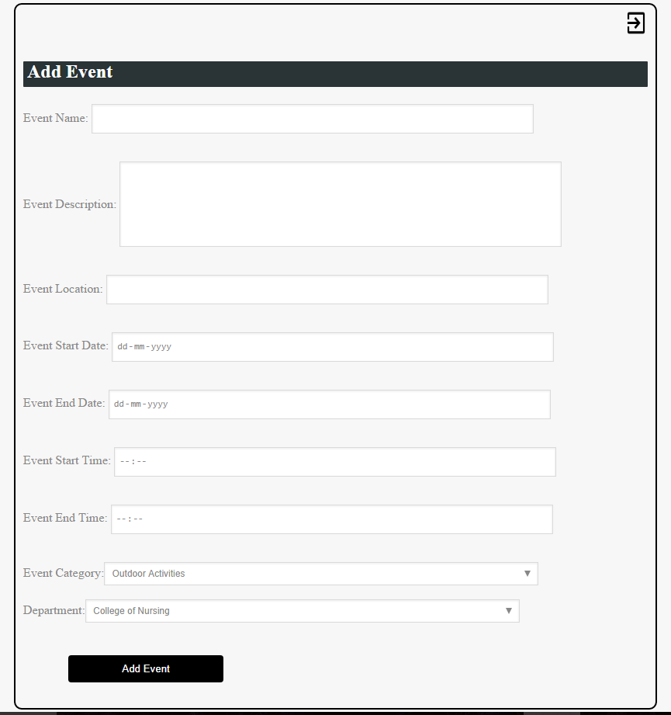
Add an Event

Slide 17
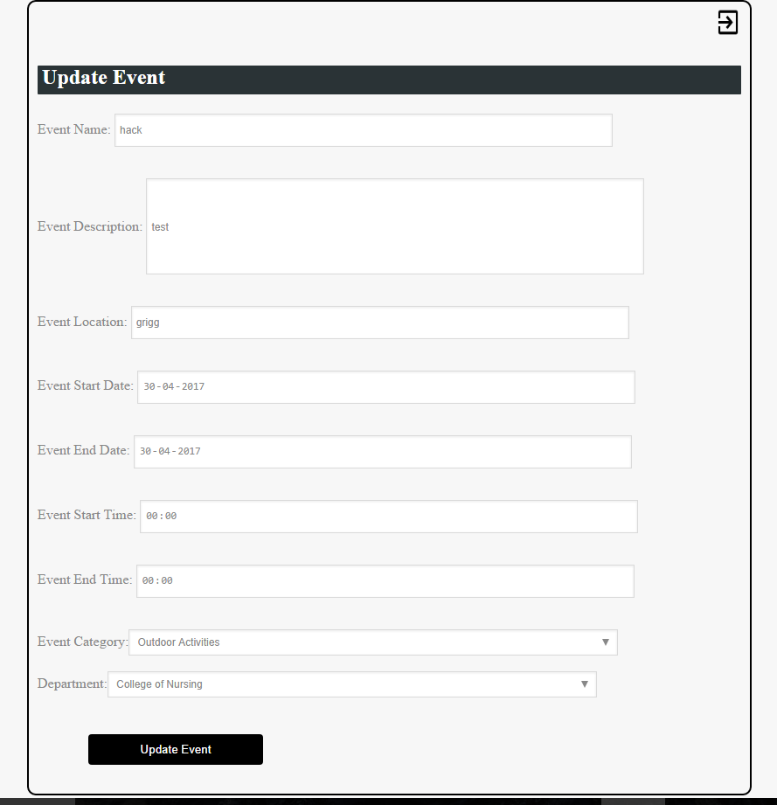
Update an Event

Slide 18
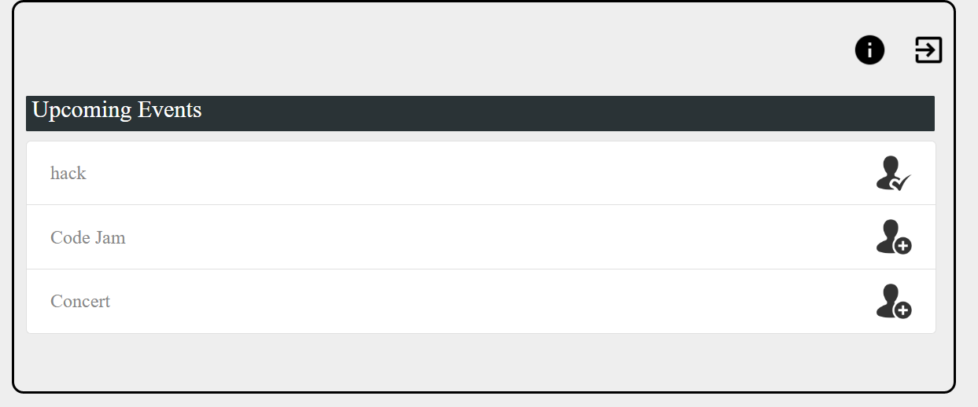
Student’s Home

Slide 19
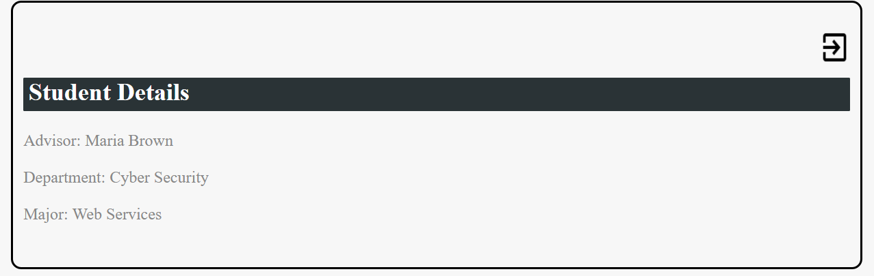
Student’s Information

Slide 20
Conclusion
System to track of upcoming events.
Effectively implemented CRUD capabilities.
Only Advisor can
-CREATE Event
-READ Event
-UPDATE Event
-DELETE Event
Students can
- VIEW and register for Events
- VIEW their profile

Slide 21
Future Scope
Data Analysis based on events attendance, eventspriority : success
scalability for large gatherings.

Slide 22
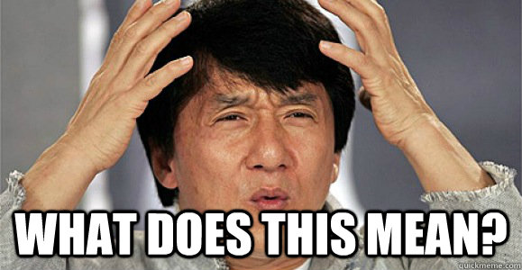
Questions?

