Slide 1
Predicting 30-Day Heart Failure Readmission Risk
AAI-500 · Probability and Statistics for Artificial Intelligence
Professor Dallin Munger
Group 4
Ian Schmitt · Keana Gindlesperger · Guna Pasupathy
UNIVERSITY OF SAN DIEGO | SHILEY-MARCOS SCHOOL OF ENGINEERING

Slide 2
Problem & Objectives
● ~20% of heart-failure patients are readmitted within 30 days — costly and often preventable.
● Goal: identify factors associated with 30-day readmission and build a defensible risk model.
● Objectives
– Clean and validate the data
– Explore distributions and test associations (Ch 1–5)
– Fit and interpret a logistic-regression model
– Translate results into recommendations and state limitations
University of San Diego · Shiley-Marcos School of Engineering
1

Slide 3
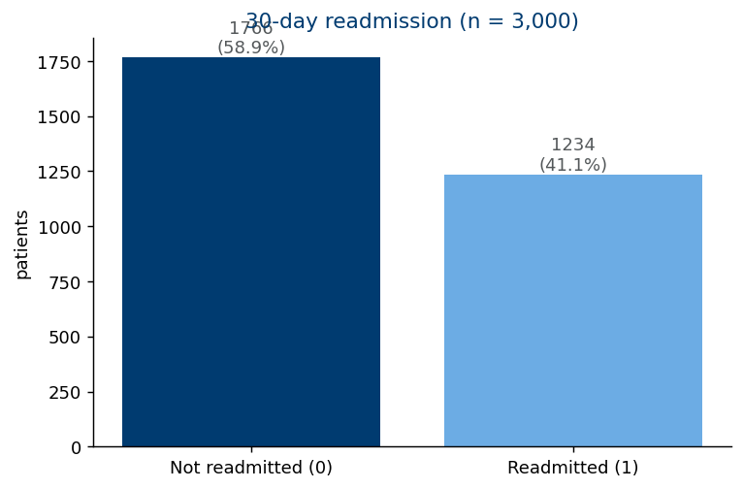
The Dataset
● Kaggle: Heart Failure Readmission & SDOH
● 3,000 patients × 16 variables
● Clinical: age, BMI, BNP, sodium, creatinine, BP, heart rate
● Treatment: ACE inhibitor, beta blocker, diuretic, adherence
● Social: income level, distance to hospital
● Target: readmitted_30d (41.1% positive)
University of San Diego · Shiley-Marcos School of Engineering
2

Slide 4
Data Quality & Cleaning
● ~3% missing values in BMI, sodium, and creatinine.
● Impossible negative creatinine values (18 rows) and a few extreme outliers.
● Out-of-range readings set to NaN using clinically plausible ranges.
● Modeling uses complete-case analysis (no imputation — outside course scope).
● No duplicate rows; patient_id excluded as an identifier.
University of San Diego · Shiley-Marcos School of Engineering
3

Slide 5
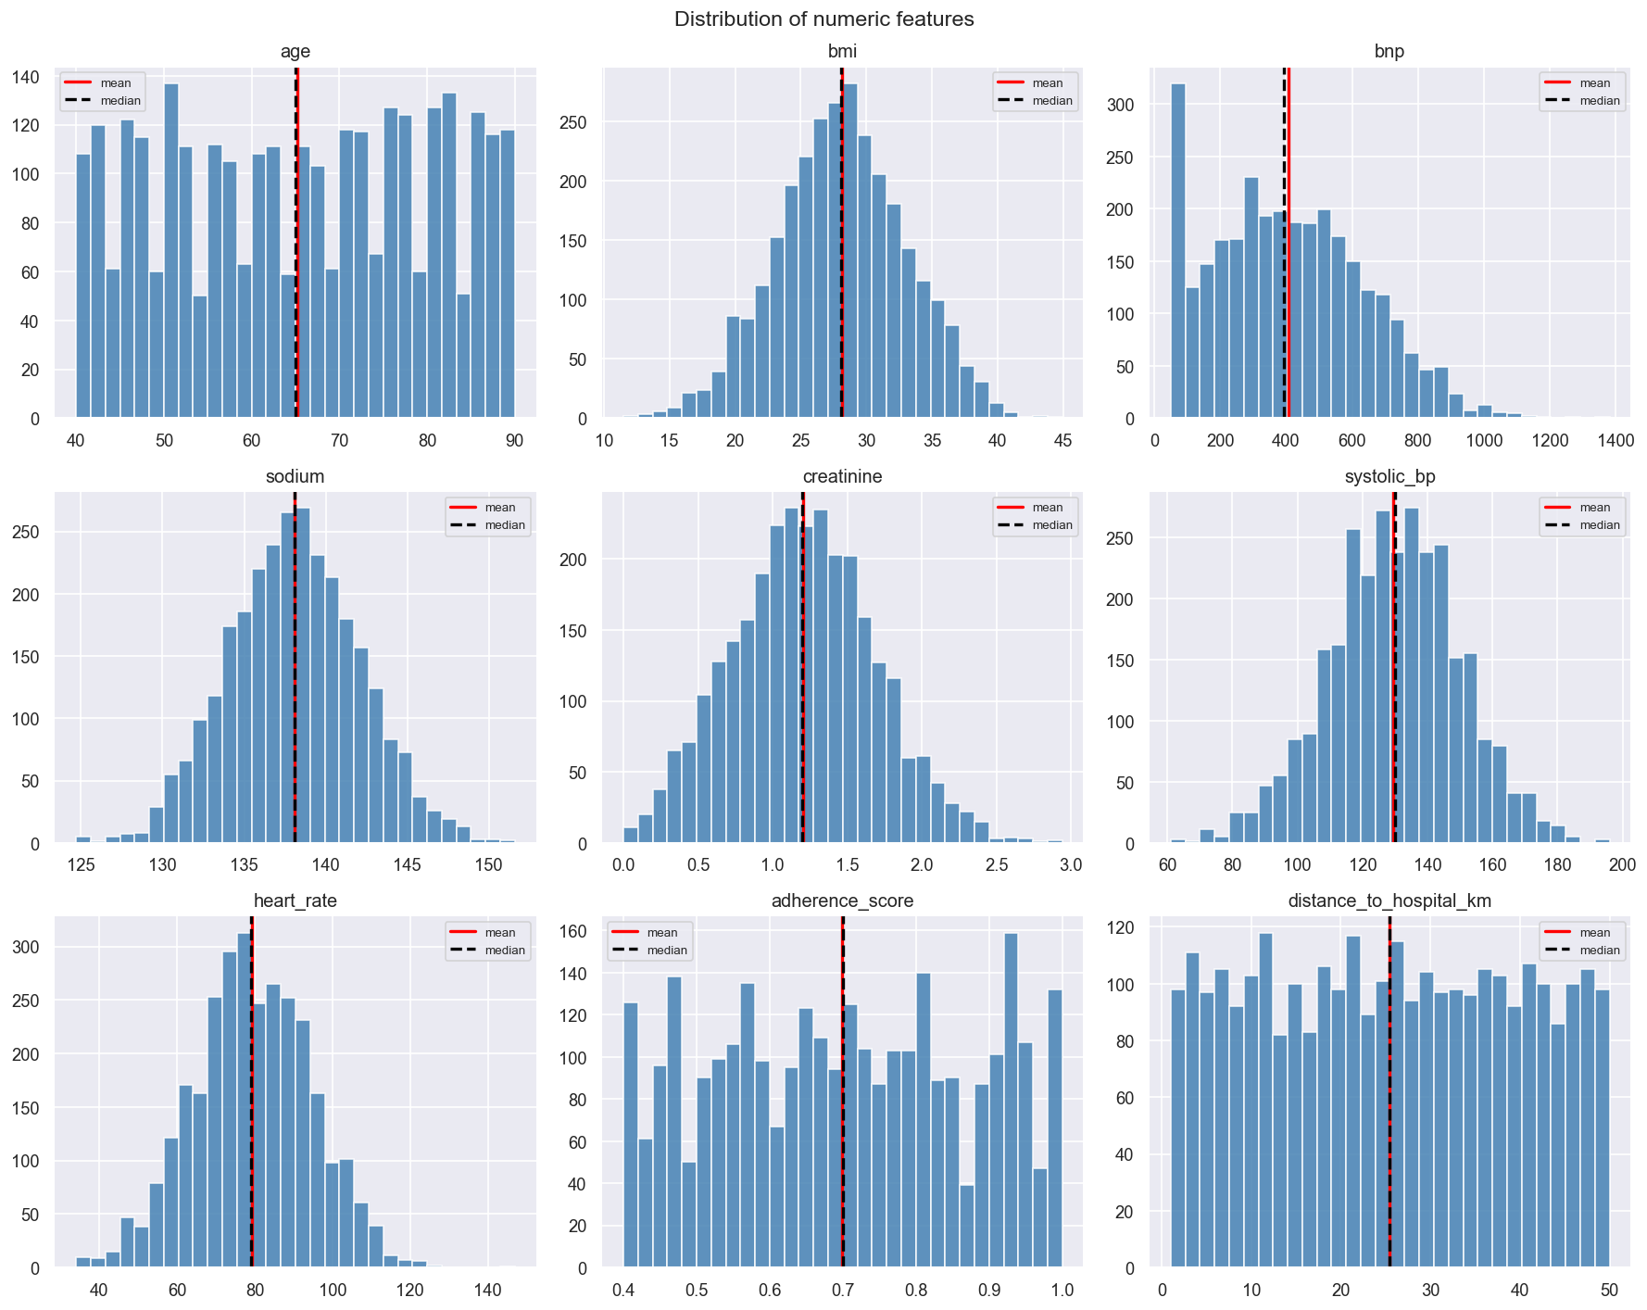
EDA — Distributions
● Sodium ≈ normal
● BNP right-skewed (fits a gamma)
● Age roughly uniform (40–90), not normal
● Verified shape rather than assuming it (Ch 2)
University of San Diego · Shiley-Marcos School of Engineering
4

Slide 6
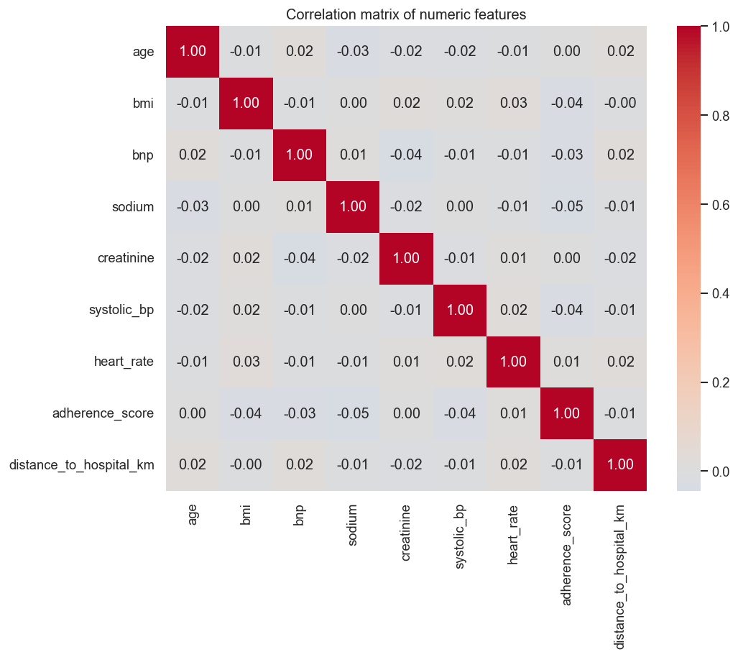
EDA — Correlations
● All pairwise |r| < 0.05
● Numeric predictors largely independent
● No multicollinearity concerns
University of San Diego · Shiley-Marcos School of Engineering
5

Slide 7
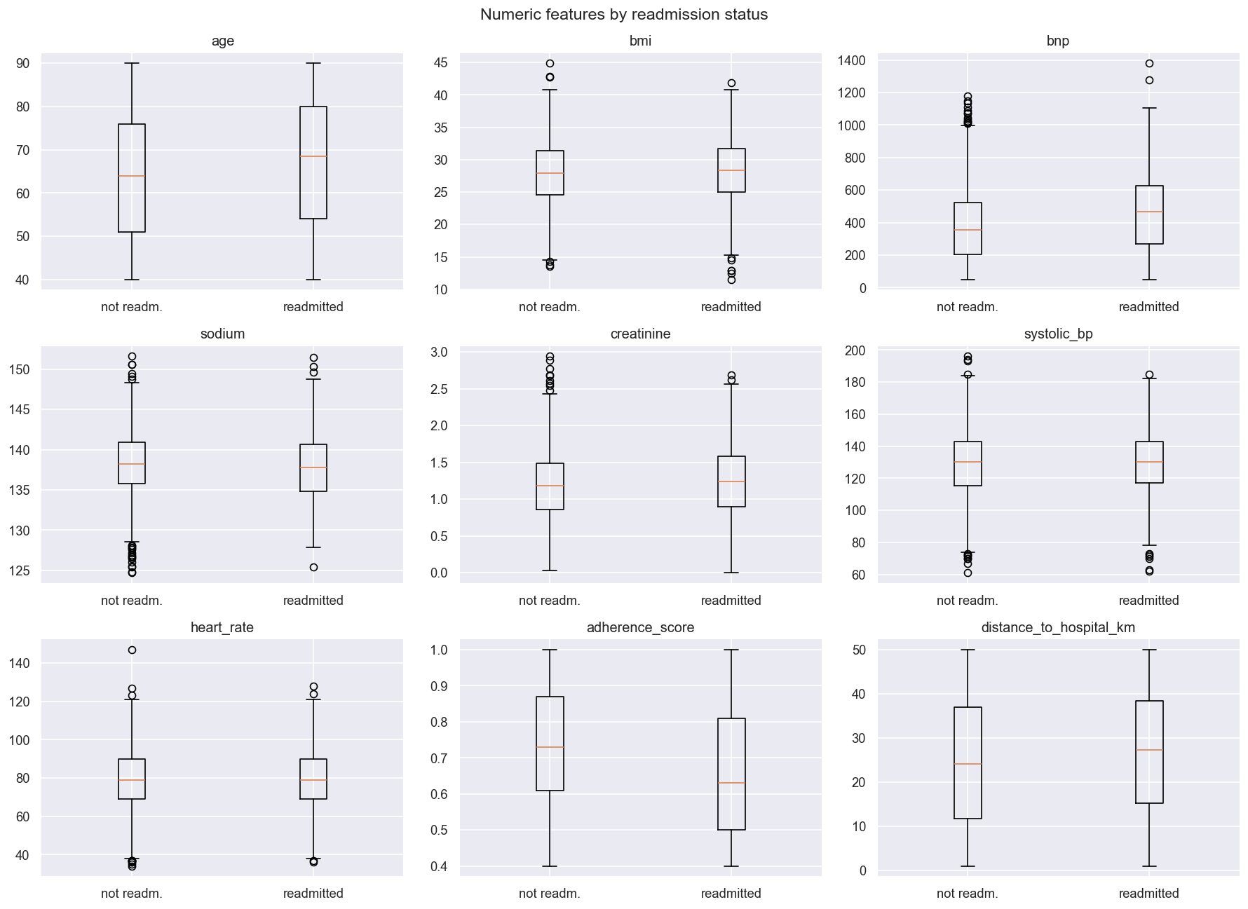
What Separates the Two Groups?
● Lower adherence → more readmission
● Higher BNP and age → more readmission
● Most other features overlap heavily
University of San Diego · Shiley-Marcos School of Engineering
6

Slide 8
Statistical Testing (Ch 5)
● Chi-square tests (categorical) and Welch's t-tests (numeric) vs. readmission.
● Bonferroni correction for multiple testing (Ch 6.5).
● Significant predictors
– adherence_score, BNP, age, ACE inhibitor, beta blocker, distance to hospital
● No association: gender, income level, BMI, heart rate, diuretic.
● Confirmed by a permutation test (p ≈ 0) and high power (~1.0).
University of San Diego · Shiley-Marcos School of Engineering
7

Slide 9
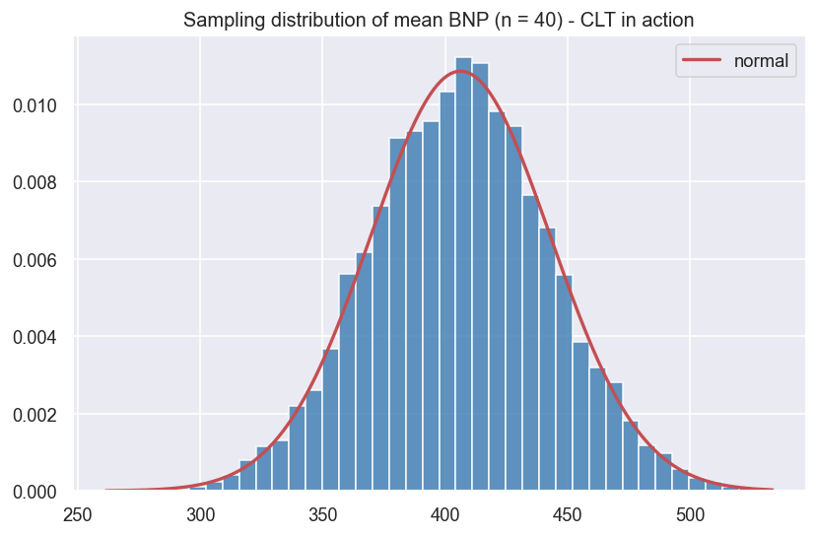
Estimation & Inference (Ch 3–4)
● CLT: sample-mean of skewed BNP is normal
● SE matches σ/√n
● Readmission rate 41.1%, 95% CI (39.4%, 42.9%)
● Bootstrap, t-based & Bayesian intervals agree
University of San Diego · Shiley-Marcos School of Engineering
8

Slide 10
Modeling — Logistic Regression (Ch 7)
● Logistic-regression GLM (statsmodels) — binary response, interpretable odds ratios.
● Numeric predictors standardized; categoricals as indicator variables.
● Complete-case analysis on the cleaned data.
● Model comparison via likelihood-ratio tests, deviance, and AIC.
● Tree/ensemble ML kept only as an out-of-scope appendix.
University of San Diego · Shiley-Marcos School of Engineering
9

Slide 11
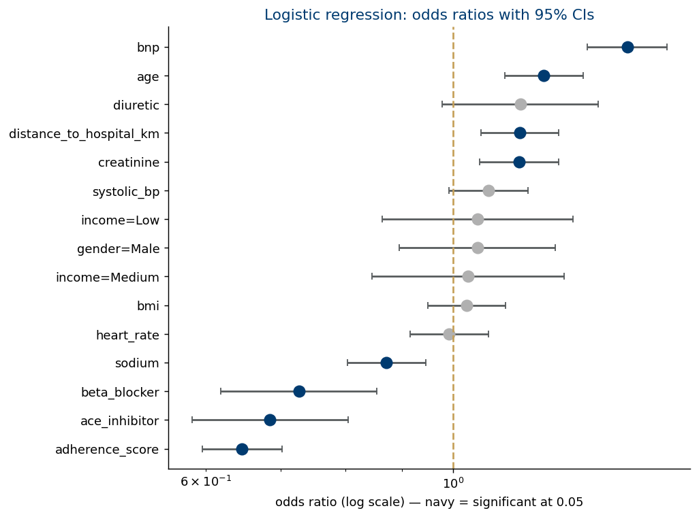
Model Results
● Protective (OR<1): adherence, ACE inhibitor, beta blocker
● Risk (OR>1): BNP, age, distance, creatinine
● LR vs null: χ²=283, p≈2e-51
● Pseudo-R² ≈ 0.08 (modest)
● Accuracy 0.654 vs 0.583 baseline
University of San Diego · Shiley-Marcos School of Engineering
10

Slide 12
Key Findings & Recommendations
● Medication adherence is the strongest signal — lower adherence, higher risk.
● Elevated BNP and older age are the main clinical risk markers.
● ACE inhibitors / beta blockers are associated with lower risk.
● Recommendation: target adherence support and BNP monitoring for high-risk patients.
● Effects are real but modest — useful for triage, not a standalone decision tool.
University of San Diego · Shiley-Marcos School of Engineering
11

Slide 13
Limitations
● Single-source observational data — associations are not causal.
● No time-to-event information, so survival analysis is out of scope.
● Social determinants are coarsely encoded and likely under-represented.
● Modest model fit; predictors explain little variance individually.
● Coursework analysis — not validated for clinical deployment.
University of San Diego · Shiley-Marcos School of Engineering
12

Slide 14
Conclusion
● A clean, reproducible workflow from Kaggle data to an interpretable model.
● Methods grounded in the AAI-500 curriculum (Ch 1–7).
● Adherence, BNP, and age are the most informative readmission factors.
● Thank you — questions?
University of San Diego · Shiley-Marcos School of Engineering
13

