Slide 1
Bike Share Analysis
Recommendations to Increase Revenue
Gunardi A / 9. April 2023

Slide 2
Target:
Solution:
Increasing revenue.
Maximizing the number of annual membership.

Slide 3
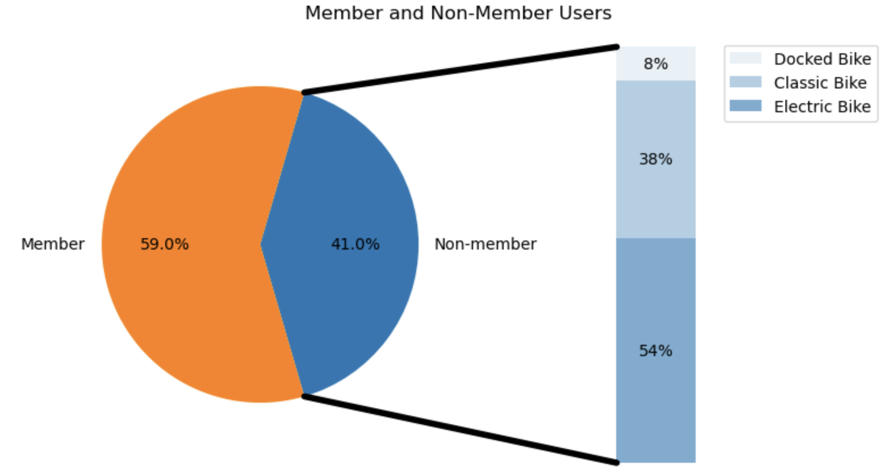
Different Bike Popularity for Non Member
Electric Bike
54% non member prefers renting electric bike.

Slide 4
1st Suggestion
Create attractive 3-month introductory offer for electric bike to attract non member to switch to membership.

Slide 5
Docked Bike Usage
Bike Type | Average Distance (m) | Average Duration (Minute) | Non Member Rental
Classic | 2087 | 24.5 | 66%
Docked | 2176 | 50.7 | 100%
Electric | 2253 | 16.2 | 57%
100% of docked bike rental is from non member.
Average usage duration is
2X longer than classic bike,
3X longer than electric bike.

Slide 6
2nd Suggestion
Attracting new customer to use our rental bikes by targeting our marketing effort on docked bike.
Furthermore it could increase our brand awareness, as renting docked bike is suitable for first timer seeking short distance biking option in inner city.

Slide 7
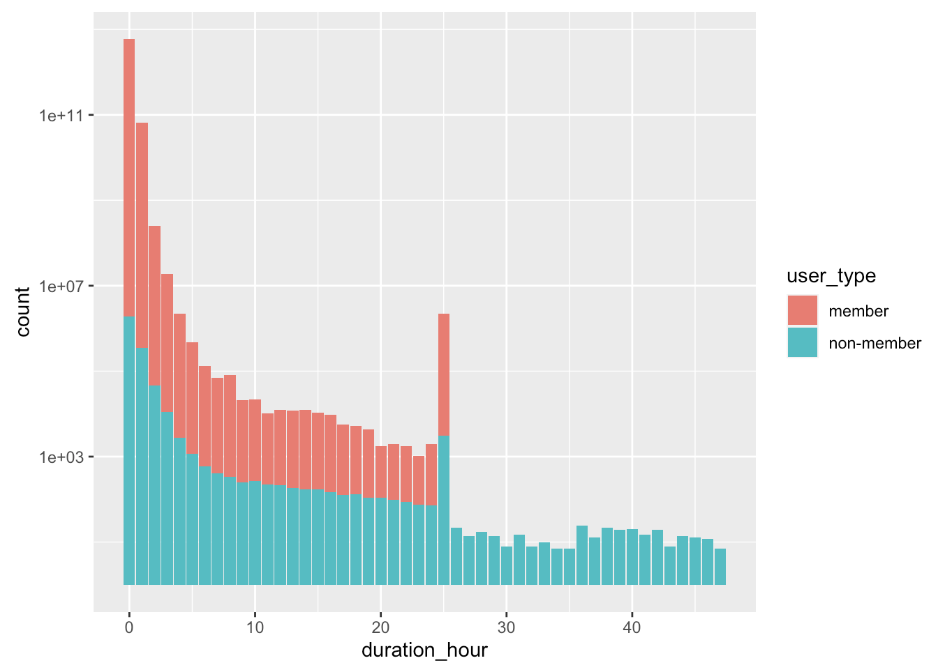
>24 Hours Bike Rent
5311 bike rents (~0.09% annual rent) are longer than 24 hours.
87% is by non member user.
At 25th hour, there is a surge of bike return. Probably due to last minute return wave.

Slide 8
3rd Suggestion
Create a grace time period for member user who tries to return at midnight in order to not pass 24 hour rental. This grace time period should only be applicable at midnight to avoid misuse.
We could pitch this grace time period as an advantage to become a member.

