Slide 1
APEXPLANET DATA ANALYTICS INTERNSHIP
Internship Journey & Portfolio
V. Gunasekaran
B.Tech – Artificial Intelligence and Data Science
ApexPlanet Software Pvt. Ltd.
1

Slide 2
Internship Overview
Organization
ApexPlanet Software Pvt. Ltd.
Domain
Data Analytics
Approach
Practical, project-based tasks
• Worked through multiple stages of the data analytics lifecycle.
• Progressed from data preparation and EDA to dashboard development.
• Applied statistical validation and data storytelling.
• Focused on converting analytical findings into business insights.
2

Slide 3
Task 1 – Data Preparation
Objective
Prepare the dataset for reliable downstream analysis.
Work Completed
Inspected data, checked missing values and duplicates, cleaned and prepared the dataset.
Tools
Python • Pandas • Google Colab
• Inspected the structure and quality of the sales data.
• Checked for missing values and duplicate records.
• Prepared a cleaner dataset for exploratory analysis.
• Created a reliable foundation for later dashboard and statistical work.
3

Slide 4
Task 2 – Exploratory Data Analysis
Objective
Explore the dataset to identify trends, patterns and relationships.
Analysis
Descriptive statistics, sales, product, customer analysis and visualizations.
Tools
Python • Pandas • Matplotlib • Seaborn • Google Colab
• Examined sales performance across categories and products.
• Explored customer and geographic patterns.
• Used visualizations to make trends easier to interpret.
• Generated findings used in the dashboard and storytelling stages.
4

Slide 5
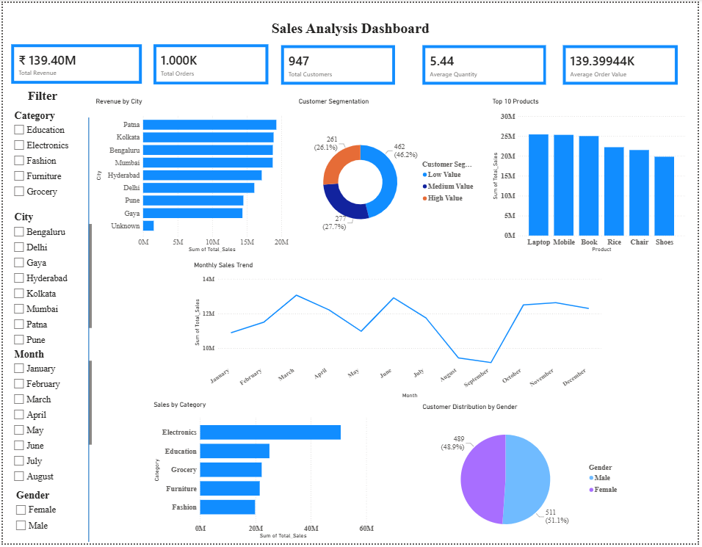
Task 3 – Interactive Power BI Dashboard
Dashboard Features
Revenue KPIs • Sales trends • Category analysis • Product analysis • City analysis • Customer segmentation • Interactive slicers
Tools
Power BI • Power Query • DAX
5

Slide 6
Task 4 – Data Storytelling & Statistical Validation
Data Storytelling
Converted analytical findings into observations, business insights and recommendations.
Statistical Validation
Used correlation analysis, independent sample t-test and chi-square testing.
Tools
Python • Pandas • Matplotlib • Seaborn • SciPy • Power BI
• Analysed revenue by category and city.
• Studied monthly sales trends and top-performing products.
• Explored customer segmentation and demographic patterns.
• Used statistical tests to validate selected observations.
6

Slide 7
Key Business Insights
Products & Categories
Identified high-performing categories and products contributing strongly to revenue.
Geographic Performance
Analysed city-wise revenue to identify stronger and weaker market performance.
Customer Behaviour
Used segmentation and demographic analysis to understand customer patterns.
Time Trends
Examined monthly sales fluctuations to support seasonal planning.
Evidence-Based Decisions
Statistical validation added evidence beyond visual interpretation.
7

Slide 8
Technical Skills Developed
Programming
Python
Data Analysis
Pandas • NumPy • EDA
Visualization
Matplotlib • Seaborn • Power BI
Statistics
Correlation • T-Test • Chi-Square
Tools
Google Colab • GitHub
8

Slide 9
Key Learnings & Reflection
• Worked with real-world data from preparation through interpretation.
• Improved systematic exploratory analysis and pattern identification.
• Gained practical experience building an interactive Power BI dashboard.
• Learned to validate observations statistically instead of relying only on visual patterns.
• Improved communication through data storytelling.
• Learned to organize and present technical work using GitHub.
• Most importantly, learned that data analytics is about turning data into decisions—not simply creating charts.
9

Slide 10
THANK YOU
V. Gunasekaran
B.Tech – Artificial Intelligence and Data Science
ApexPlanet Data Analytics Internship
10

