Slide 1
Predictive maintenance of industrial machinery
IBM SKILLSBUILD – AICTE PROJECT
Presented By:
1.Surada Guna Sekhar - SAGI RAMAKRISHNAM RAJU ENGINEERING COLLEGE - Computer Science and Engineering

Slide 2
OUTLINE
Problem Statement (Should not include solution)
Proposed System/Solution
System Development Approach (Technology Used)
Algorithm & Deployment
Result (Output Image)
Conclusion
Future Scope
References

Slide 3
Problem Statement
Industrial machinery often encounters unexpected failures such as tool wear, heat dissipation issues, power failures, and overstrain, which lead to unplanned downtime, high maintenance costs, and reduced productivity. Traditional maintenance approaches are largely reactive, addressing failures only after they occur, resulting in significant operational inefficiencies. The core challenge is to anticipate these failures in advance by identifying patterns that indicate potential breakdowns, allowing industries to minimize downtime, reduce costs, and enhance machine reliability.

Slide 4
Proposed Solution
Data Collection:
Collected Kaggle Predictive Maintenance dataset with 5 key sensor readings.
Captured machine conditions and historical failure records.
Data Preprocessing:
Cleaned missing values and removed outliers.
Applied feature engineering and PCA transformation to optimize model performance.
Machine Learning Algorithm:
Utilized IBM Watson AutoAI on IBM Cloud Lite to generate 9 ML pipelines.
Selected Batched Tree Ensemble Classifier (Snap Random Forest) as best model.
Deployment:
Deployed trained model on IBM Cloud Lite as a real‑time endpoint for predictive maintenance.
Evaluation:
Achieved 99.7% accuracy, high precision/recall, and minimal misclassifications.

Slide 5
System Approach
System requirements:
Platform: IBM Cloud Lite (Watson Studio & AutoAI)
Dataset: Kaggle – Machine Predictive Maintenance Classification
Compute Environment: Cloud‑based AutoAI pipelines (no local execution)
Deployment: IBM Cloud Lite real‑time endpoint for predictive maintenance
Library required to build the model:
IBM AutoAI (built‑in ML pipelines) – handles preprocessing, model selection, and hyperparameter tuning automatically
Python (Cloud Environment) – used for minor preprocessing in notebooks
Internal libraries used by AutoAI pipelines:
scikit‑learn (classification & evaluation)
xgboost and lightgbm (boosted ensemble methods)

Slide 6
Algorithm & Deployment
Algorithm Selection:
Batched Tree Ensemble Classifier (Snap Random Forest) chosen for its high accuracy and reliability.
Data Input:
5 sensor features from the dataset (temperature, pressure, torque, etc.).
1 target label indicating machine failure type.
Training Process:
Dataset uploaded to IBM Cloud Lite AutoAI.
AutoAI generated 9 pipelines and performed hyperparameter tuning.
Selected model achieved Holdout Accuracy: 99.7% | CV Accuracy: 99.5%.
Prediction Process:
Deployed model as a cloud endpoint for real‑time predictive maintenance.
Integrates with IoT dashboards for live alerts.

Slide 7
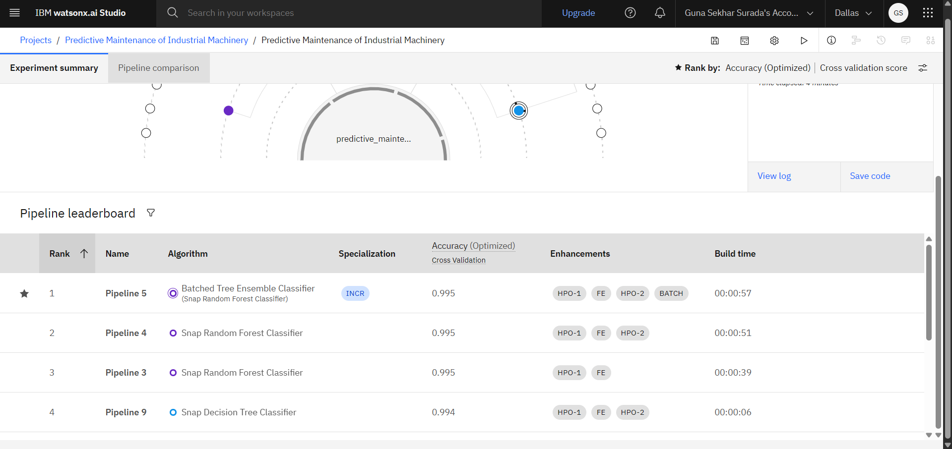
Result
IBM AutoAI Pipeline Leaderboard – Model Selection and Accuracy Comparison

Slide 8
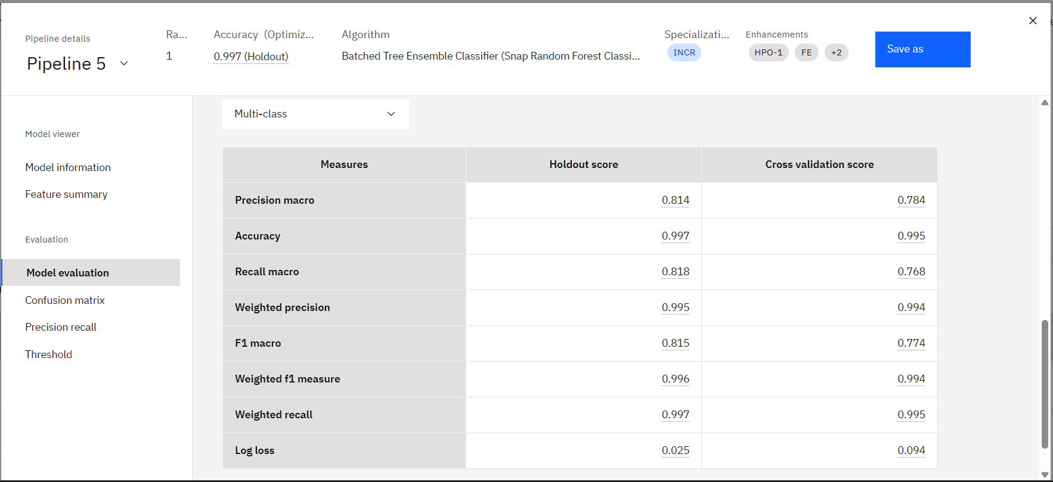
Result
Comprehensive Model Performance and Accuracy Metrics

Slide 9
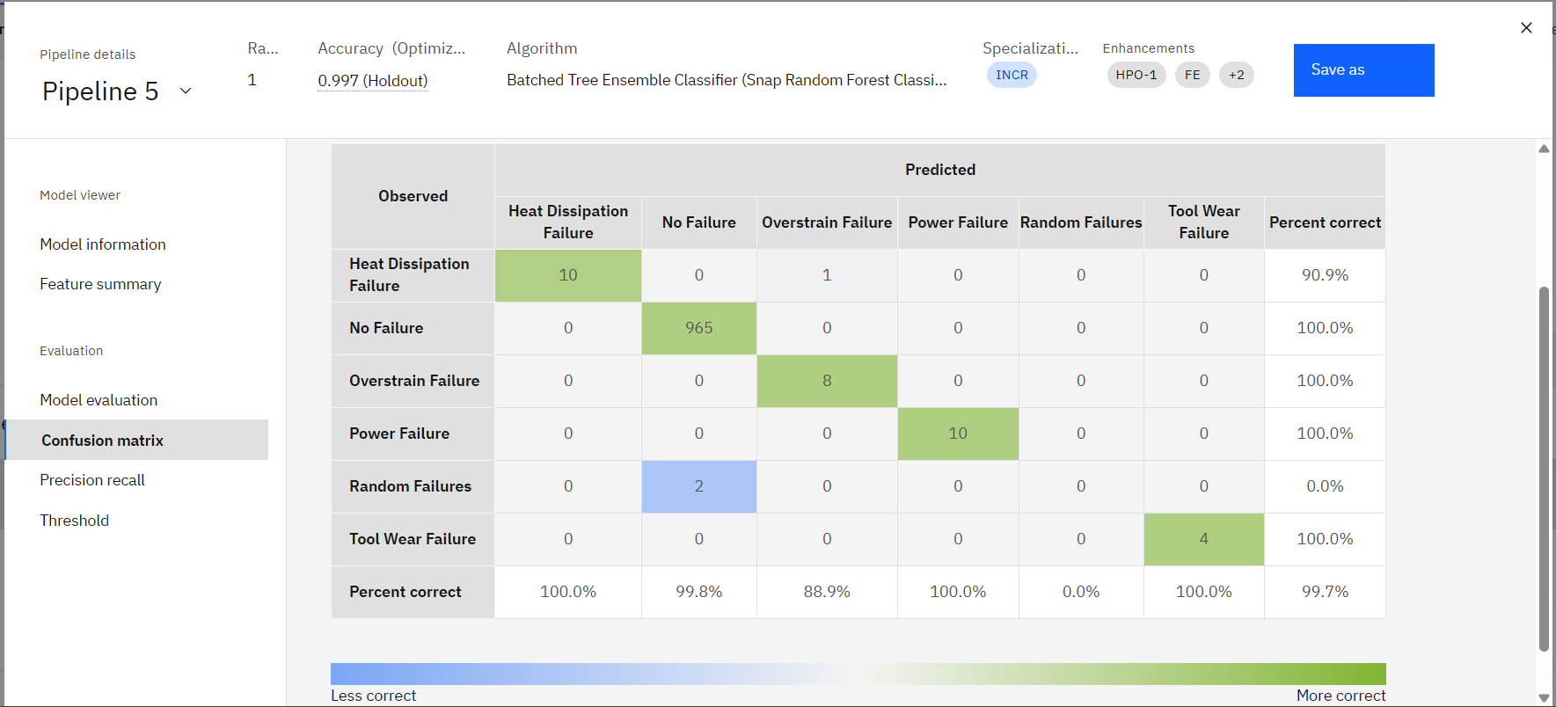
Result
Confusion Matrix

Slide 10
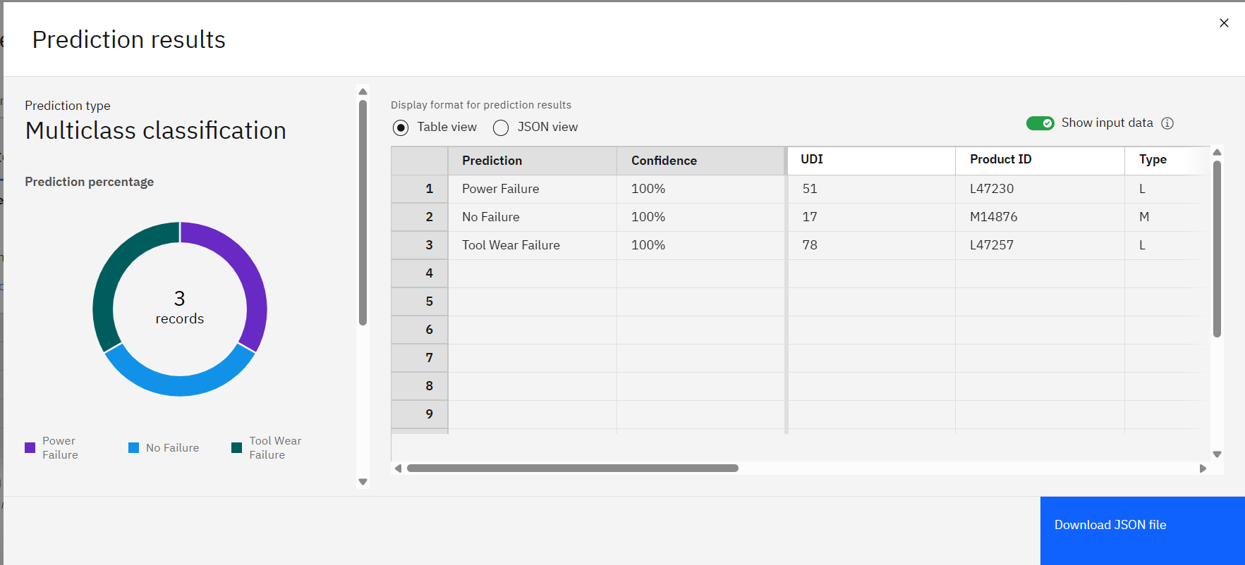
Result
Multiclass Prediction Results with Confidence Scores

Slide 11
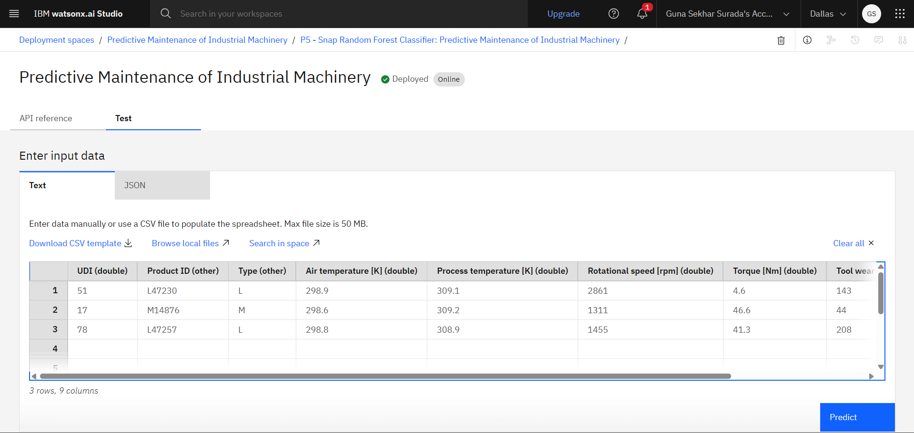
Result
Model Deployment and Testing Data for Prediction

Slide 12
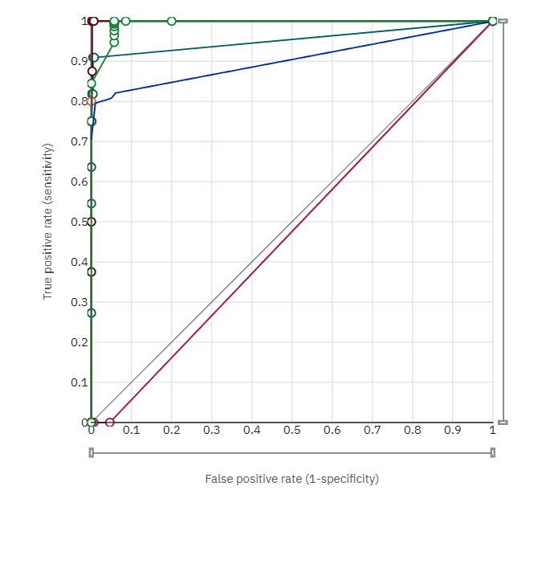
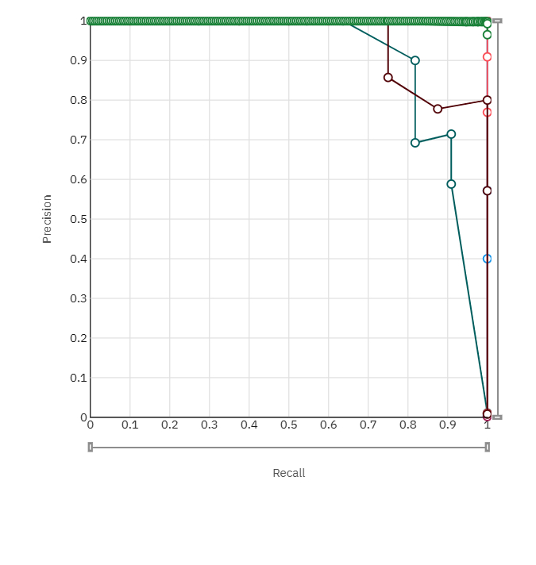
Result
ROC Curve
Precision‑Recall Curve

Slide 13
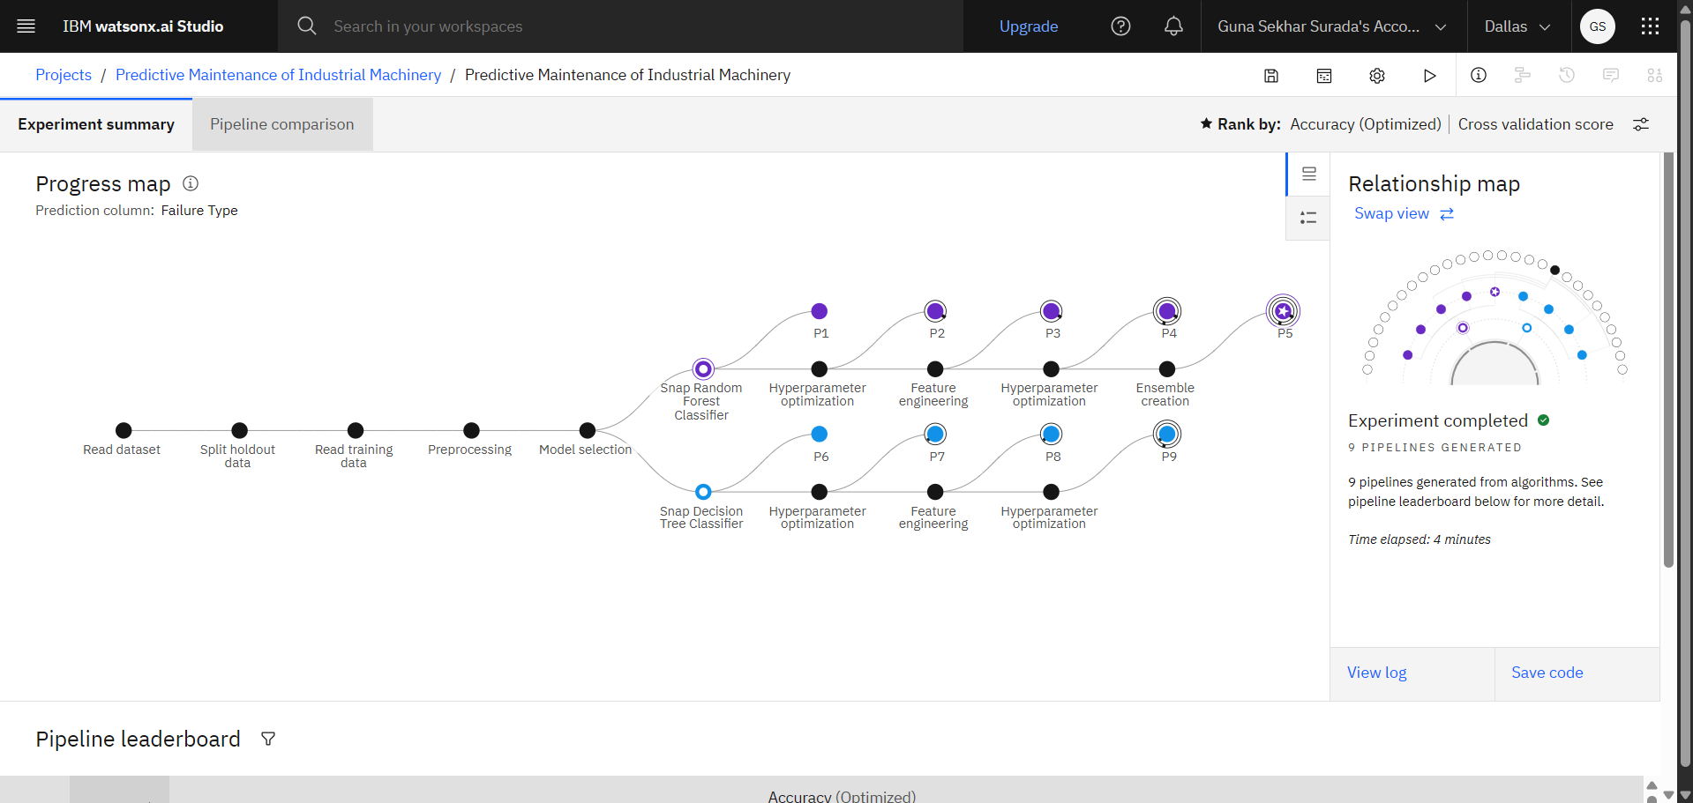
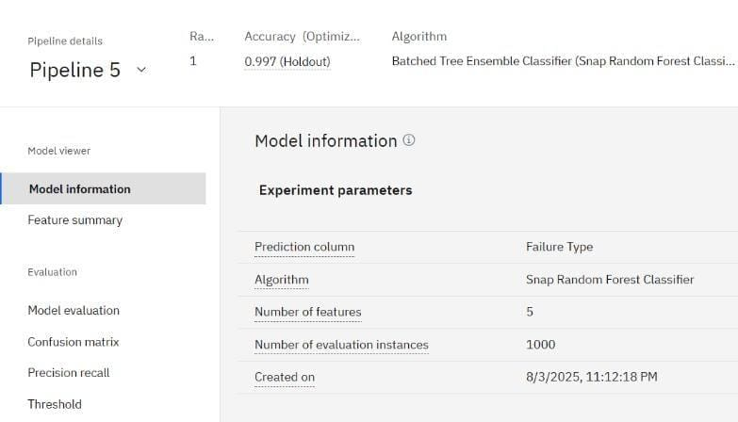
Result
Model Information
Progress Map

Slide 14
Conclusion
This project successfully developed and deployed a cloud‑based predictive maintenance system using IBM Cloud Lite and Watson Studio AutoAI. By analyzing real‑time sensor data to identify patterns that precede machine failures, the model achieved 99.7% prediction accuracy with high precision and recall.
Key outcomes:
Early failure prediction minimized unplanned downtime.
Optimized maintenance scheduling reduced operational costs.
Reliable classification of multiple failure types (Tool Wear, Power Failure, Heat Dissipation, Overstrain).
This demonstrates the effectiveness of AI‑driven predictive maintenance in improving industrial reliability and efficiency.

Slide 15
Future scope
Integration with live IoT sensor streams to enable real‑time monitoring and automated alerts.
Edge Computing Deployment for instant, on‑site predictions without cloud latency.
Expansion to diverse industrial machine types and larger datasets for higher generalization.
Hybrid Machine Learning + Deep Learning models to detect rare and complex failure modes.
Predictive maintenance dashboards for visual analytics and maintenance planning.

Slide 16
References
Kaggle dataset link – https://www.kaggle.com/datasets/shivamb/machine-predictive-maintenance-classification
Github Link -- https://github.com/gunasekhar1706/Final-Project-Submission.git
IBM Watson Studio AutoAI Documentation
IBM Cloud Lite Deployment Guide
Research papers on Predictive Maintenance and Failure Classification

Slide 17
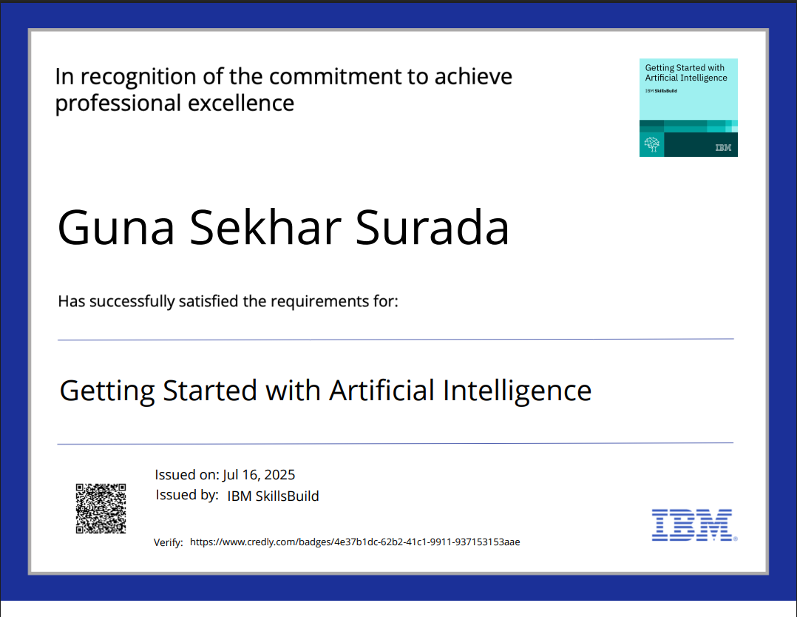
IBM Certifications

Slide 18
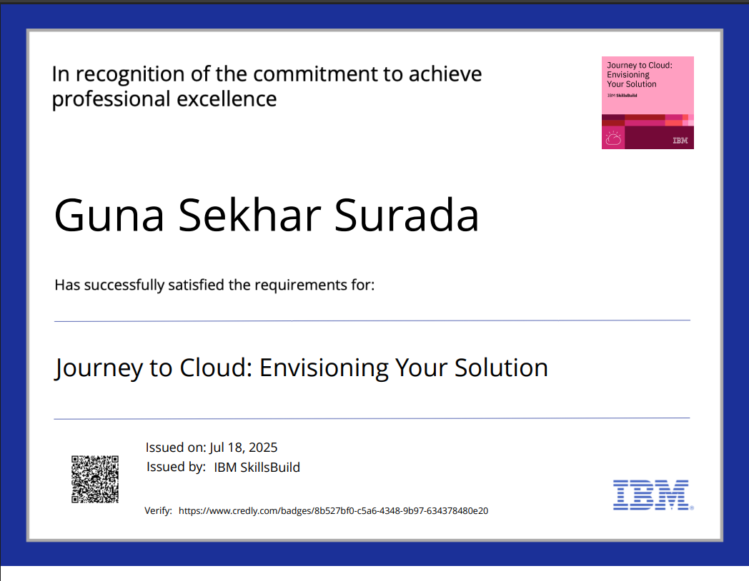
IBM Certifications

Slide 19
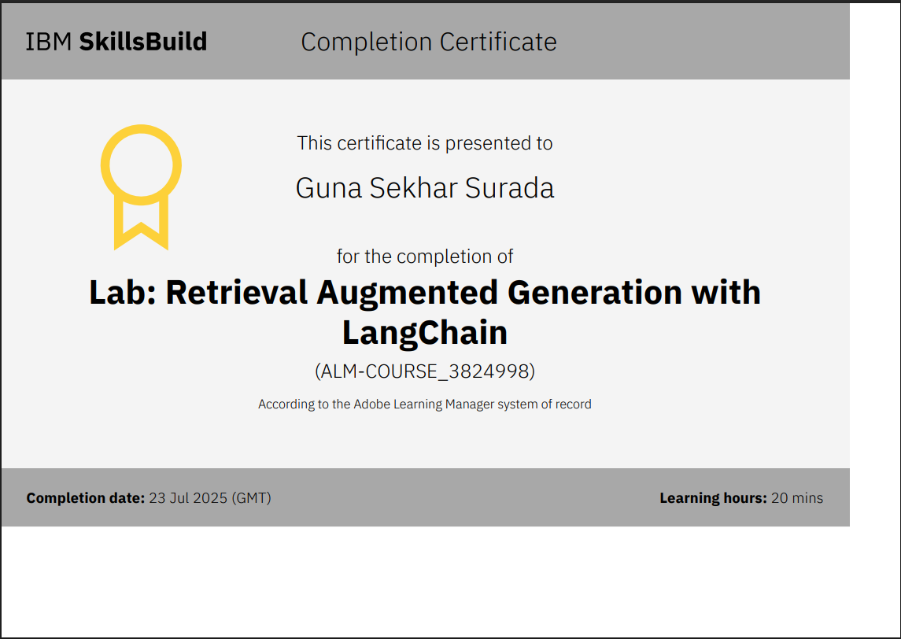
IBM Certifications

Slide 20
THANK YOU

