Slide 1
Mouse & Keyboard Control using Hand Gesture Recognition
Guna Sekhar Subbarao Karanam
VOOBA RAJKUMAR
GBHUVANA REDDY
EE 604: Image Processing, IIT Kanpur, 2026

Slide 2
Problem
Input: live video from a normal laptop webcam
Output: mouse + keyboard actions (move, click, scroll, drag, type)
Constraints: real time on CPU, no extra hardware, works for new users, no false clicks
2
Notes:
Input, output, constraints.

Slide 3
Existing work vs. ours
Existing approach | Problem | Ours
CNN on pixels (Kopuklu '19) | needs GPU, big data | small MLP on 21 hand points
'Fingers up' rules (virtual mice) | fails on new users, tilt | learned, invariant features
Cursor = fingertip | jumps when you click | cursor = index knuckle
Raw / averaged cursor | shakes or lags | One-Euro filter
Act on every frame | false clicks | temporal voting
3
Notes:
What was done before, and how we differ.

Slide 4
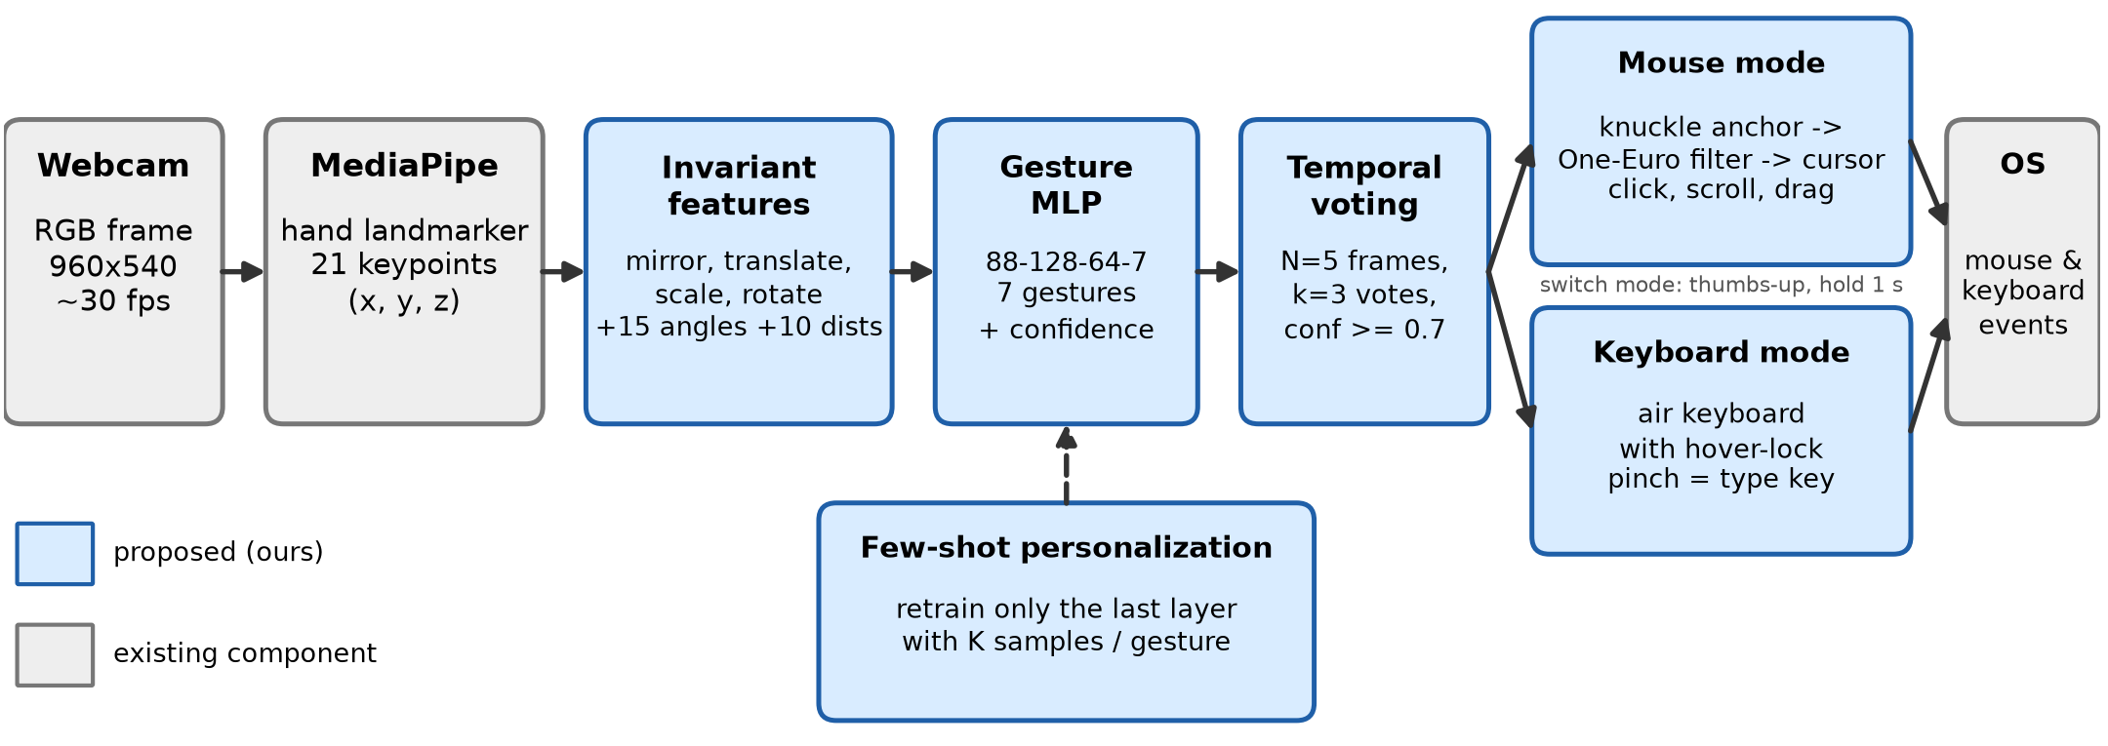
Method
4
Notes:
Grey = existing (webcam, MediaPipe, OS). Blue = ours.

Slide 5
Key ideas
1. Invariant features (mirror, move, scale, rotate) -> position and tilt don't matter
2. Gesture MLP + augmentation -> fast, works on new people
3. Voting: 3 of last 5 frames -> no false clicks
4. Knuckle anchor + One-Euro filter -> steady cursor, accurate clicks
5. Air keyboard with hover-lock
5
Notes:
Say WHY for each line.

Slide 6
Gestures
Gesture | Action
Point | move cursor / hover key
Pinch thumb + index | left click / type key
Pinch thumb + middle | right click
Two fingers (V) | scroll
Fist | drag
Open palm | pause
Thumbs up (1 s) | switch mouse / keyboard
6

Slide 7
Experiments
Dataset: own recordings, 15,378 frames, 3 users, 7 gestures
Tests: random 80/20 split + leave-one-user-out (unseen person)
Tools: MediaPipe, PyTorch, OpenCV, PyAutoGUI
Hardware: laptop CPU, no GPU
7

Slide 8
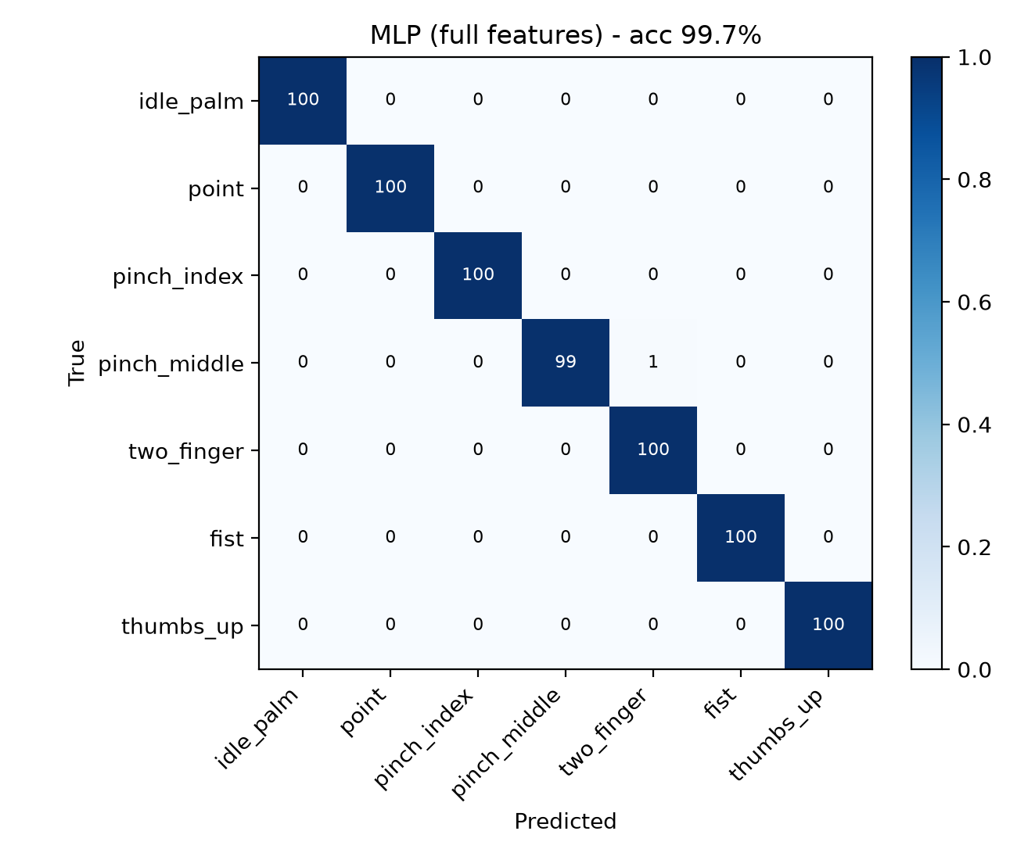
Result 1: gesture accuracy
Method | Same users % | New user % | ms/frame
Rule-based (usual) | 89.9 | 89.8 | 0.03
SVM | 99.7 | 90.2 | 0.15
CNN on image | 99.9 | - | 4.01
MLP (ours) | 99.7 | 96.6 | 0.72
8
Notes:
On a NEW person ours is best. CNN is as accurate on known users but about 5x slower and 12x bigger.

Slide 9
Result 2: control quality
Measure | Usual | Ours
Cursor shake (px / frame) | 4.21 (no filter) | 2.59
Cursor lag (ms) | 64 (moving avg.) | 11
Clicks for 30 real pinches | 50 (no voting) | 30
Cursor jump at click (px) | 182.5 (fingertip) | 53.4
Speed (FPS on CPU) |  | 32.2
9
Notes:
Each row = one novelty: usual design vs ours.

Slide 10
Live demo
1. Move, click, scroll, right click, drag
2. Turn filter / anchor / voting off live -> see the difference
3. Thumbs up -> type on the air keyboard
10
Notes:
Mouse, then toggles f / a / v / r, then keyboard.

Slide 11
Conclusion
Webcam-only mouse + keyboard at 32 FPS on CPU
96.6% on unseen users (rules: 89.8%)
Steady cursor, no false clicks
Future: swipe gestures, more users
Thank you! Code: https://github.com/gunasekharkaranam/gesture-mouse-keyboard
11

