Slide 1
PREDICTING DEFAULT OF CREDIT CARD CLIENTS
Nithin Hariprasad, Gunasri Babu ,Venkata Satya Surya Kinjal Vadapalli, Gopu Ramya, Navya Madhuri UNIVERSITY of HOUSTON Cullen College of Engineering

Slide 2
CONTENTS
Defining the Problem
Introduction
Background
Procedure
Data Visualization
Methods
Evaluation metrics
Results
Conclusion

Slide 3
PROBLEM
• Predicting credit card defaults is a critical challenge for financial institutions due to complex consumer behavior and financial uncertainties.
• The increasing issuance of credit cards has made it essential to identify potential defaulters to minimize losses and maintain financial stability.
• The objective is to build a reliable, automated model that analyzes client information and historical transaction data to predict defaults accurately.
• This approach enables banks to proactively mitigate risks by offering alternative solutions, ensuring better credit management and customer retention.

Slide 4
INTRODUCTION
• This project focuses on implementing and comparing advanced predictive models to forecast defaults using customer demographic, financial, and transactional data.
• The study employs algorithms from various paradigms, including Logistic Regression, K-Nearest Neighbors, Random Forest, and Neural Networks.
• Key metrics like Accuracy Score and ROC Curve are used to evaluate and compare model performance.
• Advanced techniques like XGBoost, Neural Networks, and ensemble methods further enhance predictive accuracy, enabling banks to mitigate risks proactively.

Slide 5
BACKGROUND
• The Taiwanese government has permitted the creation of new banks since 1990, leading to increased competition in the financial sector.
• To expand market share, banks issued credit cards to less financially skilled applicants, resulting in overuse and significant debt accumulation. • Credit card defaults, where cardholders fail to meet repayment obligations, have eroded confidence in consumer credit and posed challenges for banks and cardholders alike.
• In a robust financial system, risk prediction is crucial to mitigating damage by identifying individuals at risk of default.
• This project aims to leverage financial and transactional data to build predictive models that identify potential defaulters, enabling banks to offer alternatives like forbearance or debt consolidation to minimize losses.
• Advanced forecasting techniques are compared and evaluated to develop reliable credit risk management solutions.

Slide 6
PROJECT PLAN
1.Model Selection and Evaluation:
Logistic regression
KNN
Random Forest
Decision Tree
SVM with linear kernel
SVM with nonlinear kernel.
2.Feature Selection: Lasso Technique, KNN, Correlation.
3. Model Structure Selection and Hyperparameter Tuning – Random Search
4. Variable Selection with Bi-directional Elimination (Wrapper Method)
5. Advanced Model Building :
XGBoost : Boosting ensemble method for improved prediction.
Deep Learning Model (Two Layers): Implement a simple neural network.
Ensemble Model: Combine top-performing models for increased accuracy.
6. Model Performance Visualization - Accuracy Score, ROC Curve

Slide 7
DATASET EXPLANATION AND APPROACH
What dataset is used?
Default of Credit Card Clients Dataset,
https://archive.ics.uci.edu/dataset/350/default+of+credit+card+clients
Default of Credit Card Clients Dataset
This dataset contains 30K Instances of 24 different features
Attributes/Features = 24, Target variable is categorical and is labeled as Default with labels named, 1 and 0
Labeled or Unlabeled Data?
The dataset is labeled as all the datapoints are tagged with appropriate labels
Classification / Regression?
This dataset is used for classification

Slide 8
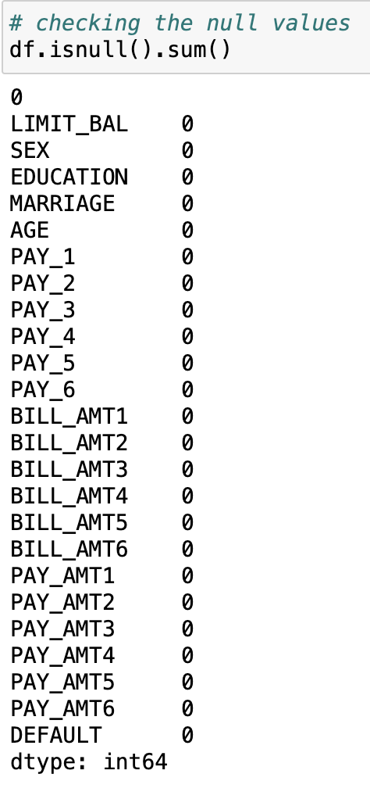
DATA CLEANING
Key data cleaning steps included:
• Dropping the unnecessary ID index column to streamline the dataset.
• Ensuring consistent data types across all columns for accurate analysis.
• Verifying the dataset for null values (none were present).
• These steps ensured a clean and structured dataset for effective model training.

Slide 9
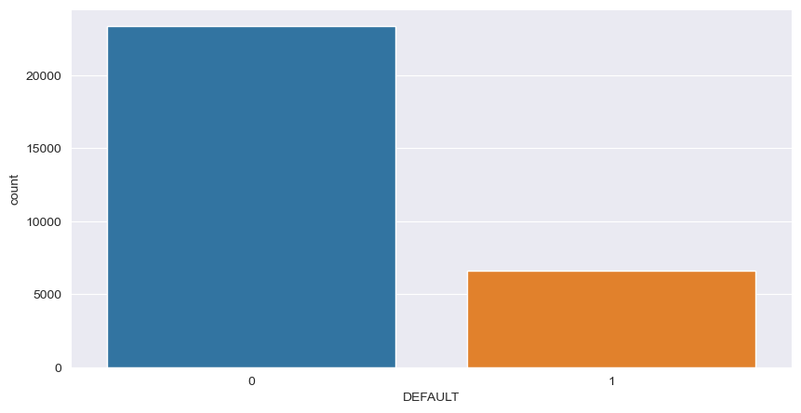
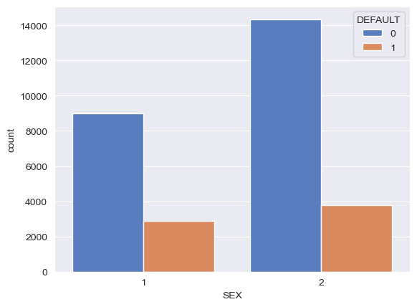
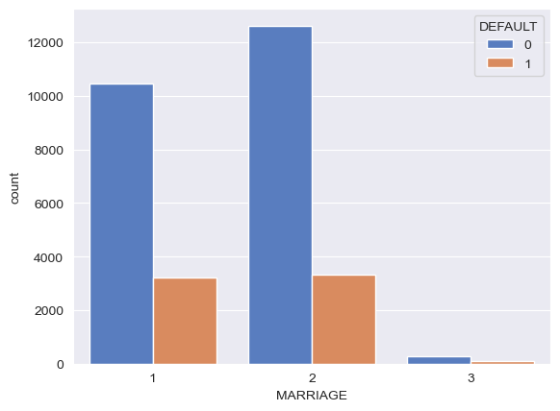
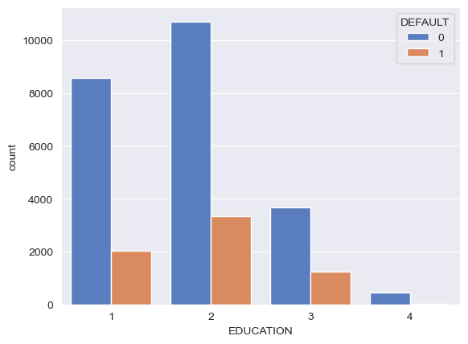
EDA
Default Count
Sex
Marriage Status
Education Level
DEFAULT
SEX
MARRIAGE
EDUCATION

Slide 10
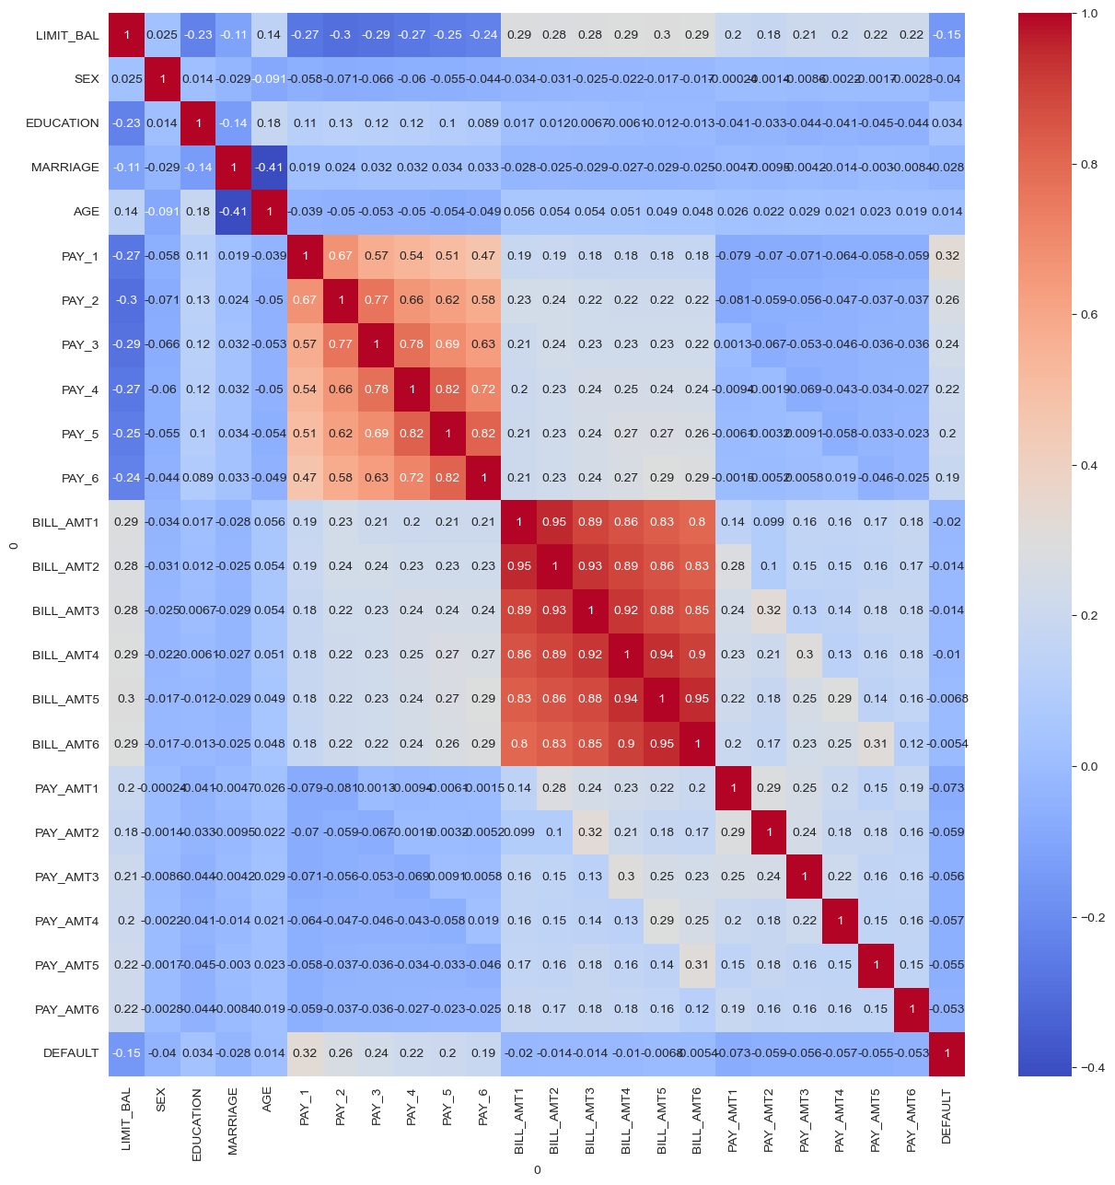
Insights from EDA
Negative Correlation:
LIMIT_BAL: There is a moderate negative correlation (-0.15) between 'LIMIT_BAL' (credit limit) and default. This suggests that higher credit limits are associated with a lower likelihood of default.
AGE: A slight negative correlation (-0.02) is observed between 'AGE' and default. This implies that older individuals may have a slightly lower probability of defaulting.
Positive Correlation:
PAY_1, PAY_2, PAY_3, PAY_4, PAY_5, PAY_6: There is a moderate to strong positive correlation (ranging from 0.19 to 0.32) between payment statuses ('PAY_1' to 'PAY_6') and default. This indicates that delayed payments in previous months are associated with a higher likelihood of default in the current month.
BILL_AMT1, BILL_AMT2, BILL_AMT3, BILL_AMT4, BILL_AMT5, BILL_AMT6: There is a weak positive correlation (ranging from 0.005 to 0.073) between bill amounts ('BILL_AMT1' to 'BILL_AMT6') and default. This suggests that higher bill amounts in previous months are weakly associated with a higher probability of default.
Weak Correlation:
SEX, EDUCATION, MARRIAGE: These demographic variables ('SEX', 'EDUCATION', 'MARRIAGE') show very weak correlations (ranging from -0.04 to 0.034) with default. This implies that gender, education level, and marital status have minimal direct impact on the likelihood of default.
PAY_AMT1, PAY_AMT2, PAY_AMT3, PAY_AMT4, PAY_AMT5, PAY_AMT6: Similarly, there is a weak correlation (ranging from -0.059 to -0.006) between payment amounts ('PAY_AMT1' to 'PAY_AMT6') and default. This suggests that the amount paid in previous months has a limited influence on default likelihood.

Slide 11
METHODS

Slide 12
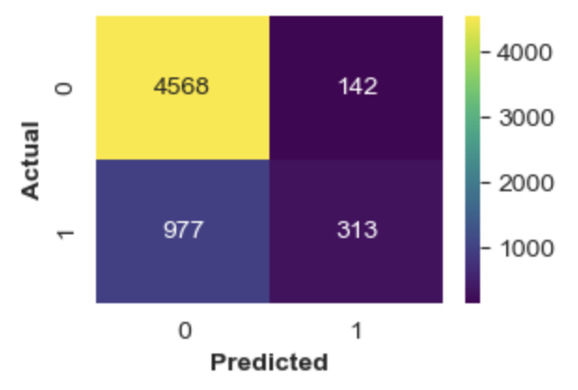
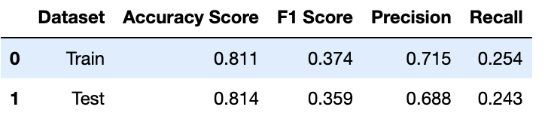
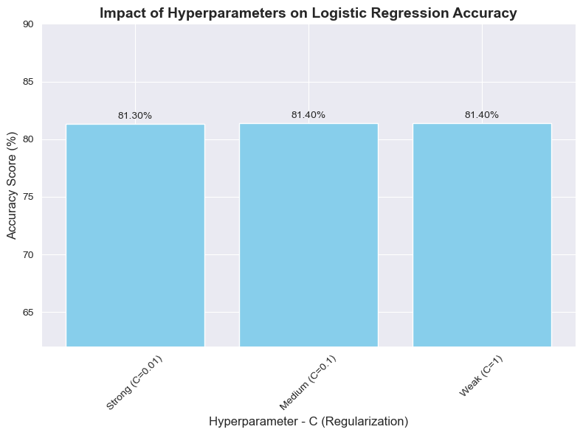
Logistic Regression : Logistic Regression is a statistical method used for binary classification problems, where the target variable has two possible outcomes (e.g., Yes/No, Default/No Default). Objective: Logistic Regression is used to predict whether a credit card holder will default on their payment (binary outcome: Default or No Default). The model evaluates the relationship between various customer attributes (independent variables) and the likelihood of default (dependent variable).
The logistic regression model exhibits similar performance on both the training and test datasets.
Accuracy Score: The model achieves an accuracy of approximately 81.4% on the test data, indicating its effectiveness in correctly predicting outcomes.
F1 Score and Precision-Recall: While the F1 score and precision-recall metrics are relatively lower, they highlight the balance between precision (ability to identify relevant instances) and recall (ability to capture all relevant instances) in the model's predictions.
Confusion Matrix
Model Performance – Impact of hyper tuning parameter
Conclusions on Logistic Regression Hyperparameter (C) Tuning:
Consistent Accuracy: Varying the hyperparameter C (regularization strength) between 0.01, 0.1, and 1 resulted in a stable accuracy score around 81.4%, indicating robust model performance.
Limited Impact of C: The accuracy score remained largely unchanged across different C values, suggesting that within the tested range, 𝐶C did not significantly affect the model's ability to generalize.

Slide 13
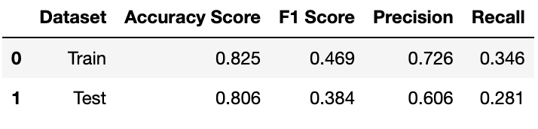
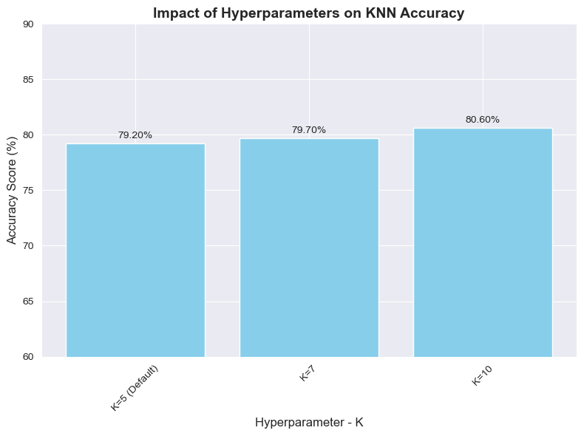
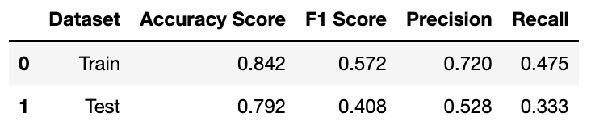
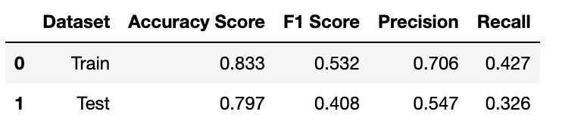
KNN :Its a simple, non-parametric, and versatile machine learning algorithm used for classification and regression tasks. It is based on the idea that similar data points are likely to have similar outcomes. Predictions are made based on the similarity between data points, measured using a distance metric. As k increases from 5 to 7 to 10: Increases from 0.999 to 0.810 to 0.825.Shows a slight decrease from 0.817 (for 𝑘=5k=5) to 0.809 (for 𝑘=7k=7) and then a slight increase to 0.819 (for 𝑘=10k=10
Model Performance – Impact of hyper tuning parameter
K=10
K=7
K=5
Train Data:
Higher k values result in reduced model complexity, reflected by lower accuracy but still high performance on the training set (e.g., 𝑘=10).
Test Data:
Moderate k values (e.g., 𝑘=5) yield better generalization as indicated by higher test accuracy, balancing bias and variance.

Slide 14
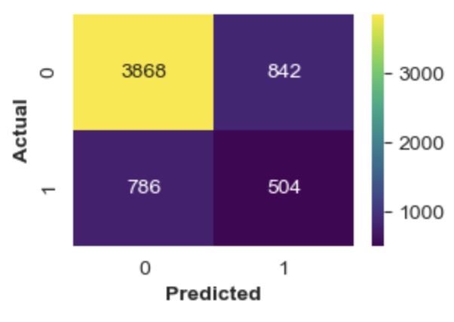
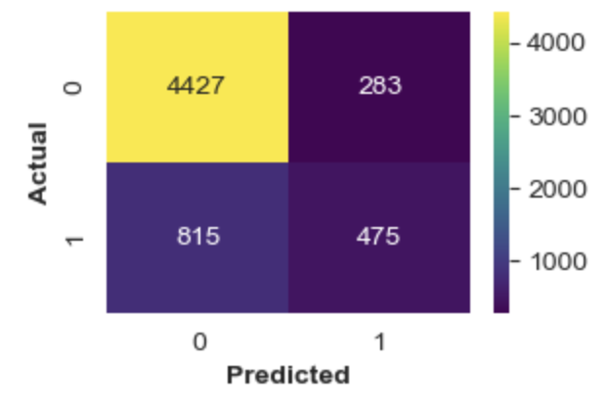
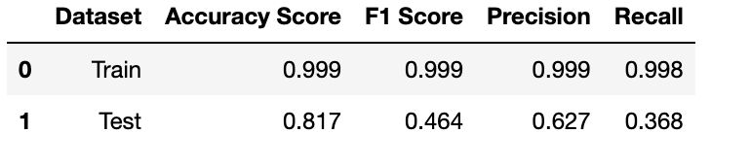
Random Forest & Decision Tree:
Random Forest Classifier – An ensemble ML model, constructs multiple decision trees during training, predicts the class .It consists of multiple decision trees, each trained on a different subset of the data (created using bootstrapping, i.e., sampling with replacement).
Decision Tree Classifier – It is a is a supervised machine learning algorithm used for classification tasks. It splits the data into subsets based on the value of input features, creating a tree-like structure where each node represents a decision point and each leaf represents an outcome
Confusion Matrix(GINI)
Random Forest – Model Performance
Confusion Matrix

Slide 15
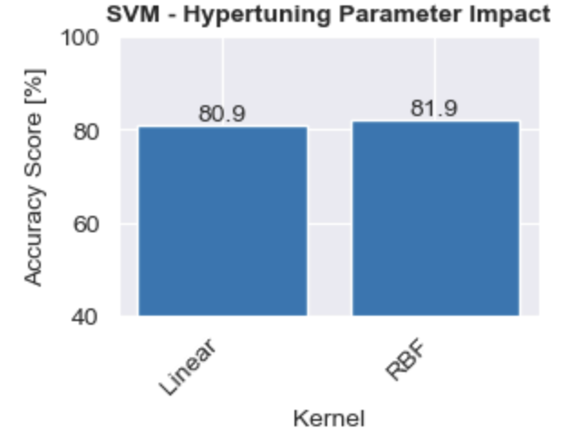
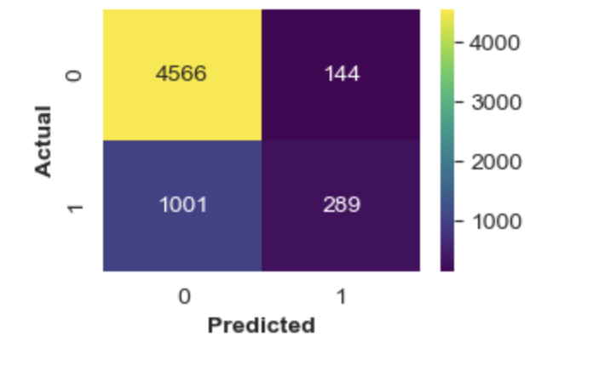
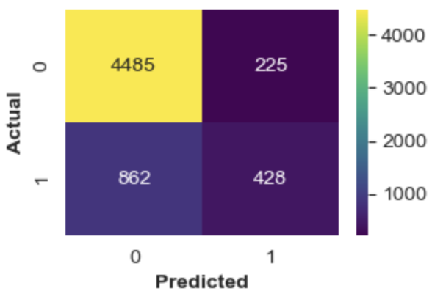
Support Vector Machine Classifier:
SVM -Its a supervised machine learning algorithm used for classification . It is especially effective for high-dimensional datasets and scenarios where the data is not linearly separable. SVM aims to find the best decision boundary (hyperplane) that separates classes in a dataset.
Linear Kernel-A linear kernel assumes that the data can be separated by a straight line (or hyperplane in higher dimensions). The decision boundary is a linear hyperplane that maximizes the margin between classes.
Non Linear Kernal - A non-linear kernel transforms the input space into a higher-dimensional feature space where data can be separated linearly.
SVM with Non-linear Kernel (RBF): Achieves a higher accuracy of 81.9% compared to SVM with Linear Kernel (80.9%).
Model Performance - SVM Kernels
SVM with Linear Kernel - Confusion Matrix
SVM with Non-Linear Kernel - Confusion Matrix

Slide 16
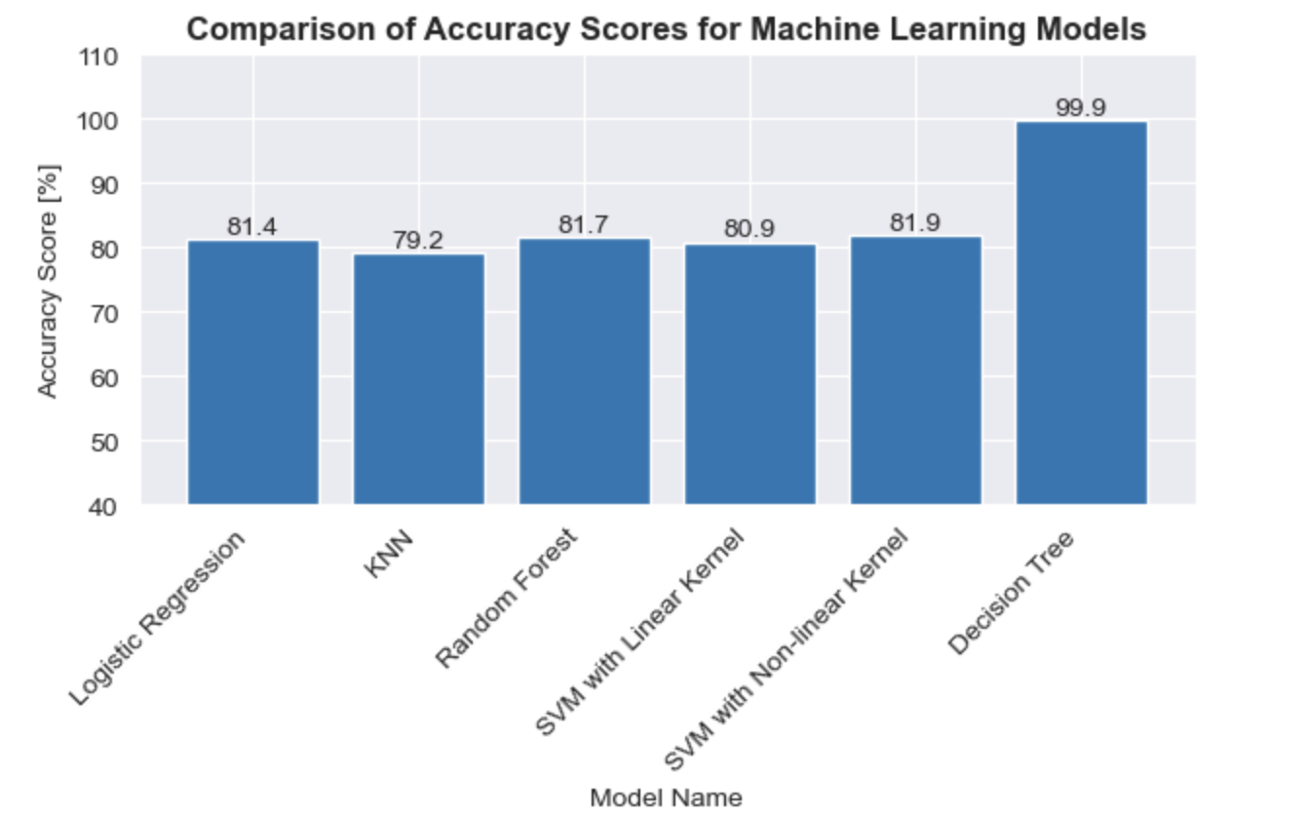
ML Models – Performance Comparison
Decision Tree outperforms other models with the highest accuracy of 90.9%.
SVM with a non-linear kernel also shows strong performance at 81.9% accuracy.
While all models perform reasonably well, Decision Tree emerges as the most accurate predictor for credit default.
99.4
In coming slides, features are further reduced using Lasso, a prominent feature selection method

Slide 17
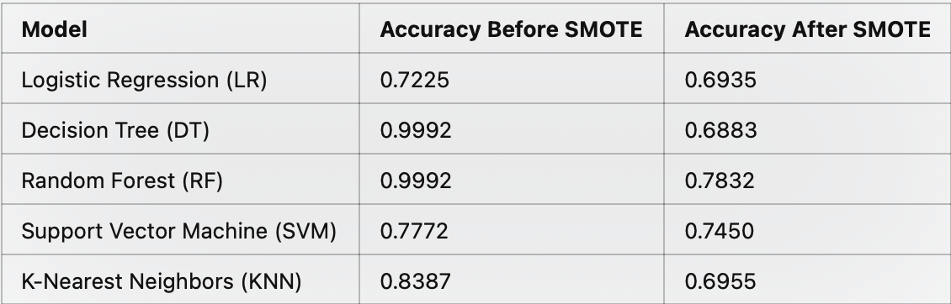
SMOTE Technique and Results: Why SMOTE? • Synthetic Minority Oversampling Technique (SMOTE) was applied to address class imbalance in the credit card default dataset. • It generates synthetic samples for the minority class, improving class representation and potentially enhancing model performance.
Conclusion:
SMOTE was applied to address class imbalance, but it resulted in lower accuracy across all models.
• Models performed better with the original dataset, so SMOTE was excluded from the final approach.
• This underscores the importance of evaluating preprocessing techniques based on actual outcomes.

Slide 18
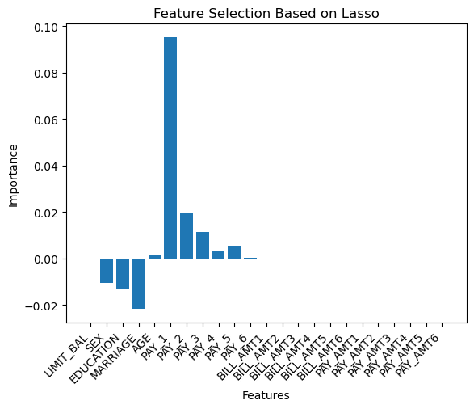
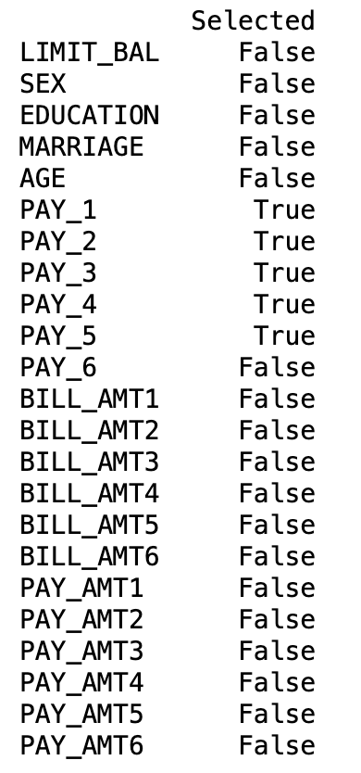
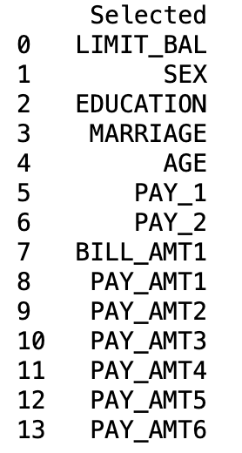
Feature Selection Techniques Lasso Regression-It penalizes the absolute size of regression coefficients, shrinking some to zero, effectively selecting only the most important features. Handles multicollinearity by excluding redundant features. Identifies important predictors like PAY_1, PAY_2, and PAY_3. K-Nearest Neighbors (KNN)-Based Feature Selection-KNN-based feature selection identifies relevant features by evaluating how effectively each feature contributes to class separability. A simple and interpretable method for feature selection. Correlation-Based Feature Selection: Measures the correlation of each feature with the target variable and selects features with a high correlation coefficient. Quickly identifies features strongly associated with the outcome. Captures linear relationships between features and the target variable.
Lasso
KNN
Correlation
Lasso was preferred over KNN and correlation for feature selection because it effectively handles multicollinearity by selecting important features like 'SEX', 'EDUCATION', 'MARRIAGE', 'PAY_1', 'PAY_2', and 'PAY_3' while excluding redundant ones like 'LIMIT_BAL' and 'AGE'. This promotes model interpretability and simplicity, making it suitable for classifying customer default behavior.
6 of 24 features from Lasso selected for further model training

Slide 19
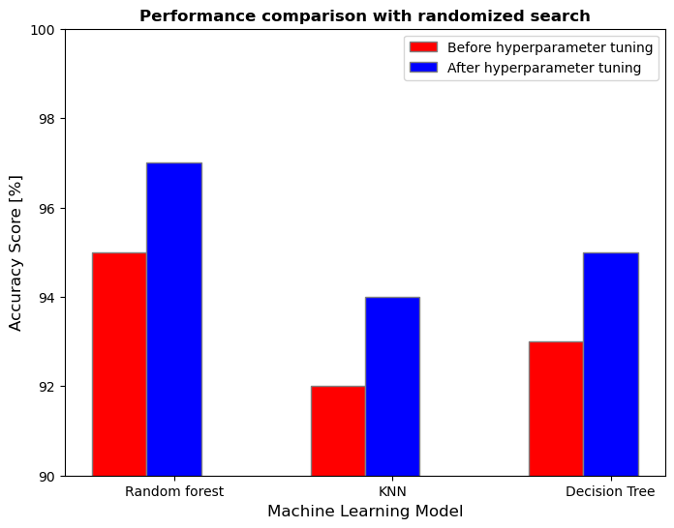
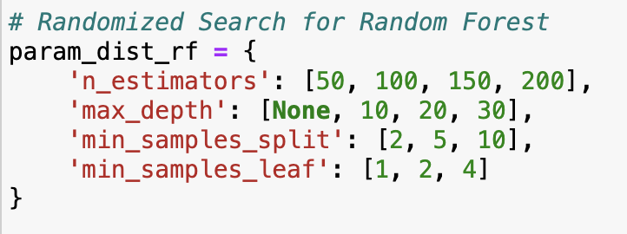
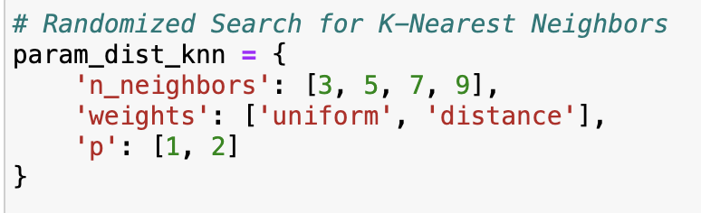
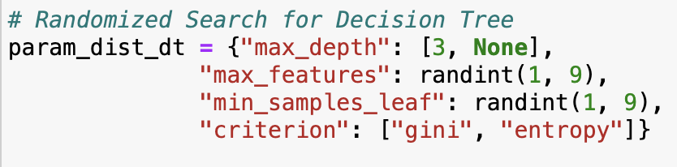
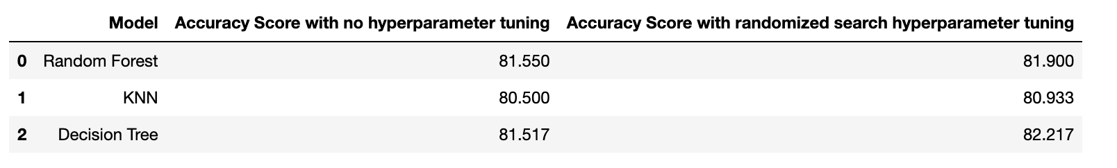
Hyperparameter Tuning using Randomized Search CV
Hyperparameter tuning using randomized search led to improved accuracy scores across all models.
Random Forest showed the most significant improvement in accuracy after hyperparameter tuning, indicating the effectiveness of this method for optimizing model performance.

Slide 20
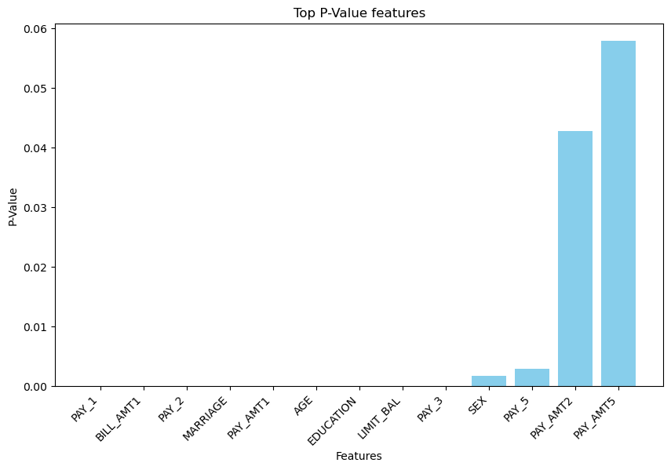
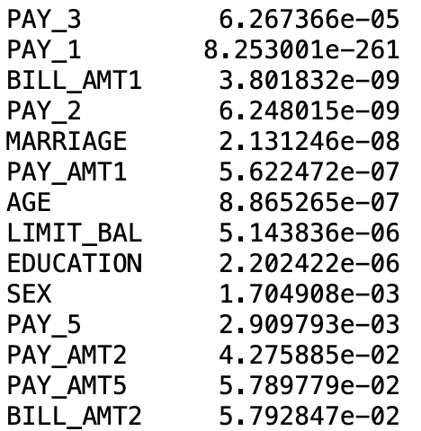
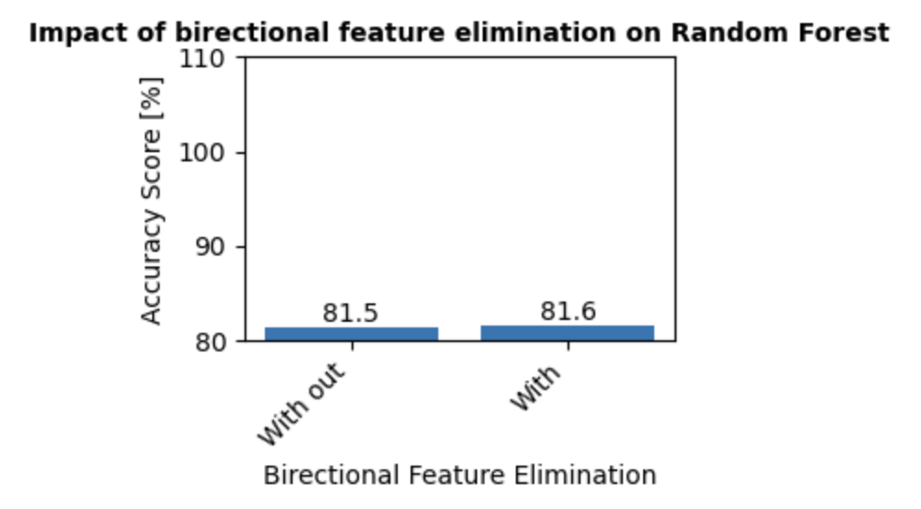
Variable selection using Bidirectional method: The Bi-Directional Wrapper Method is a feature selection technique that combines both forward selection and backward elimination strategies. It iteratively adds or removes features based on their contribution to the predictive performance of the model.
Selected features
Random Forest machine learning model is selected
95% significance level is taken into account for backward feature elimination
14 out of 24 features are shortlisted from Bidirectional Elimination method
Similar performance is seen for Random Forest with and without bidirectional elimination methods

Slide 21
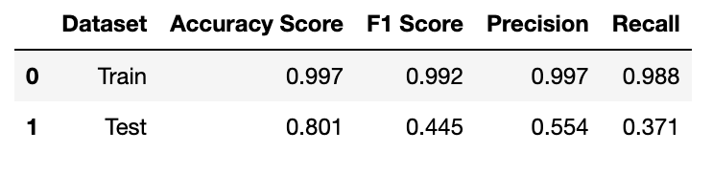
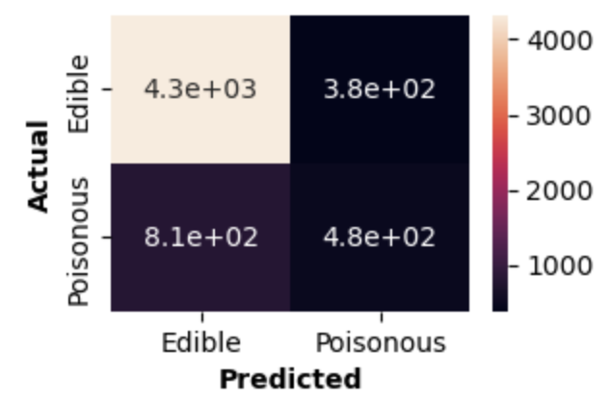
XGBoost :
Boosting: It is an ensemble technique where weak learners (typically decision trees) are sequentially trained.Each new tree corrects the errors of the previous ones, improving model performance iteratively.
Gradient Boosting: In Gradient Boosting optimizes a loss function (e.g., mean squared error for regression or log loss for classification) by adding models (decision trees) that predict the residuals (errors) of the previous model.
Extreme Optimization: XGBoost enhances standard Gradient Boosting by introducing speed, regularization, and parallelism, making it faster and less prone to overfitting.
Model accuracy = 99.7
Training Dataset Performance: Achieved high accuracy (99.7%), F1 score (99.2%), precision (99.7%), and recall (98.8%), indicating strong performance on the seen data.
Test Dataset Performance: Experienced a drop in performance with an accuracy of 80.1%, F1 score of 44.5%, precision of 55.4%, and recall of 37.1%.
Implication: The significant performance gap between training and test datasets suggests potential overfitting.

Slide 22
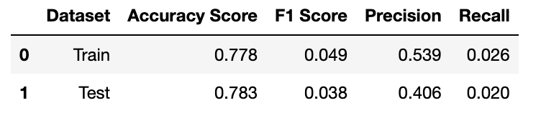
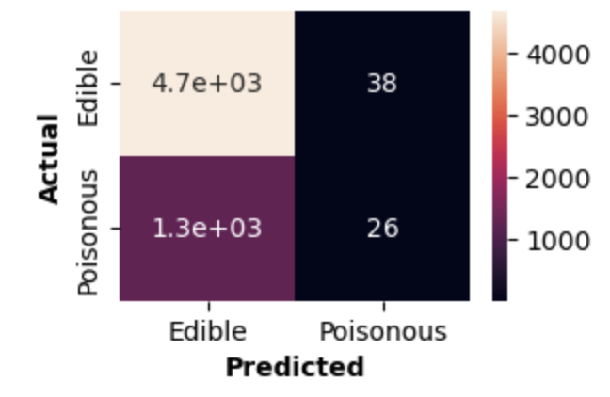
Deep learning Neural : It is a type of machine learning algorithm inspired by the structure and functioning of the human brain. It is composed of multiple interconnected layers of neurons (nodes) that process data, extract patterns, and make predictions or decisions.
Two hidden layers with 100 neurons in each layer
DL – Model Performance
Training Dataset Performance: The deep learning model achieved an accuracy of 77.8% on the training dataset, with a very low F1 score of 0.049, precision of 0.539, and recall of 0.026. This suggests that the model struggled to capture meaningful patterns in the training data.
Test Dataset Performance: On the test dataset, the model performed similarly with an accuracy of 78.3%, but the F1 score dropped further to 0.038, precision to 0.406, and recall to 0.020. These metrics indicate poor performance in correctly identifying positive cases and overall prediction effectiveness.
Implication: The low F1 score, precision, and recall on both training and test datasets suggest that the deep learning model is not effectively learning important features or patterns within the data.

Slide 23
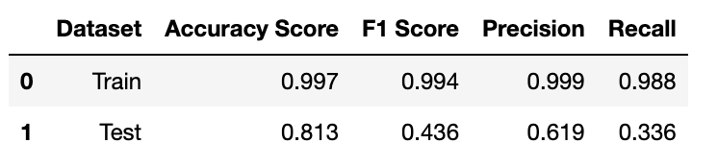
Ensemble model
Combination of multiple models, enhance overall performance, often achieving better reinspired by human brain structure, composed by multiple layers of interactions, with more than 2 hidden layers.
Random Forest, KNN, and XGBoost are found to be giving high accuracy. So these three models are considered for ensembling.
Training Dataset Performance: The ensemble model achieved a very high accuracy score of 99.7% on the training dataset, along with a high F1 score of 0.994, precision of 0.999, and recall of 0.988. These metrics indicate excellent performance in capturing patterns and making accurate predictions on the training data.
Test Dataset Performance: On the test dataset, the ensemble model performed well with an accuracy score of 81.3%. However, the F1 score dropped to 0.436, precision to 0.619, and recall to 0.336. While these metrics are lower than the training set, they still demonstrate good predictive capability on unseen data.
Analysis: The ensemble method shows significant overfitting tendencies, as indicated by the large disparity between training and test performance. Despite the high accuracy on the training set, the model's generalization to new data is limited, as seen in the lower F1 score, precision, and recall on the test set.
Ensemble Model - Performance

Slide 24
RESULTS

Slide 25
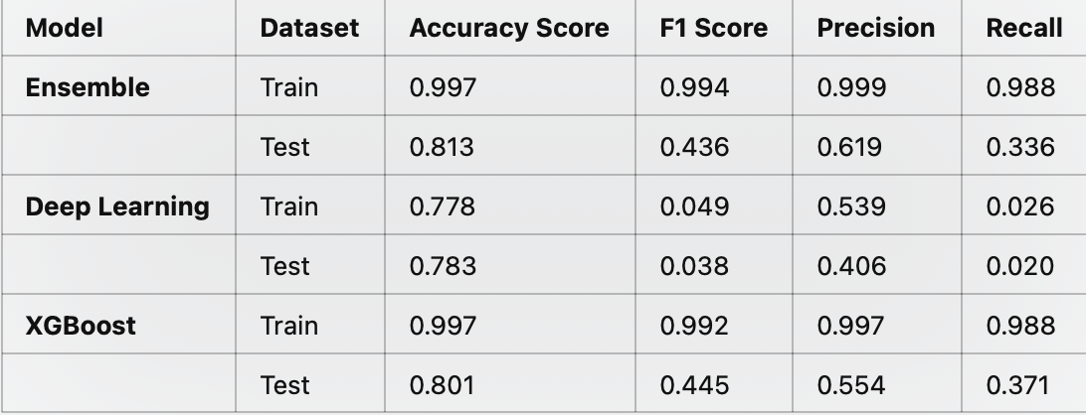
It is clear that the Ensemble Method has performed better than all other models

Slide 26
CONCLUSION

Slide 27
Its important to carefully chose the important variables through various technique for forecasting problems. Such as using statistical tests to find the variables improving the model performances.
From the results we find that Ensemble Method forecasting model outperforms the other baseline models as it has high learning space.
Future Plan
To quantify the impact of variables, we can use statistical tests like Cliff’s delta, Cohen’s D effect size.
Usage explainable AI techniques like SHAP (SHapley Additive exPlanations) or LIME to understand the importance of features and make the model’s predictions more transparent.

Slide 28
THANK YOU

