Slide 1
Vidhyaa Giri college of Arts and Science
.
PRIYADHARSHNI .D
(TEAM LEADER)
.
GUNASUNDARI.K
.
PALANISAMI.G

Slide 2
Voyage vista : Illuminating Insights from Expeditionary Analysis
INTRODUCTION
Uber was founded by Travis Kalanik and Garrett Camp in 2009,and is headquarted in San Francisco .The company has an estimated 110 million user world wide .
Uber is a transportation company with an app that allows passengers to hail a ride and drivers to charge fares and get paid .More specifically,uber is a ridesharing company that hires independent contractors as drivers .

Slide 3
OBJECTIVES
To analyse the number of trips taken by Uber drivers to understand the trends based on month-wise , week-wise , mile-wise ,etc . By various visualization such as bar charts , linecharts and piecharts .Uber drive data was collected in 2016 .Finally , dashboards and stories has been created and published .

Slide 4
Number of Visualization
Category-wise miles covered.
Month-wise miles covered.
Week-wise miles covered.
Quarter-wise miles covered.
Month-wise trips covered.
Quarter-wise trips covered.
Hour-wise trips covered.

Slide 5
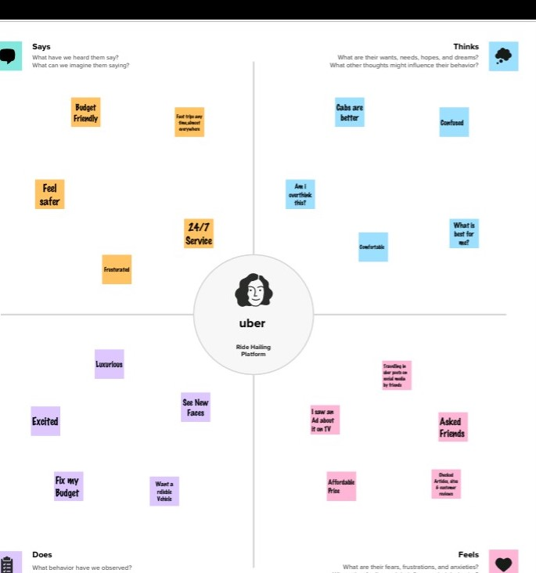

Slide 6
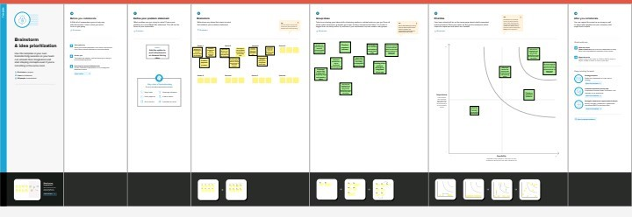
Brainstorming and idea prioritazion

Slide 7
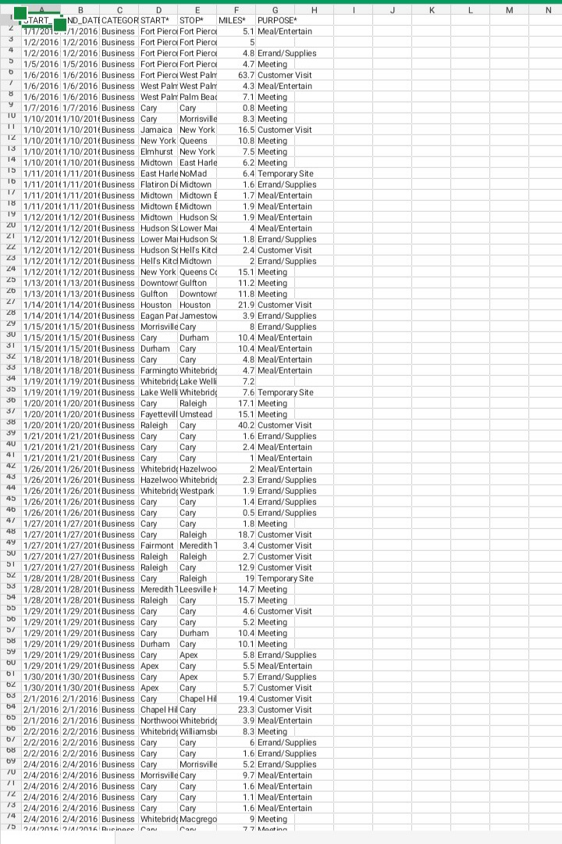
Data set

Slide 8
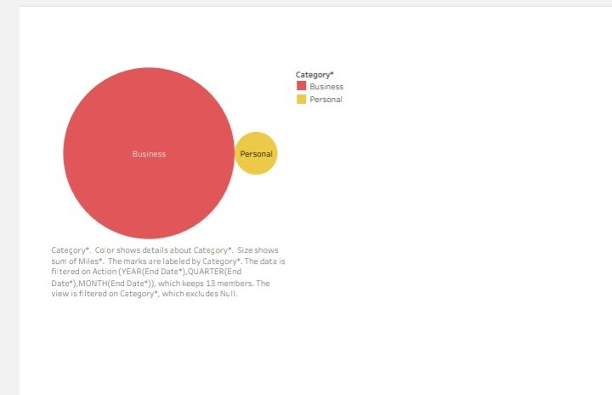
Category -wise miles covered

Slide 9
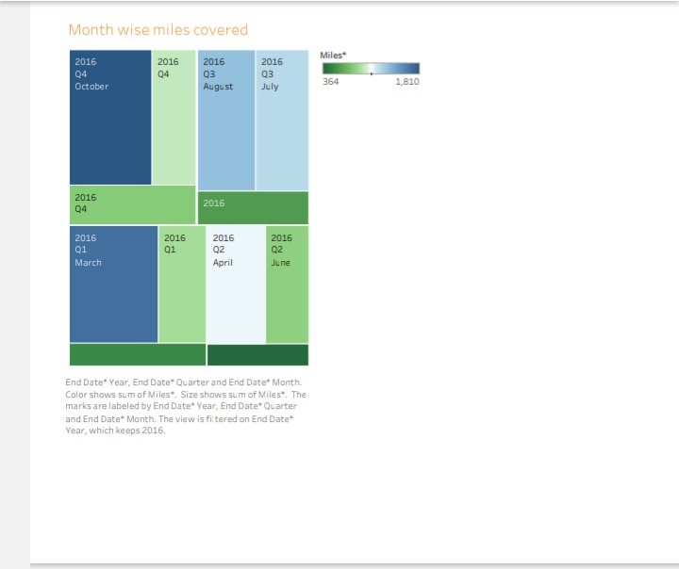
Month- wise miles covered

Slide 10
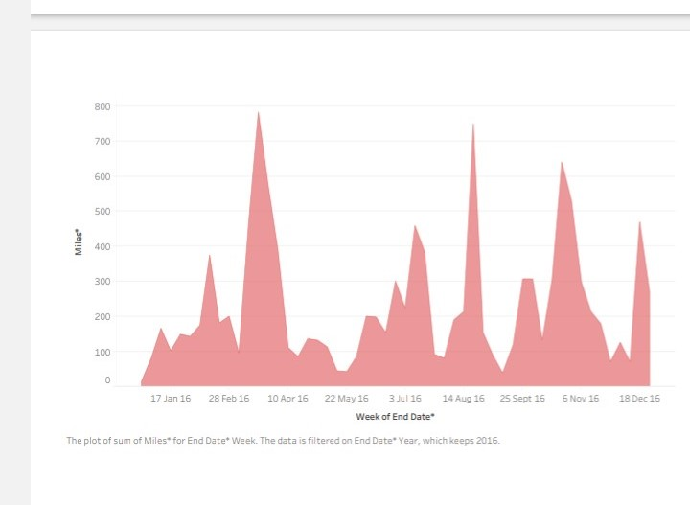
Week- wise miles covered

Slide 11
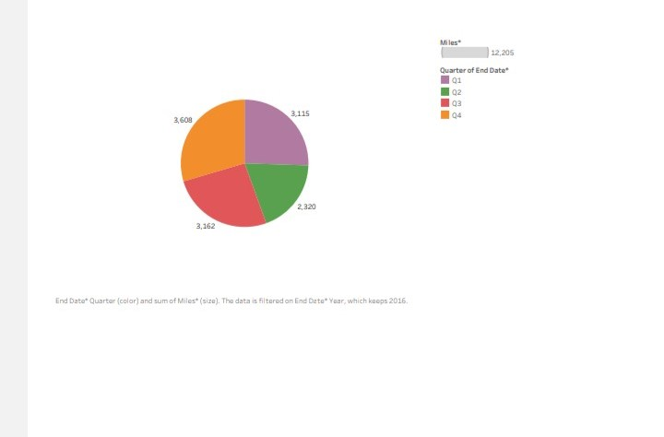
QUARTER-WISE MILES COVERED

Slide 12
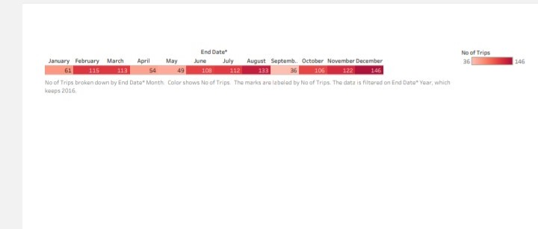
Month-wise trips covered

Slide 13
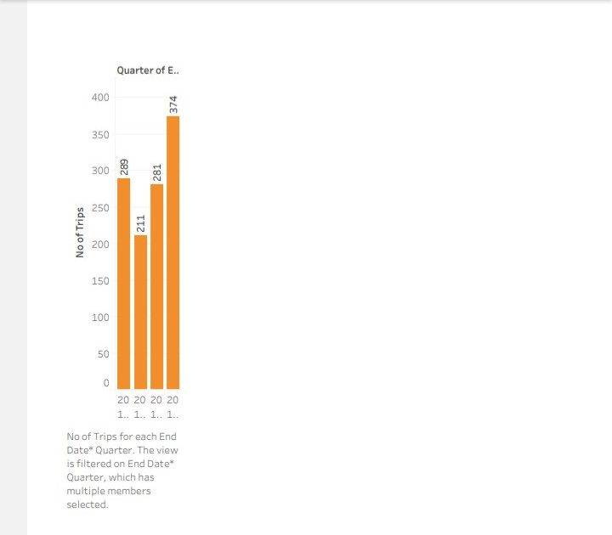
Quarter-wise trips covered

Slide 14
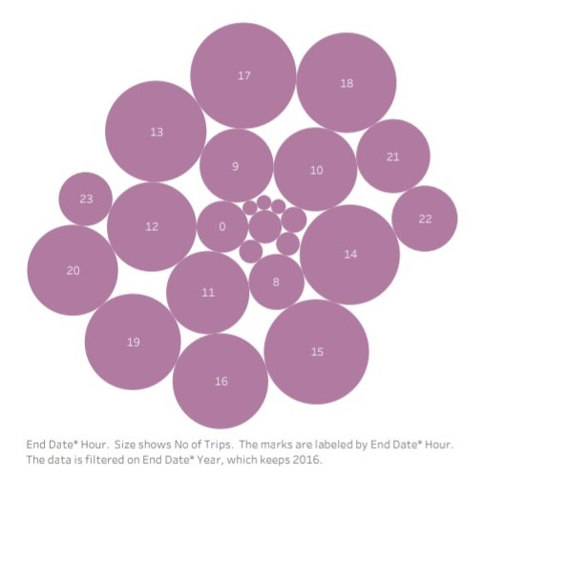
Hour-wise trips covered

Slide 15
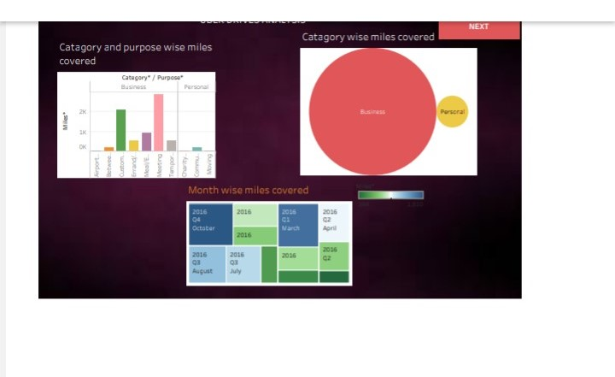
DASHBOARD 1

Slide 16
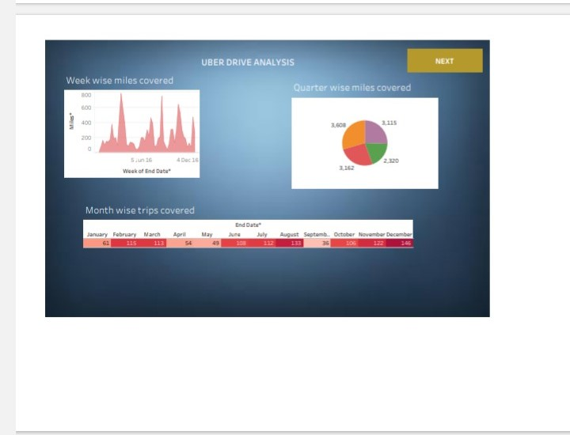
DASHBOARD 2

Slide 17
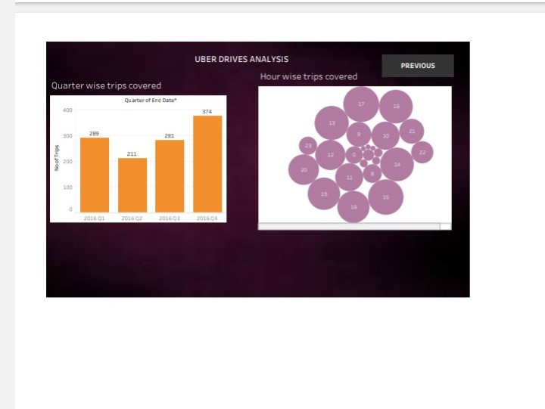
DASHBOARD 3

Slide 18
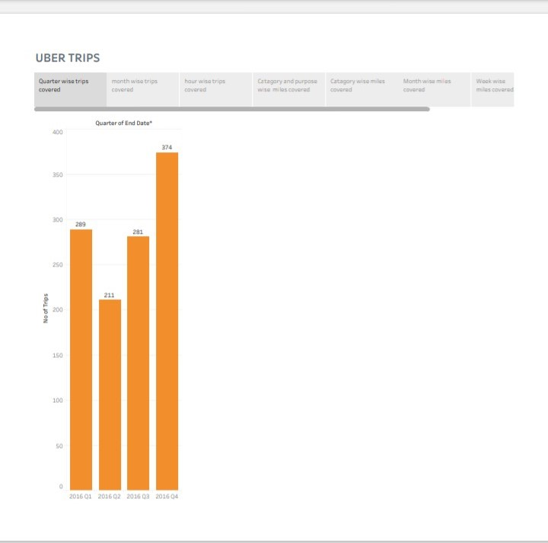
UBER TRIPS

Slide 19
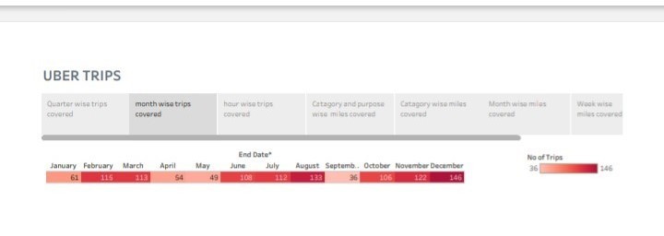

Slide 20
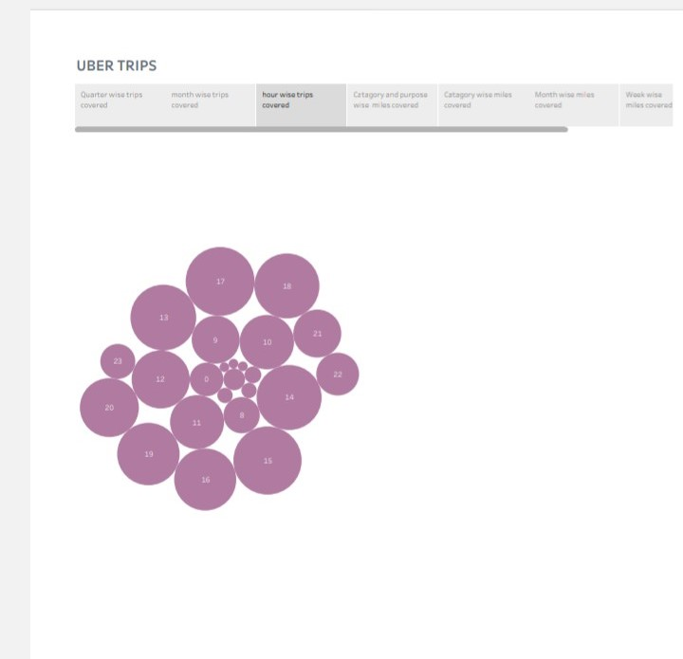

Slide 21
Tableau Published Link
https://public.tableau.com/views/UBERDRIVEANALYSIS/Dashboard1?:language=en-US&publish=yes&:display_count=n&:origin=viz_share_link

Slide 22
Conclusion
Uber have taken the pre-existing concept of taxiing people and improved and modeled it suit the world as it is today .
The Competative advantage lies in their simplicity and ease of use.
Uber produces fair superior benefits when it comes to ease of ordering certainty of car arrival time , ability to see the route taken .

