Slide 1
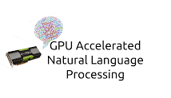
Optimised IR Search Engine on Unigram and Bigram models with comparison of parallel vs serial programming
Prof Rupesh Nasre
CH18B035 – Gunavardhan Reddy

Slide 2
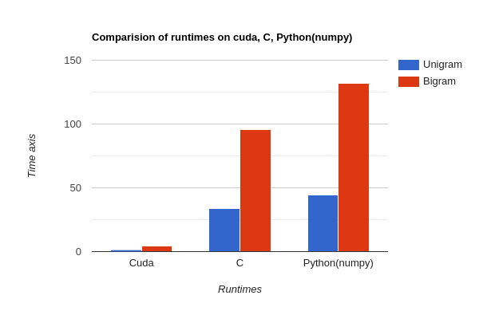
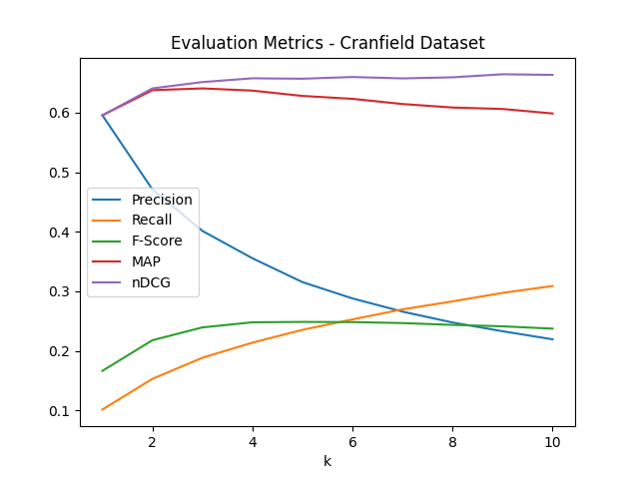
Conclusions/Results
Ranking of documents in cranfield dataset on
225 queries which took ~1625s on sequential python code now takes ~1.47s on cuda by performing 225*1400 parallel GPU operations,
which is almost ~1100 times faster
Note the times shown in bar graph is of C functions compiled in optimised mode and python optimised with numpy libraries which use multithreading. And we notice an improvement of ~40 times on C and ~50 times on python
Increased performance time on bigram model is due to vocabulary size of ~25000 compared to that of ~8300 on unigram model
Comparision of models unigram and bigram using nDCG@(2) measure which takes into account relevance of the documents we notice an improvement from ~61% to ~64%
~3% improvement which is huge can be asserted to the fact that the documents in the cranfield dataset are highly correlated and can be put under 5 to 10 topics as the bigram model takes into consideration of collocations and cooccurrences of words.*

Slide 3
PROBLEMS FACED
Working with different languages, though python offers the flexibility of working with cuda and c, there are issues like:
      Conversion of datatypes from python to cuda and c
      Debugging erros in other languages as python does’t display the error
      Memory allocation issues when transferring huge data
Dataset isn’t big enough to notice the difference in GPU loading times on Unigram and Bigram models
* ref - https://ieeexplore.ieee.org/document/7959986

