Slide 1
CS6370 || NLP || Course Project
Prof Sutanu Chakraborti
CH18B015 Narendhiran
CH18B035 A Gunavardhan

Slide 2
Exploring Information Retrieval on technical dataset with traditional NLP and modern Deep
Learning methods
The main objective of this work is to improve the recommendation list of relevant documents from the Cranfield Dataset when given a query.
This work describes our two approaches and corresponding results for the information retrieval task on technical dataset.
Our first approach is implementing Latent Semantic Analysis model and to evaluate metrics and correlation coefficients on test data.
The second approach leverages the modern methods of Transformer models(Deep learning architectures) and their capability to learn contextual representations of the query and corpus in order to perform semantic search.

Slide 3
Motivation why statistical and ML?
Limitations of VSM which are being addressed:
Semantic sensitivity: Vector Space Model(VSM) is based on term vocabulary, because of which the documents with similar context but different terms(synonyms) wouldnot be associated, resulting in reduce of recall.
Word Relatedness: VSM assumes the words in the documents are independent, which results in retrieval of irrelevant documents, resulting in reduce of precision.
Collocations and Cooccurrences: VSM(especially uni-gram approach) disregards the Collocations and Cooccurrences of words as it just takes appearance of word in document into consideration
Computation complexity

Slide 4
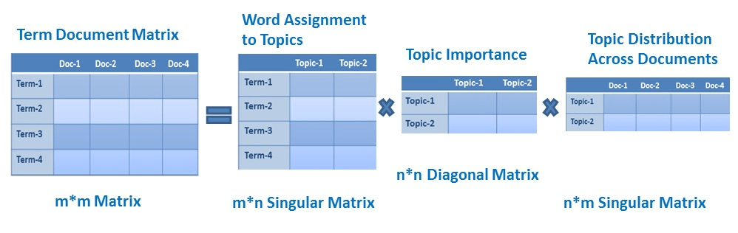
PROPOSED MODEL - LSA
Assumption : Each document contains mixture of topics and each topic contains collection of words known as latent topics and words

Slide 5
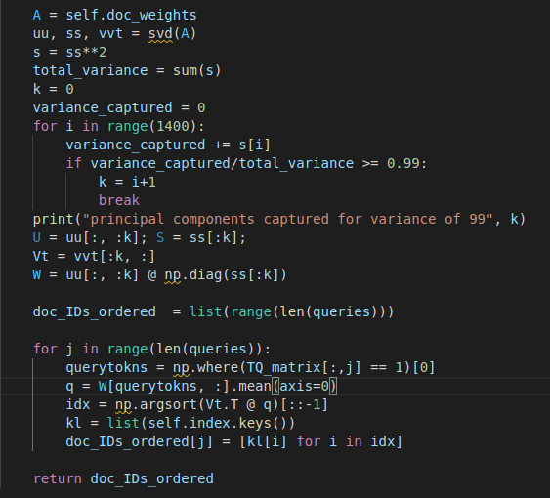
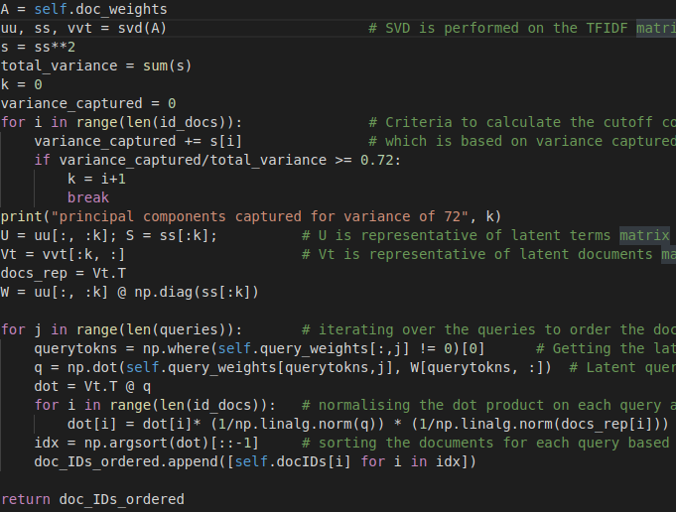
WORKING/CODE IMPLEMENTATION
LSA :
Code performing SVD on term document matrix and selecting the principle components capturing 72% of the variance of the sparse matrix
Then ranking the queries based on cosine similarity of the new latent dimensions of the document term vectors

Slide 6
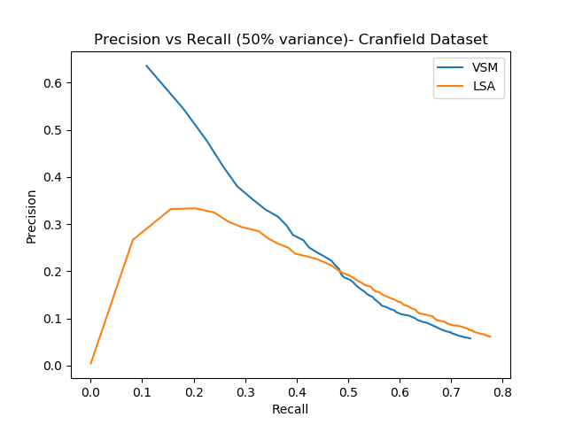
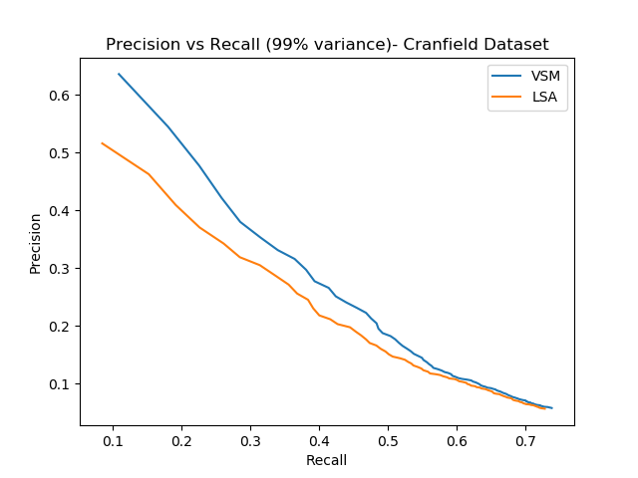
EXPERIMENTS
Taking a low value of k might not capture entire essence or the main latent concept and latent variable of the data set resulting in poor precision.
In the same sense taking high value of k might result in consideration of unimportant latent concepts or terms resulting in poor recall and also computationally heavy.

Slide 7
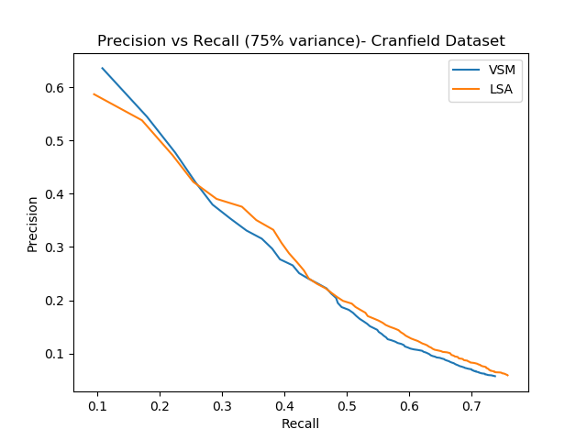
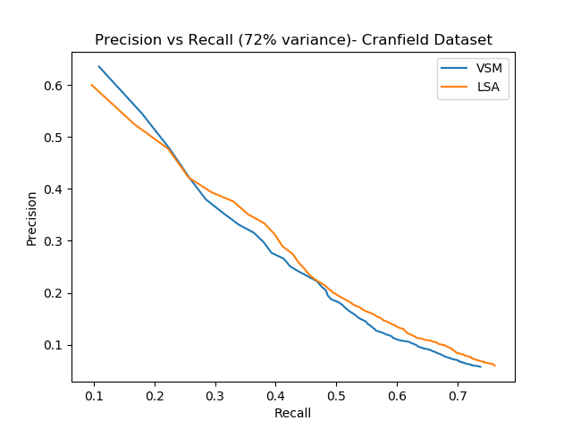
EXPERIMENTS CONCLUSION
As noticed after conducting various experiments we notice that the optimal value of k is when it captures around 72 percent of the variance and following results are for the same

Slide 8
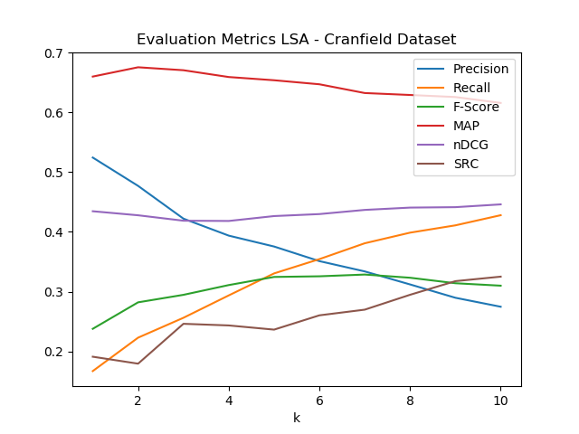
RESULTS/CONCLUSIONS
SRC | VSM | LSA
K=14 | 0.344 | 0.347
K=15 | 0.350 | 0.353
K=16 | 0.354 | 0.357
Changes from the mid review :
  Weights to the latent words derived from the query
  (mistake) considered dot product rather than cosine similarity
  Improvement noticed from mid review are 14% improvement

Slide 9
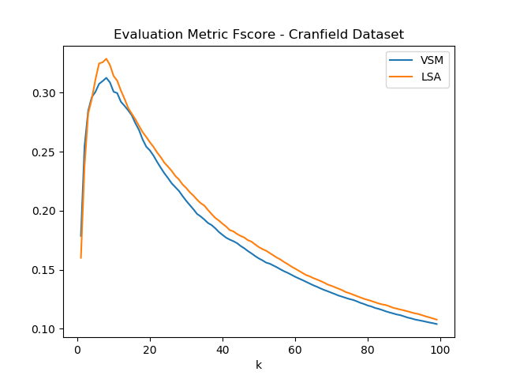
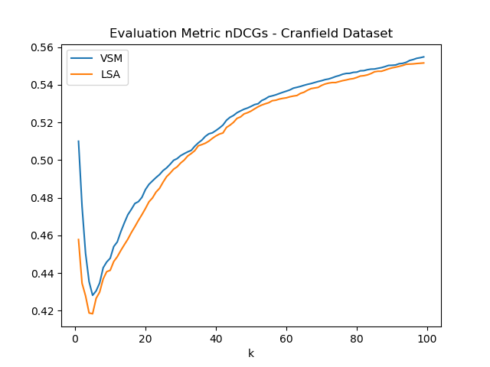
COMPARISION ON VSM

Slide 10
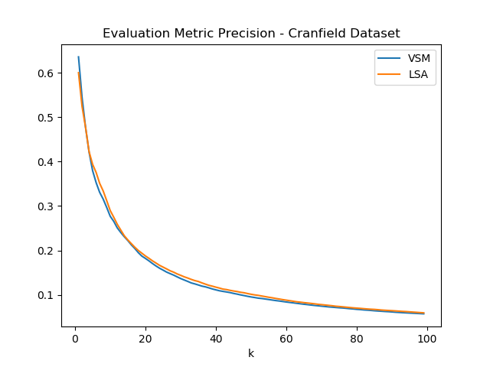
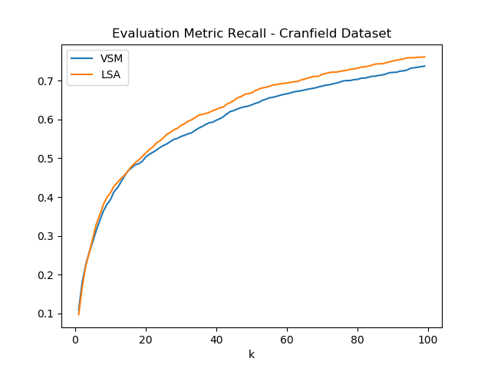
COMPARISION ON VSM

Slide 11
What is BERT?
Breakthrough results achieved in using attention-mechanisms in Sequence modelling resulted finally in introduction of BERT based language modelling.
Transformers are the latest advancement of Attention-mechanism in Deep Learning currently producing SOTA results in several applications of DL such as LSTM based language translation, object detection, image captioning etc..
BERT, which stands for Bidirectional Encoder Representations from Transformers, is a model to generate sentence embeddings by making usie of Transformers.
In 2018, Google introduced and open-sourced BERT. In its research stages, the framework achieved groundbreaking results in 11 NLG & NLU tasks. By 2020, BERT was applied to more than 70 different languages

Slide 12
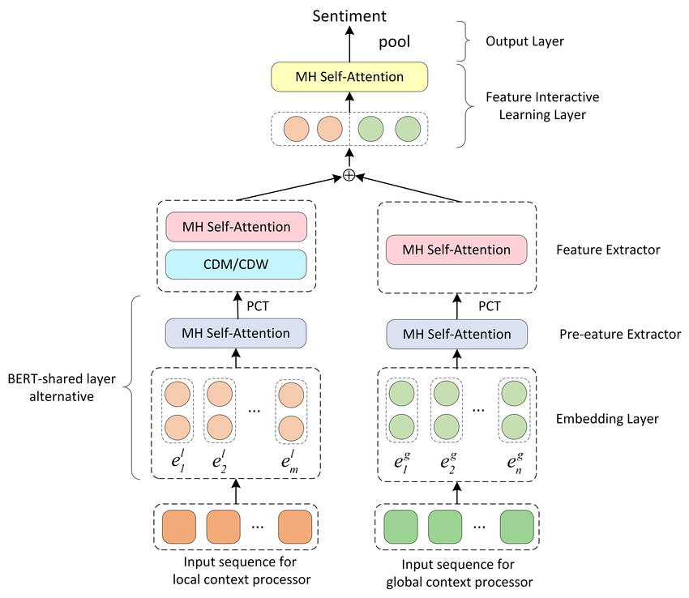
How BERT works?
The transformer is the part of the model that gives BERT its increased capacity for understanding context and ambiguity in language.
The transformer does this by processing any given word in relation to all other words in a sentence, rather than processing them one at a time.
A sample embedding training architecture illustrates how combining the embedding layer and multi-head attention model gives BERT embeddings

Slide 13
How BERT was trained and used?
Using it's bidirectional capability, BERT is pre-trained on two different, NLP tasks: Masked Language Modeling and Next Sentence Prediction.
In MLM training a word in a sentence is hidden and then have the model predict what word has been hidden (masked) based on the hidden word's context.
The objective of Next Sentence Prediction training is to have the program predict whether two given sentences have a logical, sequential connection or whether their relationship is simply random

Slide 14
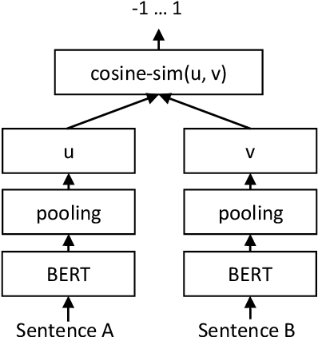
Using pretrained Bert and custom training BERT
BERT model has been trained on several large data corpuses for generating sentence embeddings.
There are several variants of BERT. Sentence-Bert is being popularly used for both pretrained modelling and custom training and fine tuning.
Bert model can also be fine-tuned and custom trained by users according to their requirements .

Slide 15
Observation and Conclusion
Using of only pretrained BERT models performed poorly on comparison with traditional NLP modelling. This may arise from the fact that these models are trained on general corpora and may not produce accurate document embedding for scientific documents.
Custom training of model was described in the paper 'BERT Meets Cranfield' .
Recent research developments are focused on creating BERT embeddings purely from scientific corpora and on optimizing the preprocessing algorithms before the input is fed to BERT tokenizer for learning.

Slide 16
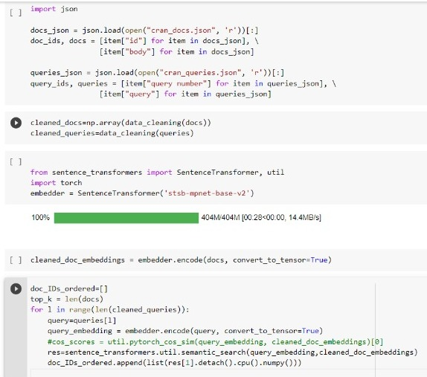
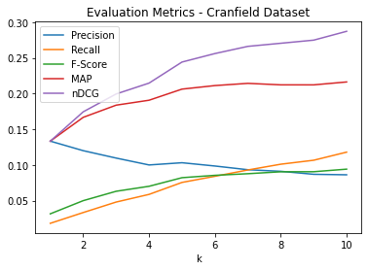
IMPLEMENTING AND EVALUATION METRICS
Evaluation metrics when pretrained embeddings used

Slide 17
References
1. Author, Tomek Strzalkowski : Natural Language Information Retrieval. https://link.springer.com/content/pdf/bfm%3A978-94-017-2388-6%2F1.pdf (1999)
2. Susan T. Dumais*, George W. Furnas, and Thomas K. Landauer : Indexing by Latent Semantic Analysis - https://courses.iitm.ac.in/pluginfile.php/344755/mod resource/content/1/deerwester-jasis90.pdf
3. Improving Information Retrieval System Performance with Concepts : https://jeffreymorgan.io/articles/information-retrieval-concept-matching/
4. Vector Space Model : https://en.wikipedia.org/wiki/Vector space model
5. Latent Semantic Analysis : https://en.wikipedia.org/wiki/Vector space model
6. Than Than Wai; Sint Sint Aung : Enhanced frequent itemsets based on topic modeling in information filtering : https://en.wikipedia.org/wiki/Vector space model
7. Jay Gopalakrishnan : Latent Semantic Analysis : http://web.pdx.edu/ gjay/teaching/mth271 2020/html/17 LSA.html
8. Pyspellchecker : https://pypi.org/project/pyspellchecker/
9. Faruqui, Manaal and Dodge, Jesse and Jauhar, Sujay K. and Dyer, Chris and Hovy, Eduard and Smith, Noah A. : Retrofitting Word Vectors to Semantic Lexicons : https://github.com/pp30/NLP-Wikipedia Relatedness
10. IR-BERT: Leveraging BERT for Semantic Search in Background Linking for News Articles, https://arxiv.org/pdf/2007.12603.pdf
11. BERT meets Cranfield:Uncovering the Properties of Full Ranking on Fully Labeled Data,https://djoerdhiemstra.com/wp-content/uploads/eacl2021swr.pdf
12. ElasticBERT: Information Retrieval using BERT and ElasticSearch, https://towardsdatascience.com/elasticsearch-meets-bert-building-search-engine-with-elasticsearch-and-bert-9e74bf5b4cf2
13. NEURAL RANKING MODELS FOR DOCUMENT RETRIEVAL, https://arxiv.org/pdf/2102.11903.pdf

