Slide 1

"Amazon Footwear Analytics: Winning Strategies for New Sellers"

Slide 2
Business Problem:
Advising a new seller on the top-performing footwear brands on Amazon
Domain Understanding:
To help a new seller choose the right footwear brands on Amazon, we need to understand which brands are popular, have good customer reviews, and sell well. This includes looking at sales trends, prices and customer preferences
Key factors influencing pricing and decisions:
Brand
Sales Count(past month)
Price
Rating
Discount
Gender
Footwear Category
Enables new sellers to make informed decisions and secure better deals.

Slide 3
Use Case Market Trend Insights: Identify market trends (e.g., demand for certain brands ) to help sellers make informed decisions.
Objective :
Identify top-performing footwear brands on Amazon based on sales, ratings, pricing, and discounts.
Provide data-driven insights to help the seller make informed decisions.
Enable the seller to maximize sales and stay competitive in the marketplace.

Slide 4
Web Scraping – Details
🌍 Website Scraped
https://www.amazon.in/s?k=footwear&page=1&crid=1DSEFWZC11KF3&qid=1741462138&sprefix=footwear%2Caps%2C273&xpid=veLoGGYEX9jWG&ref=sr_pg_1
🛠️ Tools & Libraries Used
BeautifulSoup – Extracting data from HTML pages Requests – Sending HTTP requests to fetch the webpage Pandas – Storing and structuring the extracted data CSV Handling – Exporting scraped data for analysis

Slide 5
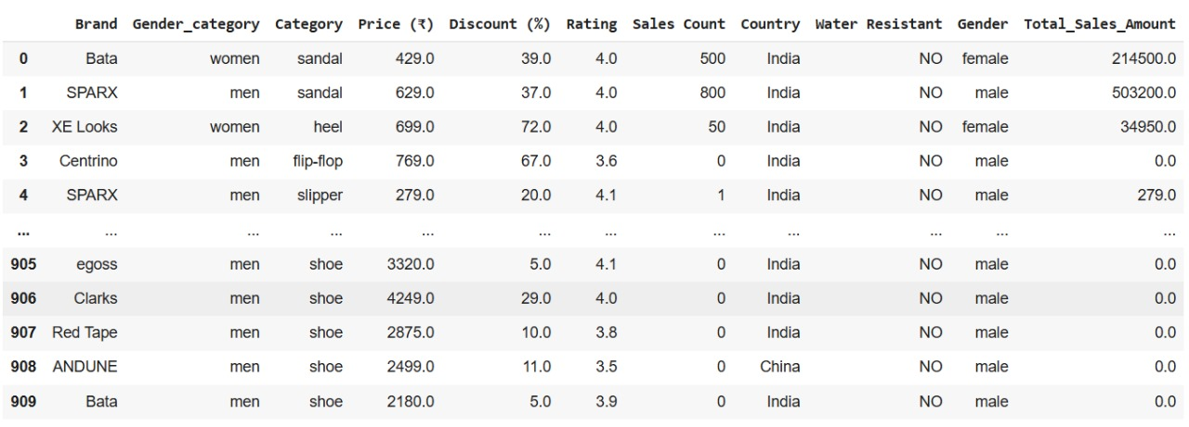
Data Used For Analysis

Slide 6
📊 Summary of the Data:
Total Records: 910 , Total Columns: 11 (key attributes for analysis)
Feature: Description
Brand – Manufacturer of the footwear.
Gender – Target gender for the footwear
Gender Category – Gender-based category for better classification
Category – Type of footwear ( Shoes , Sandals, etc.).
Price (₹) - Selling price of the footwear.
Discount (%) -Percentage discount on the original price.
Rating -Customer rating of the footwear (out of 5).
Sales Count -Number of units sold.
Country - Country where the footwear is being sold.
Water Resistant -Indicates if the footwear is water-resistant (Yes/No).
Total Sales Amount -Total revenue generated from sales of the footwear

Slide 7
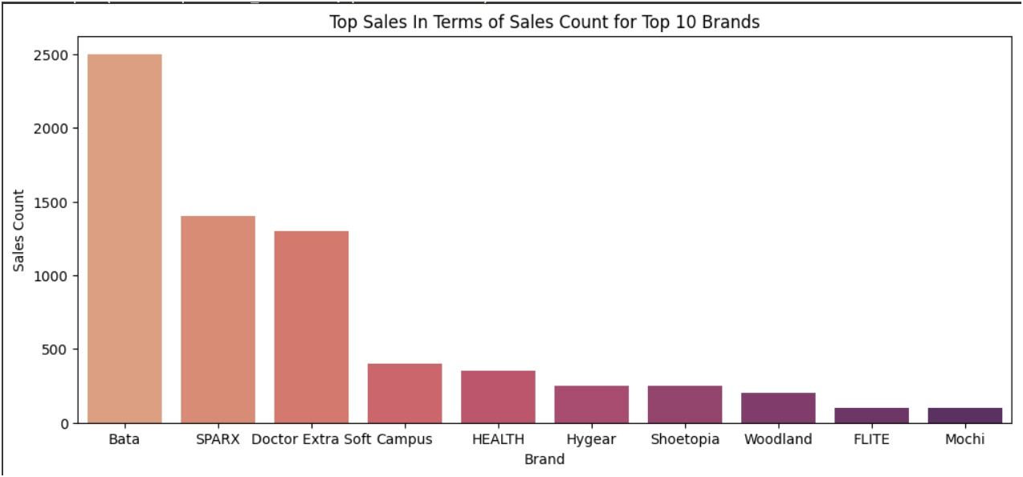
Bivariate Analysis : Top 10 Brands in terms of sales
Bata leads in sales with the highest count, followed by Sparx and Doctor Extra Soft. These three brands significantly outperform others, making them strong choices for new sellers on Amazon.

Slide 8
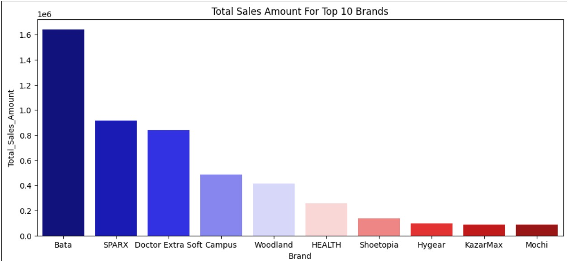
Bivariate Analysis :Top 10 Brands in terms Sales Amount
Bata has the highest total sales amount, followed by Sparx and Doctor Extra Soft. These brands generate the most revenue, making them strong choices for new sellers looking to maximize profitability on Amazon.

Slide 9
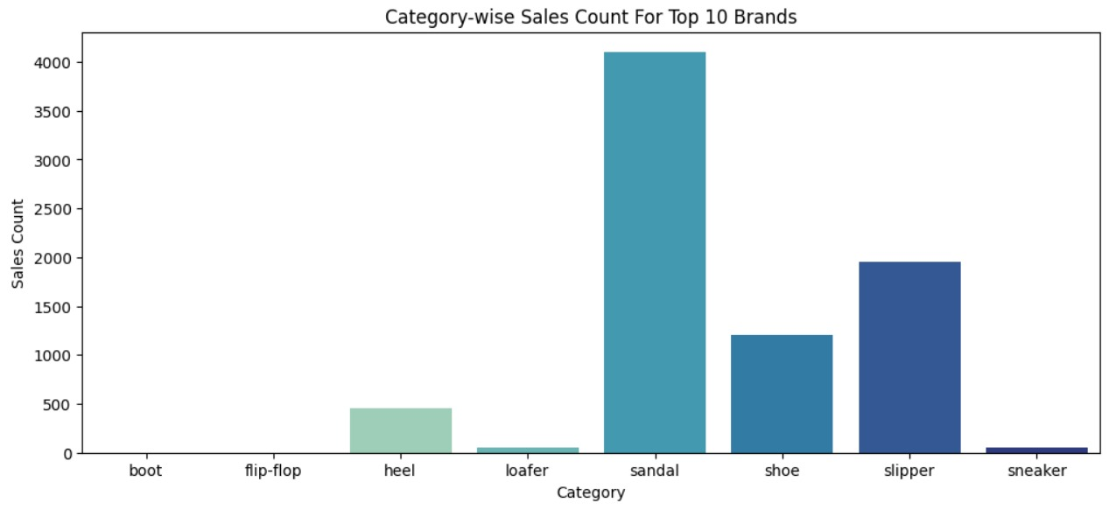
Bivariate Analysis : Top 10 Brands Category-wise Sales Count
Sandals have the highest sales count, followed by slippers and shoes, making them the most popular footwear categories. New sellers should prioritize these categories for better sales performance.

Slide 10
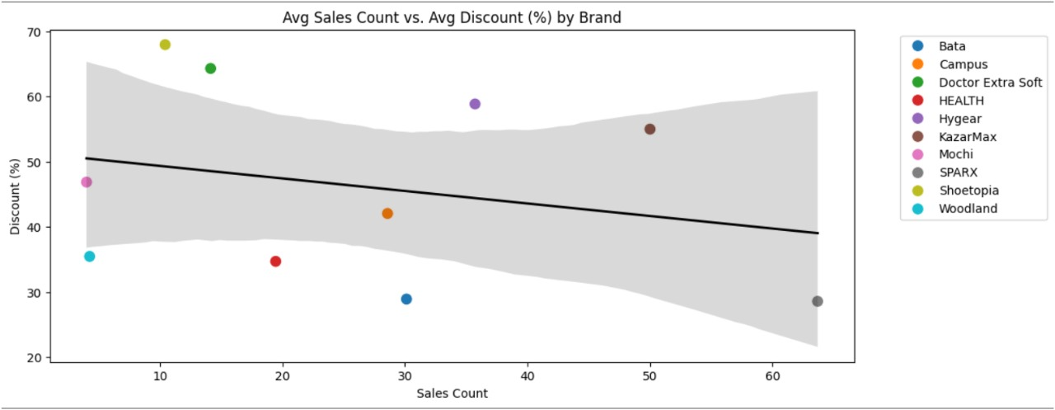
Bivariate Analysis: Avg Sales Count vs Avg Discount(%) By Brand
There is a slight negative correlation between discount percentage and sales count, meaning higher discounts do not always lead to higher sales. Brands with moderate discounts tend to perform better in terms of sales.

Slide 11
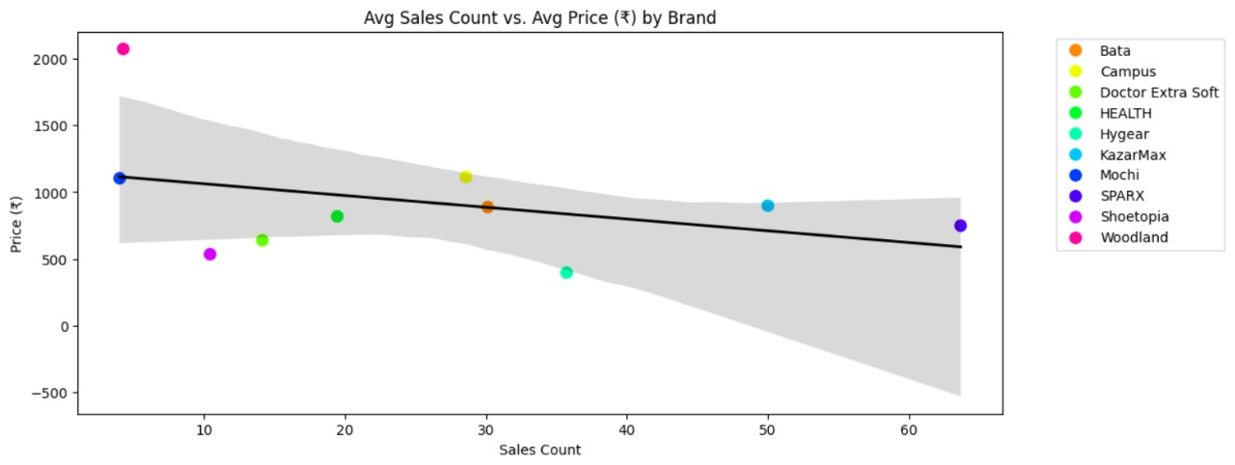
Bivariate Analysis :Avg Sales Count vs Avg Price By Brand
There is a slight negative correlation between price and sales count, suggesting that lower-priced footwear tends to sell more. However, some higher-priced brands still maintain steady sales, indicating that brand value and quality may also influence purchasing decisions

Slide 12
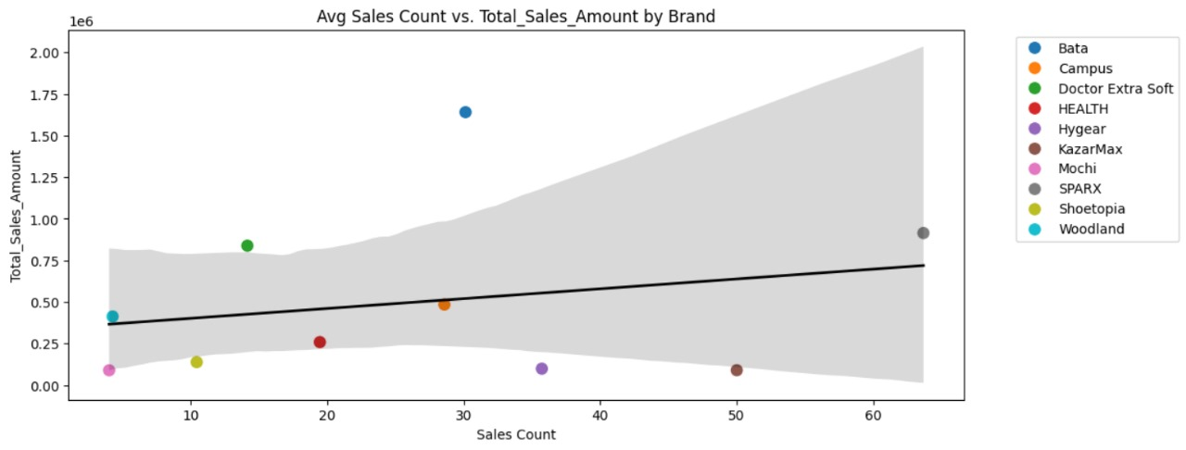
Bivariate Analysis: Avg Sales Count vs Total Sales Amount By Brand
There is a positive correlation between sales count and total sales amount, meaning that brands with higher sales volumes generate more revenue. However, some brands achieve high total sales amounts despite lower sales counts, likely due to higher pricing.

Slide 13
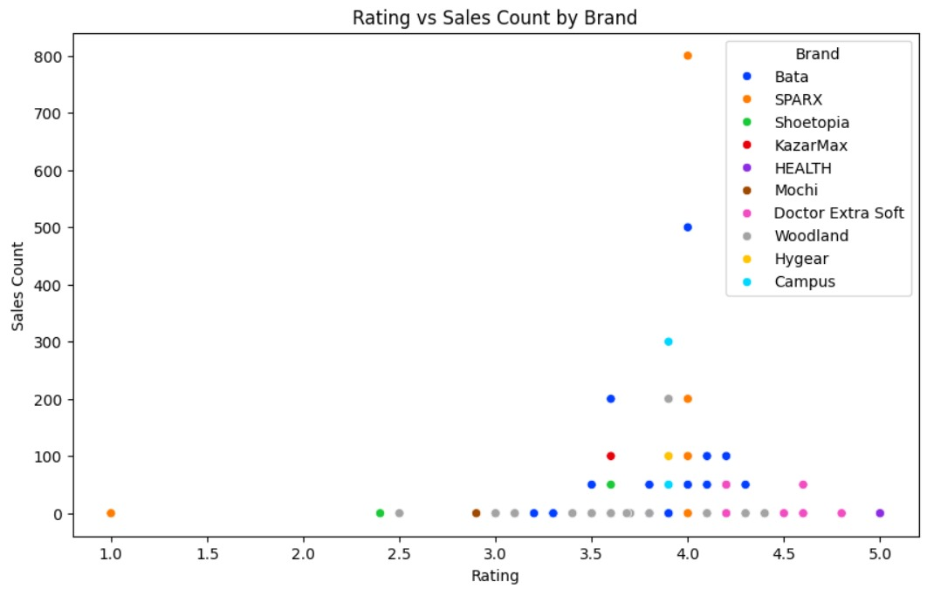
Bivariate Analysis: Avg Sales Count vs Avg Price By Brand
Higher-rated footwear brands (above 4.0) tend to have more sales, indicating that customer ratings play a crucial role in influencing purchasing decisions. Brands with lower ratings (below 3.0) struggle to achieve significant sales

Slide 14
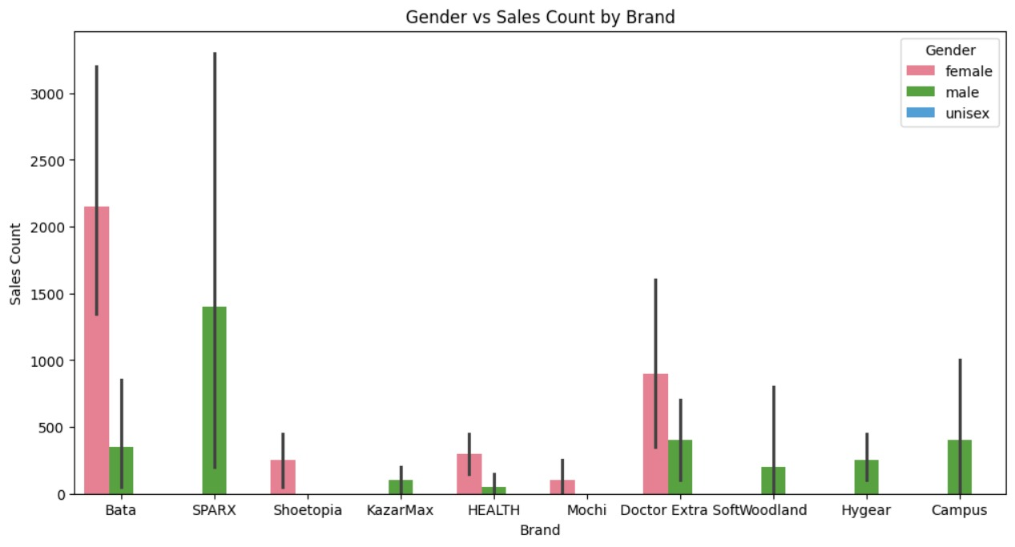
Bivariate Analysis: Gender vs Sales Count
Bata and Doctor Extra Soft have the highest sales for female footwear, while Sparx leads in male footwear. Unisex footwear has minimal sales, indicating that gender-specific products perform better.

Slide 15
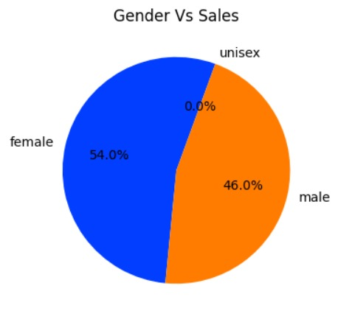
Bivariate Analysis: Gender vs Sales
Female footwear accounts for 54% of total sales, slightly outperforming male footwear at 46%, while unisex footwear has no significant sales..

Slide 16
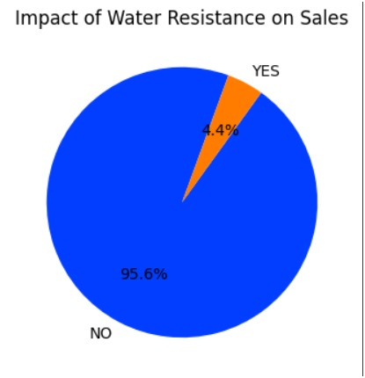
Bivariate Analysis: Impact of Water Resistance on Sales
Water resistance has minimal impact on sales, with 95.6% of purchases coming from non-water-resistant footwear.

Slide 17
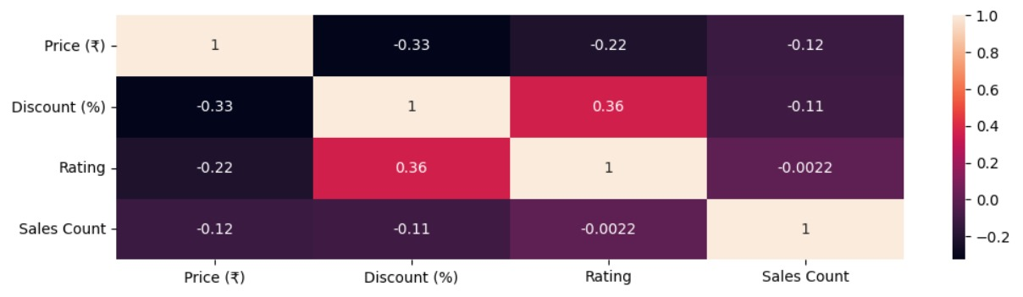
Multivariate Analysis: Correlation Heatmap
There is a negative correlation between price and discount (-0.33), meaning higher-priced footwear tends to have lower discounts.
Rating and discount have a positive correlation (0.36), suggesting that products with higher discounts tend to receive better ratings.
Sales count has very weak correlations with price (-0.12), discount (-0.11), and rating (-0.0022), indicating that these factors alone do not strongly impact sales.

Slide 18
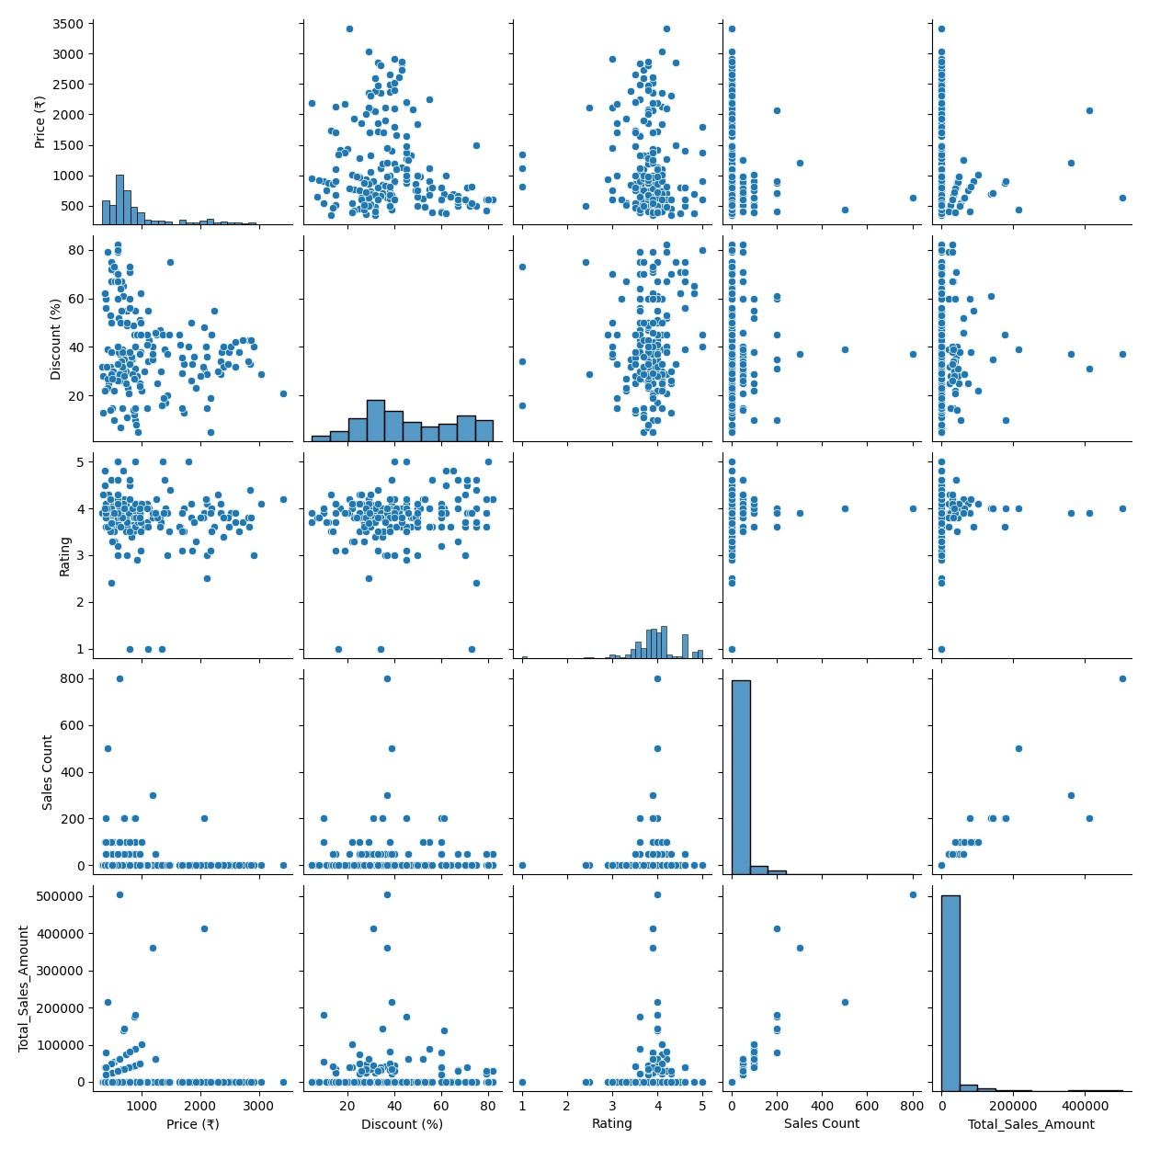
Multivariate Analysis Steps: Pairplot

Slide 19
Multivariate Analysis: Pairplot
No Strong Linear Relationship: Most variables, including price, discount, rating, and sales count, do not show clear linear correlations with each other.
Higher Discounts Have Wide Variability: Products with higher discounts are spread across different price ranges, indicating that discounts are not limited to low-cost or high-cost items.
Sales Count and Total Sales Amount: Higher sales counts generally lead to higher total sales amounts, but some expensive products contribute significantly to total sales even with lower sales counts.

Slide 20
Conclusion
Top-Performing Brands: Bata, Sparx and Doctor Extra Soft dominate both sales count and total sales amount, making them the best choices for new sellers.
Popular Footwear Categories: Sandals, slippers, and shoes have the highest sales, indicating strong customer demand in these categories.
Pricing and Discounts: Lower-priced footwear tends to have higher sales, and moderate discounts positively impact customer ratings but do not guarantee higher sales.
Impact of Ratings: Higher-rated products (above 4.0) tend to sell more, showing that customer feedback plays a key role in purchasing decisions.
Gender-Based Sales: Female footwear slightly outperforms male footwear, and unisex footwear has minimal sales, suggesting that gender-specific products are more marketable.
Water Resistance is Not a Key Factor: Only 4.4% of sales come from water-resistant footwear, meaning customers do not prioritize this feature.
Sales vs. Total Revenue: While higher sales counts contribute to total revenue, some premium-priced products generate high revenue even with lower sales.

Slide 21
Recommendation for New Sellers:
Focus on Bata, Sparx and Doctor Extra Soft as top-selling brands.
Prioritize sandals, slippers, and shoes for higher sales.
Maintain competitive pricing with moderate discounts for better customer appeal.
Stock highly rated footwear (4.0+ ratings) to boost sales.
Target both male and female categories, as unisex products have low demand.

Slide 22


