Slide 1

Exploratory Data Analysis
<Project name>
<Date>

Slide 2
Agenda
Problem Description
Approach
Hypothesis
EDA
Forecasting Model
Recommendations

Slide 3
Problem Description
Australian company to make a forcast of the future data,
what needs to be done is to firstly understand the past data
I have made some hypothesis that could bring light upon the questions at hand. By referencing the data and the insights it might provide, I will eliminate the to hypothesis that are most crucial.
The hypothesis model requires there being a null hypothesis that must be rejected with a significant p-value hence we aim to arrive at the alternative hypothesis.
Lastly there will be a forecasting model to better understand the timeline

Slide 4
Approach
Required libraries: Pandas, Matplotlib, Numpy, Sklearn, Seaborn
Used methods: Kernal Density Estimation, correlation, timeline forecast, cluster analysis
Sales in this case is the dependent variable and all others are possible independent variables which affect the sales rate!

Slide 5
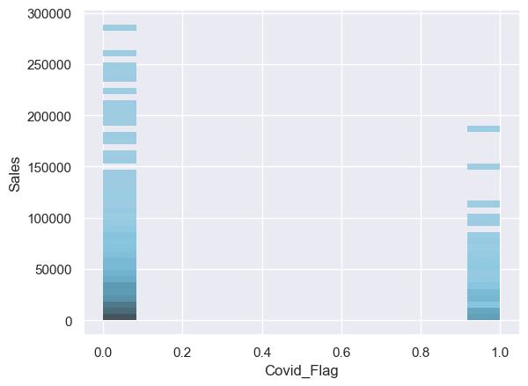
Hypothesis
me discount throughout years
Ha.2: There are some prodH0.3: Price discounts have no effect in sales during Covid
Ha.3: Promotions (three type) have caused more gross income
Thanks to the discounts, despite it beings fewer than other years there has been sales

Slide 6
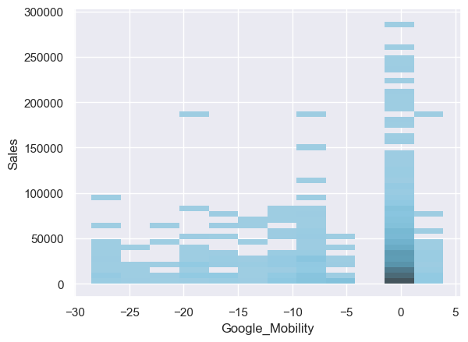
Hypothesis
H0.2: All 6 products get the same discount throughout years
Ha.2: There are some products that gets more discounts
H0.3: Price discounts have no effect in sales during Covid
Ha.3: Promotions (three type) have caused more gross income
Throughout Covid there has been lots of discounts
The most powerful sales seems to be the % 90- 85 point

Slide 7
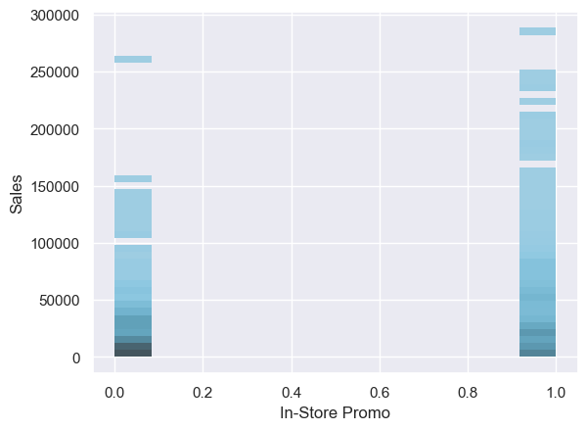
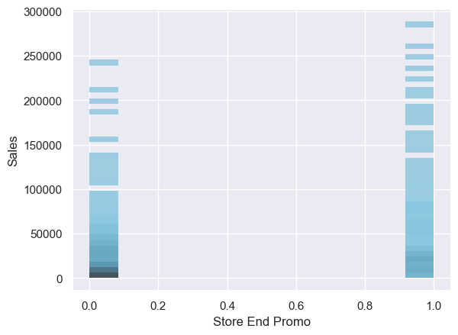
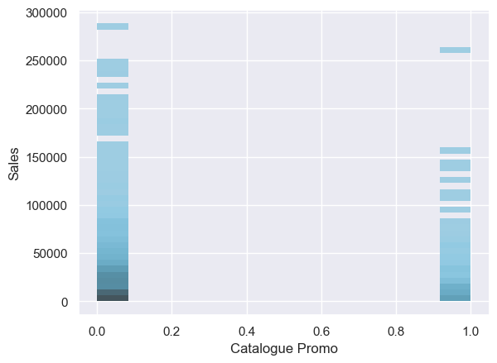
EDA
H0.7: There is no statistically significant difference between the success between Instore Catalogue and Store end promotion
Ha.7: Some promotions are more successful than others.
Store end promotions & In-store promotions got more sales than Catalogue promotions

Slide 8
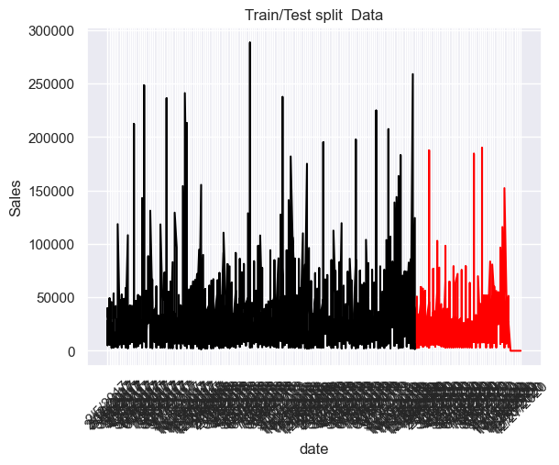
Forecasting Model A model was trained to forcast the sales While x is the date, y is the sales

Slide 9
Recommendations
Making discounts between 10-15% makes sense In the covid period
In-store Promotion and Store-end promotions tends to have higher sales rates than catalogue promotion
Despite any cathrostaphy as long as there being money around, with the right amount of discount,youre items will get sold

Slide 10
For Those Interested
The study was made on python anaconda, firstly the data was cleansed by the help of pandas functions. Then the Kernal Density Estimation plot was made with reference to sales being on the y-axis since it is the dependent variables that gets affected by others.
According to the csv sheet turned into excel I have made my 7 hypothesis where I saw 3 were of most importance. The plots were made to see if there was any pattern and in order to find out if one could reject the null hypothesis.
The null was rejected once the plots were analyzed and the recommendations were driven from the data

Slide 11
Thank You

