Slide 1
Week-2 topic
Visualization(data sciences)

Slide 2
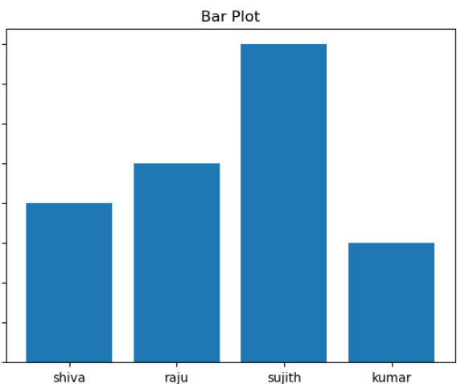
Data visualization is the graphical representation of information and data. By using visual elements like charts, graphs, and maps, data visualization tools provide an accessible way to see and understand trends, outliers, and patterns in data
example
names | marks
Raju | 72
Sujith | 91
Shiva | 58
Kumar | 45

Slide 3
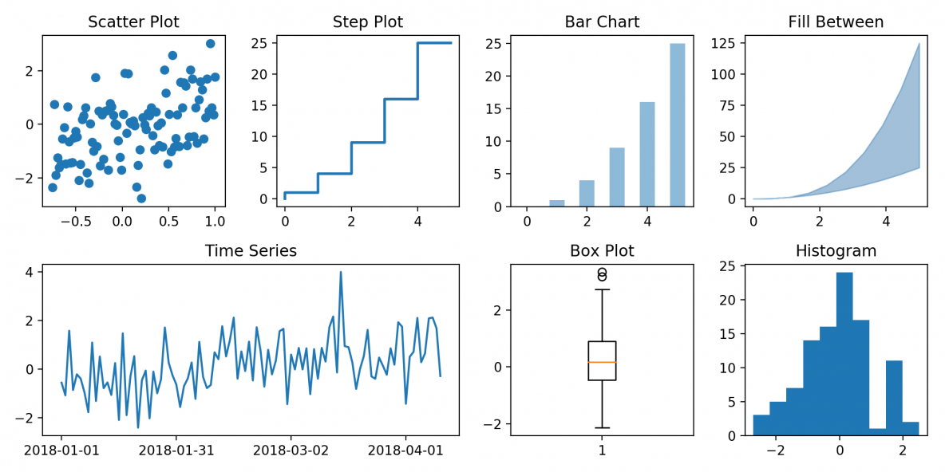
Type of plots

Slide 4
Python
Data visualization libraries
Matplotlib
Seaborn
Plotly
Bokeh
Altair
Pyal

Slide 5
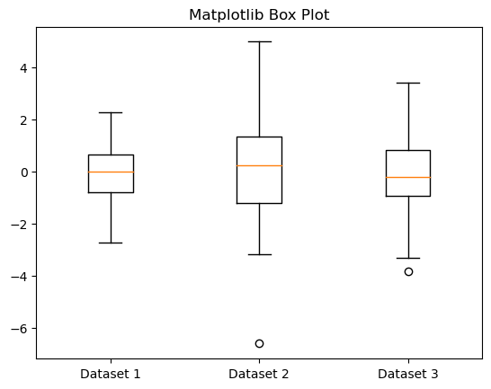
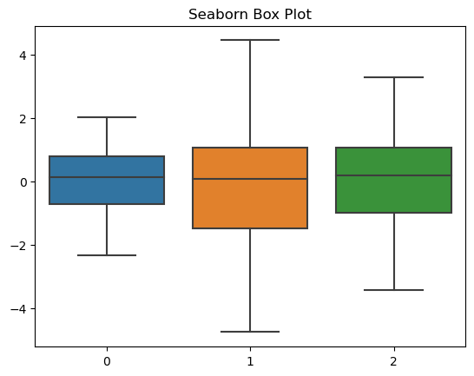
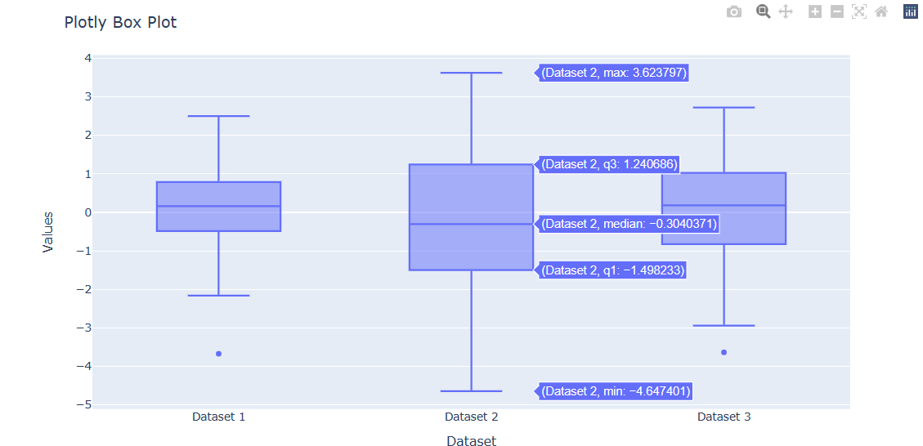

Slide 6
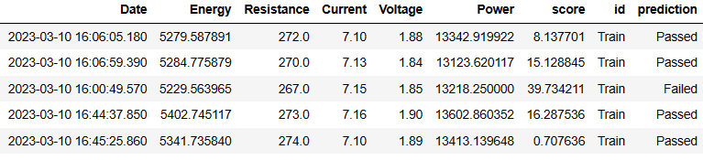
Week -2 task [weldability]
Explanation :
Data sheet
ProdData_2023_versionD.csv
Target feature
Contains date with timeseries(timestamp)
Defines train & test period
date | Col-1 | Col-1 | id | prediction
01-02-23 | 23.4 | 23 | Train | Passed
01-02-23 | 783.4 | 89 | Train | Failed
02-02-23 | 83.4 | 76 | Test | Passed
03-02-23 | 493.4 | 33 | Test | Failed

Slide 7
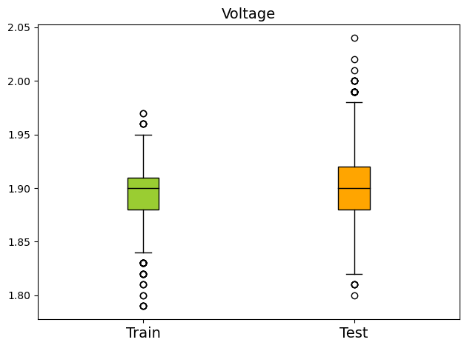
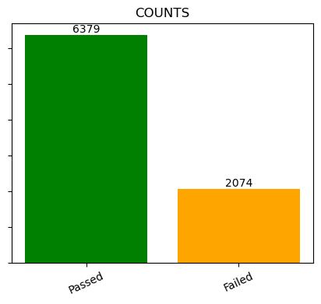
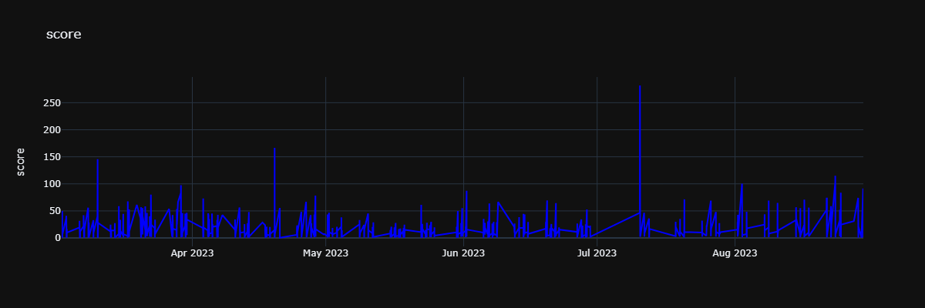
Requirements :
Capture range of each feature(power, energy, voltage, resistance) in Train and Test data separately
e.g.
Capture the count of predictions
e.g.
Capture the data of feature (score) thought out date(series)
e.g.

