Slide 1
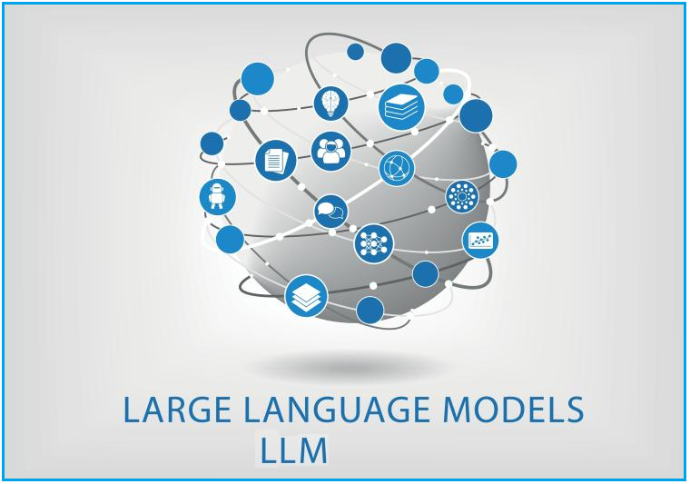
LARGE LANGUAGE MODELS

Slide 2
Agenda :
Introduction
How large language models work
Applications
Popular Examples of Large Language Models
Implementation

Slide 3
Introduction :
Large Language Models (LLMs) are advanced artificial intelligence (AI) models designed to understand and generate human-like text based on input data. These models have the capability to process, comprehend, and produce natural language text, making them valuable tools for a wide range of natural language processing (NLP) tasks.
Any large, complex data set can be used to train LLMs, including programming languages. Some LLMs can help programmers write code. They can write functions upon request or, given some code as a starting point, they can finish writing a program.

Slide 4
How Large Language Models Work
Tokenization: LLMs break down input text into smaller units called tokens, such as individual words or subwords.
Word Embeddings: Each token is represented as a dense vector in a high-dimensional space, capturing its semantic meaning and context.
Self-Attention Mechanism: LLMs use self-attention to weigh the importance of each token in relation to others, allowing them to understand the context of the input sequence.
Transformer Architecture: LLMs utilize the Transformer architecture, consisting of multiple layers of self-attention and feedforward neural networks, to process and generate text.
Training Process: LLMs are trained on large datasets of text using unsupervised learning techniques, enabling them to learn intricate patterns and relationships in language.

Slide 5
Popular Examples of Large Language Models
GPT-3 (Generative Pre-trained Transformer 3): Developed by OpenAI, GPT-3 was one of the largest and most advanced LLMs available at the time. It gained widespread attention for its ability to generate coherent and contextually relevant text across a variety of tasks, from language translation to creative writing.
BERT (Bidirectional Encoder Representations from Transformers): Developed by Google, BERT introduced the concept of bidirectional context in pre-training. It significantly advanced the state-of-the-art in various natural language processing tasks, including question answering, sentiment analysis, and more.
T5 (Text-To-Text Transfer Transformer): Developed by Google AI, T5 is a versatile LLM that operates on a text-to-text framework, meaning it can handle a wide range of tasks by framing them as text generation tasks. It achieved state-of-the-art results across multiple benchmarks and tasks.

Slide 6
4. XLNet: Developed by researchers at Google AI and Carnegie Mellon University, XLNet introduced the concept of permutation language modeling, which allows the model to consider all permutations of the input sequence. This approach improved upon some limitations of previous models like BERT.
5. RoBERTa (Robustly optimized BERT approach): RoBERTa is an optimized version of BERT, developed by Facebook AI. It addressed some of the training data and optimization issues present in the original BERT model, leading to improved performance on various natural language understanding tasks.

Slide 7
Applications :
Natural Language Understanding (NLU)
Language Translation
Content/Text Generation
Code Generation
Debugging and Documentation of Code
Question Answering
Language Transfer
Sentiment Analysis
Text Summarization
Image generation from texts
Chat-bots

Slide 8
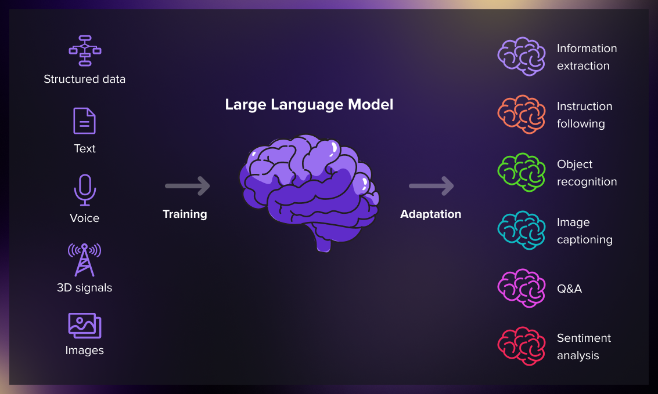

Slide 9
Implementation
Example-1 :
Building a Chatbot with a graphical user interface (GUI) using OpenAI's GPT-3 model
Required libraries :
1. Tkinter (for GUI)
2. OpenAI(library for interacting with OpenAI's APIs, including the GPT-3 language model, for accessing that models)
3. messagebox: A module from the tkinter library used for displaying message boxes and dialogs.
4. langchain.llms.OpenAI: A module for integrating OpenAI's GPT-3 model into the chatbot application.
LLM model used : GPT

Slide 10
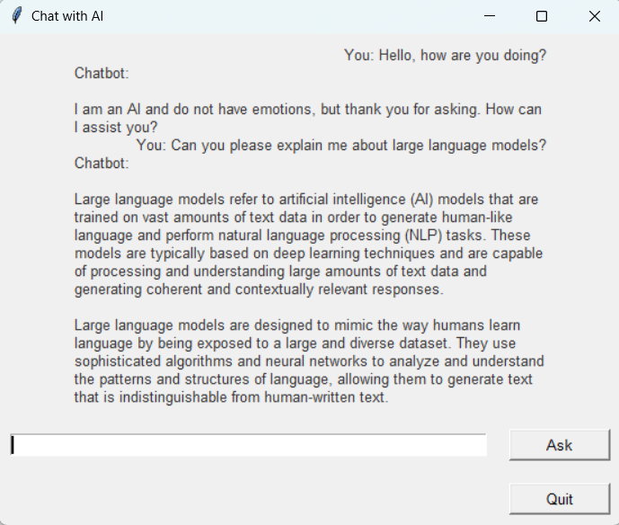
Output:
A chatbot interface where users can input questions and receive responses which is generated by OpenAI's GPT-3 model.

Slide 11
Example-2 :
Image To Text Generator (Image captioning)
Required libraries :
Transformers: Library for working with transformer-based models, including VisionEncoderDecoder Model and ViTImageProcessor.
Torch: PyTorch library for deep learning.
PIL: Python Imaging Library for image processing.
LLM Model Used : VisionEncoderDecoderModel with ViT-GPT2 architecture from the nlpconnect/vit-gpt2-image-captioning pretrained model.

Slide 12
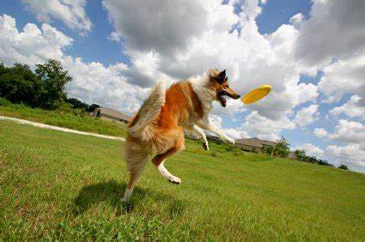
Input image :
Output text :
['a dog catching a frisbee in a field']

Slide 13
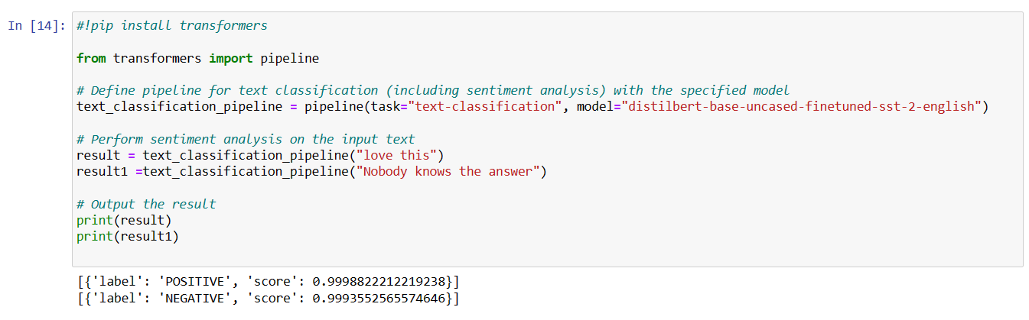
Example:3
Simple example for Sentiment-analysis
LLM model used : Distilbert-base-uncased-finetuned-sst-2-english

Slide 14
THANK YOU

