Slide 1
Fine-Tuning Large Language Models

Slide 2
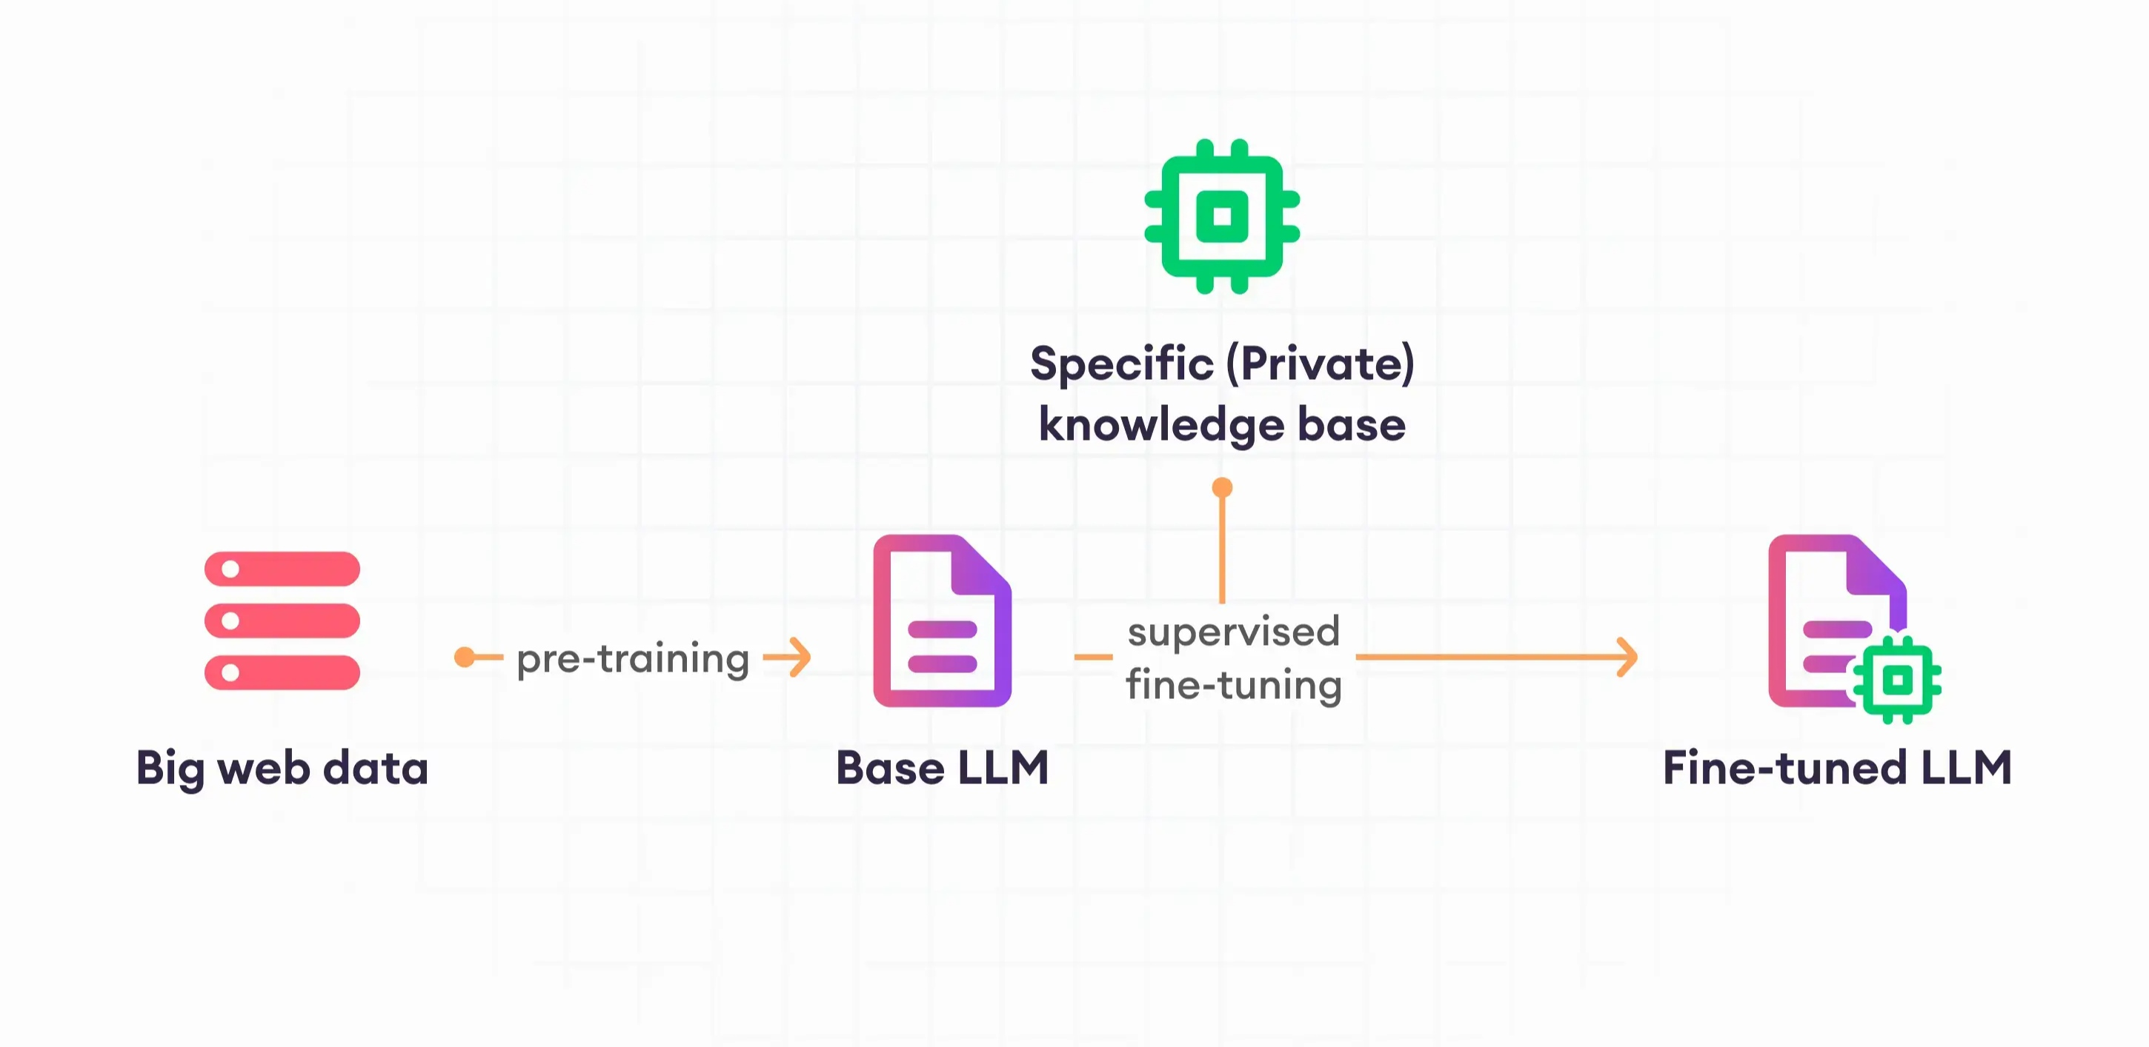
Intrduction:
Fine tuning is a concept in Large Language Model(LLMS) which is used to enhance the performance of pre-trained models for a specific task or domain. It is a supervised learning process where new dataset of labelled examples is used to update the weights of a LLM.

Slide 3
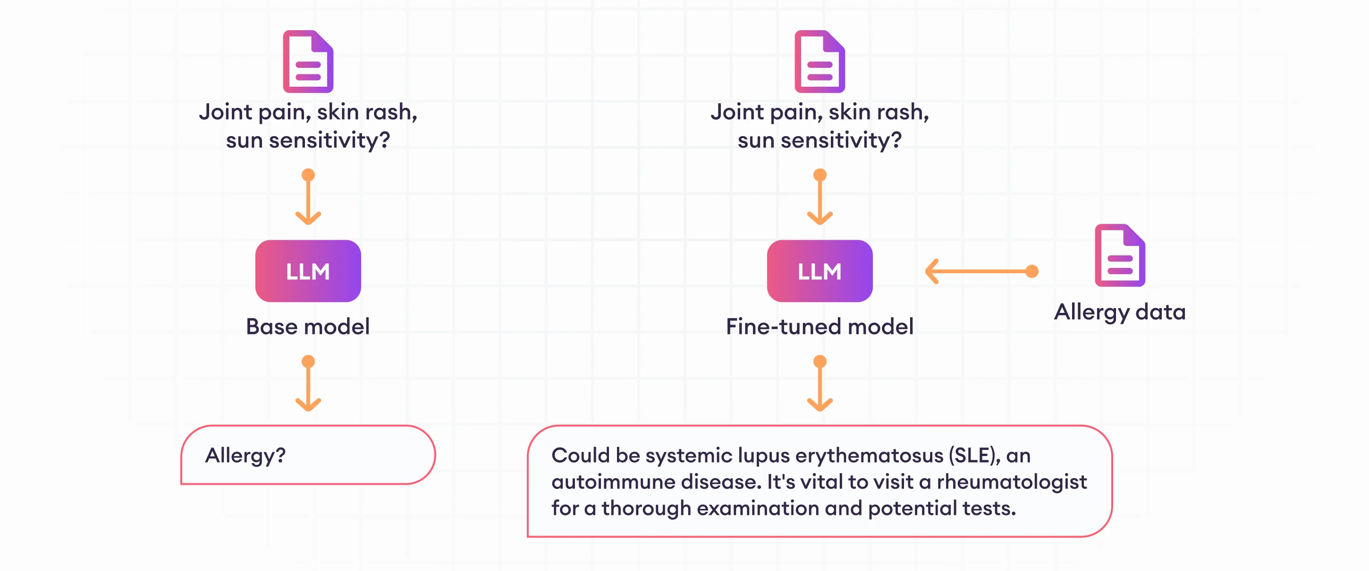

Slide 4
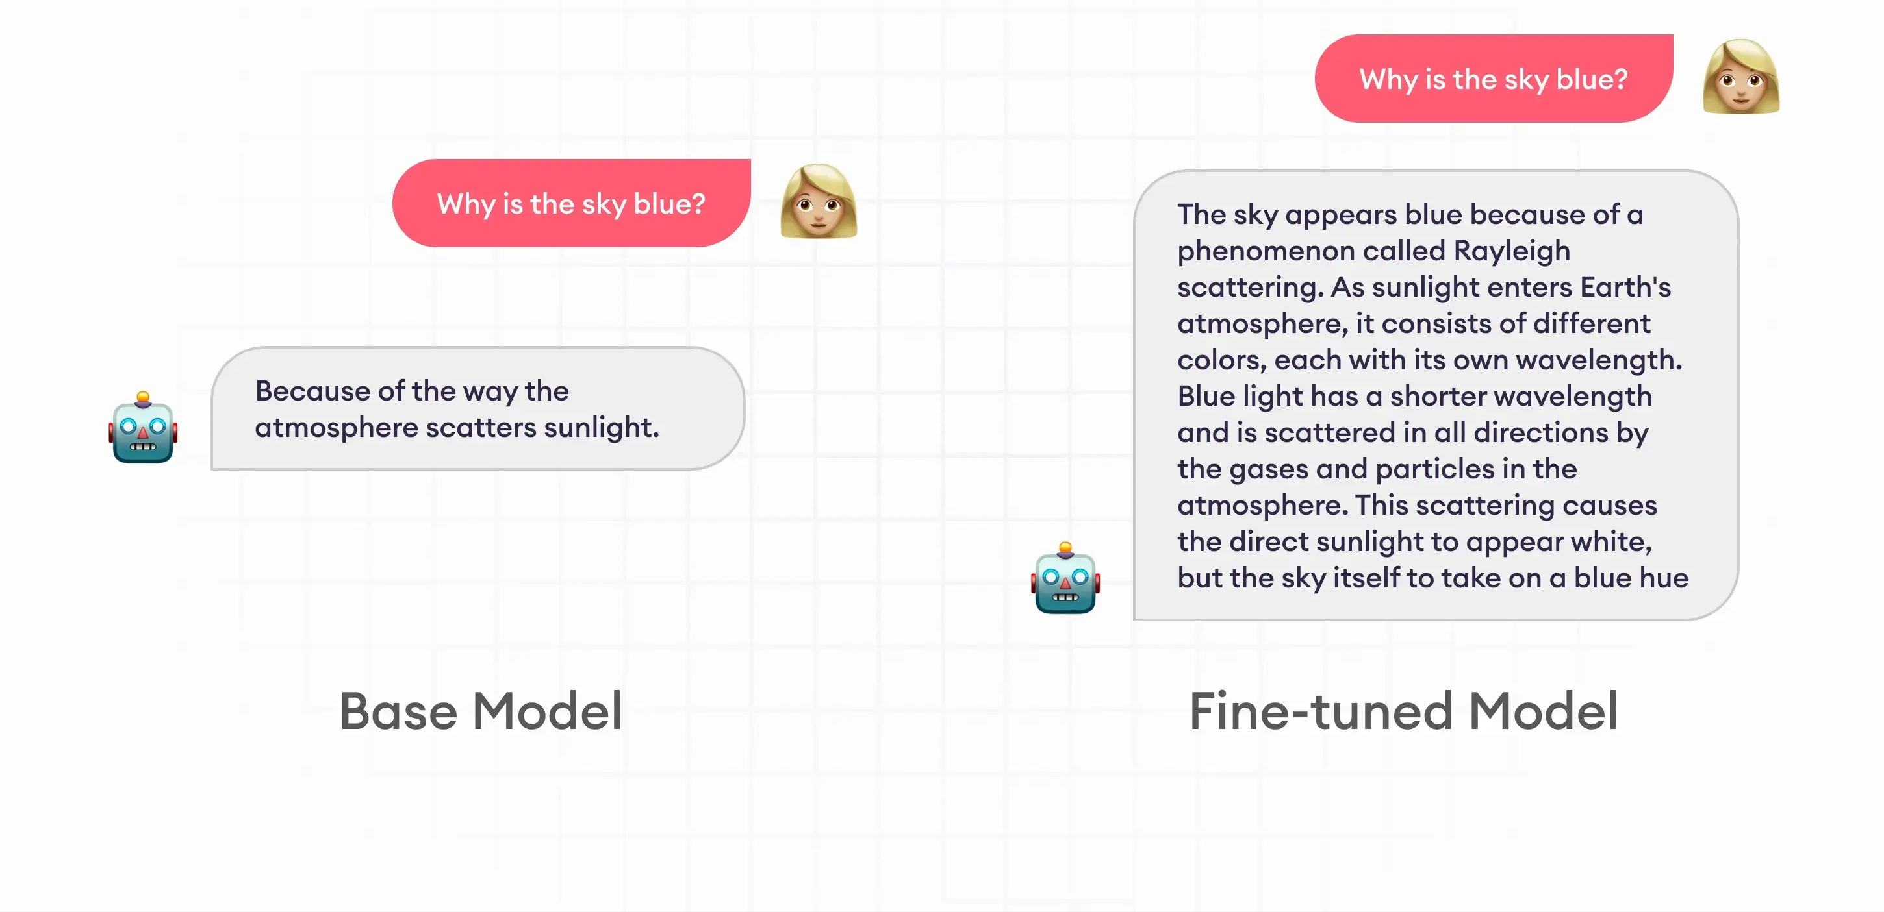

Slide 5
Thank You

