Slide 1
Fine-Tuning Large Language Models

Slide 2
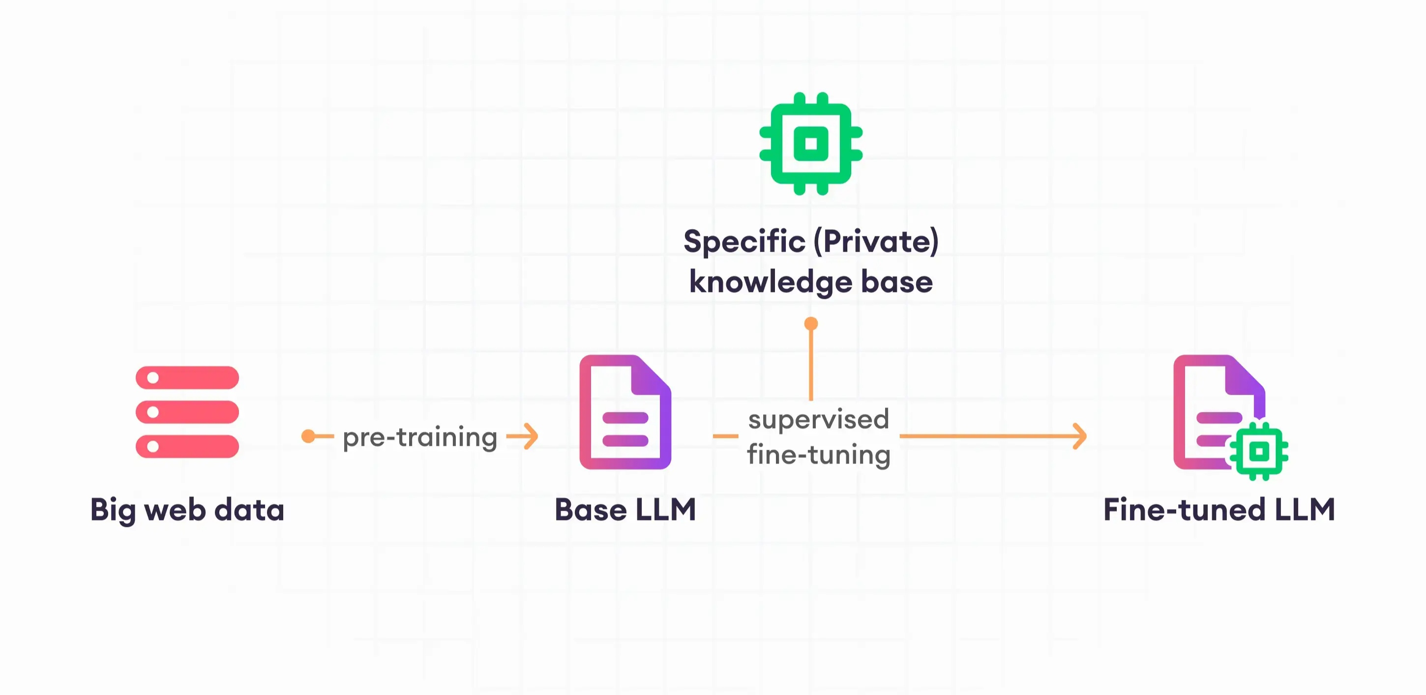
Introduction:
Fine tuning is a concept in Large Language Model(LLMS) which is used to enhance the performance of pre-trained models for a specific task or domain. It is a supervised learning process where new dataset of labelled examples is used to update the weights of a LLM.

Slide 3
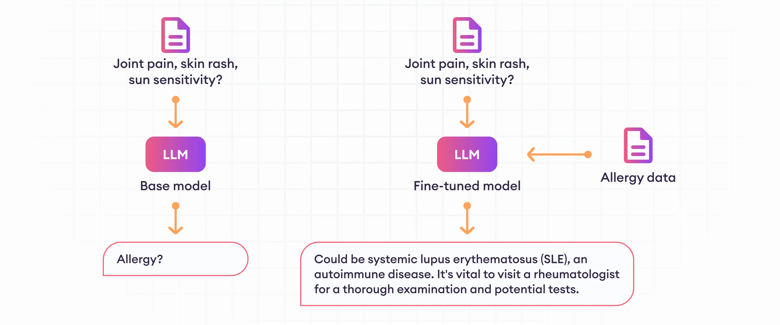

Slide 4
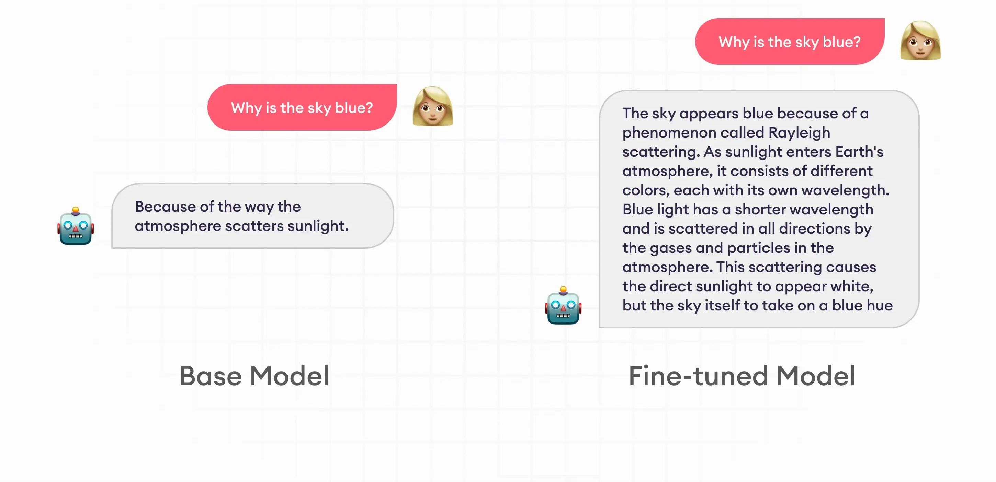

Slide 5
Problems we face while fine tuning:
As we know large language models has billions of parameters. Its not feasible to retrain all the weights or parameters from scratch.
We lack computational resources(GPU).
We also lack storage requirements.
To train all the parameters again it would take much time.
Solution:
To avoid above problems we use a matrix decomposition technique called LoRA (Low Rank Adaptation)
Note: LoRa is given by Microsoft in the year of 2021

Slide 6
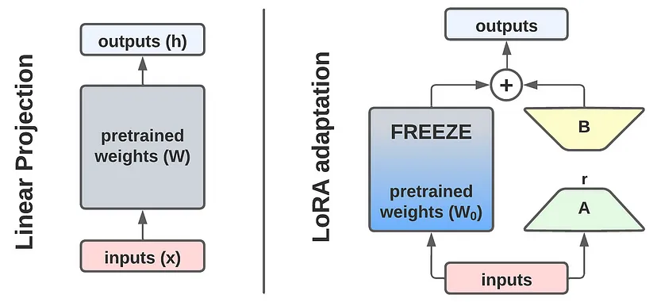
Let’s understand working of LoRA:
Low Rank Adaptation (LoRA) is a technique for efficiently fine-tuning large language models for new tasks.

Slide 7
Let’s understand working of LoRA:
The core idea here is to create a low rank representation of the weights and bias matrix and fine-tune it and keep the pre trained weights frozen during the whole time.
By training only a small fraction of the total parameters, LoRA drastically reduces the computational resources required for fine-tuning.
Less parameters also reduces the storage requirements and faster training since we do not have to calculate gradients for all parameters.

Slide 8
Thank You

