Slide 1
Identification of tomato plant disease using leaf images using CNN
GUNDA SAI YESHWANTH
192CS006

Slide 2
Brief Overview
Identification of tomato plant diseases based on images of leafs .
Used deep learning state-of art models such as lenet,Alexnet,and inception.
Dataset is taken from Plant Village datasets which consists of 10 different types of diseases and overall around 18000 images .
Project is done using Google Collaboratory which is specifically designed for ML purpose .
All these images are stored in google drive and while running algorithm they are taken from drive as input to model

Slide 3
Brief Overview Cont..
These images are transformed into size 256*256*3 and so the model input which is generally considered standard.
The pixel values are normalized and standardized so that the model converges faster.
These values are given to different models which are explained later in this presentation to classify the images
Lenet accuracy : 97.7%, AlexNet accuracy : 94% ,AlexNet with momentum : 97.9% and finally inception v3 : 100%, all of these with 2 classes classification

Slide 4
WORK TILL MID-SEM
Collected relevant Dataset from Internet and learnt how to do deep learning work in google colaboratory.
Learnt the concepts of deep learning and how to code them in python
Studied the state-of-art models in Deep learning
Implemented Le-Net architecture which is one of the basic models It consists of 6 layers which includes convolution layers and pooling layers with convolution size 5*5*x and pool size 2*2*x

Slide 5
WORK TILL MID-SEM Cont..
Next implemented AlexNet which is little advanced than LeNet due to its activation function relu which is 6 times faster than LeNet sigmoid activation function.
AlexNet consists of 8 layers which is very similar architecture as leNet but has 1st convolution layer with 11*11*x and second layer with 5*5 and remaining with 3*3 and all convolution layers with 3*3*x
LeNet gave an accuracy of 97.7% and alexNet 94%
Then added momentum to AlexNet to give an accuracy of 97.9%

Slide 6
WORK DONE AFTER MID-SEM
Studied about advanced architectures of deep learning, one such is InceptionV3
The model itself is made up of symmetric and asymmetric building blocks, including convolutions, average pooling, max pooling, concats, dropouts, and fully connected layers. Batchnorm is used extensively throughout the model and applied to activation inputs. Loss is computed via Softmax.
This model is already trained on popular imageNet dataset
Took this model form keras and removed last layers from model and added dense layers at bottom
Trained on the model and resulted in accuracy of 91% on 10 classes

Slide 7
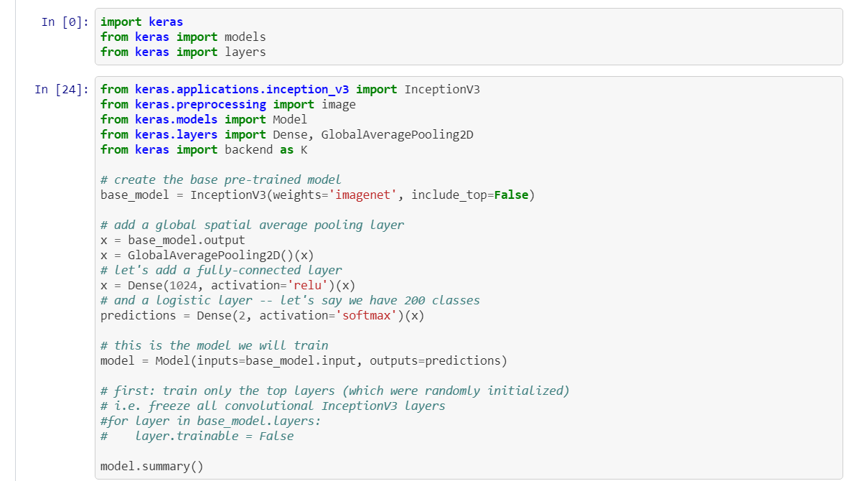
Snapshots of final model

Slide 8
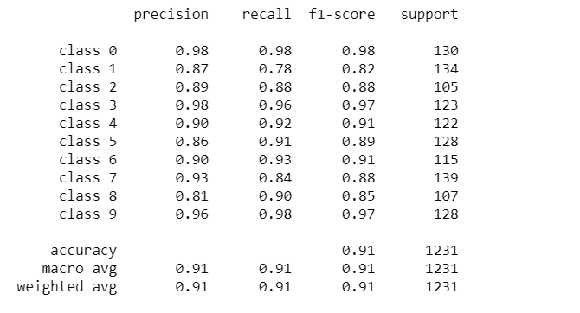
Results

Slide 9
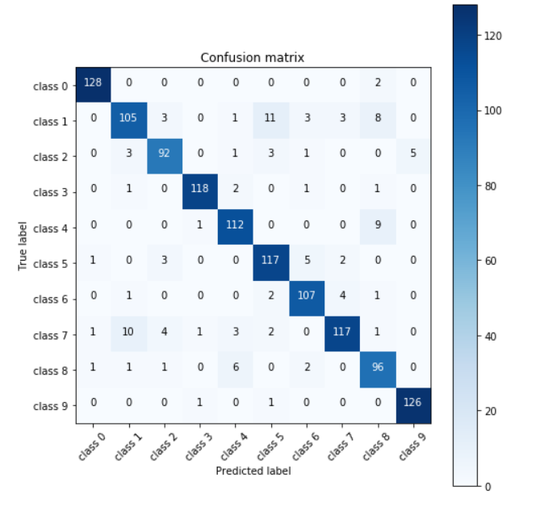
Confusion matrix

Slide 10
FUTURE ENHANCEMENTS
Train the images with upcoming latest models
Perform image Augmentation for smaller sample diseases images.

Slide 11
References
[1] . https://papers.nips.cc/paper/4824-imagenet-classification-with-deep-convolutional-neural-networks.pdf
[2] .https://static.googleusercontent.com/media/research.google.com/en//pubs/archive/44903.pdf
[3] .http://yann.lecun.com/exdb/publis/pdf/lecun-01a.pdf
[4] . http://citeseerx.ist.psu.edu/viewdoc/download?doi=10.1.1.335.3398&rep=rep1&type=pdf
[5] . http://www-isl.stanford.edu/~widrow/papers/c1960adaptiveswitching.pdf
[6] .https://www.rctn.org/bruno/public/papers/Fukushima1980.pdf
[7] . https://github.com/gundasai/deeplearning

Slide 12
THANK YOU

