Slide 1
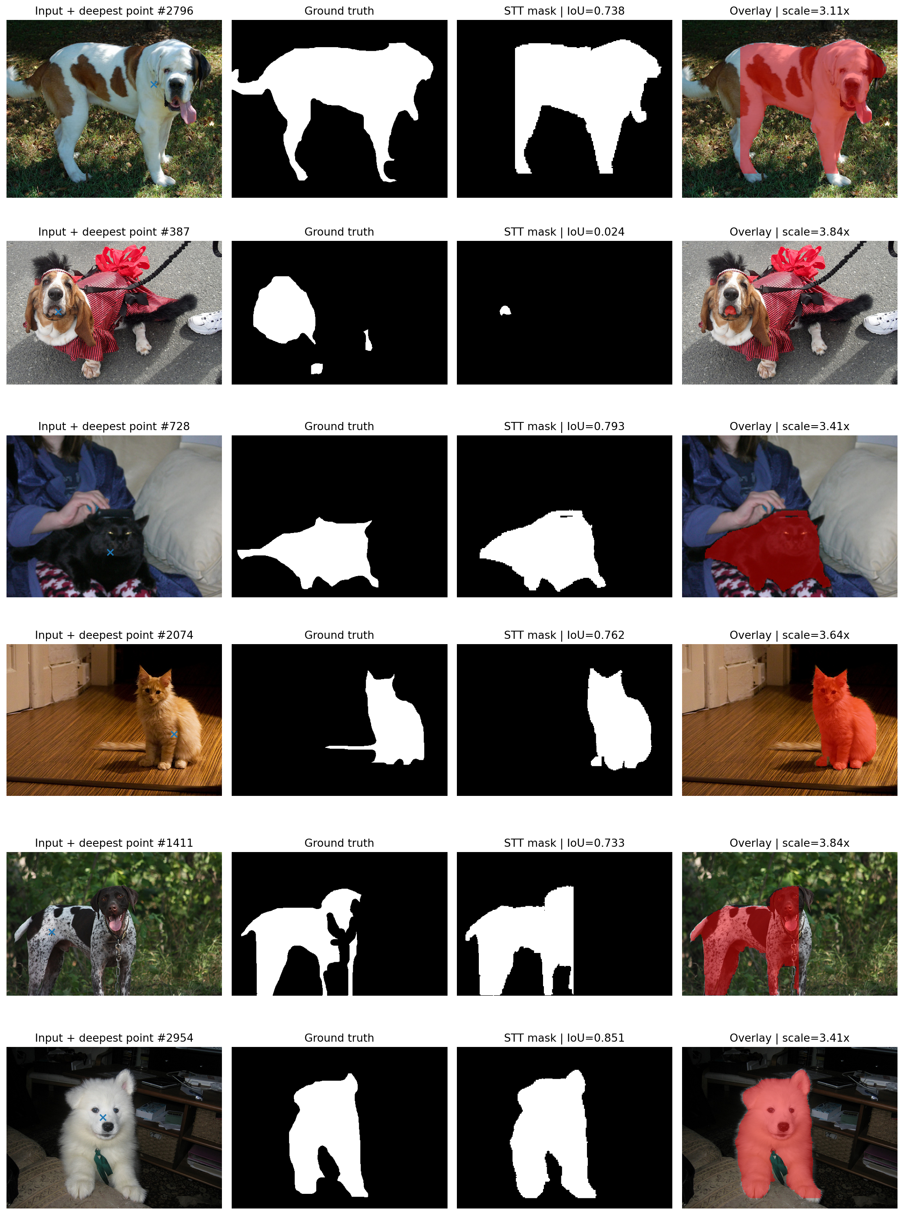
Segment This Thing
Efficient Point-Prompted Object Segmentation
Why this project: testing whether a recent CVPR model is not only accurate, but fast, robust and useful from one click.
Reproduction • Evaluation • Robustness • Extension
Gundeep Singh
Aditya Bakhale
Raghavendra Prasad Shetti

Slide 2
01 • PROJECT RATIONALE
What is this project about:
We built an external evaluation and reliability framework around a recent pretrained segmentation model.
We reproduced STT-B, adapted it to an external dataset, evaluated its quality and efficiency, stress-tested its prompt and image robustness, compared it with SAM under a controlled protocol, investigated whether its confidence predicts failures, and extended its masks into geometric object measurements.
USER NEED
one click → target object
RESEARCH NEED
SELECTION LOGIC
accuracy + reliability, not only IoU
• Single-point segmentation is intuitive for annotation and interactive tools. • STT-B is recent, research-backed, and has official code/checkpoint. • Its efficiency claim is testable against a known baseline: SAM ViT-B. • The same outputs support accuracy, robustness, confidence, and object-measurement analysis.
PRACTICAL NEED
fast response on limited GPU
Core framing
Segmentation is useful only when the mask is good enough, the system is fast enough, and failures can be understood.

Slide 3
02 • REPRODUCTION TARGET
What STT-B promised us
STT-B uses foveated tokenization: more detail near the user point and cheaper representation farther away. That made it ideal for our question: can we trade a small amount of accuracy for much faster interactive segmentation?
Image + point
input
↓
Foveator
multi-scale tokens
↓
WHAT WE REPRODUCED
STT-B
segmentation model
• Official STT-B pretrained checkpoint. • Official predictor and foveation configuration. • Inference-only evaluation; no retraining or fine-tuning. • Best mask selected using the model's predicted-IoU output.
↓
Candidates
masks + scores
↓
Best mask
highest score
Implemented foveation: token size 16; strides [1,2,4,6,8]; grid sizes [4,4,6,8,10].

Slide 4
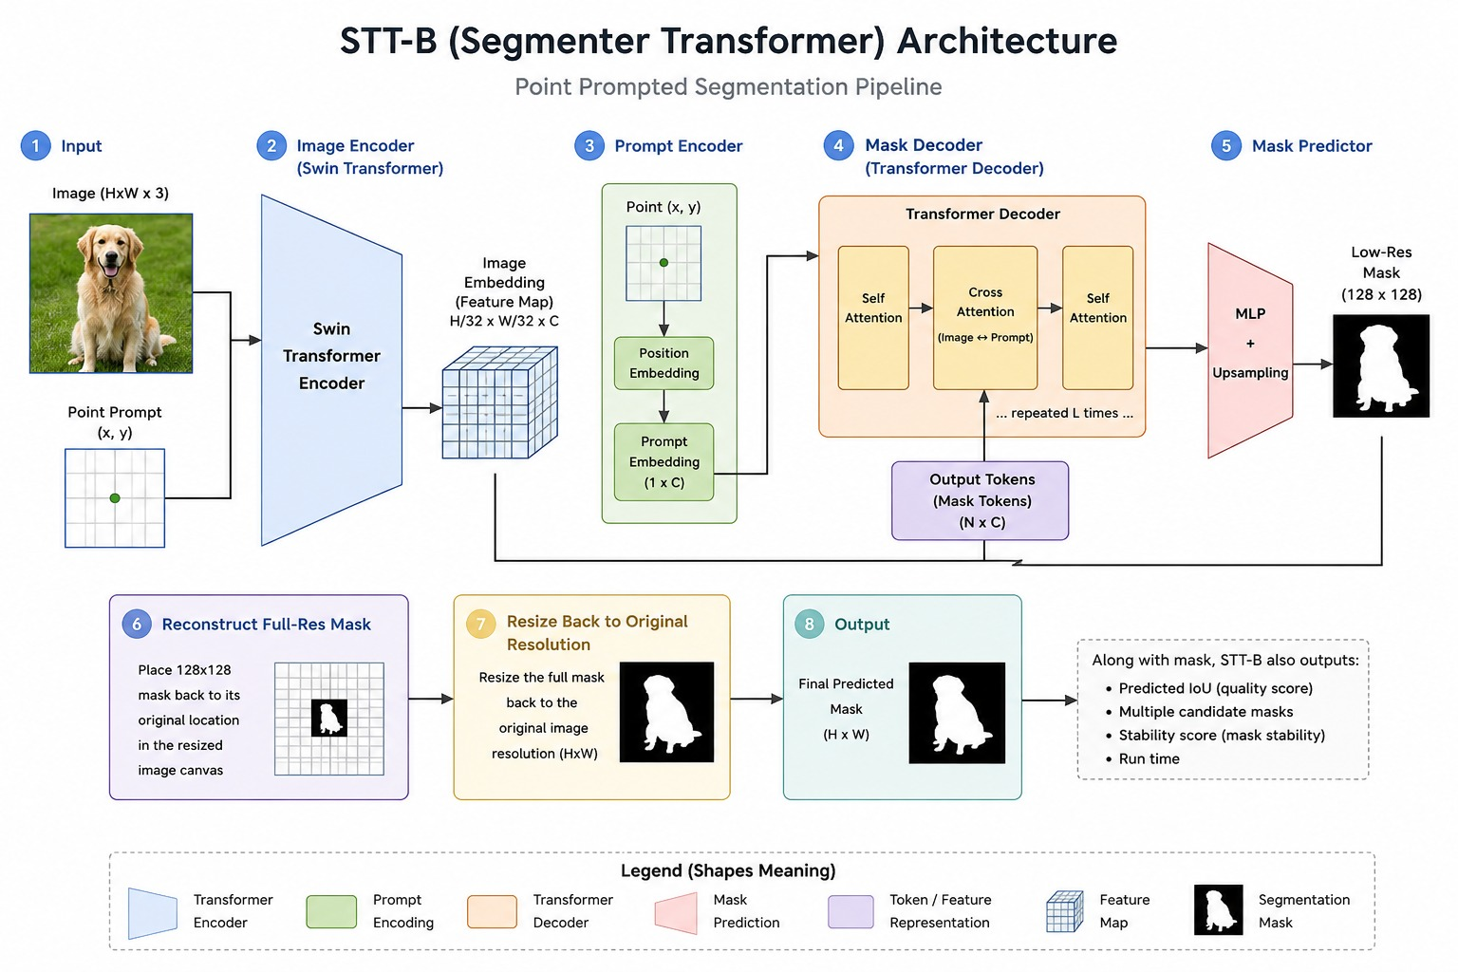
03 • REPRODUCTION TARGET
Project architecture

Slide 5
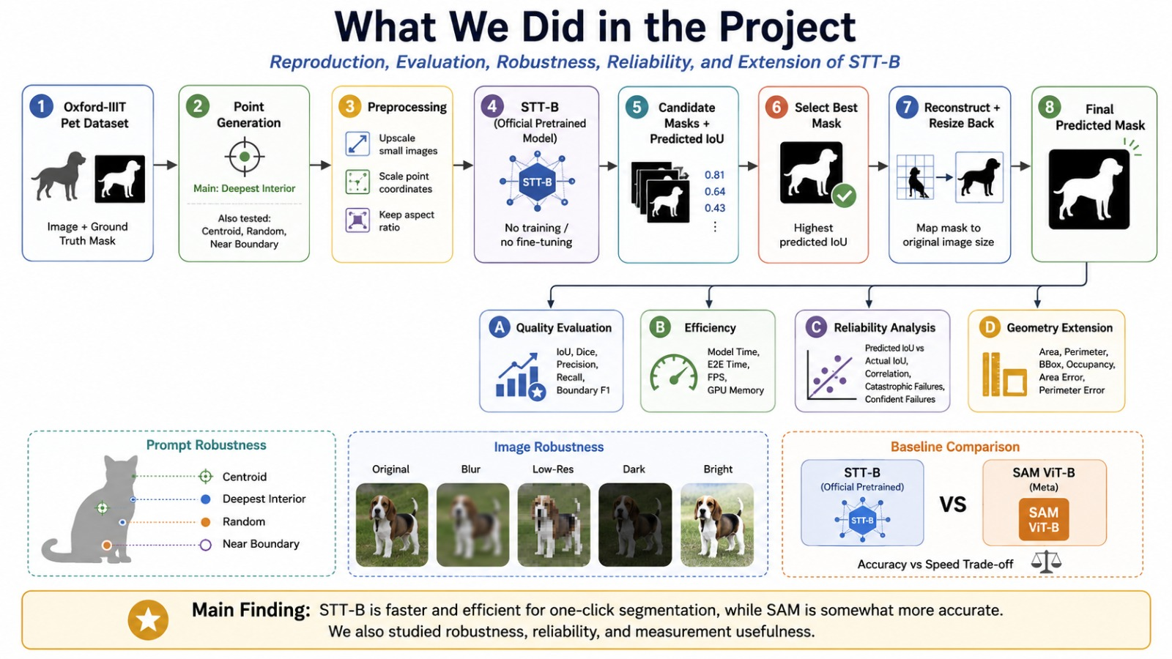
04 • REPRODUCTION TARGET
What our project architecture:

Slide 6
05 • METHOD
How the project was built around that choice
Every experiment answers one part of the same project rationale: quality, speed, robustness, reliability, and whether the mask becomes useful data.
Dataset
GT mask
Point
Preprocess
STT-B
Best mask
Evaluate
→
→
→
→
→
→
THREE ANALYSIS BRANCHES
QUALITY
EFFICIENCY
EXTENSION
IoU • Dice • Precision • Recall • Boundary F1
model runtime • E2E runtime • FPS • GPU memory
area • perimeter • bbox • occupancy • errors
Final protocol: 499 valid main images; 100 paired samples for robustness and STT-vs-SAM.

Slide 7
06 • EXPERIMENTAL SETUP
What exactly was tested
DATASET
PRIMARY EVAL
ROBUSTNESS
BASELINE
Oxford-IIIT Pet
3,669 test images
499 valid
500 sampled, 1 skipped
100 paired
4 prompts + 5 degradations
100 paired
STT-B vs SAM ViT-B
PROTOCOL CHOICES THAT MATTER
Why this matters
• Trimap label 1 treated as foreground; labels 2/3 as non-foreground. • Small images upscaled so the short side reaches at least 1280 px, then predictions are mapped back. • Deepest-interior point used for the predetermined main evaluation. • Tesla T4 GPU; official STT-B checkpoint; no training or fine-tuning.
The protocol keeps the project defensible: we evaluate a released research model under documented conditions rather than tuning the setup until the numbers look best.

Slide 8
07 • MAIN RESULT
Fast and precise, but not boundary-perfect
MEAN IOU
DICE
PRECISION
RECALL
0.607
CI 0.584–0.628
0.715
CI 0.692–0.736
0.855
CI 0.846–0.864
0.723
CI 0.694–0.749
BOUNDARY F1
E2E RUNTIME
GPU MEMORY
AREA ERROR
0.095
CI 0.088–0.102
0.093 s
~11 FPS
0.397 GB
mean peak
34.85%
vs GT
Good point of the model: strong foreground precision and fast response.
Limitation: the object boundary/shape is the hard part.

Slide 9
08• VISUAL EVIDENCE
What the masks actually look like
WHAT TO NOTICE
• Several examples produce usable full-object masks around IoU ≈ 0.73–0.85. • One displayed case collapses to a tiny mask: IoU ≈ 0.024. • This supports the reliability story: averages hide catastrophic cases. • Keep this figure: it explains the project faster than text.
Takeaway: STT-B can be very useful when it works, but the failures are important enough to analyze.

Slide 10
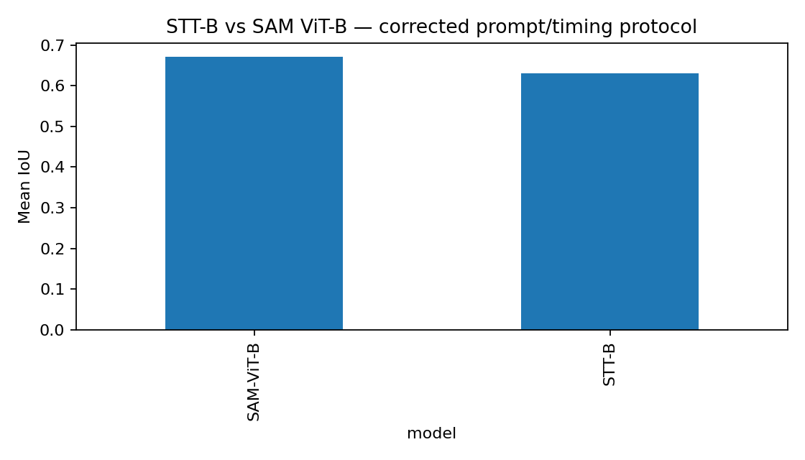
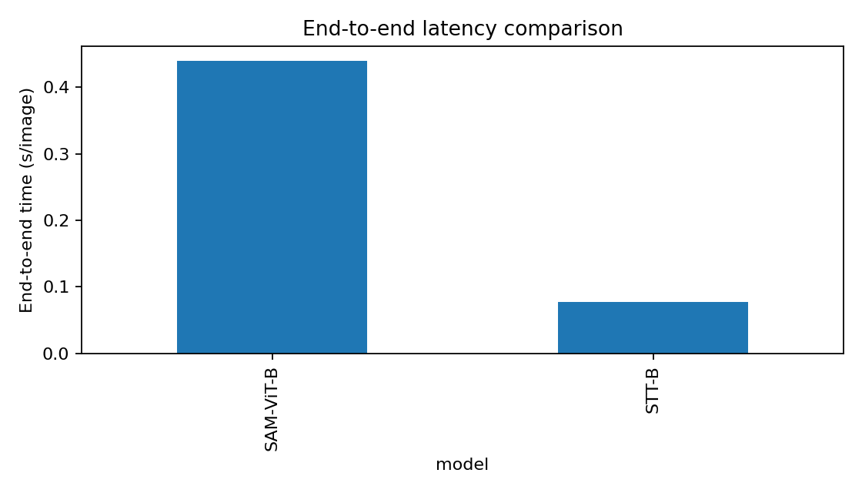
09 • ACCURACY–EFFICIENCY TRADE-OFF
Why STT-B was worth evaluating
STT-B IOU
SAM IOU
STT-B FPS
SAM FPS
0.631
0.672
13.54
2.28
SAM is slightly more accurate; STT-B is much faster. This is exactly the project question: not a universal winner, but a useful trade-off.

Slide 11
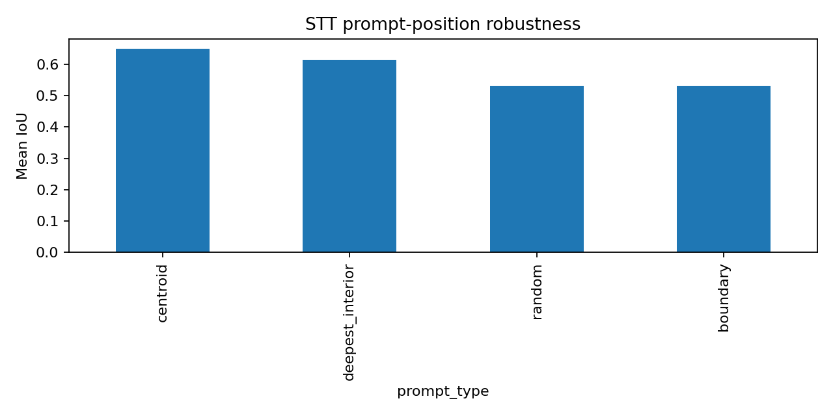
10 • PROMPT SENSITIVITY
The user click is part of the system
ABLATION RESULT
• Centroid prompt: IoU 0.650 — strongest in this ablation. • Deepest interior: 0.616. • Random and boundary: ≈0.532 each. • Point location materially changes segmentation quality.
Why this belongs in the project: real interactive systems depend on users, not just architecture.

Slide 12
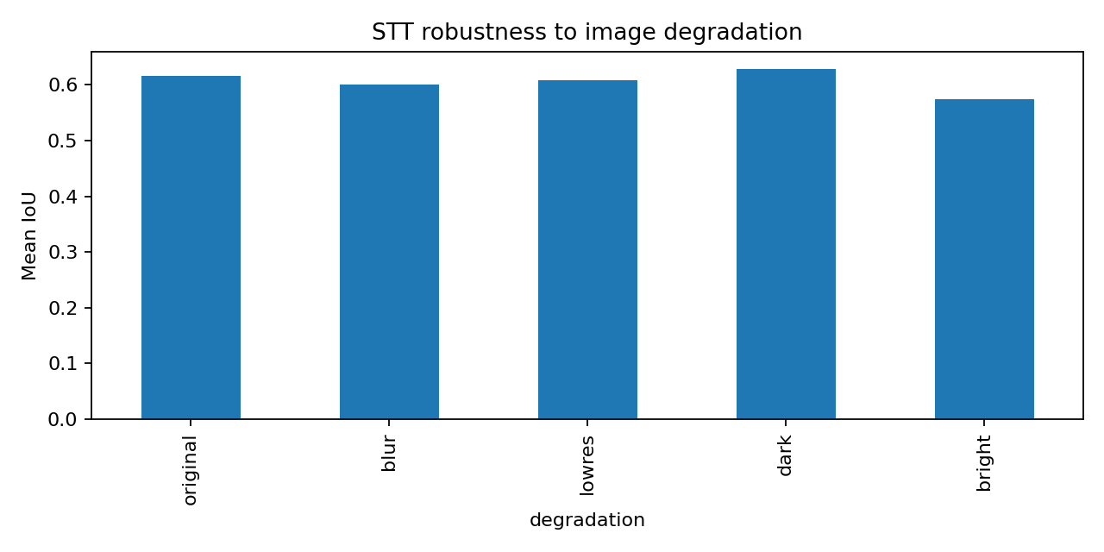
11 • IMAGE ROBUSTNESS
What happens when input quality changes
ROBUSTNESS RESULT
• Original IoU: 0.616. • Dark: 0.629; low-res: 0.608; blur: 0.600. • Bright: 0.574 — largest mean drop. • The model is not equally sensitive to all image changes.
This supports the choice of project because it goes beyond clean benchmark accuracy into stress testing.

Slide 13
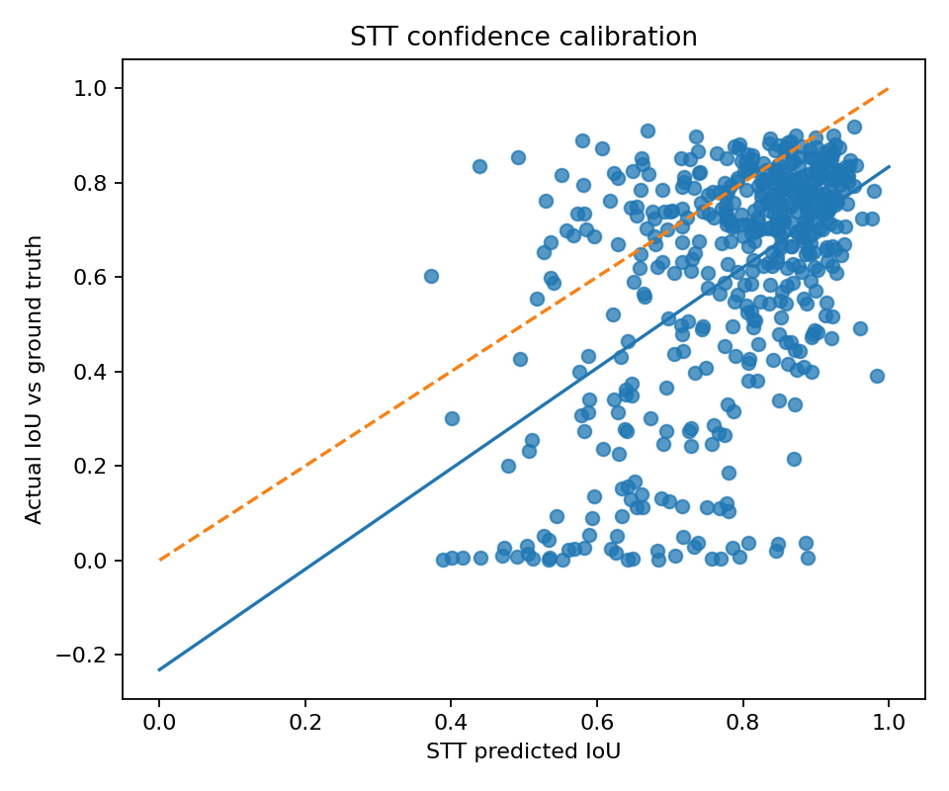
12 • RELIABILITY
Confidence helps, but does not guarantee correctness
LOW-IOU FAILURES
CONFIDENT FAILURES
66 / 499
IoU < 0.25
22 / 499
high score, poor mask
CONFIDENCE CORR.
GEOMETRY ERROR
0.518
predicted vs actual IoU
34.85% area
27.06% perimeter
Why this matters: the model is fast and useful, but reliability inspection is necessary before trusting every mask.

Slide 14
13 • Conlusion & Future work
Conlusion & Future work
Future Scope
Final conclusion
Fine-tuning + better boundary accuracy
Better prompt selection + multi-click correction
Confidence calibration + testing on more datasets
STT-B is a strong efficiency-focused segmentation model for fast point-prompted interaction. It is not pixel-perfect, but it is useful when speed, simplicity and interpretable failure analysis matter.
Gundeep Singh • Aditya Bakhale • Raghavendra Prasad Shetti

