Slide 1
EXPLORATORY DATA ANALYSIS
Used Car Price Analysis
Data Collection, Cleaning & EDA on the Cars24 Marketplace
987 listings • 12 scraped attributes • 8 cities
Used Car Price Analysis | Cars24 Dataset
1

Slide 2
Business Problem
The used car market lists thousands of vehicles that vary by brand, model, fuel type, transmission, age, and mileage.
Buyers struggle to judge fair value; sellers struggle to price competitively.
TARGET VARIABLE
Final_price
The actual selling price of the used car — the real market outcome after negotiation, as opposed to the initial listed price.
Goal
Identify the key factors driving resale price of used cars, and surface patterns that support smarter buying and pricing decisions.
Analyzing Final_price against brand, year, fuel, transmission and mileage reveals which attributes actually move resale value.
Used Car Price Analysis | Cars24 Dataset
2

Slide 3
Data Collection
Web-scraped directly from the Cars24 used-car marketplace
1
2
3
4
Request
Parse
Structure
Expand
HTTP GET requests sent to Cars24 city-specific listing pages with a browser user-agent header.
BeautifulSoup parses each listing card; Regular Expressions extract year, brand, price and mileage from unstructured text.
Extracted fields are assembled into a Pandas DataFrame — one row per car listing.
Scrape repeated across 8 cities × 10 target brands to broaden coverage, then exported to CSV.
Cities covered
Bangalore · Hyderabad · Delhi · Chennai · Noida · Ahmedabad · Jaipur · Mumbai
Tech stack
Requests · BeautifulSoup · Regex · Pandas · NumPy · Matplotlib · Seaborn
Used Car Price Analysis | Cars24 Dataset
3

Slide 4
Dataset Snapshot
987
12 → 11
8
0
2012–2026
Car listings (rows)
Raw → final columns
Cities scraped
Duplicate rows
Manufacturing years
Feature
Type
Description
Year
Numerical
Manufacturing year
Brand / Model / Variant
Categorical
Make, model & trim
KM_Driven
Numerical
Total kilometers driven
Fuel
Categorical
Petrol / Diesel / CNG / Electric
Transmission
Categorical
Manual / Automatic
EMI/Month
Numerical
Monthly installment (₹)
Listed_price_Lakh
Numerical
Initial asking price (₹ Lakh)
Final_price
Numerical (target)
Actual selling price (₹ Lakh)
Location
Categorical
City / dealership area
Used Car Price Analysis | Cars24 Dataset
4

Slide 5
Data Quality Assessment
Missing values by column, before cleaning (n = 987)
What stands out
Registration is missing in ~87% of rows — too sparse to impute reliably.
Model, Brand and Location each have 30–35% missing — mergeable via grouped mode/fill.
Core numeric fields (KM_Driven, Fuel, Transmission, Final_price) are fully populated.
No duplicate listings were found in the raw data.
Used Car Price Analysis | Cars24 Dataset
5

Slide 6
Data Cleaning Strategy
Impute by group
Drop unreliable column
Year filled with median; Brand with mode; Model/Variant filled with the most common value within each Brand (and Brand+Model) group.
Registration dropped outright — 87% missing exceeded the 70% usability threshold.
Parse & convert types
Fill remaining gaps
Stripped currency text (‚L’, commas, ‚km’) via regex; cast Year, KM_Driven, EMI/Month and Final_price to numeric types.
EMI/Month and Listed_price imputed using Brand/Model group means; Location gaps labeled “User Not Defined.”
Result: 987 rows × 11 clean columns — zero nulls, zero duplicates, all numeric fields properly typed.
Used Car Price Analysis | Cars24 Dataset
6

Slide 7
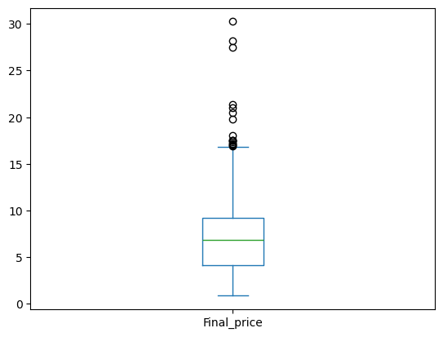
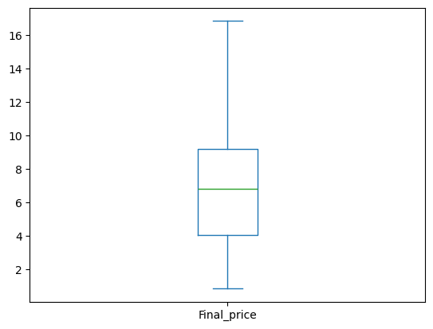
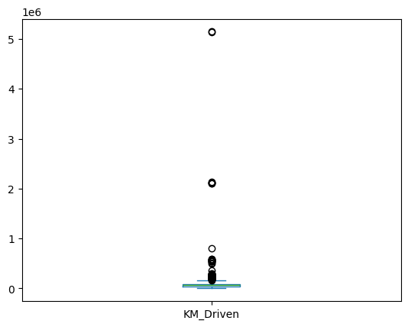
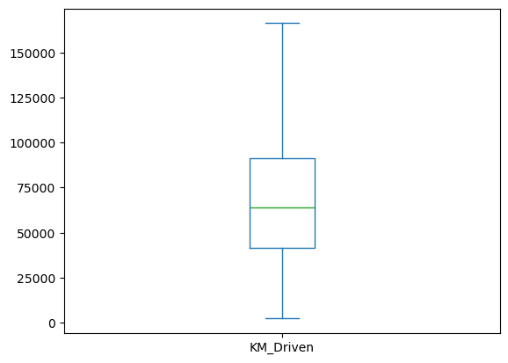
Outlier Treatment
IQR method applied to Final_price and KM_Driven (clipped to [Q1−1.5×IQR, Q3+1.5×IQR])
Final_price — before
Final_price — after clip
KM_Driven — before
KM_Driven — after clip
Before clipping, KM_Driven ranged up to 5.15 million km — clearly scraping/data-entry noise, not real mileage. The IQR clip pulls extreme values in without deleting rows, keeping the full 987-row sample intact for analysis.
Used Car Price Analysis | Cars24 Dataset
7

Slide 8
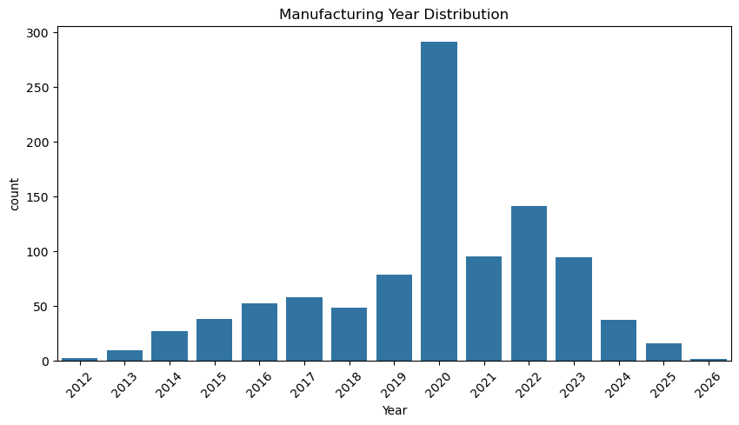
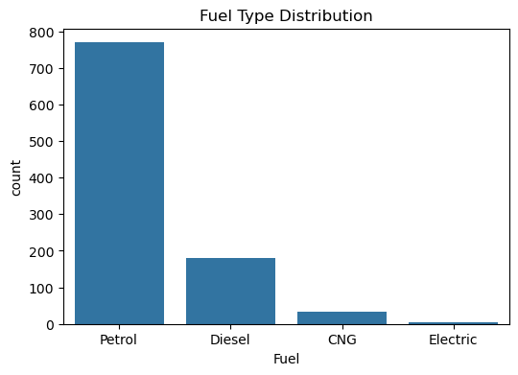
Univariate Analysis
Manufacturing year and fuel type
Listings cluster around 2019–2023, and Petrol dominates the fuel mix — the used market skews toward recent, petrol-driven vehicles with limited CNG/Electric supply.
Used Car Price Analysis | Cars24 Dataset
8

Slide 9
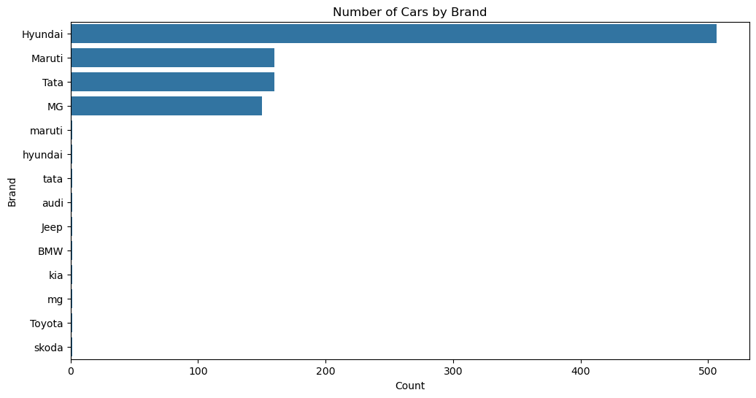
Brand Landscape
Top brands by volume
Hyundai
507
Maruti
160
Tata
160
MG
150
Hyundai, Maruti, Tata and MG together account for 977 of 987 listings (~99%). A small residual of ~10 lowercase-tagged brand entries reflects an unmerged second scraping batch — flagged as a data-quality limitation.
Used Car Price Analysis | Cars24 Dataset
9

Slide 10
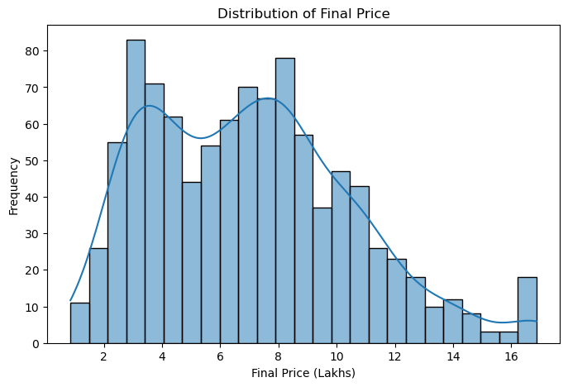
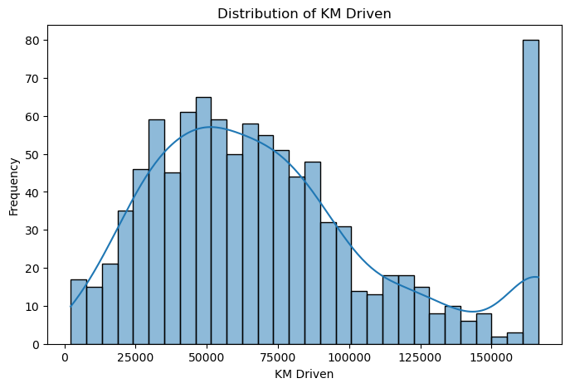
Price & Mileage Distributions
Final_price (₹ Lakh)
KM_Driven
Final_price is right-skewed with a median near ₹6.8L; KM_Driven is similarly right-skewed, with most cars clustered under ~1 lakh km driven.
Used Car Price Analysis | Cars24 Dataset
10

Slide 11
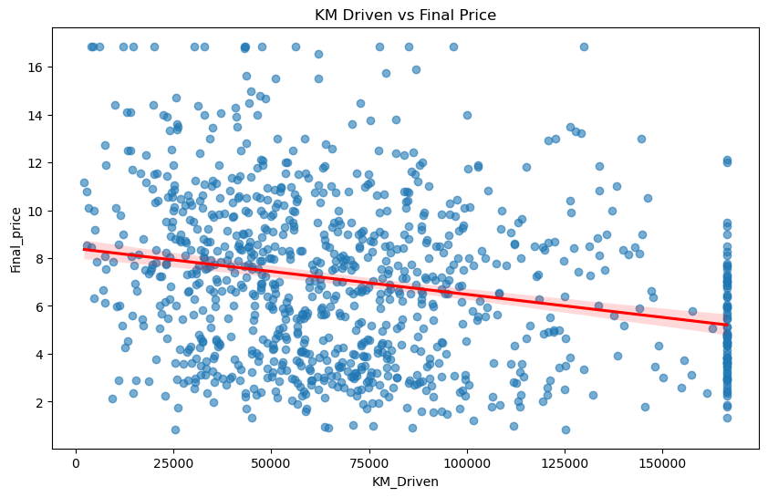
Mileage vs. Price
Does higher mileage push resale value down?
Observation
The regression line trends downward: cars with more kilometers driven tend to sell for less.
Business Insight
Mileage is a usable, low-friction pricing lever — sellers can anchor asking price to KM bands, and buyers can use it to sanity-check a quoted price.
Used Car Price Analysis | Cars24 Dataset
11

Slide 12
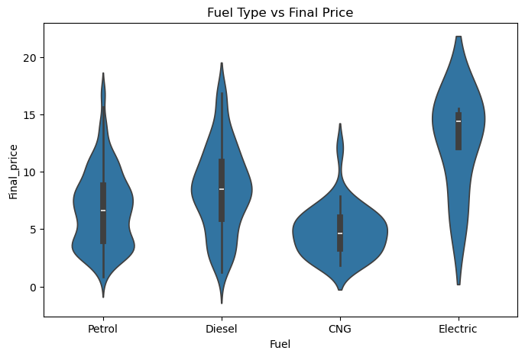
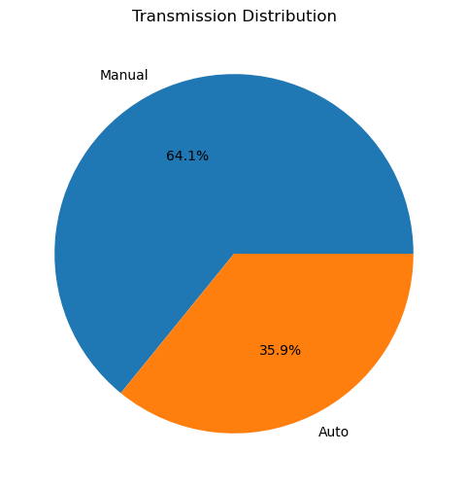
Price by Fuel Type & Transmission
Final_price distribution by fuel type
Transmission mix
Fuel type shapes both the price range and spread; automatic-transmission cars command a premium over manual, consistent with buyer demand for convenience.
Used Car Price Analysis | Cars24 Dataset
12

Slide 13
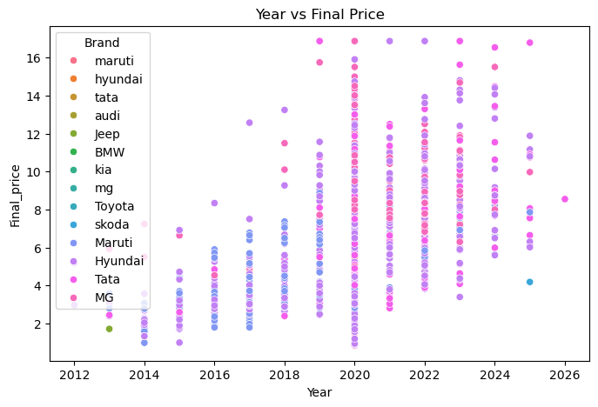
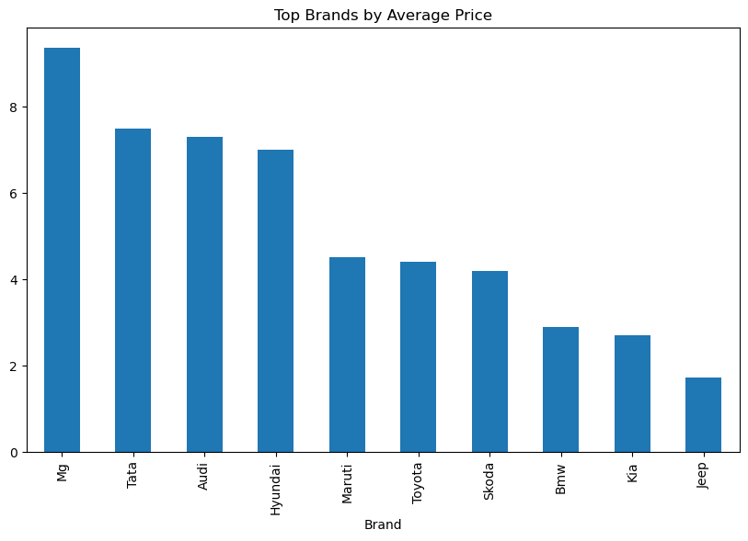
Price Trend by Year & Brand
Year vs. Final Price (by Brand)
Average Final Price by Brand
Newer cars (2020–2025) cluster at higher prices; older cars (2013–2017) mostly sit in the ₹1–6L band. MG, Tata and Hyundai post the highest average resale prices among major brands.
Used Car Price Analysis | Cars24 Dataset
13

Slide 14
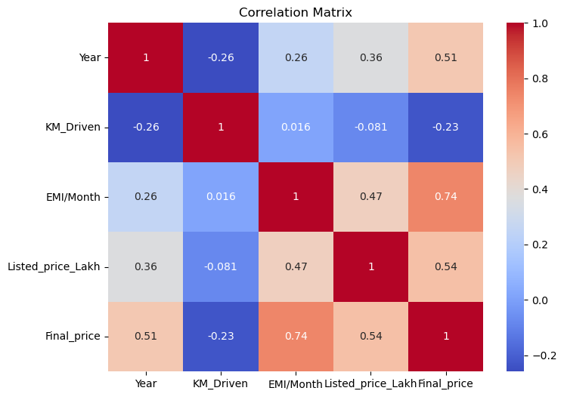
Multivariate Analysis
Correlation between numeric features
Reading the matrix
EMI/Month
+0.74
Strongest driver of Final_price
Listed_price
moderate +
Asking price tracks final price
Year
moderate +
Newer cars sell higher
KM_Driven
negative
More mileage, lower price
Used Car Price Analysis | Cars24 Dataset
14

Slide 15
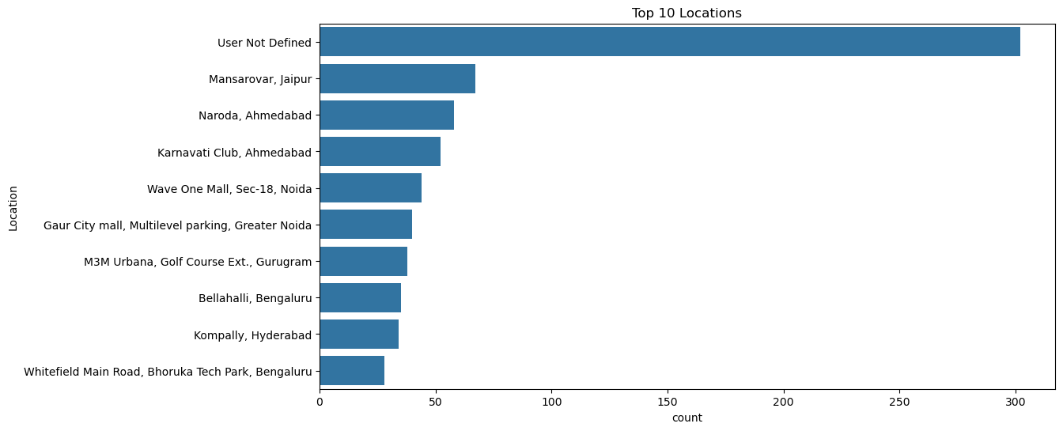
Market Activity by Location
Top 10 cities by listing count
Listing volume is concentrated in a handful of metro locations — useful signal for where inventory and marketing spend will have the most reach.
Used Car Price Analysis | Cars24 Dataset
15

Slide 16
Key Findings
1
Age
2
Mileage
Newer cars command higher resale value; price rises steadily with manufacturing year.
Higher KM_Driven consistently pulls Final_price down.
3
Brand
4
Transmission
Premium/preferred brands (MG, Tata, Hyundai) hold higher average prices than budget brands.
Automatic vehicles resell for more than manual, on average.
5
EMI/Month
6
Geography
The strongest numeric correlate of Final_price (r ≈ 0.74) — financing terms track sale price closely.
A handful of metro cities account for most listings and market activity.
Used Car Price Analysis | Cars24 Dataset
16

Slide 17
Limitations & Next Steps
Limitations
Recommended Next Steps
Brand labels are inconsistently cased for ~10 rows (“maruti” vs “Maruti”) — an unmerged scrape batch.
Registration column dropped entirely (87% missing) — no state/region-of-registration signal remains.
Imputed Model, Brand and Listed_price values rely on group means/modes, which can mask real variation.
Sample skews toward Hyundai/Maruti/Tata/MG — smaller brands are underrepresented for reliable comparison.
Normalize Brand/Model casing at scrape time to eliminate duplicate categories.
Re-scrape or source Registration data separately if regional pricing effects matter.
Build a regression/tree-based model to quantify each feature's price impact, not just correlation.
Expand brand and city coverage for a more representative, balanced sample.
Used Car Price Analysis | Cars24 Dataset
17

