Slide 1

EMPLOYEE MANAGEMENT SYSTEM
SQL PROJECT PRESENTATION
Submitted By: Gunde Ravi
Course: Data Analyst
Institution: Innomatics Research Labs

Slide 2

About Me
Educational background : B.Tech in Electrical and Electronics Engineering (EEE), completed in 2025.
Why I want to learn Data Analyst : B.Tech in EEE graduate and aspiring Data Analyst with hands-on experience in Python, SQL, Excel, Power BI, and Data Science projects.
LinkedIn: https://www.linkedin.com/in/gunde-ravi-675047292/
EMPLOYEE MANAGEMENT SYSTEM | SQL PROJECT PRESENTATION
2

Slide 3
Agenda
Project Domain Understanding
Objective of the Project
Problem Statement
Database Relationships (ER Model)
Database Design — Table Summary
SQL Concepts Used
Key Business Questions — SQL Analysis
– Employee Insights
– Job Role & Department Analysis
– Qualification & Skills Analysis
– Leave & Absence Patterns
– Payroll & Compensation Analysis
– Employee Ranking Analysis
Conclusion (Key Findings)
Experience / Challenges
Q&A
EMPLOYEE MANAGEMENT SYSTEM | SQL PROJECT PRESENTATION
3

Slide 4
Introduction
The Employee Management System is a database project developed using SQL.
The system is designed to manage employee-related information such as job departments, salaries, bonuses, qualifications, leaves, and payroll.
SQL queries are used to analyze employee information, department performance, salary distribution, qualifications, leave patterns, and payroll data.
EMPLOYEE MANAGEMENT SYSTEM | SQL PROJECT PRESENTATION
4

Slide 5
Problem Statement
The objective of this project is to design and implement an Employee Management System that efficiently stores and manages employee-related data within an organization. The system needs to track various aspects of employee information, including personal details, job roles, salary structures, qualifications, leave records, and payroll data. The system should ensure the integrity and consistency of data by using relational tables with appropriate foreign keys and cascading actions.
The system should allow for easy management and querying of employee data, providing insights such as payroll calculation, leave tracking, and department-specific job roles. The goal is to streamline HR operations, ensuring that all relevant employee data is accessible and accurately updated across different modules.
EMPLOYEE MANAGEMENT SYSTEM | SQL PROJECT PRESENTATION
5

Slide 6
Project Objectives
To create a structured database for managing employee information.
To maintain employee and department details.
To manage salary, bonus, and payroll information.
To analyze employee qualifications and job roles.
To study employee leave and absence patterns.
To compare salaries and bonuses across departments.
To use SQL for meaningful employee and payroll analysis.
EMPLOYEE MANAGEMENT SYSTEM | SQL PROJECT PRESENTATION
6

Slide 7
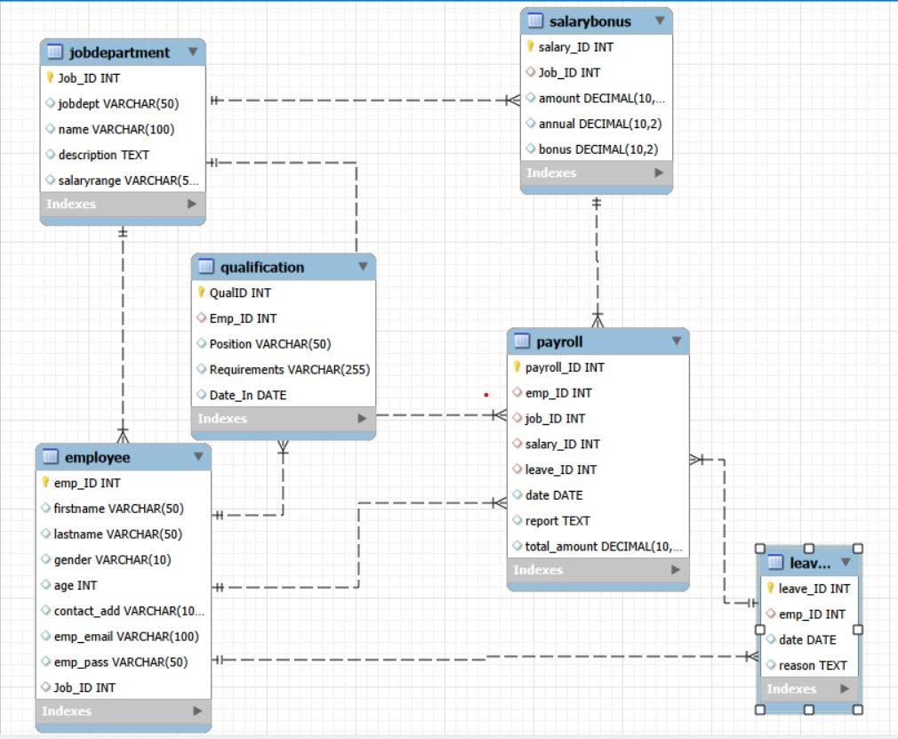
Database Relationships
EMPLOYEE MANAGEMENT SYSTEM | SQL PROJECT PRESENTATION
7

Slide 8
Database Design
The Employee Management System consists of 6 main tables:
JobDepartment
Stores job ID, department, job name, description, and salary range.
SalaryBonus
Stores salary amount, annual salary, and bonus information.
Employee
Stores employee personal details and job information.
Qualification
Stores employee qualifications, positions, requirements, and dates.
Leaves
Stores employee leave dates and reasons.
Payroll
Stores payroll information, salary, leave, and total payment amounts.
EMPLOYEE MANAGEMENT SYSTEM | SQL PROJECT PRESENTATION
8

Slide 9
SQL Concepts Used
The following SQL concepts were used in the project:
CREATE DATABASE and CREATE TABLE
PRIMARY KEY and FOREIGN KEY
SELECT and WHERE
COUNT(), SUM(), AVG(), MAX()
GROUP BY and ORDER BY
CAST(), REPLACE(), TRIM()
SUBSTRING_INDEX() and ROUND()
Window Functions — RANK()
INNER JOIN and LEFT JOIN
Subqueries (derived tables)
EMPLOYEE MANAGEMENT SYSTEM | SQL PROJECT PRESENTATION
9

Slide 10
EMPLOYEE INSIGHTS · QUESTION 1
How many unique employees are currently in the system?
SQL QUERY
SELECT COUNT(DISTINCT emp_id) AS unique_employees
FROM employee;
OUTPUT
60
unique_employees — 60 distinct employees are recorded in the Employee table
EMPLOYEE MANAGEMENT SYSTEM | SQL PROJECT PRESENTATION
10

Slide 11
EMPLOYEE INSIGHTS · QUESTION 2
Which departments have the highest number of employees?
SQL QUERY
SELECT jd.jobdept AS department, COUNT(DISTINCT e.emp_id) AS employee_count
FROM employee e
JOIN jobdepartment jd ON e.job_id = jd.job_id
GROUP BY jd.jobdept
ORDER BY employee_count DESC;
OUTPUT
Department | Employee Count
Finance | 9
IT | 9
Marketing | 8
Operations | 8
Engineering | 7
HR | 7
Sales | 7
Legal | 5
EMPLOYEE MANAGEMENT SYSTEM | SQL PROJECT PRESENTATION
11

Slide 12
EMPLOYEE INSIGHTS · QUESTION 3
What is the average salary per department?
SQL QUERY
SELECT jd.jobdept, AVG(sb.annual) AS avg_salary
FROM jobdepartment jd
JOIN salarybonus sb ON jd.job_id = sb.job_id
GROUP BY jd.jobdept
ORDER BY avg_salary DESC;
OUTPUT
Job Dept | Avg Salary
Legal | 1,015,200.00
Engineering | 973,714.29
Sales | 905,142.86
Finance | 868,000.00
IT | 850,666.67
Operations | 825,000.00
Marketing | 787,500.00
HR | 750,857.14
EMPLOYEE MANAGEMENT SYSTEM | SQL PROJECT PRESENTATION
12

Slide 13
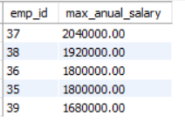
EMPLOYEE INSIGHTS · QUESTION 4
Who are the top 5 highest-paid employees?
SQL QUERY
SELECT e.emp_id, MAX(sb.annual) AS max_anual_salary
FROM employee e
JOIN salarybonus sb ON e.job_id = sb.job_id
GROUP BY e.emp_id
ORDER BY max_anual_salary DESC
LIMIT 5;
OUTPUT
EMPLOYEE MANAGEMENT SYSTEM | SQL PROJECT PRESENTATION
13

Slide 14
EMPLOYEE INSIGHTS · QUESTION 5
What is the total salary expenditure across the company?
SQL QUERY
SELECT SUM(sb.annual) AS sum_of_anual_salary
FROM employee e
JOIN salarybonus sb ON e.job_id = sb.job_id;
OUTPUT
₹5,18,52,000.00
sum_of_anual_salary — total annual salary expenditure across all employees
EMPLOYEE MANAGEMENT SYSTEM | SQL PROJECT PRESENTATION
14

Slide 15
JOB ROLE & DEPARTMENT ANALYSIS · QUESTION 6
How many different job roles exist in each department?
SQL QUERY
SELECT jobdept, COUNT(DISTINCT name)
FROM jobdepartment
GROUP BY jobdept
ORDER BY COUNT(DISTINCT name) DESC;
OUTPUT
Job Dept | Distinct Job Roles
Finance | 9
IT | 8
Operations | 8
Engineering | 7
HR | 7
Marketing | 7
Sales | 7
Legal | 5
EMPLOYEE MANAGEMENT SYSTEM | SQL PROJECT PRESENTATION
15

Slide 16
JOB ROLE & DEPARTMENT ANALYSIS · QUESTION 7
Which job roles offer the highest salary?
SQL QUERY
SELECT jd.jobdept, MAX(sb.annual) AS max_salary
FROM jobdepartment jd
JOIN salarybonus sb ON jd.job_id = sb.job_id
GROUP BY jd.jobdept
ORDER BY max_salary DESC;
OUTPUT
Job Dept | Max Salary
Finance | 20,40,000.00
Engineering | 19,20,000.00
IT | 18,00,000.00
Marketing | 18,00,000.00
Sales | 16,80,000.00
Operations | 16,20,000.00
Legal | 15,60,000.00
HR | 14,40,000.00
EMPLOYEE MANAGEMENT SYSTEM | SQL PROJECT PRESENTATION
16

Slide 17
QUALIFICATION & SKILLS ANALYSIS · QUESTION 8
Which employees have the highest number of qualifications?
SQL QUERY
SELECT e.emp_id, e.firstname, e.lastname, COUNT(*) AS total_count
FROM employee e
JOIN qualification q ON e.emp_id = q.emp_id
GROUP BY e.emp_id, e.firstname, e.lastname
ORDER BY total_count DESC;
OUTPUT
Emp ID | First Name | Last Name | Total Count
1 | John | Doe | 1
2 | Jane | Smith | 1
3 | Alice | Brown | 1
4 | Bob | Johnson | 1
5 | Charlie | Williams | 1
6 | Dave | Miller | 1
Sample of 60 rows — every employee currently has exactly one qualification on record (a 60-way tie), so no single employee stands out with more than one.
EMPLOYEE MANAGEMENT SYSTEM | SQL PROJECT PRESENTATION
17

Slide 18
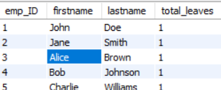
LEAVE & ABSENCE PATTERNS · QUESTION 9
Which employees have taken the most leaves?
SQL QUERY
SELECT e.emp_ID, e.firstname, e.lastname, COUNT(l.leave_ID) AS total_leaves
FROM employee e
JOIN leaves l ON e.emp_ID = l.emp_ID
GROUP BY e.emp_ID, e.firstname, e.lastname
ORDER BY total_leaves DESC
LIMIT 5;
OUTPUT
All 5 employees have 1 total leave, indicting an equal number of leaves taken by each employee.
EMPLOYEE MANAGEMENT SYSTEM | SQL PROJECT PRESENTATION
18

Slide 19

PAYROLL & COMPENSATION ANALYSIS · QUESTION 10
Which department receives the highest total bonuses?
SQL QUERY
SELECT jd.jobdept AS department, SUM(sb.bonus) AS total_bonus
FROM jobdepartment jd
JOIN salarybonus sb ON jd.job_id = sb.job_id
GROUP BY jd.jobdept
ORDER BY total_bonus DESC
LIMIT 1;
OUTPUT
EMPLOYEE MANAGEMENT SYSTEM | SQL PROJECT PRESENTATION
19

Slide 20
EMPLOYEE RANKING ANALYSIS · QUESTION 11 (1/4)
How are employees ranked by annual salary within each department?
SQL QUERY
SELECT e.emp_id, e.firstname, e.lastname, jd.jobdept AS department, sb.annual,
RANK() OVER (PARTITION BY jd.jobdept ORDER BY sb.annual DESC) AS department_rank
FROM employee e
JOIN jobdepartment jd ON e.job_id = jd.job_id JOIN salarybonus sb ON e.job_id = sb.job_id
ORDER BY jd.jobdept, department_rank;
OUTPUT
Emp ID | Employee Name | Department | Annual Salary | Dept Rank
1 | John Doe | Operations | 540,000.00 | 6
2 | Jane Smith | Finance | 660,000.00 | 5
3 | Alice Brown | IT | 480,000.00 | 6
4 | Bob Johnson | Marketing | 576,000.00 | 5
5 | Charlie Williams | Finance | 564,000.00 | 6
6 | Dave Miller | Engineering | 780,000.00 | 4
7 | Eve Davis | Sales | 960,000.00 | 4
8 | Frank Wilson | IT | 504,000.00 | 5
9 | Grace Moore | HR | 660,000.00 | 4
10 | Harry Taylor | Operations | 576,000.00 | 4
11 | Irene Anderson | Marketing | 624,000.00 | 4
12 | Jack Thomas | Legal | 1,080,000.00 | 3
13 | Karen Jackson | Finance | 720,000.00 | 4
14 | Louis White | IT | 456,000.00 | 7
15 | Maria Harris | Engineering | 660,000.00 | 5
EMPLOYEE MANAGEMENT SYSTEM | SQL PROJECT PRESENTATION
20

Slide 21
Conclusion
The Employee Management System demonstrates how SQL can be used to manage and analyze employee-related data.
The project organizes employee, department, salary, qualification, leave, and payroll information into a structured relational database.
SQL queries help identify salary trends, employee distribution, qualification patterns, leave behavior, payroll information, and employee rankings.
The use of JOINs, aggregate functions, subqueries, and window functions provides useful insights for employee and payroll management.
EMPLOYEE MANAGEMENT SYSTEM | SQL PROJECT PRESENTATION
24

Slide 22
Q & A
Questions & Discussion
EMPLOYEE MANAGEMENT SYSTEM | SQL PROJECT PRESENTATION
26

Slide 23

THANK YOU
Gunde Ravi | Innomatics Research Labs — SQL Project

