Slide 1

ROCK PAPER SCISSORS
Matt Hirschi, Keegan Gunderson, Colton Moore, Alec Baird

Slide 2
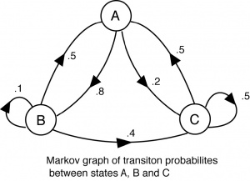
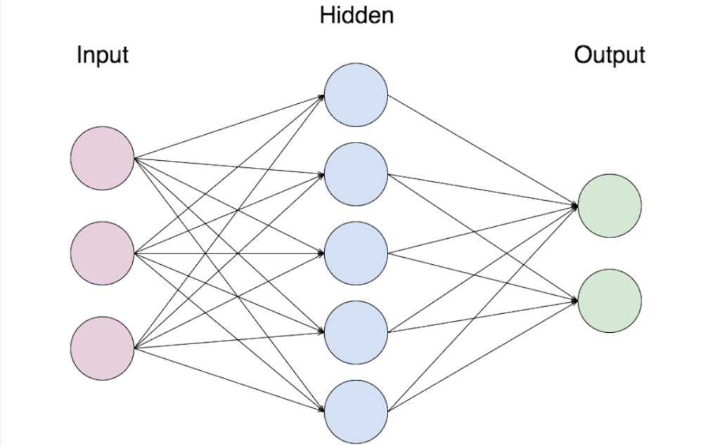
Neural Network needed lots of data potential to be very accurate harder to run and train on Markov Chain -No pre-pr0cessing -data create per game series -good flexibility but can lead to less accurate forecast.
Neural Network
Markov Chain

Slide 3


